Slide 1
Human resources slide 1
DSCI498
Milestone 1
Arteid Memaj,
PhD Student in Applied Mathematics

Slide 2
Human resources slide 2
AGENDA
Introduction
Data
Model Process & Results
Next Steps

Slide 3

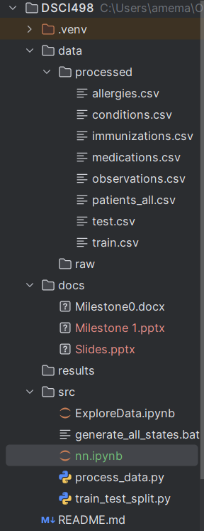

Human resources slide 3
6
Statistics:
Million people affected by heart failure in the United States alone.
It accounts for 1 in 9 deaths
Leading cause for hospitalizations among older adults
Substantial health care cost: Estimated at over $30 billion

Slide 4
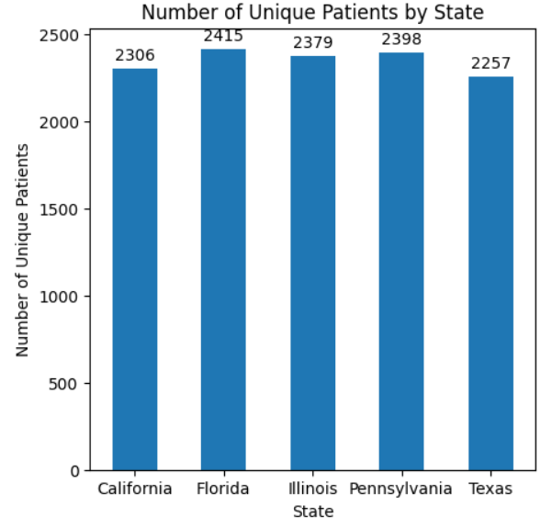
Human resources slide 9
Source Data
Synthetic data (Synthea)
Circumvents patient privacy concerns and legal restrictions
Can be generated in large volumes
It provides a clean data
My Data
5 diverse U.S. States: PA, CA, IL, TX and FL
Allergies, Medications, Clinical Measurements (vitals), Immunizations, Demographics and Conditions
Conditions: Y
Approximately 459 features.

Slide 5

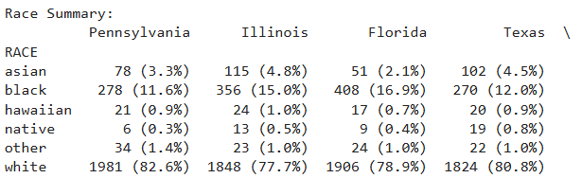

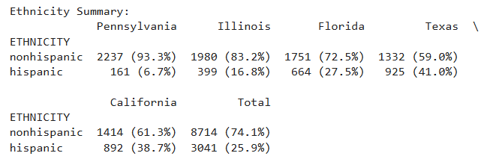
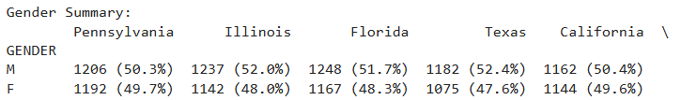
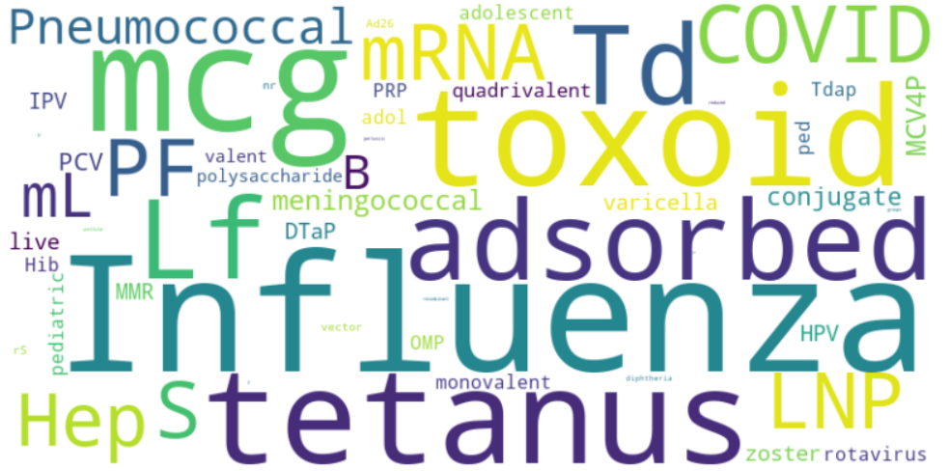
Human resources slide 7
Population

Slide 6
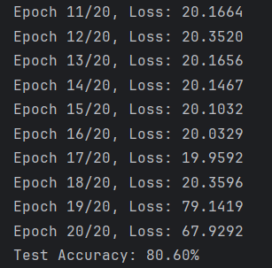
Human resources slide 7
Model 1
Train / Test
Data was split randomly between a train & test.
Approximately 9400 patients in the train
Approximately 2350 patients in the test
450+ features
Architecture
Started off with feed-forward architecture.
Two hidden layers (128 and 64 neurons) with a final Sigmoid activation to output a probability [0,1]
Loss Function & Optimizer
Binary Cross-Entropy Loss for the binary classification with a learning rate of 0.001
0.35 output probability was classified as predicted of 1.
Training Process
Model was trained over 20 epochs with mini-batch gradient descent.
Performance
Model achieved a test accuracy of 80.60% - A promising start point.

Slide 7
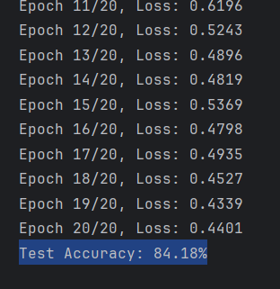
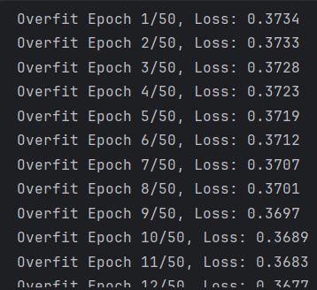
Human resources slide 7
Model 2 (Hyperparameter Tuning)
Train / Test
Data was split randomly between a train & test.
Approximately 9400 patients in the train
Approximately 2350 patients in the test
450+ features
Architecture
Started off with feed-forward architecture.
Two hidden layers (128 and 64 neurons) with a final Sigmoid activation to output a probability [0,1]
Loss Function & Optimizer
Binary Cross-Entropy Loss for the binary classification with a learning rate of 0.01
0.35 output probability was classified as predicted of 1.
Training Process
Model was trained over 50 epochs with mini-batch gradient descent.
Performance
Model achieved a test accuracy of 80.60% - A promising start point.

Slide 8
Human resources slide 4
Real World Data
Longitudinal Data:
More Features
Continuing

Slide 9
Human resources slide 10
Thank You

