Slide 1
B.TECH AI · FINAL EVIDENCE REVIEW
Autonomous Parking System
Reinforcement Learning, Fuzzy Logic and a Safety Shield: what the evidence supports
Strict in-bay metric, retrained PPO, hybrid diagnosis and shield verification, all on held-out seeds
I069 Jia Jadhav
I072 Armaan Shaikh
B.Tech Artificial Intelligence
forward path
target bay
Recorded simulator episode, seed 9170 (a held-out far start picked to contrast outcomes): Fuzzy-precise ends fully inside the bay.
Notes:
The drawing is a real recorded trajectory (viewer/assets/data/fuzzy_precise_seed9170.json). Seed 9170 was selected to contrast pose and strict outcomes, so it is illustrative, not typical.

Slide 2
Headline: what changed and what did not
Pooled over 500 held-out episodes (seeds 3000-3099, 5000-5199, 9000-9199)
1.0 % → 57.8 %
5.8 % → 68.2 %
Strict in-bay success, Fuzzy-only → Fuzzy-precise
Pose success, original PPO → retrained PPO v2
The old 88 % was pose tolerance, not parked inside the lines.
Much better, but still below Fuzzy and it fails far starts (11 %).
0 collisions
No RL benefit
With the braking-envelope shield, every controller
RL + Fuzzy hybrid equals Fuzzy-only
Costs completion: success drops, timeouts rise, some runs deadlock.
A stall latch hands control to pure Fuzzy; PPO is not consulted.
Verdict: READY WITH CAVEATS. Strict success is bounded at about 58 %, no learned controller beats Fuzzy, and safety is shown only under the simulator’s own model.
Source: autonomous-parking/experiments/corrected_evaluation/summary_all.md; experiments/hybrid_diagnosis/; experiments/shield_verification/
Notes:
Every number is from the corrected evaluation matrix. McNemar tests are paired on identical seeds.

Slide 3
End-to-end workflow, as implemented
Each box maps to a file in the repository
Training
Scenario +
Simulator
Controller
selection
Safety shield
(optional)
Evaluation
Visualisation
rl/train_ppo.py
PPO, curriculum,
validation seeds
environment/
bicycle model, 8 rays,
OBB collision
make_adapter()
fuzzy / PPO / hybrid
integration/
envelope_shield.py
evaluation/
strict + pose metric,
McNemar, CIs
viewer/ (three.js)
replay of recorded
episodes
Observation (14): slot offset (world frame), heading error sin/cos, speed, steer angle, 8 ray distances. Action (2): steer, throttle/brake (negative = brake; forward-only, no reverse gear).
Inference path: observation → controller proposes action → (optional) envelope shield simulates one step then full braking; if the car footprint would hit anything, it replaces the action with hold-steer + full brake → simulator step.
The viewer replays recorded episodes. It is not live inference.
Notes:
The shield is a model-based filter, not a learned component.

Slide 4
Implemented now vs future work
Only the left column is claimed
IMPLEMENTED AND TESTED (131 tests pass)
FUTURE WORK (not claimed)
Perpendicular parking simulator with randomised start pose and distance
Fuzzy-only and Fuzzy-precise navigators
PPO original (100k) and PPO v2 (retrained, ~420k)
Weighted RL + Fuzzy hybrid with fuzzy shield and stall latch
Braking-envelope shield, fail-closed on NaN
Strict in-bay metric next to legacy pose metric
Paired evaluation: exact McNemar, Wilson CIs, stratified by start distance
Replay viewer with strict-vs-pose HUD
Reverse gear and re-manoeuvring (remaining strict misses are heading-limited)
Parallel parking results (code exists, excluded from every number)
Learned hybrid arbitration instead of hand-set weights
PPO that handles far starts (v2: 11 % on starts ≥ 4.5 m)
Shield that proposes its own escape action (today it only brakes)
Sensor noise, latency, moving obstacles, brake mismatch
Formal verification of the shield
Live in-browser inference in the viewer

Slide 5
Corrected success metric: pose is not "inside the bay"
Same trajectories, two definitions. The geometry was not loosened.
Pose success (legacy)
bay 2.4 × 4.8 m
Centre ≤ 0.40 m from slot centre, heading error < 15°, speed ≤ 0.20 m/s for 2 steps, no collision. Looser than the 0.30 m bay clearance, so a "success" can overhang.
car 1.8 × 4.2 m, centred 0.32 m short of the slot centre (legacy stop radius)
only 0.30 m clearance at each end and 0.30 m each side
A heading error of 9° already swings a corner out: half-width = 0.9 cosθ + 2.1 sinθ = 1.22 m > 1.20 m
Strict (contained) success
Pose criterion AND the whole 4.2 × 1.8 m car footprint inside the bay lines (success_mode="contained"). Fuzzy-only drops from 88 % to 1 %; a smaller stop radius (0.10 m, tuned on seeds 7000-7099 only) lifts Fuzzy-precise to 58 %. Misses left are heading-limited: forward-only motion cannot re-manoeuvre.
Source: environment/parking_env.py; evaluation/tune_precision.py; tests/test_containment_metric.py

Slide 6
Pose success vs strict success, n = 500
Failures retained; shared seeds across controllers
Paired tests (exact McNemar, pooled)
Fuzzy-precise vs PPO v2
strict success: 94 vs 37 discordant, p ≈ 7e-7
Fuzzy-only vs Fuzzy-precise
strict success: 0 vs 284, p ≈ 6e-86
Fuzzy-precise vs PPO v2
pose success: 106 vs 6, p ≈ 1e-24
Collision rates (pose mode): 11.8 / 11.8 / 43.4 / 4.2 / 13.0 %
Source: autonomous-parking/experiments/corrected_evaluation/summary_all.csv, paired tests in summary_all.md
Notes:
Sets A (3000-3099), B (5000-5199) and C (fresh 9000-9199) pooled, n = 500. Note: the original PPO checkpoint used seeds 5000-5039 for best-checkpoint selection (overlap with set B); set C is clean.

Slide 7
Same start, three controllers: recorded trajectories (seed 9170)
Authentic episodes from the simulator, drawn from the viewer’s recorded JSON
Fuzzy-only (legacy)
Fuzzy-precise
PPO v2
Stopped within pose tolerance, NOT inside the bay
Parked inside the bay (0.21 m, 5.7°)
Parked inside the bay (0.09 m, 0.1°)
Seed 9170 is a held-out far start chosen because it contrasts the outcomes; it is not a typical episode. On far starts PPO v2 usually fails (see the PPO slide).
Notes:
Cyan outline = start pose, coloured outline = final pose. Heights and widths of the car outlines use the real 4.2 x 1.8 m footprint, scaled with the map.

Slide 8
PPO: original was under-trained; v2 is better but still limited
Retrained with the curriculum recipe, 3 seeds, ~420k steps each; selected on validation seeds 7000-7099
Candidates (validation)
six checkpoints: 55-70 % success, 2-6 % collision
Selected: seed 3 best, 70 % / 3 %
Pooled held-out
pose 68.2 %, strict 46.4 %, collision 4.2 %
Original: pose 5.8 %, collision 43.4 %
Training notes
reward normalisation is configured but never used; no observation normalisation
Reading: PPO v2 matches Fuzzy near the bay and collapses on far starts. We claim "much better than the original", not "better than Fuzzy".
Source: autonomous-parking/models/README.md; autonomous-parking/experiments/corrected_evaluation/stratified.md; experiments/ppo_retrain/

Slide 9
Why RL + Fuzzy equals Fuzzy-only: the stall latch
Measured on 100 seeds of the original hybrid; PPO is queried and its output is state-dependent
1 Spawn
Mamdani shield fires in ~77 % of episodes (about 45 % of starts are within 0.3 m of a neighbour)
2 Brake
Shield brakes, car stays still, PPO action is overridden
3 Latch
After 12 stalled steps (1.2 s) control goes to pure FuzzyOnlyController
4 Fuzzy drives
PPO and shield are no longer consulted; latch fires in 96 of 100 episodes
Without the latch the original hybrid gets 3 % success and 97 % timeouts.
No RL weight raised success; more RL weight traded collisions for timeouts.
Pooled 500 episodes: hybrid pose success 87.0 % vs Fuzzy-only 88.2 % (McNemar 7 vs 1, p = 0.07).
Source: experiments/hybrid_diagnosis/; tests/test_hybrid_integrity.py

Slide 10
Envelope shield: collisions go to zero, completion pays for it
Pose-mode outcomes, n = 500, without and with the shield
Deadlock, not caution: 60 of 81 Fuzzy-only+shield timeouts never moved more than 1 m. The shield rejects every proposed action and proposes none of its own (active in 96 % of steps, median final distance to the slot 4.27 m).
Collision-free only under its own model: with real brakes at 0.85× the modelled strength, 49 of 198 adversarial episodes collide (0.7×: 114, 0.5×: 156).
Source: experiments/shield_verification/*.json; evaluation/shield_stress.py

Slide 11
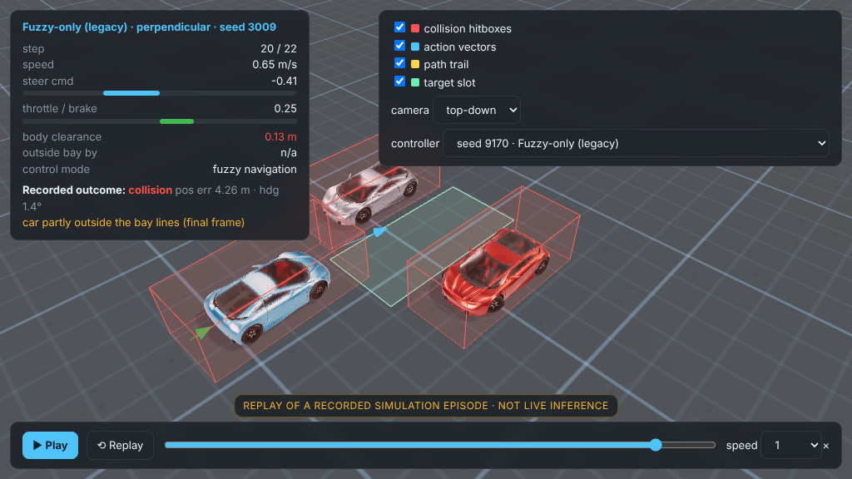
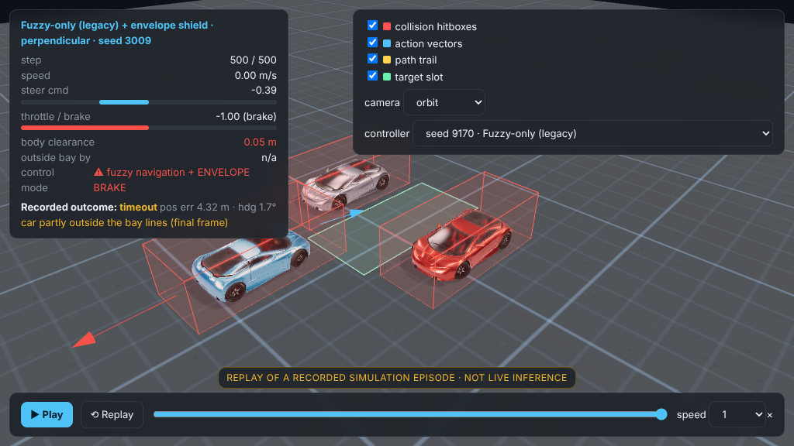
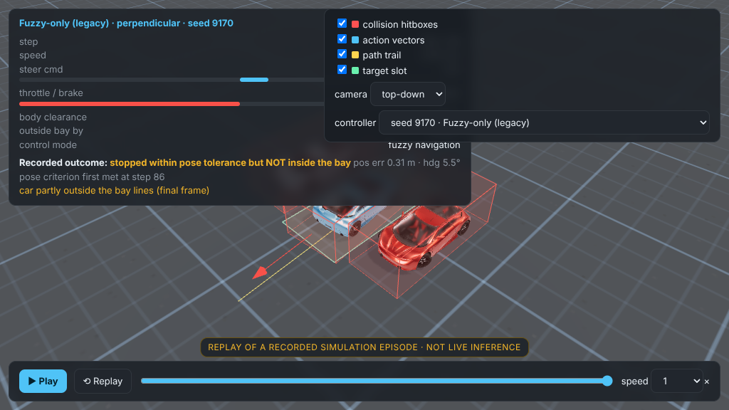
Seed 3009: collision without the shield, a freeze with it
Recorded trajectories (left) and frames from the rendered 3D viewer (right)
Fuzzy-only: collision after 22 steps
Fuzzy-only + shield: brakes, times out
Viewer frames captured in headless Chromium with software WebGL. Camera framing in top-down and chase modes was not verified.

Slide 12
Scenario validity and known limits
Absolute rates depend on the start generator; the ranking evidence is paired
44.6 % of starts
Forward-only
Model-based safety
have body clearance < 0.30 m to a neighbour (6.4 % < 0.05 m); start distance is uniform in [0.05, 1] × 6 m, so many starts begin beside the bay.
The car cannot re-manoeuvre; remaining strict misses are heading-limited. Reverse code exists but is excluded from every number.
Ground-truth geometry, perfect brakes, no latency, no moving obstacles. Not formally verified.
Selection overlap
Illustrative seeds
Small hand-set parts
The original PPO checkpoint’s best-model selection used seeds 5000-5039 (overlaps set B). Fresh set C (9000-9199) is clean for every controller.
Seed 9170 in the viewer was picked to contrast outcomes. One simulator, perpendicular parking only.
Hybrid weights and shield thresholds are hand-set; stop radius tuned on seeds 7000-7099 only.
Source: autonomous-parking/experiments/corrected_evaluation/start_features.csv, stratified.md; models/README.md

Slide 13
What we claim, and what we do not
Verdict: READY WITH CAVEATS
SAFE TO CLAIM
DO NOT CLAIM
Fuzzy-precise parks fully inside the bay in 57.8 % of 500 held-out episodes
The legacy 88 % is pose tolerance, strict is 1 %
Retrained PPO v2 is far better than the original PPO
The hybrid equals Fuzzy-only because of the stall latch
The shield gave 0 collisions in every simulated run, at the cost of completion
"RL + Fuzzy beats Fuzzy-only" (it does not)
"PPO solves parking" (it fails far starts)
"Collision-free" without "in this simulator model"
"Formally verified" or "universally safe" shield
"Parks inside the bay" for the legacy Fuzzy-only
That 9170 is a typical episode

Slide 14
Reproduce and inspect
Python 3.11+ required (pinned dependency versions)
cd autonomous-parking
python -m pytest tests/ -q # 131 passed
python -m evaluation.evaluate_matrix # resumable
python -m evaluation.summarize_corrected
python -m evaluation.stratify
python -m evaluation.shield_stress
python prepare_comparison.py --seed 9170
python ../viewer/serve.py # replay viewer
python demo.py --controller fuzzy_precise+env --seed 3009
Evidence
README.md
CHANGELOG.md
PRESENTATION_READINESS_AUDIT.md
PROFESSOR_DEFENSE_QA.md
DEMO_RUNBOOK.md
autonomous-parking/experiments/
corrected_evaluation/
hybrid_diagnosis/
ppo_retrain/
shield_verification/

