Slide 1
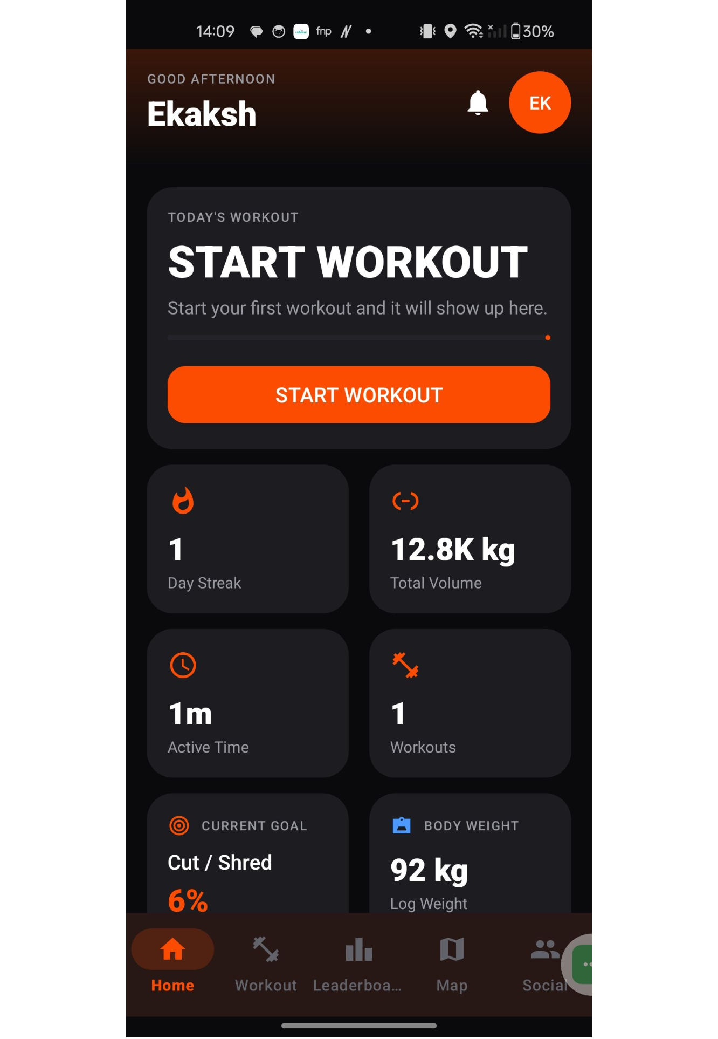
GymFit
Fitness and Workout Tracking Application
Name: Muskaan Mahajan (T046) & Armaan Thakur (T033)
Submitted to: Dr. Preetjot Kaur

Slide 2
GymFit brings scattered fitness tasks into one app
PROBLEM
SOLUTION
Manual workout tracking makes consistency and history harder to maintain.
Progress, goals, achievements, rankings, maps, and social activity are often split across separate tools.
GymFit combines workout logging, fitness statistics, goals, achievements, leaderboard participation, map viewing, and social activity in one Android application.

Slide 3
APPLICATION LIFECYCLE
The app flow moves from startup state to feature navigation
Android Studio develops, builds, and tests the Java/XML application on a physical phone.
SplashActivity checks the current authentication/session state.
Signed-out users go to LoginActivity or SignUpActivity; users needing setup follow onboarding.
MainActivity hosts the main destinations: Home, Workout, Social, Map, and Leaderboard.
Dedicated activities open for tasks such as active workouts, profile editing, chat, and workout summaries.

Slide 4
AUTHENTICATION
Authentication connects the user to the main app
LoginActivity handles existing-user sign-in.
SignUpActivity creates a new account and coordinates initial profile setup.
AuthRepository connects the screens to Firebase Authentication.
MainActivity becomes the navigation container after the startup decision.
Java files: SplashActivity.java, LoginActivity.java, SignUpActivity.java, AuthRepository.java, MainActivity.java

Slide 5
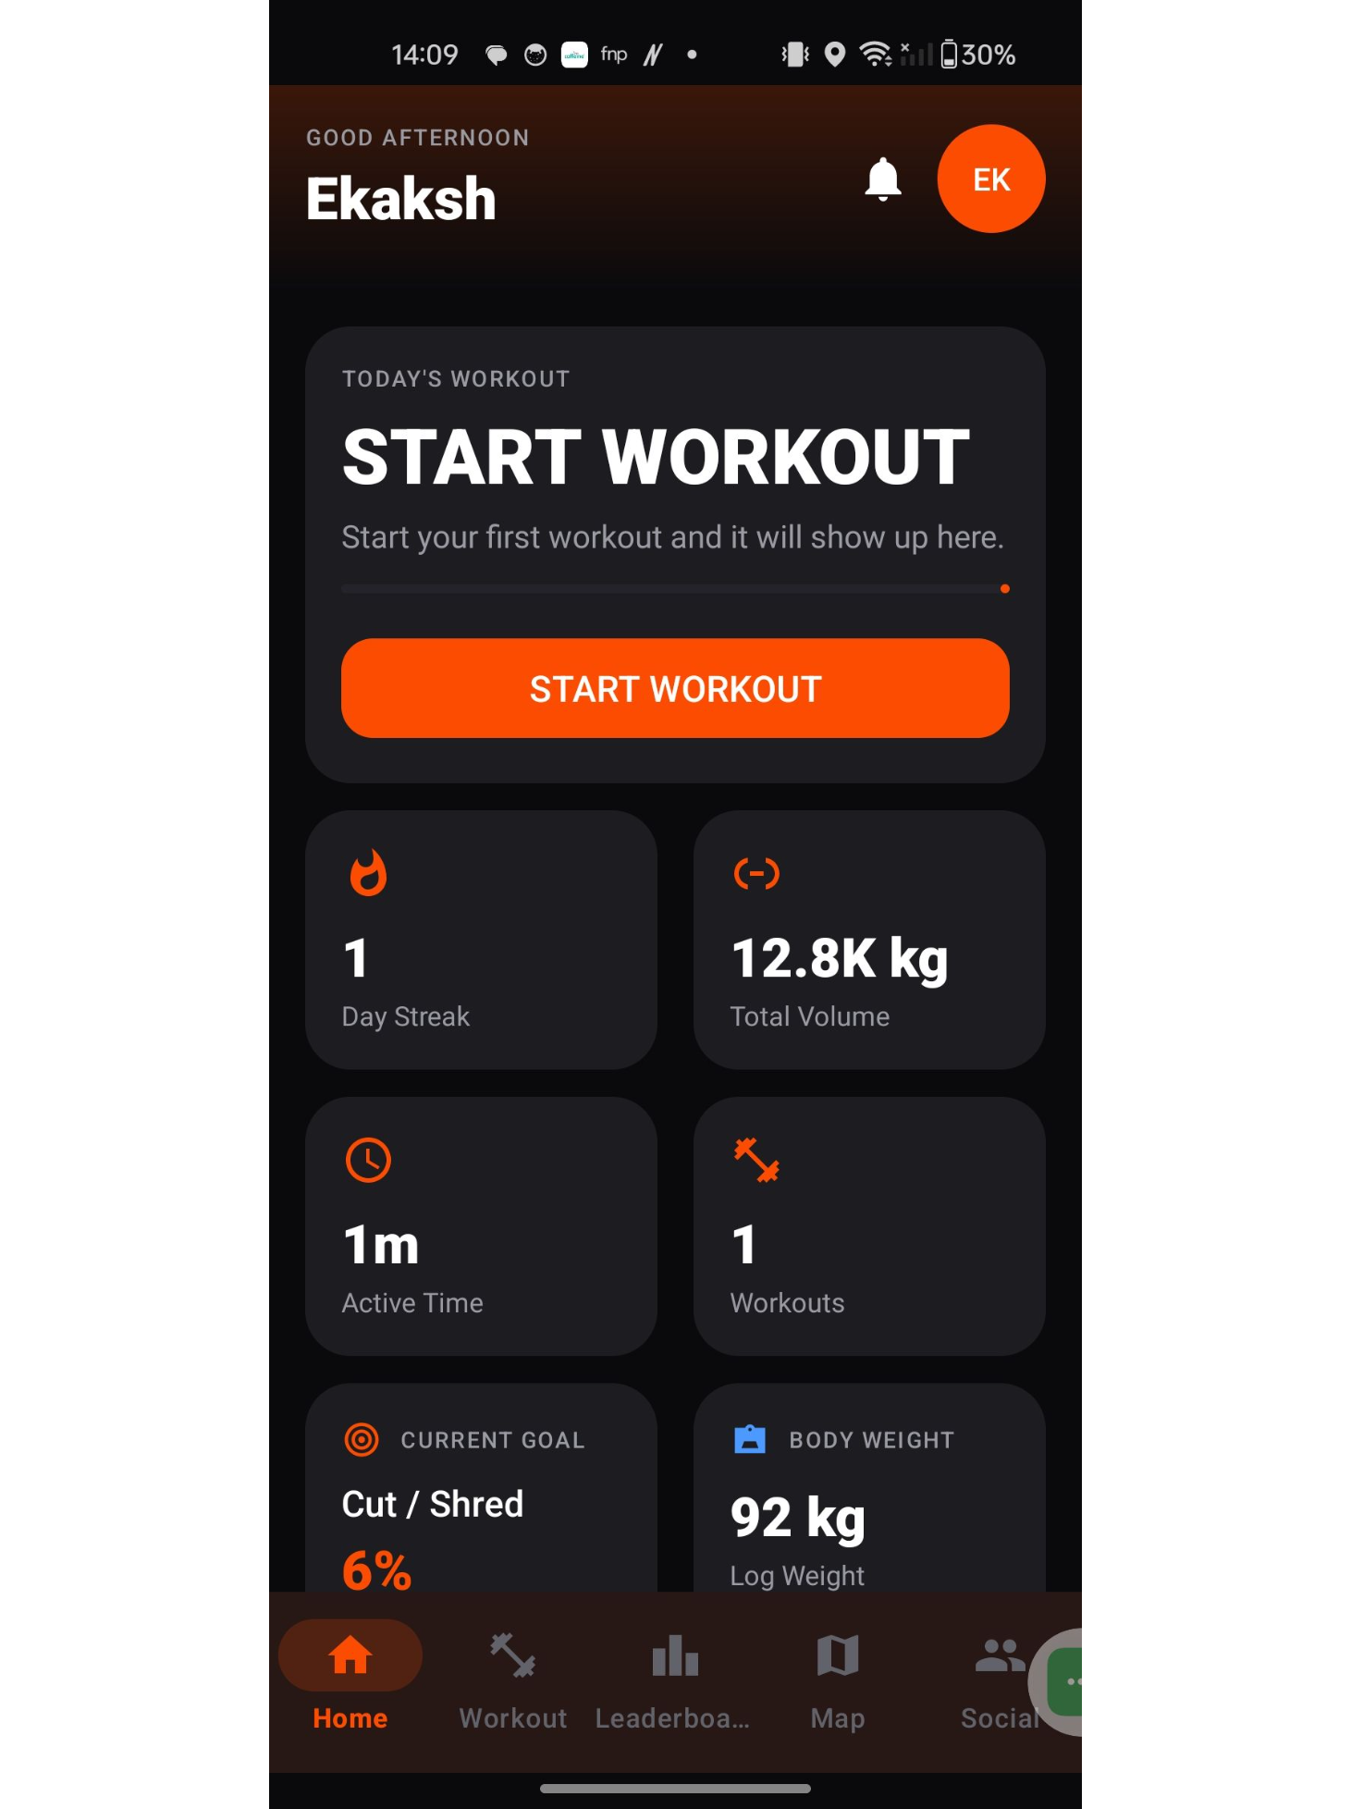
HOME DASHBOARD
The home dashboard turns workout data into quick decisions
HomeFragment surfaces high-priority metrics to reinforce consistency before a user launches a new session.
METRIC AGGREGATION
TARGET TRACKING
Day Streak & Volume
Calculated active time, completed counts, and cumulative kilograms.
Goals & Weight
Current phase (e.g. Cut/Shred) paired with quick body-weight updates.
Files: HomeFragment.java · fragment_home.xml · StatsService.java · BodyWeightActivity.java

Slide 6
WORKOUT FLOW
Workout logging follows a clear session-to-summary path
SESSION PATH
JAVA FILES
WorkoutFragment starts the workout flow.
ActiveWorkoutActivity captures exercises, sets, repetitions, and weights.
ExercisePickerDialog and ExerciseLogAdapter support selection and repeated exercise rows.
WorkoutCompletionService coordinates completion and follow-up updates.
WorkoutRepository persists workout data; summary and history screens display the result.
WorkoutFragment.java, ActiveWorkoutActivity.java, ExercisePickerDialog.java, ExerciseLogAdapter.java, WorkoutCompletionService.java, WorkoutRepository.java, WorkoutSummaryActivity.java, WorkoutHistoryActivity.java
XML LAYOUTS
fragment_workout.xml, activity_active_workout.xml, dialog_exercise_picker.xml, activity_workout_summary.xml, activity_workout_history.xml

Slide 7
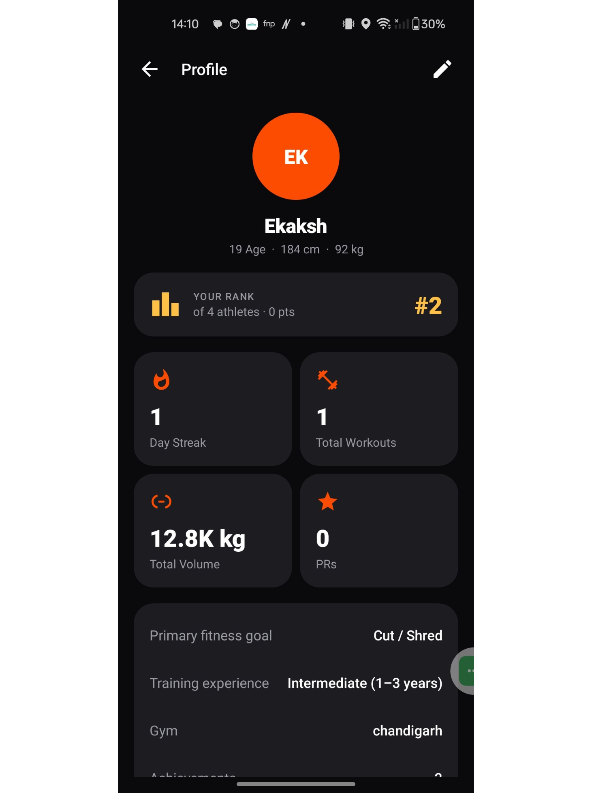
PROFILE & PROGRESS
Profile and progress make improvement visible
Profile information includes fitness details, goal, training experience, and gym context.
Progress screens aggregate workout and body-weight information.
PrService supports personal-record logic; AchievementService and ChallengeService support progress-related rules.
ProfileActivity, ProgressActivity, AchievementsActivity, and ChallengesActivity provide the related screens.
Files : ProfileActivity.java, EditProfileActivity.java, ProgressActivity.java, PrService.java, AchievementService.java, ChallengeService.java

Slide 8
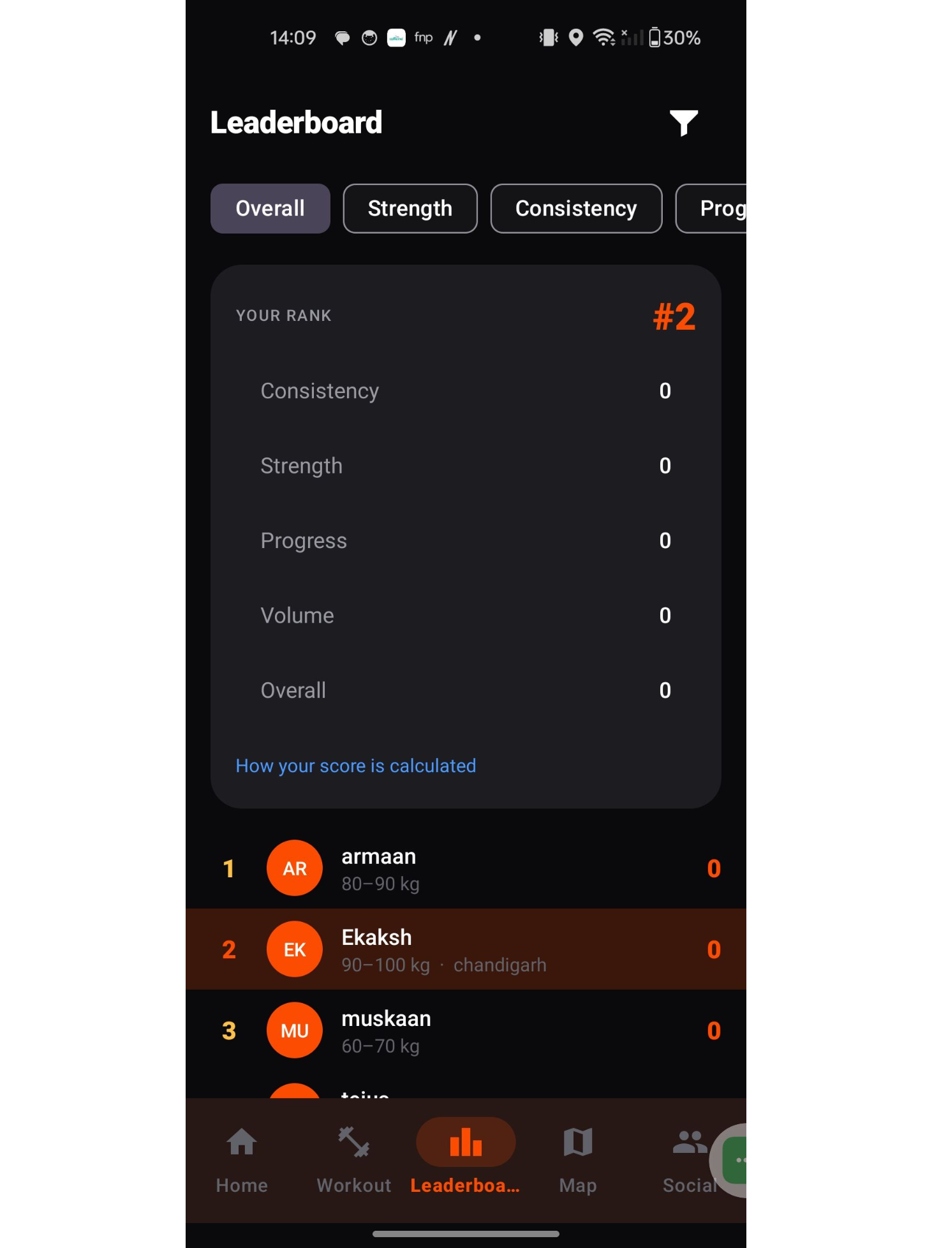
LEADERBOARD
The leaderboard presents rankings without hiding the data path
Categories shown in the interface include Overall, Strength, Consistency, and Progress.
LeaderboardService builds leaderboard entries from available profile and fitness data.
LeaderboardFragment displays the results; LeaderboardEntry represents one row.
The exact scoring formula should be explained only from the verified implementation.
Files : LeaderboardFragment.java, LeaderboardService.java, LeaderboardEntry.java, fragment_leaderboard.xml

Slide 9
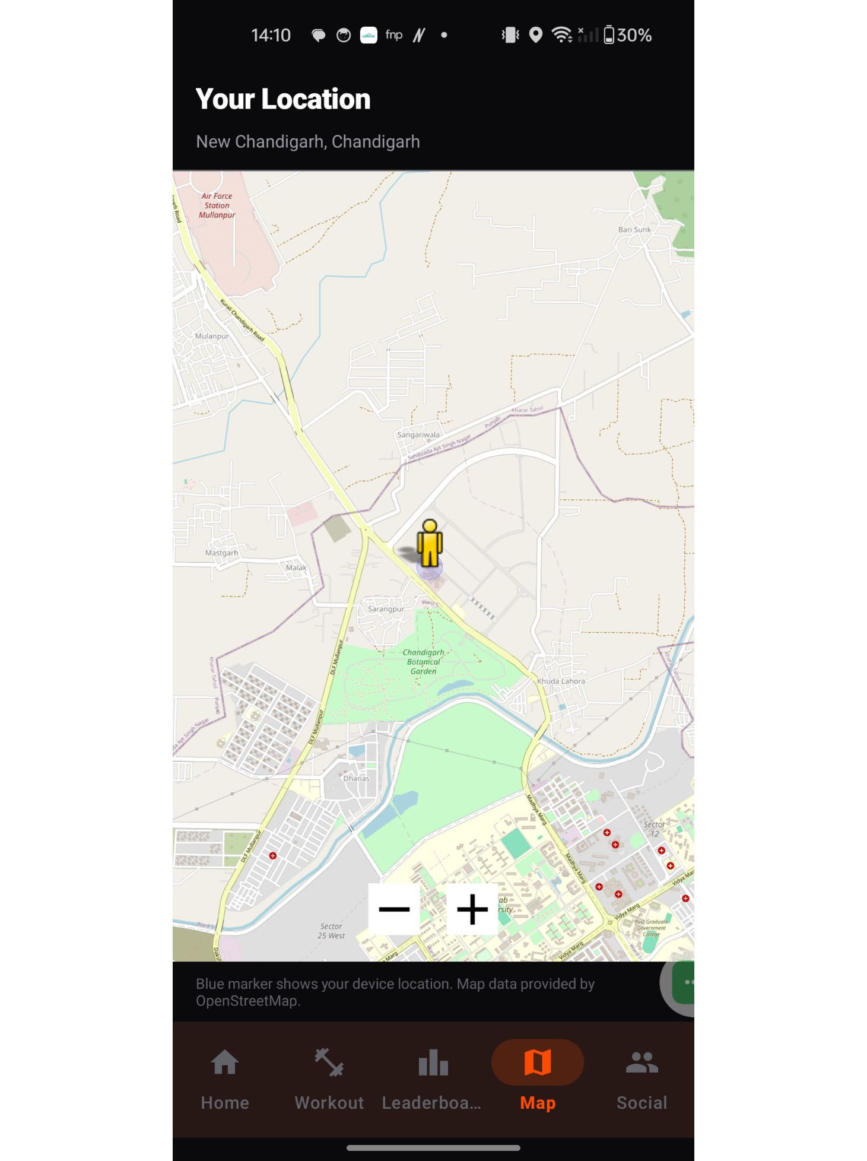
LOCATION SERVICES
The map combines device location with OpenStreetMap
MapFragment uses osmdroid to display OpenStreetMap tiles.
Android location APIs provide coordinates after permission and location services allow it.
Geocoder attempts to turn coordinates into readable city/state text, with fallback handling needed when it fails.
A local current-location marker does not automatically mean the exact location is shared with other users.

Slide 10
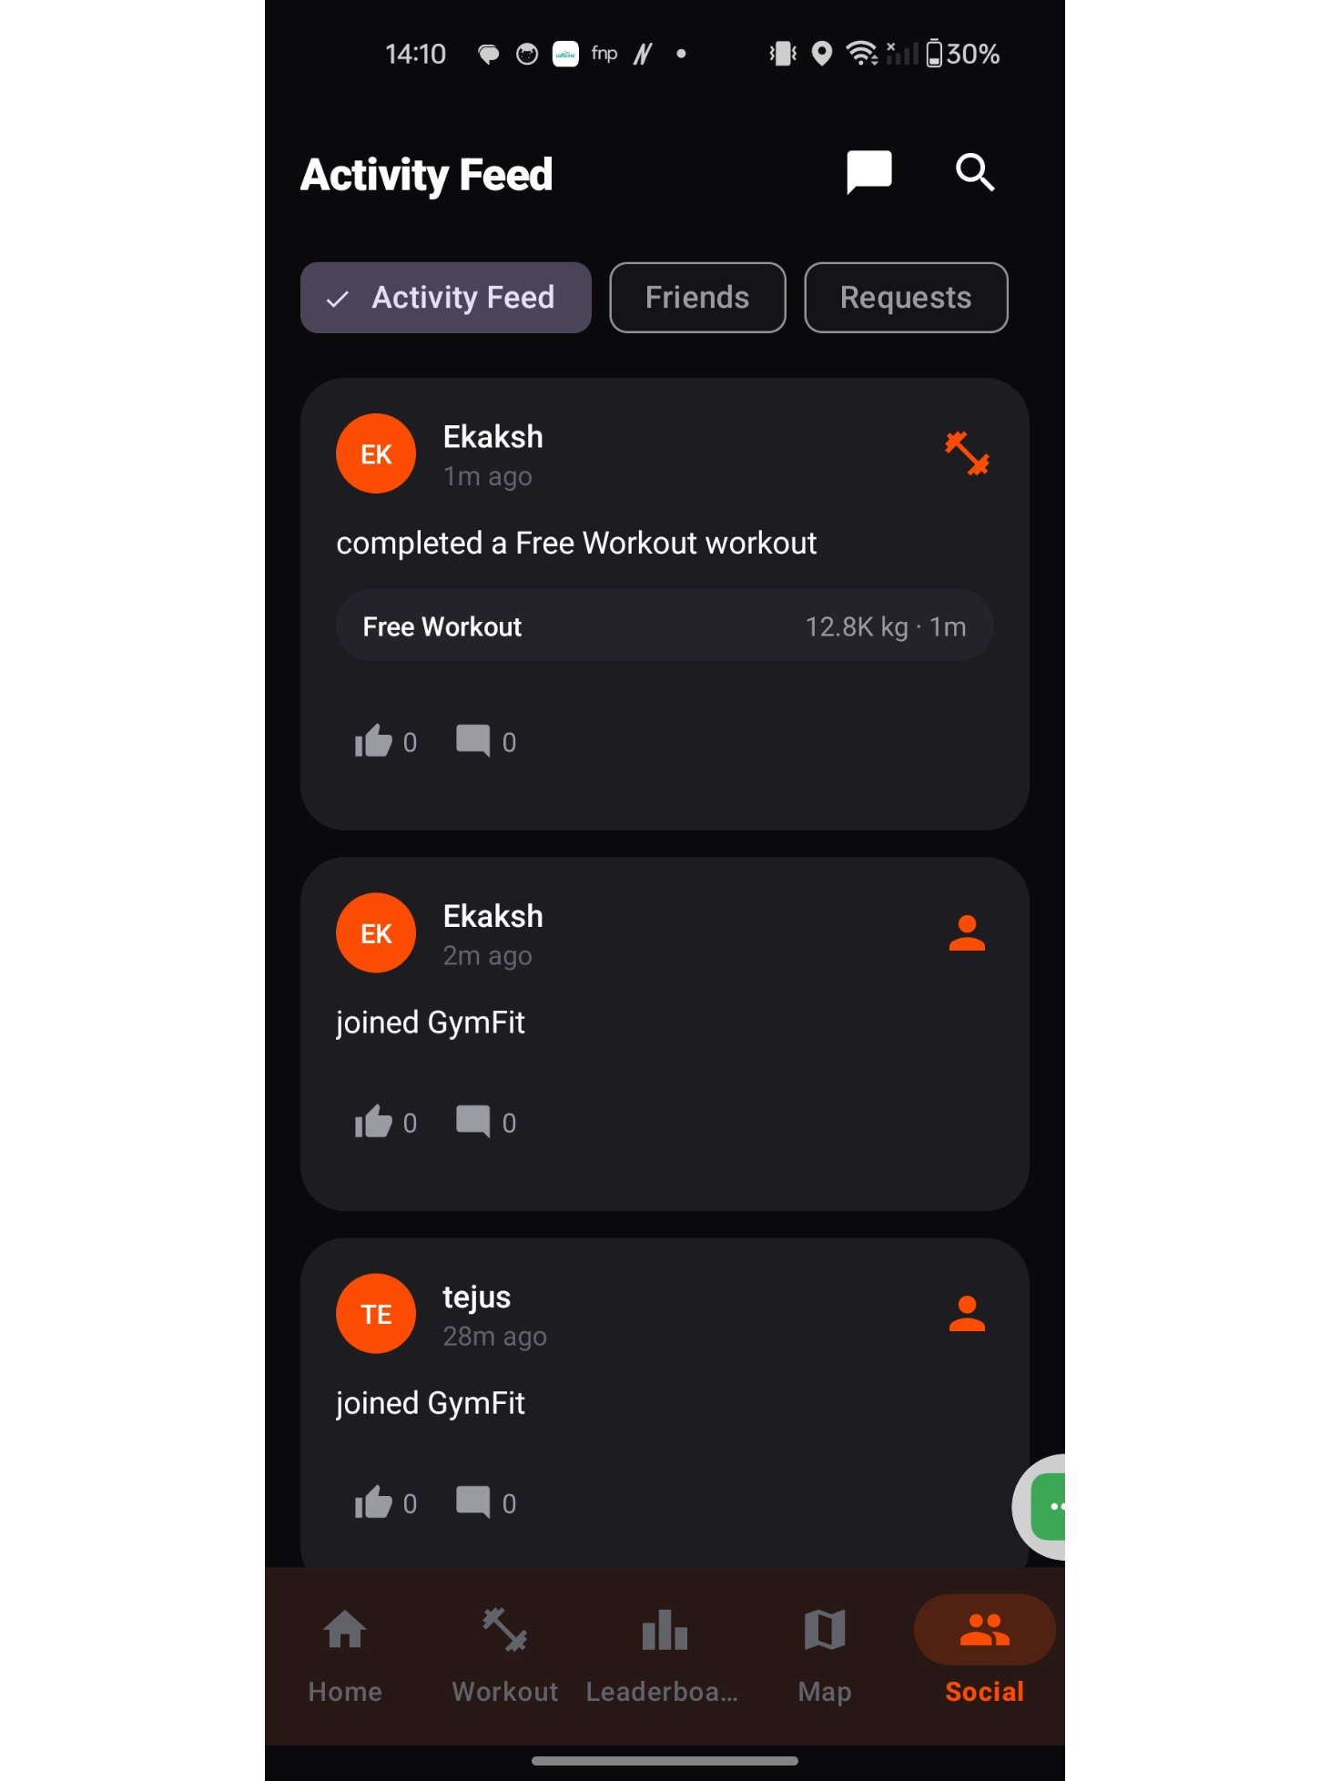
COMMUNITY & ACCOUNTABILITY
The social feed turns completed activity into a shared timeline
SocialFragment loads activity posts through SocialRepository.
ActivityFeedAdapter converts ActivityPost data into visible feed rows.
Kudos and comments are represented as related social interactions where implemented.
Friend requests and user search are handled separately through FriendRepository and UserRepository.
Files : SocialFragment.java · ActivityFeedAdapter.java · SocialRepository.java · FriendRepository.java · UserRepository.java · CommentsActivity.java · fragment_social.xml · item_activity_feed.xml

Slide 11
Components
Activity | Manages individual screens, such as Login and Active Workout.
Fragment | Displays sections of the main interface, such as Home, Workout, Social, Map, and Leaderboard.
XML Layouts | Define the user interface, including buttons, text fields, cards, and screen layouts.
RecyclerView & Adapter | Display lists of data, such as activity feed posts and exercise records.
Intent | Enables navigation between Activities and can pass data between them.
Firebase Authentication | Handles user registration and login.
Cloud Firestore | Stores and retrieves cloud data, including profiles, workouts, and social activities.
osmdroid | Displays OpenStreetMap inside the application.

Slide 12
Components
TextView | Displays text such as usernames, workout duration, and statistics.
EditText | Allows users to enter information, such as login credentials and profile details.
Button | Performs actions when tapped, such as starting a workout or submitting a form.
ImageView | Displays images and icons in the interface.
LinearLayout | Arranges UI elements vertically or horizontally.
ConstraintLayout | Positions UI elements using constraints to create flexible layouts.
Material Components | Provides styled UI elements consistent with Material Design.
CardView | Displays content inside card-shaped containers.
Dialog | Displays a small interactive window, such as the exercise picker.

Slide 13
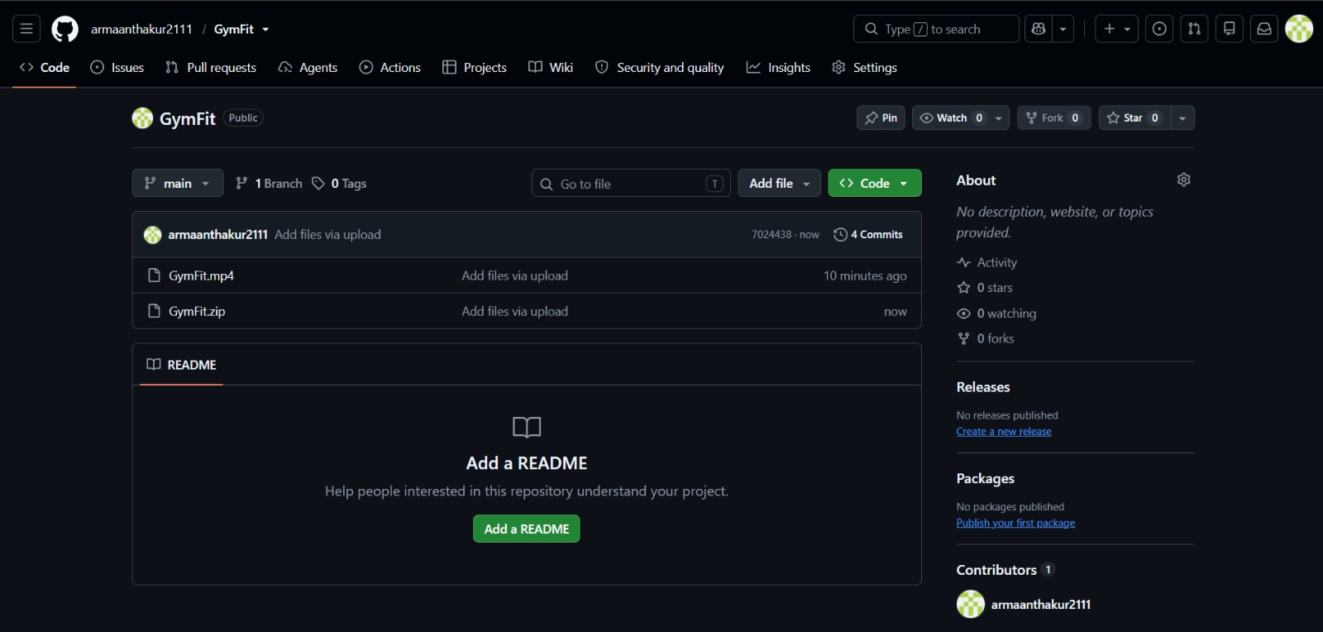
Github

