Slide 1
Predicting Floc Size in South San Francisco Bay
Can waves and currents alone tell us how big suspended mud particles are?
A physics-only replication of Egan et al. (2022) and Egan's CS229 study
ML Mini Project, Team 7

Slide 2
Problem statement
1
Input
Hourly measurements of waves, tidal current, turbulence, temperature and salinity.
The question
Can we predict the size of suspended mud flocs from wave and current measurements alone?
2
Output
Mean floc diameter d (micrometres), measured by a laser particle sizer (LISST).
3
Test
Does the model still work on days, and seasons, it has never seen?
Why physics only: biology sensors are costly, need frequent cleaning, and are not in the public dataset.

Slide 3
Why floc size matters
1
2
3
Settling speed
Bigger flocs sink faster. Speed grows with diameter squared, so a 2x error in size is a 4x error in settling speed.
Coasts and ports
Sediment models guide dredging, marsh restoration and sea-level defences. They need a settling speed that is rarely measured.
Pollutants and ecology
Contaminants and algae travel on flocs, so floc size decides where they end up.
The problem: most models assume one fixed floc size, yet our data shows it changes by about 3x within a single season.

Slide 4
How flocs grow and break
Grow
Particles collide and stick, helped by sticky biological 'glue' from algae. Calm water lets flocs grow.
Settling speed (Stokes law)
w_{s} = (ρ_{f} - ρ₀) g d² / 18μ
Break
Wave motion near the bed shears flocs apart. Stronger waves mean smaller flocs.
d: floc diameter (what we predict)
ρf, ρ0: floc and water density
g: gravity, μ: water viscosity
Double d at the same density and it sinks 4x faster
Arrive
The tide carries flocs formed elsewhere. Here, water from upstream arrives about 4 hours later.
What theory predicts: strong waves give smaller flocs; strong tide 4 hours earlier brings larger ones.

Slide 5
The data: Stanford Digital Repository
NSF OCE-1736668 field campaign on the shallow shoals (about 2 m deep) of South San Francisco Bay
Three deployments of about four weeks: Summer 2018, Winter 2019, Spring 2019
2.5 GB public archive; we used the laser sizer, the CTD and the 15 cm current meter at platform P2
After cleaning: 1,120 hourly samples (Summer 427, Winter 406, Spring 287)
Instrument | What it measures | How often
LISST laser sizer, 35 cm above bed | Particle size distribution: our target d | Every 60 s
ADV acoustic current meter, 15 cm | 3D velocity and pressure: waves, tide, turbulence | 8 per second, 14 min each hour
CTD sensor | Temperature and salinity | Every 60 s
Not in the archive: chlorophyll and light-absorption (biology) sensors used by both papers.

Slide 6
From raw signals to a feature table
Feature | Plain meaning | Expected effect
u_b wave velocity | How hard waves shake the water at the bed | Smaller flocs
ū tidal current | Flood (+) or ebb (-) tide now | Weak
ū₄ current 4 h ago | Water arriving from upstream | Larger flocs
ε turbulence | Small-scale stirring | Breakup
T temperature | Season; proxy for biology | Spring growth
S salinity | Season; river inflow | Weak
Target: floc size d
Average the 1-minute laser readings over each 14-minute burst
Drop readings where the optics are saturated
Remove isolated spikes at the size extremes (paper's 40% rule)
Take the volume-weighted mean diameter
Quality control: bursts with more than 10% bad current samples are dropped. Gaps are never filled.

Slide 7
Workflow and code structure
1
2
3
4
5
6
Raw files
Data/ (.mat)
Load + QC
src/load.py
Features
build_features
Feature table
outputs/cache
Models
run_random_forest
Report
outputs/
Code layout
Live demo (two commands)
src/ load, features, models, predict
scripts/ all models, figures, diagnostics
outputs/ cached table, tables, figures, report
ven/bin/python build_features.py
ven/bin/python run_random_forest.py
Prints our scores next to both papers and saves a CSV.

Slide 8
Our model choice: Random Forest
Why a Random Forest
How our data suits it
Same model as Egan's CS229 report, so scores compare directly (32 trees, default settings)
Captures thresholds: waves only break flocs above a certain strength
Built for small tables: no scaling, robust to noisy sensors
Explains itself: feature importance shows which physics matters
Tabular: 1,120 rows x 6 features, one row per hour
Mixed units (m/s, °C, PSU, W/kg) are fine for trees
Features interact (tide x waves); trees learn this without hand-made terms
Averaging many trees smooths the noise in field data
Limitations: a forest cannot predict beyond the range it was trained on, and neighbouring hours are near-copies, so a random split overstates accuracy. Also run for comparison: LASSO (journal paper) and SVR (class paper's second model).

Slide 9
How we test: three ways to hold data out
Random 70/30
Test hours sit next to training hours, so it is optimistic (class paper)
Time-blocked
Whole multi-day stretches held out with a 12 h gap. Closest to real forecasting (ours)
Leave one season out
Train on two seasons, predict the third. New-conditions test (ours)
Training hour
Test hour
Gap (unused)
Score r²: 1 = perfect, 0 = no better than guessing the average, below 0 = worse than that.

Slide 10
Results: how accurate is it
Share of floc-size variation explained (r²)
0.34
accuracy on unseen time periods, all seasons (95% interval 0.15 to 0.49)
Class paper, reported (random split)
0.81
Our copy of class-paper setup
0.60
Our features, random split
0.64
Below 0
when predicting a season the model never saw
Our features, held-out time blocks
0.34
One season, held-out blocks (best)
-0.14

Slide 11
Results: what drives floc size
Drop in r² when the feature is shuffled
Matches the journal paper
ū₄ current 4 h ago
0.15
Stronger waves give smaller flocs
Stronger tide 4 h earlier brings larger flocs
Turbulence adds almost nothing
Salinity is weak within a season, unlike the class paper, which ranked it first
u_b wave velocity
0.13
ū current now
0.05
S salinity
0.04
T temperature
0.04
ε turbulence
0.01
Pooled model, all seasons. Longer bar = the model relies on it more.

Slide 12
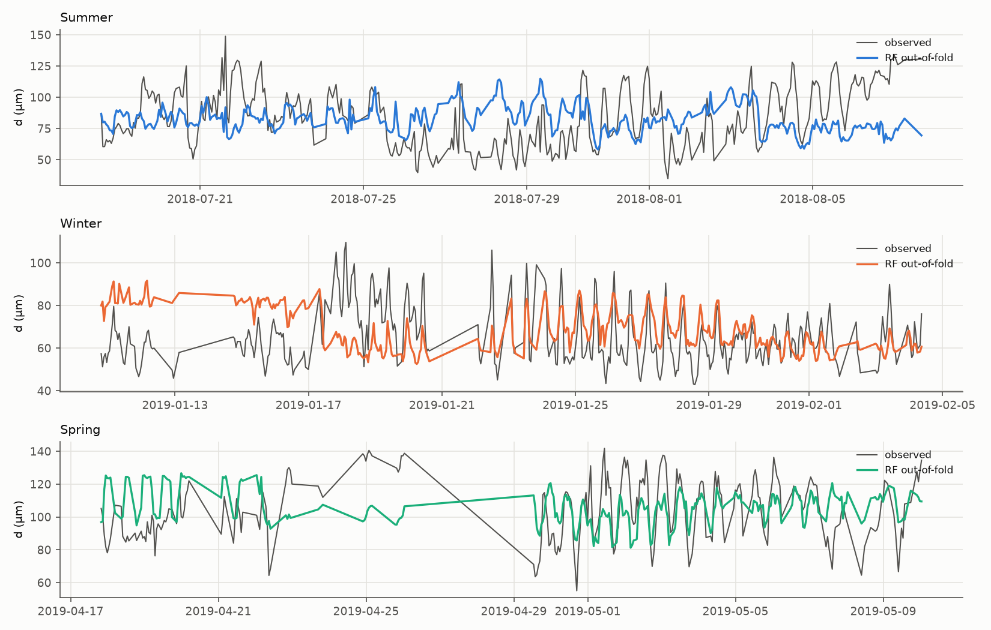
Results: what the model gets right and wrong
Gets right
The tide-to-tide rhythm, especially late Winter and Spring.
Gets wrong
Multi-day shifts in the average size, such as early Winter and late Summer. These are likely driven by biology and by where the mud comes from, which we cannot measure.
Grey: measured floc size. Colour: prediction for days the model never saw ('out-of-fold').

Slide 13
Conclusions
1
The physics matches the published paper: waves break flocs, and the delayed tide brings larger ones.
2
Physics alone explains about a third of floc-size variation across seasons (r² 0.34) and very little within one season.
3
Random splits inflate accuracy: the same model scores 0.64 that way, which explains much of the class paper's 0.81.
4
A model meant to last years needs biology and sediment sensors and more deployments, more than a new algorithm.
Next step: the same group's optics data on Dryad, which lists a 15 cm sizer and a particle-type index.

Slide 14
Comparison and reasons for the difference
 | Journal paper (2022) | Class paper (CS229) | This project
Inputs | 11: physics, biology, sediment | 8: physics, biology | 6: physics only
Location | Optics platform, sizer 15 cm | Single optics platform | Platform P2, sizer 35 cm
Model | LASSO + feature elimination | Random Forest, SVR | Random Forest (main), SVR, LASSO
How scored | Fit on its own data | Random 70/30 split | Held-out time blocks, plus both of theirs
Reported r² | 0.15 to 0.65 | 0.81 (RF), 0.76 (SVR) | 0.34 held-out; 0.60 / 0.53 class setup; 0.17 to 0.43 fit
1
Missing inputs
No particle-type or chlorophyll data. These drive spring and multi-day changes.
2
Scoring method
Random splits and fits on the same data reward memorising neighbouring hours.
3
Different spot
35 cm vs 15 cm above the bed, and a different platform.

