Slide 1
Complex Systems Theory
a paper by Stephen Wolfram
presented @ Dallas Papers We Love
Nik Clarkson 3/2/2015

Slide 2
Stephen Wolfram
Wrote 3 books on particle physics by age 14
published a widely cited paper on heavy quark production at 18
Became faculty at Caltech at age 21
1985 tonight’s paper
1988 released Mathematica 1.0
1992 – 2002 A New Kind of Science
2009 Wolfram Alpha – Computational data
Notes:
Stephen Wolfram and the interesting things about him.

Slide 3
Why is this paper interesting?
Insight into Wolfram’s thought process
The birth of a New Kind of Science

Slide 4
Phenomenon of great complexity
In the natural world
Bees
Birds
Minerals
In the artificial world
Networks
Facebook groups
Optimization algorithms

Slide 5
Is the answer simplicity?
Observed Complexity
Wolfram
The Unexplained
Complexity of Rules
Principles
Axioms
Equations
Theorems
Models
Notes:
I really like this slide

Slide 6
in search of a generalized governing law

Slide 7
Cellular Automata
A grid of cells
A list of possible states for a single cell
A collection of rules governing state transitions

Slide 8
Conway’s Game of Life
John Horton Conway – October 1970 Scientific American
Each cell has eight neighbors
The Rules
Any live cell with fewer than two live neighbors dies, as if caused by under-population.
Any live cell with two or three live neighbors lives on to the next generation.
Any live cell with more than three live neighbors dies, as if by overcrowding.
Any dead cell with exactly three live neighbors becomes a live cell, as if by reproduction.

Slide 9
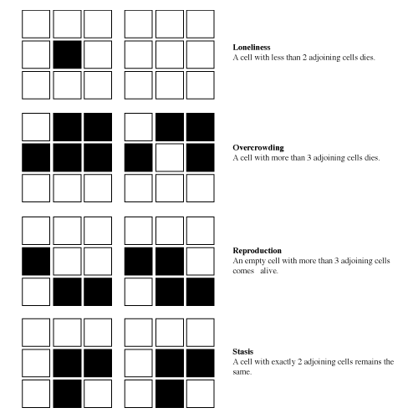
Conway’s Rules
Game of Life
Notes:
http://pmav.eu/stuff/javascript-game-of-life-v3.1.1/

Slide 10
Elementary Cellular Automata
Only 2 cell states
One dimension
One rule

Slide 11
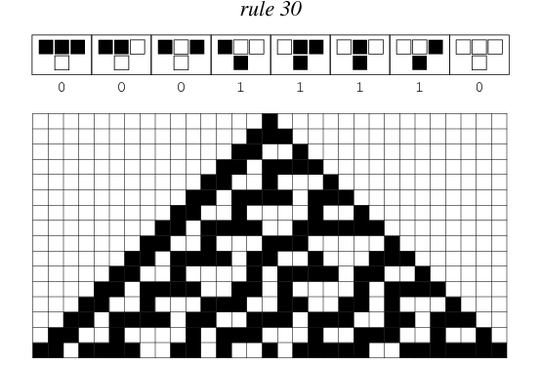

Slide 12
Consequence
The implication that complicated patterns of growth can arise from simple basic processes
External Randomness – boat on the ocean
Initial conditions – car on a bumpy road
Internal complexity generation – Rule 30

Slide 13
Physics & Biology
Physics typically declares the simplest model the right one
Biology wants to use the simplest model, but often natural events step in to mess this up.

Slide 14
Stephen’s Leap of Faith
“It is only the improbability of a very complicated arrangements have been reached by biological evolution that makes a criterion of simplicity at all relevant. And in fact it may no more be possible to understand the construction of a biological organism than a computer program: each is arranged to work, but a multitude of arbitrary choices is made in its construction.”

Slide 15
Experimental Mathematics
Mathematical rules are formulated and the consequences observed
Modern computational horsepower makes this more feasible each day
Wolfram believes this might be as revolutionary as the telescope was to biology.
In 1985 and even today this field is open to ANYONE!

Slide 16
Dynamical Systems
State transitions over time
Complexity over time
Differentiable over time
Cellular Automata as discrete idealized partial differential equations
What!?
While the steps are discrete over time this averages out to appear continuous

Slide 17
Evolving Complexity
Self organization produces complexity over time
Dynamical evolution
Randomness
is relative to our knowledge, skills, and models
Chaos
Isn’t necessarily random

Slide 18
Cellular Automata aren’t just simulations
They can do computations
Propagating structures are like signals interacting
They can act as universal computers

Slide 19
Simple Computation
IsOdd() Mathematica example

Slide 20
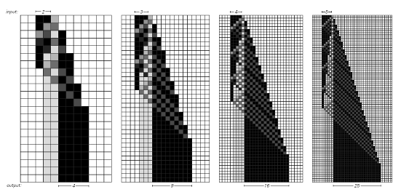
Computing Squares

Slide 21
Signals interacting
Golly application prime generator example

Slide 22
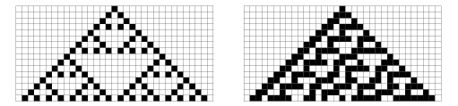
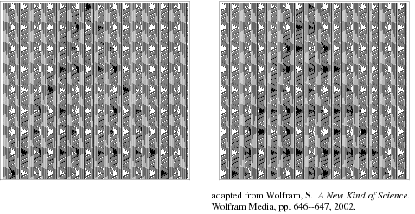
Cellular Automata as Universal Computers

Slide 23
Where simulation falls short
Cannot implicitly simulate
A computer would have to behave more complex than itself.
A universal computer cannot one up itself
Computational irreducible
Darwin’s search example
Must use explicit simulation – every generation must be calculated

Slide 24
Wait.. Why did I read this paper then?
Von Neumann space ship – complexity growth
Still a new area of study
Wolfram is searching for new principles
Quantum computing?

Slide 25
The glue between the disciplines
What binds physics and biology?

Slide 26
Twitter: @CaptainArkansas
Github: https://github.com/armadilloNik/WolframComplexSystemsTheory

