Slide 1

Student Ambassador Projects
Tomato Disease Classifier
Notes:
Korrie

Slide 2
Team Matrix Solution Type: Prototype, Blog/Video, Workshop Content
Ridwan Abdurahman (Team Lead)
Notes:
Korrie

Slide 3
The Opportunity
Industry Trends & Pain Points
The agriculture industry faces several challenges including heavy reliance on manual inspections, inaccurate and delayed disease diagnosis, overuse of chemical treatments, and decreased crop yield and quality.
Why Partner with a Startup?
Partnering with us allows you to challenge the status quo of manual and error-prone disease detection. We leverage machine learning, computer vision, and Azure OpenAI techniques to identify diseases early and accurately, offering new perspectives and innovative solutions that big companies might overlook.
Why It Matters
Our app optimizes time to value by streamlining disease detection and providing instant answers to queries, saving farmers time and resources. It empowers farmers with real-time insights and expert guidance, fostering a future where crop health is managed proactively, ensuring higher yields and better quality.
Notes:
Korrie
updated 7/21

Slide 4
Solution
Why We Built It
We built this solution in response to the pressing need for more efficient and accurate methods of tomato disease detection in the agricultural industry. Traditional approaches were time-consuming, error-prone, and often led to significant crop losses. We saw an opportunity to leverage emerging technologies to revolutionize disease management and empower farmers with real-time insights.
Addressing Customer Pain Points
Our solution directly addresses the pain points faced by farmers, such as manual inspections, delayed disease diagnosis, and decreased crop yield. By providing an automated, accurate, and user-friendly platform for disease detection and management, we enable farmers to make informed decisions quickly, leading to higher productivity and improved crop health.
Notes:
Korrie
updated 7/21

Slide 5
Solution
Powerful Customer Examples
Consider a small-scale tomato farmer who struggled with identifying diseases in their crops. With our solution, they were able to detect diseases early, apply targeted treatments, and significantly reduce crop losses. Another example is to consider that a large agricultural enterprise adopted our platform across multiple farms, resulting in streamlined operations, reduced reliance on chemical treatments, and improved sustainability practices.
Where We Fit In
While there are existing solutions in the agricultural technology space, our solution stands out for its combination of advanced machine learning, computer vision, and Azure OpenAI technology. We offer a comprehensive and integrated approach to disease management that is unmatched in the market.
Notes:
Korrie
updated 7/21

Slide 6
Solution
What Sets Us Apart
We differentiate ourselves from the competition by our relentless focus on customer needs and delivering tangible value. Our solution goes beyond simply detecting diseases; it provides actionable insights, expert guidance, and continuous support to farmers throughout the growing season. We are not just another player in the market; we are a trusted partner committed to driving positive change in the agricultural industry.
Notes:
Korrie
updated 7/21

Slide 7
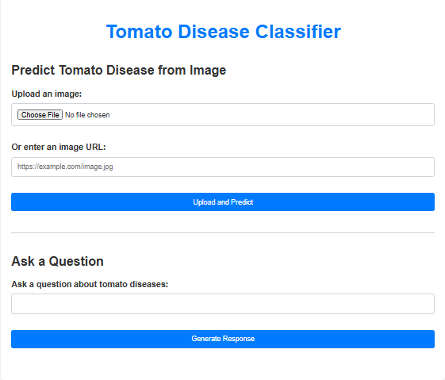
Demo
Tomato Disease Classifier Web App Interface

Slide 8

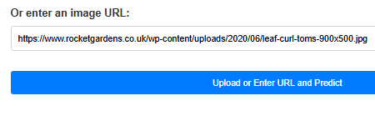
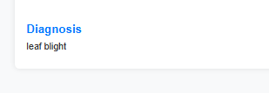
Demo
Identifying diseases through uploading an image and image url
Notes:
Korrie
updated 7/21

Slide 9
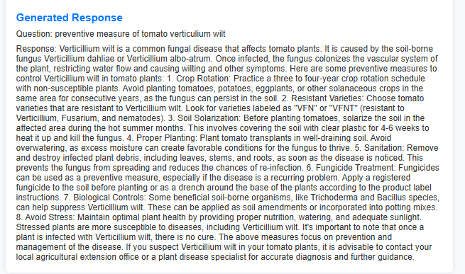
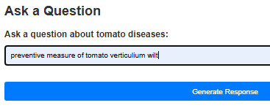
Demo
Generating Response
Notes:
Korrie
updated 7/21

Slide 10
Takeaways
Recommendations for the Audience: We recommend that our audience stop relying solely on traditional, manual methods of disease detection and embrace the power of technology to streamline their operations. Start leveraging advanced solutions like ours to optimize disease management and enhance crop health.
What Can Be Done Without Us: Farmers can independently monitor crops, implement good practices, and seek agronomist advice for disease management.
How Our Solution Speeds Up the Process: Our solution provides real-time insights and expert guidance, automating tasks and simplifying disease management for quicker decision-making.
Simplifying and Making It Cheaper: Our user-friendly platform centralizes disease detection, reducing the need for costly manual inspections and offering cost-effective alternatives to chemical treatments.
Notes:
Korrie
updated 7/21

Slide 11
Team Matrix
Thank You !!!
Notes:
Korrie

