Slide 1
<Nii Armah Nyam Odassey Tettey>
Web Tech Fall 2021 Final Exams

Slide 2
<Nii Armah> is developing a data powered website to help individuals and organizations purchase tickets and plan vacations at an affordable prices.

Slide 3
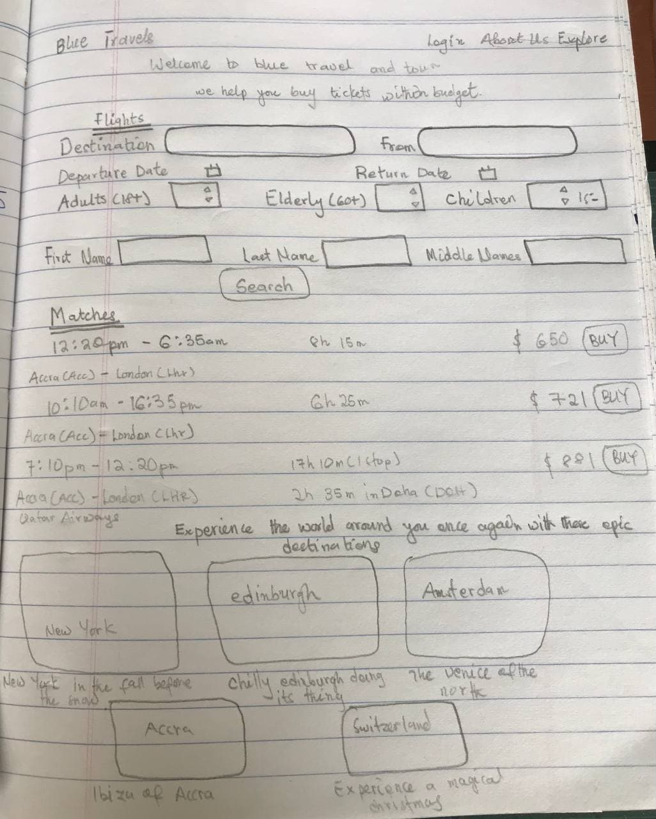
Project Title
ddd
The website gives individuals and aorgasnisations a secure place to buy tickets at an affordable price.
PAYOFF: What is a simple drawn screen that is illustrative of something the website shows that helps solve the problem. It is likely a report or some results of data entered by the participants. This is the most important square
The users of the website are individuals and organisations who have a strict budget for purchasing code.
FINISH: The website is secure and trusted so the chances of being scammed is low. When you create account, you are eligible for discount when buying tickets.

Slide 4
User / Customer
Company
Name: Blue travel Agency
Purpose: Sell airline tickets for travel
Service:
Sell airline tickets to individuals
Help customers plan vacation
Help customers apply for visas
Roles:
Company Administrators
Ticket buyers
Blue travel employees

Slide 5
Main Functions of the Website
Allow users to sign up and login for benefits
Allow users to buy tickets
Allow airline admins to upload tickets to the website
Users can cancel their ticket booking

Slide 6
Architecture
Image of 3 tier architecture and how they connect, programing languages for each tier and why, other technologies (frameworks, etc).
For building the structure of the website
CSS to design the webpage
Bootstrap was used to make the page responsive and designs
JavaScript to make the page interactive
Presentation Layer: HTML/CSS
Connects website to the database for reading on the website
Allows queries to be made to the database.
Application Layer:PHP
To store data for use by the website
MySQL Database

