Slide 1
Web Development using PHP8 & Laravel8
Module 12: Laravel Basic

Slide 2
Objectives
Application Structure & configuration
Architecture Concept
Routing
Views
Blade Template
Middleware
Models, Controllers
Validation & Error Handling
Cookie, Session, Redirection
API Development

Slide 3
Application Structure & Configuration
Installation
Configuration
Directory Structure
Mod 12.1

Slide 4
Installation - your first laravel project
There are a variety of options for developing and running a Laravel project on your own computer. Like -
sail
docker
composer
The most easy option for beginner is composer
composer create-project laravel/laravel example-app

Slide 5
The laravel installer
You may install the Laravel Installer as a global Composer dependency
composer global require laravel/installer
laravel new example-app

Slide 6
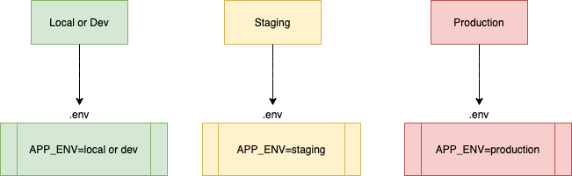
Configuration
Laravel's default .env file contains some common configuration values that may differ based on whether your application is running locally or on a production web server.

Slide 7
How to fetch specific key from .env file
Let say you have following keys/values defined in your .env file:
DB_PORT=3306
DB_HOST=mysql
DB_USERNAME=sail
DB_CONNECTION=mysql
DB_PASSWORD=password
DB_DATABASE=example_app​
Use following function to fetch the value:
# print the value of DB_HOST
echo env('DB_HOST', false);

Slide 8
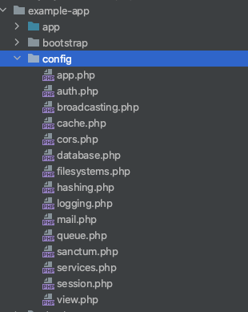
What are configuration files in Laravel?
Configuration file uses .env variables to fetch the configuration dynamically.
For example: Your database configuration might be different on local, staging or on production server depending on what is stored inside your .env file in each environment.

Slide 9
Directory Structure
The application structure in Laravel is basically the structure of folders, sub-folders and files included in a project. Once we create a project in Laravel, we get an overview of the application

Slide 10
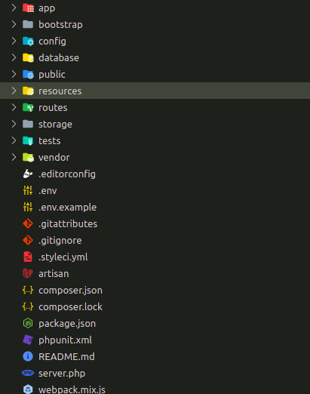

Slide 11
Directory Structure - app
It is the application folder and includes the entire source code of the project. It contains events, exceptions and middleware declaration. The App folder contains -
Console - Console includes the artisan commands necessary for Laravel
Events - This folder includes all the events for the project.
Exceptions - This folder contains all the methods needed to handle exceptions.
Http - The Http folder has sub-folders for controllers, middleware and application requests.
Jobs - The Jobs directory maintains the activities queued for Laravel application.
Listeners - Listeners are event-dependent and they include methods which are used to handle events and exceptions.
Policies - Policies are the PHP classes which includes the authorization logic.
Providers - This folder includes all the service providers required to register events for core servers and to configure a Laravel application.

Slide 12
Directory Structure - bootstrap
This folder encloses all the application bootstrap scripts. It contains a sub-folder namely cache, which includes all the files associated for caching a web application. You can also find the file app.php, which initializes the scripts necessary for bootstrap.

Slide 13
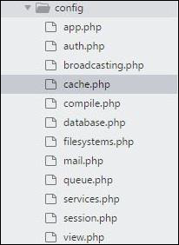
Directory Structure - config
The config folder includes various configurations and associated parameters required for the smooth functioning of a Laravel application.

Slide 14
Directory Structure - database
As the name suggests, this directory includes various parameters for database functionalities. It includes three sub-directories as given below −
Seeds - This contains the classes used for unit testing database.
Migrations - This folder helps in queries for migrating the database used in the web application.
Factories - This folder is used to generate large number of data records.

Slide 15
Directory structure - public
It is the root folder which helps in initializing the Laravel application. It includes the following files and folders −
.htaccess - This file gives the server configuration.
javascript and css - These files are considered as assets.
index.php - This file is required for the initialization of a web application.

Slide 16
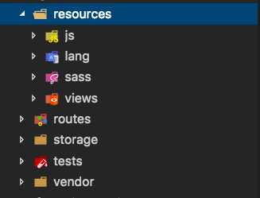
Directory structure - resources
Resources directory contains the files which enhances your web application. The sub-folders included in this directory and their purpose is explained below −
assets - The assets folder include files such as LESS and SCSS, that are required for styling the web application.
lang - This folder includes configuration for localization or internalization.
views - Views are the HTML files or templates which interact with end users and play a primary role in MVC architecture.

Slide 17
Directory Structure - storage
This is the folder that stores all the logs and necessary files which are needed frequently when a Laravel project is running. The sub-folders included in this directory and their purpose is given below-
App - This folder contains the files that are called in succession.
framework - It contains sessions, cache and views which are called frequently.
Logs - All exceptions and error logs are tracked in this sub folder.

Slide 18
Directory Structure - tests
All the unit test cases are included in this directory. The naming convention for naming test case classes is camel_case and follows the convention as per the functionality of the class.

Slide 19
Directory Structure - vendor
Laravel is completely based on Composer dependencies, for example to install Laravel setup or to include third party libraries, etc. The Vendor folder includes all the composer dependencies.

Slide 20
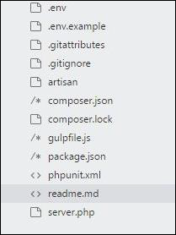
Directory structure - Others
In addition to the above mentioned files, Laravel also includes some other files which play a primary role in various functionalities such as GitHub configuration, packages and third party libraries.

Slide 21
Architecture Concept
MVC
Request Lifecycle
Mod 12.2

Slide 22
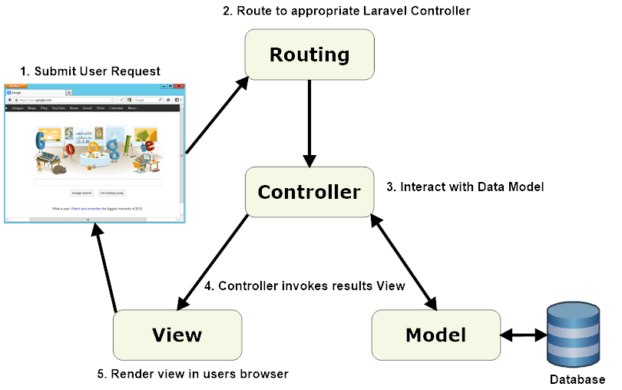
Architecture of laravel application - MVC

Slide 23
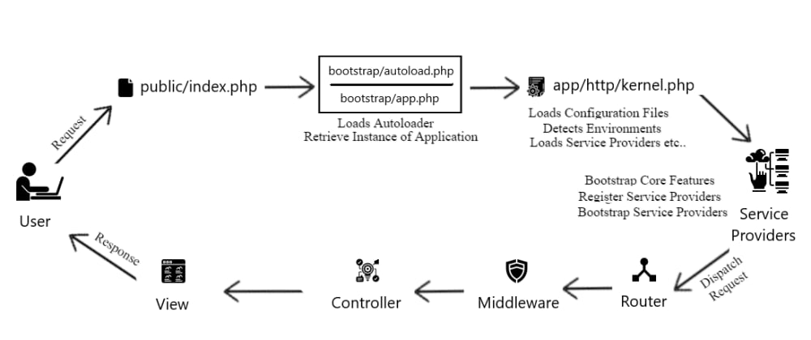
Request Lifecycle

Slide 24
The Basics
Basic Routing
Exercise to understand
Static Page/ View Routes
Redirect Routes
Route Methods
Get/ Post/ Put/ Delete/ Patch
Route Parameters
Named Routes
Generating URLs to named routes
Route Groups
Fallback Routes
Accessing Current Route
Route Caching
URL Generation
Routing

Slide 25
Basic routing
The most basic Laravel routes accept a URI and a closure.
use Illuminate\Support\Facades\Route;
Route::get('/greeting', function () {
return 'Hello World';
});

Slide 26
How a route loads a view?
How to load laravel default welcome page…
Method or
Type of request
Destination of request
Function to be executed
Route::get('/', function () {
return view('welcome');
});
welcome.blade.php

Slide 27
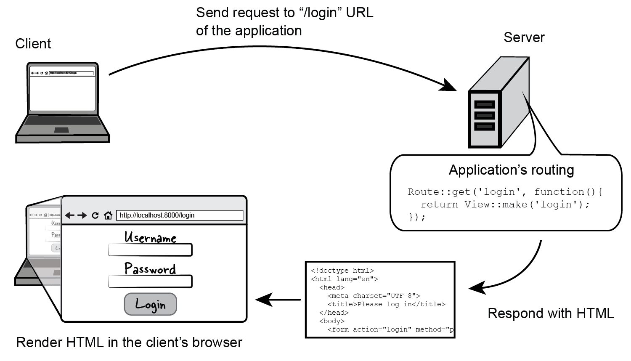

Slide 28
Defining various routes with view()
Defining a route that only renders a Blade template
Route::view('/home');
Route::view('/home', ['data' => 'value']);
Route with a required parameter
Route::get('/page/{id}', function ($id) {
return view('page', ['page' => $id]);
});

Slide 29
Defining various routes with view() cont...
Route with an optional parameter
Route::get('/hello/{name?}', function ($name = 'Guest') {
return view('hello', ['name' => $name]);
});
Named route
Route::view('/home')->name('home');
Route::get('/blog-post/{id}', function ($id) { return view('blog-post', ['id' => $id]); });
Generating url to the named route
$url = route('home');
$blogPostUrl = route('blog-post', ['id' => 1]);

Slide 30
Defining various routes with view() cont...
Route groups
Route::group(['prefix' => 'admin', 'middleware' => 'auth'], function()
{
Route::get('dashboard', function() {} );
Route::get('settings', function() {} );
});
Route model binding
Route::get('posts/{post}', function (Post $post) {
// return the view and the post
return view('post.show', compact('post'));
});

Slide 31
URL Generation - (Routes URLs)
URL::current(): It returns the current URL. consider the following example.
URL::full(): It returns the current URL with request data as GET parameters. It differs from URL::current() as URL::current() strips off request data.
Route::get('test/route',function(){
return URL::current();
});
//outputs: //http://<laravel dir>/public/test/route
Route::get('test/route',function(){
return URL::full();
});
//visit http: //<laravel dir>/public/test/route?foo=1&bar=3
//outputs: //http://<laravel dir>/public/test/route?bar=3&foo=1

Slide 32
URL Generation - (Routes URLs) Cont…
URL::previous(): It returns the URL of the previous request. Consider the following example.
As you can see, the first route redirects to the second route. Then the second route returns the previous request URL (referer).
Route::get('first_test/route',function(){
return Redirect::to('second_test/route');
});
Route::get('second_test/route',function(){
return URL::previous();
});
//visit http://<laravel dir>/public/first_test/route
//outputs
//http://<laravel dir>/public

Slide 33
URL Generation - (Routes URLs) Cont…
URL::to(): It returns the URL of specific route passed as parameter. You should note that this method doesn’t verify if the route exists or not.
Route::get('test/route',function(){
return URL::to('another/route');
});
// outputs
//http://<laravel dir>/public/another/route

Slide 34
URL Generation - (Assets URLs)
URLs to assets such as css files, javascript files and images need to be absolute URLs so Let’s take a look at some of the methods used to get assets URLs:
URL::asset(): It returns the absolute URL to asset. It accepts two parameters. The first parameter is the relative path to the asset from laravel root and the second parameter is a boolean value representing whether URL is secure or not.
Route::get('asset', function(){
return URL::asset('/app/public/assets/css/main.css');
});
//visit
//http://<laravel dir>/public/asset
//outputs
//http://<laravel dir>/public/app/public/assets/css/main.css

Slide 35
URL Generation - (Assets URLs) Cont…
Route::get('secured_asset', function(){
return URL::asset('/app/public/assets/css/main.css',true);
});
//visit
//http://<laravel dir>/public/secured_asset
//outputs
//https://<laravel dir>/public/app/public/assets/css/main.css

Slide 36
URLs Generators - Shortcuts
All methods discussed before are available to be used in views. However it is good practice to use URL generators shortcuts in your views to make them short and neat.
url(): It is identical to URL::to() method. consider the following example.
//app/routes.php
Route::get('another/route', function(){
return View::make('test');
});
//app/views/test.blade.php
<!doctype html>
<html lang="en">
<head>

Slide 37
URLs Generators - Shortcuts Cont..
<meta charset="UTF-8">
<title>
Laravel
</title>
</head>
<body>
<div class="welcome">
<p>{{ url('another/route') }}</p>
</div>
</body>
</html>
route(): It is a shortcut to the URL::route() method. It accepts the nickname of the route and returns the URL.

Slide 38
URLs Generators - Shortcuts Cont..
<div class="welcome">
<p>{{ route('route_nickname') }}</p>
</div>
action(): It is a shortcut to the URL::action() method. It generates links to controller actions.
<div class="welcome">
<p>{{ action('method_name@controller_name') }}</p>
</div>
asset(): It is a shortcut to the URL::asset() method. It accepts identical parameters. Consider the following example.
<p>{{ asset('/app/public/assets/css/main.css') }}</p>

Slide 39
Project V1.0
Install
Configure
Define Route
Review the Static Website
Build Static Website using Laravel

