Slide 1
Impacts of Network Conditions in MAPF and Continuous Learning
A study on integrating network constraints into multi-agent pathfinding.
Author: Arman Dogru, Irem Bor-Yaliniz

Slide 2

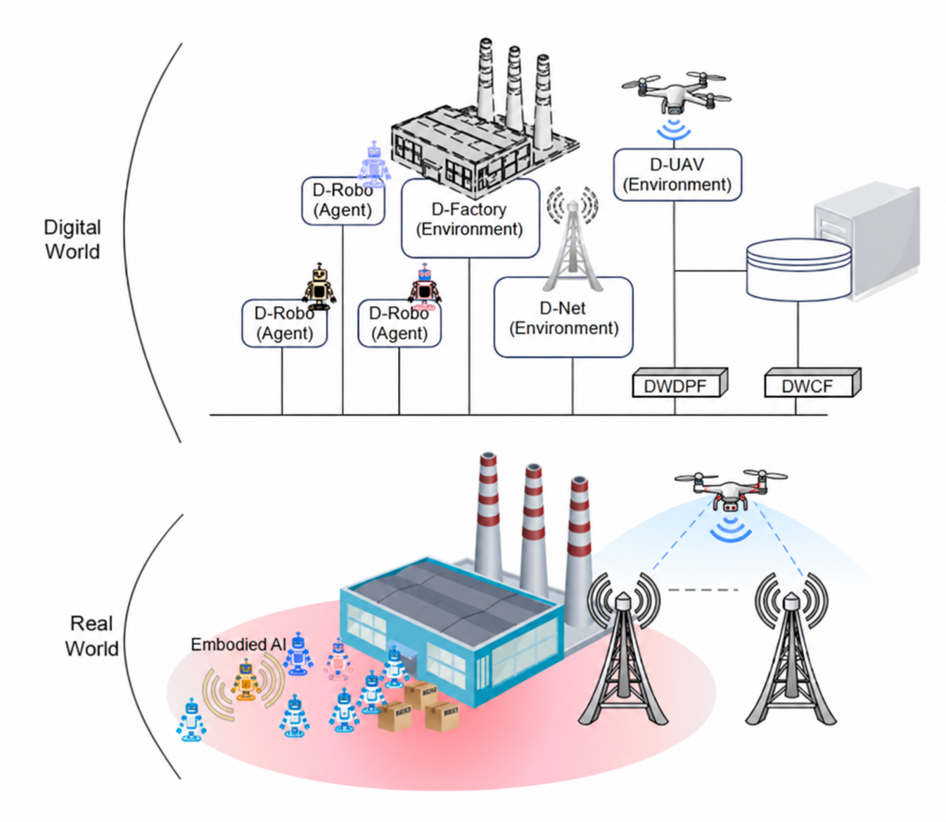
Experimental Setup
Problem: Traditional Multi-Agent Path Finding (MAPF) ignores network constraints, which can lead to communication blackouts in realistic scenarios. in our previous work we were able to prove that channel awareness can improve network quality without degrading solution quality for MAPF problems
Research Questions:
If all tasks are offloaded from agents, how would poor channel conditions impact inference?
Post-deployment, how would poor channel condition, during online learning might impact agent performanc?
How can we optimize the prioritization of agents to minimize impact of uplink/downlink delay?
Approach & Solution: Utilizes Multi-Agent Reinforcement Learning (MARL) with Centralized Training Decentralized Execution (CTDE) to address scalability with Integrated Network Digital Twin (D-Net) to simulate Agent to UAV to LEO to gNb communication. Our experimental set up aims to analyze the impact of poor connectivity in a MAPF scenario with URLLC traffic,
OLD

Slide 3

Inference vs Continuous Learning
During Inference, agents are responsible of sharing sensor data to synchronize their digital twin
They also need to receive commands, priorities, other agent locations and mission status updates
In the case of a continuous learning, on top of the existing requirements, agents need to upload their experiences to the cloud model and download model weight updates regularly

Slide 4

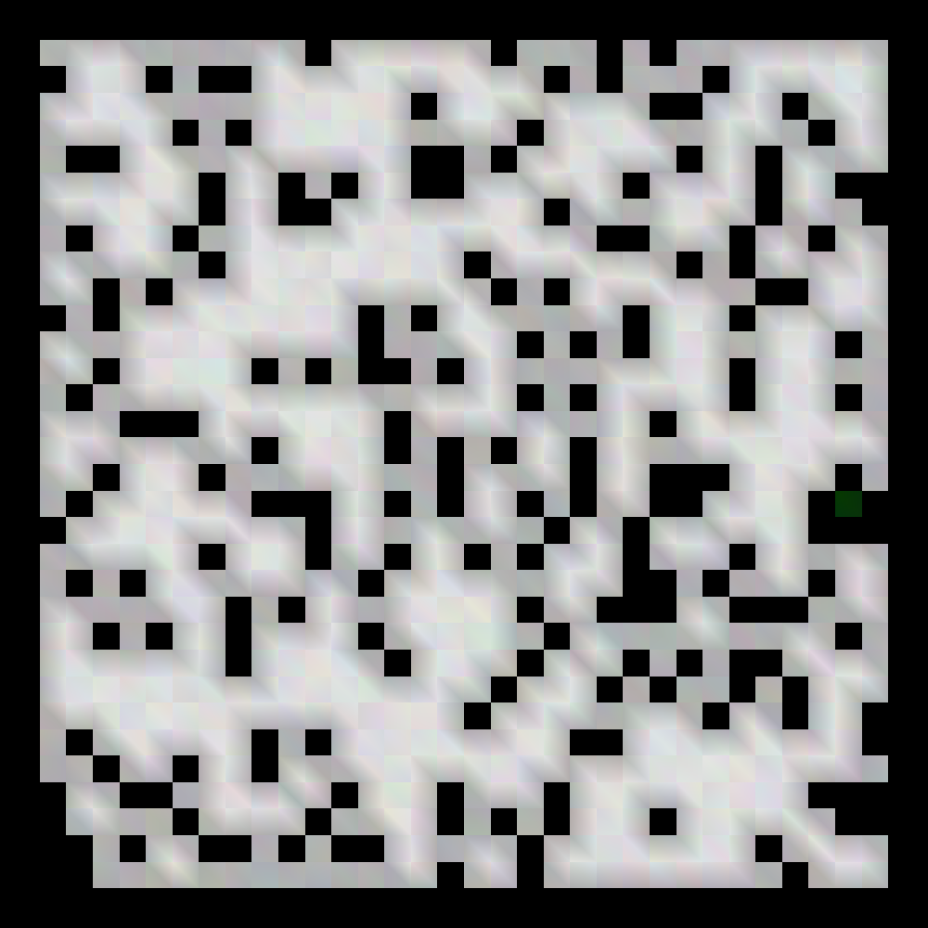
Stages
Experimental runs contain 4 stages:
Stage 1: 32x32x10 random with 4 agents
Stage 2: 32x32x10 random with 8 agents
Stage 3: 32x32x20 random with 8 agents
Stage 4: 32x32x20 random with 10 agents
Using a model that was pre-trained without any communication delay, agents were deployed in these environments
Except for the Inference runs for validation, the environment was regenerated every episode.

Slide 5
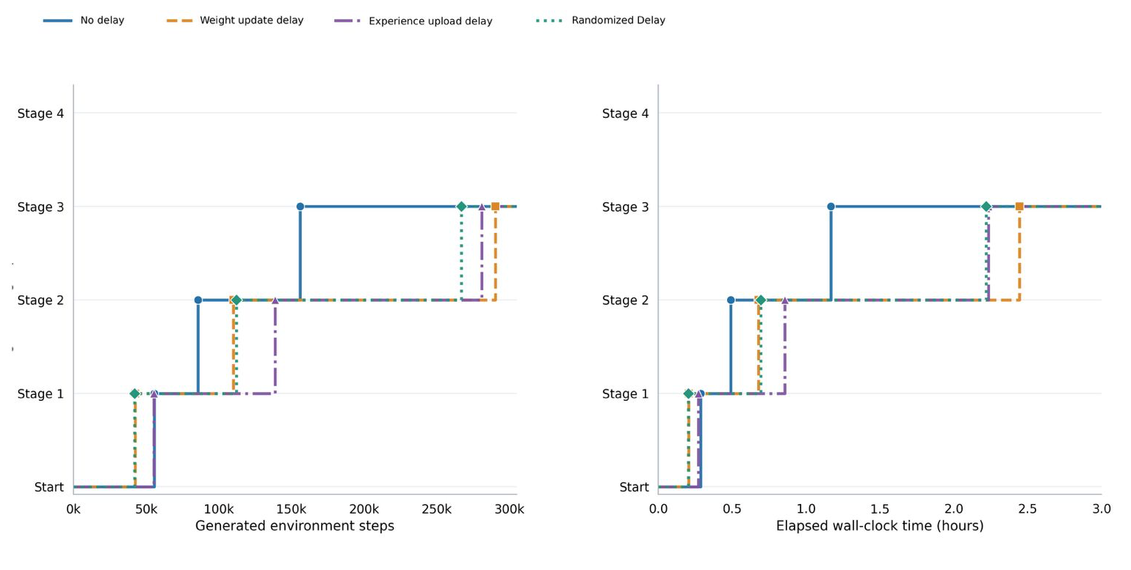
Continuous Learning
Agents performances across the stages were tracked under the assumptions of delays during uplink, downlink and both. Agents were allowed to progress in their curriculum as they were able to perform above 90% success rate during validation runs. As can be seen below, the delay in model weight updates and experience upload is stunting the progession of the model.

Slide 6
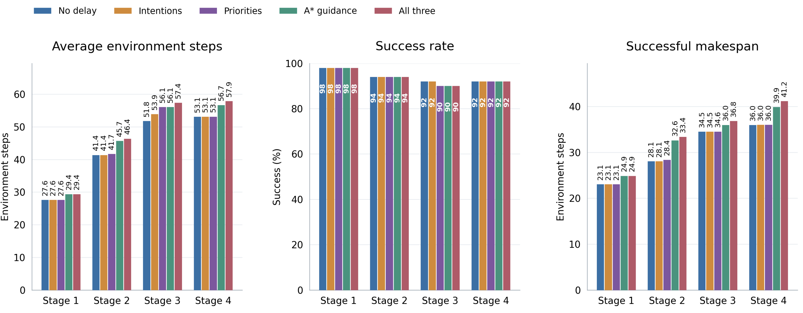
Inference Experiments
Each task delays impact on the inference performance is evaluated on series of unseen stages. (across the experiments, same seed for randomizing the task delaying occurrences were used, 5 steps delays were used)

Slide 7
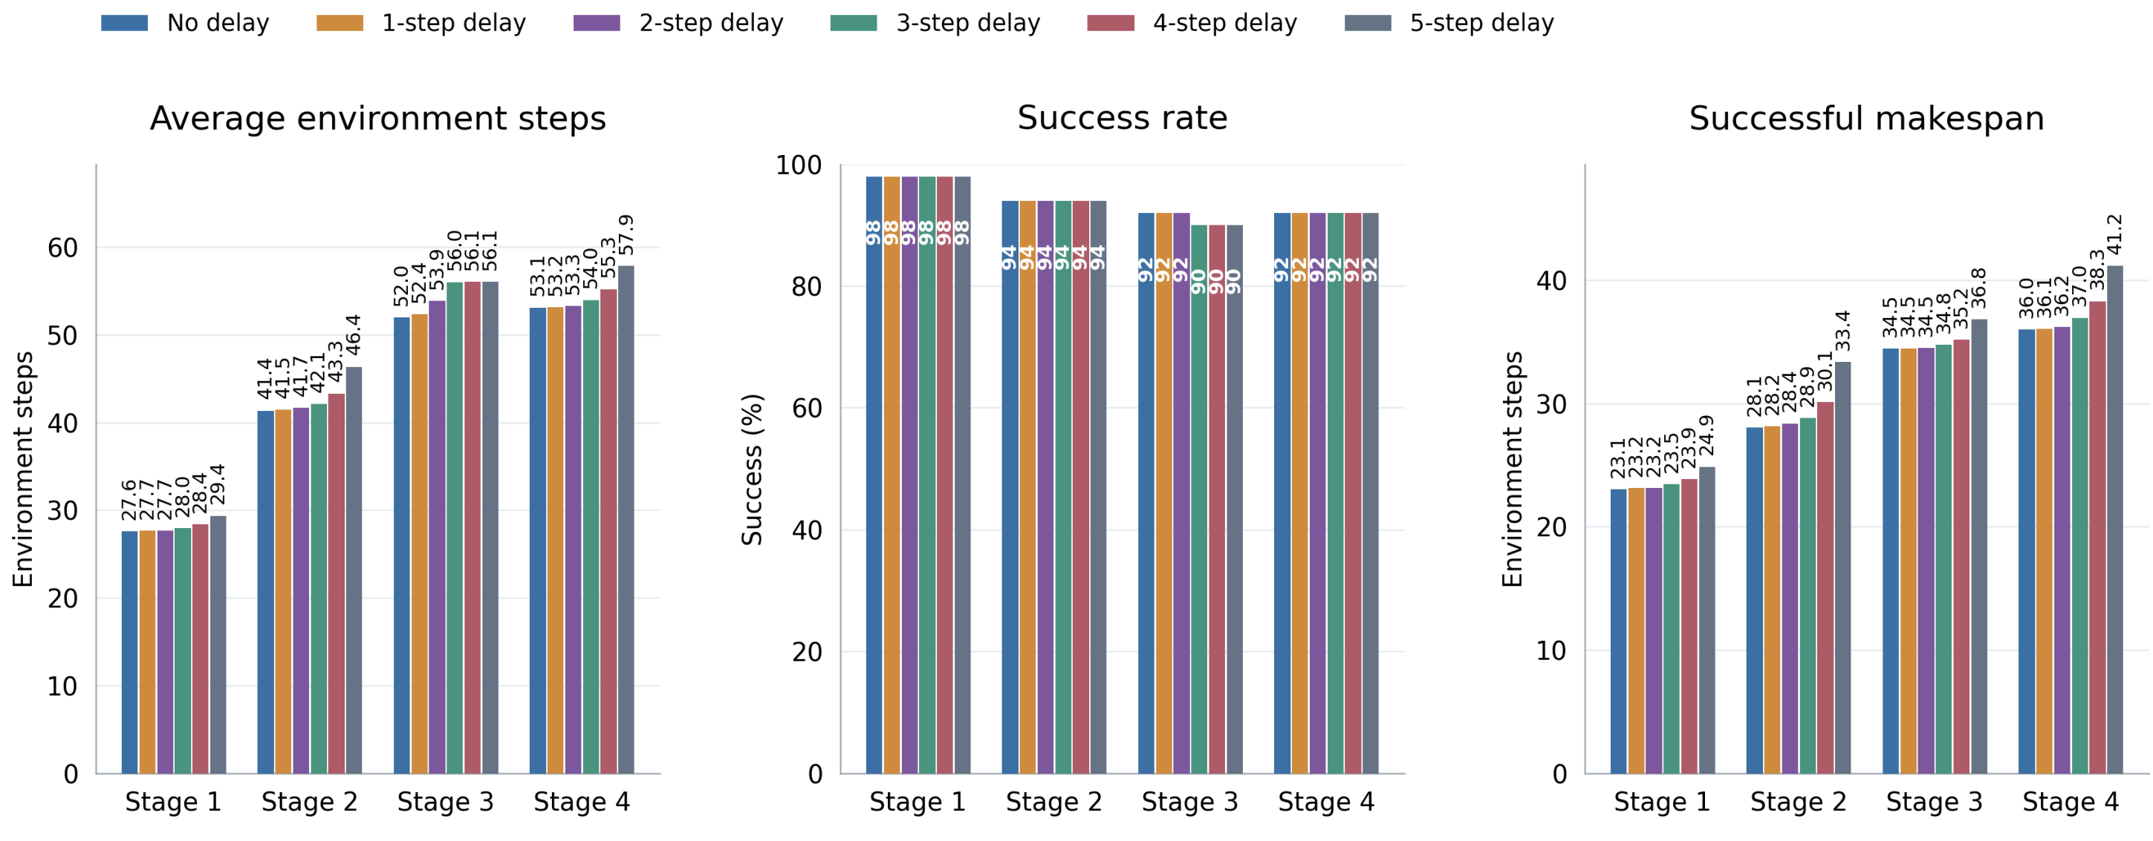
Delay Duration Impact

Slide 8
Real LEO Data
We will use CelesTrak to get LEO Starlink orbital elements

Slide 9
LEO model and datasets
CelesTrak Starlink GP/OMM orbital elements
Propagate orbits with SGP4 near Mont-Tremblant. Calculate satellite visibility, range and Doppler.
Starlink One-way Delay dataset (Garcia & Sundberg, 2025)
Replay separate uplink and downlink traces. These measurements come from Sweden, so check their relevance to our remote site.
Satellite contacts and individual handshakes
Start with one satellite relay and an explicit ground station. Simulate contact changes, buffering and resumed forwarding.
Parameters to define
Keep bandwidth, transmit power, gateway selection and handshake duration explicit as simulation assumptions.
Notes:
NEXT IMPLEMENTATION STEP. The current results described by the presenter use an artificial delay pipeline. This slide proposes a LEO module, rather than reporting an already validated satellite network.
Orbital source: CelesTrak, GP Data Formats, https://celestrak.org/NORAD/documentation/gp-data-formats.php . Starlink GP/OMM elements are inputs to SGP4 propagation. Their propagation gives geometric visibility, slant range and range rate. It does not reveal Starlink's actual serving assignments, gateway routing or spectrum allocation. Store the acquisition time, orbital epoch and source hash. An elevation threshold and serving-contact selection rule must be explicit simulation assumptions. Doppler can be calculated as f_D = -(f_c/c) times the line-of-sight range rate, with an explicitly stated sign convention and carrier frequency.
Measured latency source: Johan Garcia and Simon Sundberg, A Detailed Characterization of Starlink One-way Delay, 2025, https://zenodo.org/records/16275284 . The recordings use hardware-timestamped uplink and downlink traffic collected in Karlstad, Sweden, in April 2025. Preserve direction, trace timestamps, nanosecond units, source hash and the selected continuous segment. These are end-to-end recordings. When replaying a trace, replace the corresponding modeled delay instead of adding modeled propagation or queueing again. Missing sequence numbers alone do not establish packet loss. Delay spikes alone do not establish a confirmed handover. Treat geographical transfer to Mont-Tremblant as an assumption to test, not a local measurement.
Start with a single-satellite relay only while that satellite has valid contacts to the UAV and the modeled gateway. Gateway location is configurable. The optical inter-satellite links mentioned in the draft paper remain a subsequent extension. Capacities and individual handshake durations need sensitivity studies or independently supported measurements.
Paper reference: Irem Bor-Yaliniz, Arman Dogru and Georges Kaddoum, Joint SAGIN Resource Allocation and MAPF for Digital Twin Supported Remote Robotic Applications, supplied draft Remote_Robotic_Satellite.pdf, Sections I and II. The draft includes unresolved channel and downlink parameters, so it supplies the modeling framework rather than a calibrated network.

Slide 10
Transport integration and experiments
Cloud route and UAV processing
Cloud traffic passes through the robot, UAV, LEO relay and ground station. Compare this route with local UAV task processing.
Rate and task latency from the paper
Task Dᵢ = {sᵢ, cᵢ, τᵢ}. Link rate R = B log₂(1 + SNR). Transmission time sᵢ/R. Computation time sᵢcᵢ/f.
Complete the transport model
Add each link’s distance/c, queueing and handshake time. Include return traffic and shared uplink/downlink capacity.
Paired tests against perfect communication
Test stale mission caches and delayed experience/model delivery. Then compare FIFO with priority bandwidth and UAV/cloud offloading.
Notes:
PROPOSED IMPLEMENTATION AND EXPERIMENTS.
Paper reference: Irem Bor-Yaliniz, Arman Dogru and Georges Kaddoum, Joint SAGIN Resource Allocation and MAPF for Digital Twin Supported Remote Robotic Applications, supplied draft Remote_Robotic_Satellite.pdf.
Section I defines D_i = {s_i, c_i, tau_i}, with s_i in bits, c_i in CPU cycles per bit and tau_i in seconds. Section II, equations (1)-(4), specifies free-space path loss plus additional attenuation and Shannon-style link rates R = B log2(1+SNR), with linear SNR and bandwidth B in Hz. Equations (5)-(7) combine payload transmission s_i/R, compute time s_i*c_i/f and satellite propagation. Here f is the CPU allocation in cycles per second. Section III introduces power, CPU capacity and task-deadline constraints. These are the starting formulations for task offloading and resource allocation.
The draft's cloud-latency expression is a simplified UAV-satellite model. Explicit gateway visibility, the gateway/cloud leg, return-message payload sizes, uplink and downlink queues and individual handshakes are proposed extensions. For a modeled route, calculate propagation as the sum of each radio leg's geometric length divided by c. Add transmission per leg, queue waiting time, processing and interruption/buffering time with an event simulator. A trace-driven end-to-end mode instead replaces the matching modeled delay. Do not double-count propagation or queueing already contained in a measured trace.
Experiments: first validate the transport against orbital contacts and the observed one-way delay distribution. Keep mission-information staleness at frozen-policy inference separate from learning transport delays. In the first group, compare perfect communication with stale absolute A* guidance, stale intentions, stale priorities and their combination under identical cases and seeds. In the second group, keep mission inputs fresh and compare clean training, delayed experience upload, delayed model deployment and combined delays. Agents continue acting with cached data or fully received model snapshots. The learner uses received complete experience tuples only. This avoids mixing different causes of degradation.
Report success, makespan, failure-aware PAR-2, information age, model-version lag and task-deadline misses. Resource-allocation follow-up: compare FIFO/equal service with declared priority allocation under matched traffic, before optimizing UAV/cloud offloading. Energy is a later outcome once transmit power and computation-energy parameters are grounded. The existing partial baseline has not qualified every curriculum phase, so its mission comparisons remain exploratory.

