Slide 1
Feature Selection and Discretization based on Mutual Information
Presented by
MD.ARMAN HOSSAIN
BSSE-1029
Supervised by
Mohammad SHOYAIB
Professor
IIT, University Of Dhaka

Slide 2

Outline
Project understanding
Motivation
Problem Specification
Feature Selection Technique
Progress
Additional Work
[1]

Slide 3
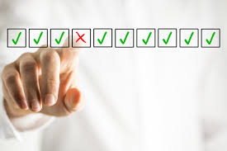
Project Understanding
Discretization
Feature Selection
Transforming continuous data into discrete one with a finite number of intervals
Selecting a subset of relevant features
Humidity |  | Humidity
85.5 |  | 3
90.4 | 65-74 → 1 | 3
78 | 75-84 → 2 | 2
96.2 | 85-96.2 → 3 | 3
80.7 |  | 2
70.5 |  | 1
65.4 |  | 1
94 |  | 3
Continuous |  | Discretized
[2]
Notes:
All features are not equally important
Irrelevant and redundant features
Improve the prediction performance of the predictors
Faster and cost-effective predictors
Reduces Training Time
Simolify the data
Rduce the noise
Continuos dtata sow the learning oricess
Some data mning algorithm can nit handle continiuos value

Slide 4
Motivation
Feature Selection
Discretization
To improve the classification performance
To reduce dimensionality
To reduce training time
USE OF FEATURE:
Machine learning
Pattern recognition
To simplify the data
To remove the noise
To accelerate the learning process

Slide 5

Problem Specification
How to select a proper subset of features through appropriate discretization ?
[3]

Slide 6
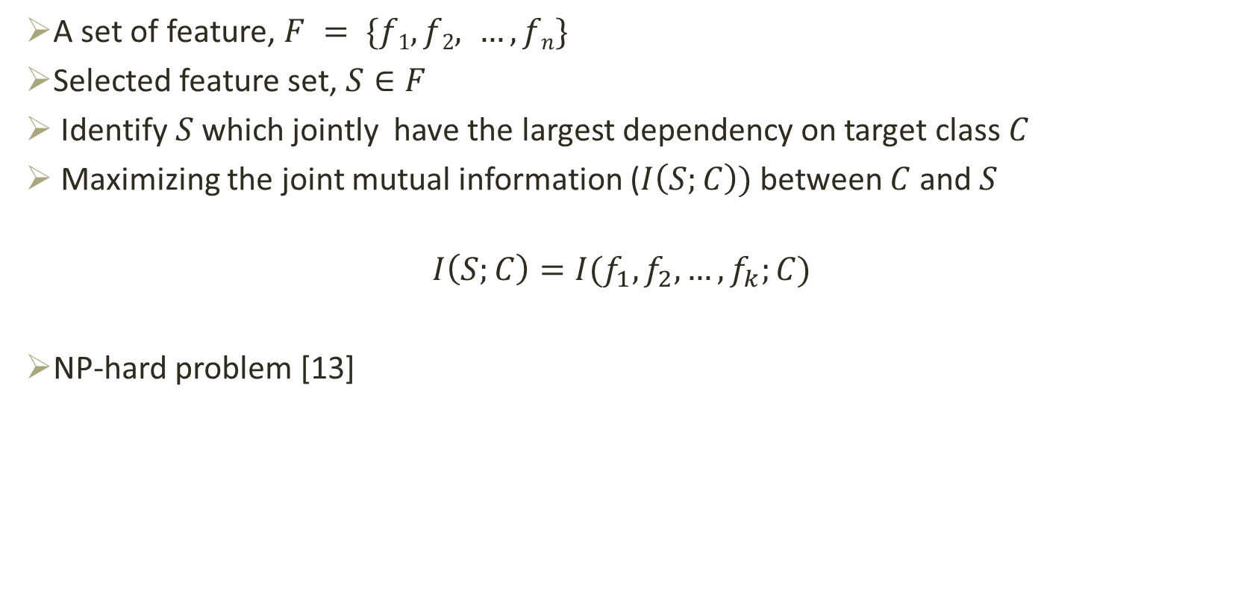
Objective of Mutual Information based Feature Selection
A set of feature, $F = \{f1, f2, …, fn\}$
Selected feature set, $S∈F$
Identify $S$ which jointly have the largest dependency on target class $C$
Maximizing the joint mutual information ($I\left(S;C\right))$between $C$ and $S$
$$I\left(S;C\right)=I(f_{1}, f_{2}, …, f_{k};C)$$
NP-hard problem [13]
F
S

Slide 7


Feature Selection Based On Mutual Information
Height | Class
6 | F
6.5 | F
7 | B
7.5 | B
7 | B
Height >=7
[4]
Basketball Player (B)
Height <7
Here height is an important feature that containing much information about a player
[5]
Football Player (F)

Slide 8
Feature Selection Based On Mutual Information
Skin Color | Height | Class
Fair | 6 | F
Fair | 6.5 | F
Fair | 7 | B
Fair | 7.5 | B
Fair | 7 | B
[4]
Basketball Player (B)
Definitely skin color is not an important feature
[5]
Football Player (F)

Slide 9
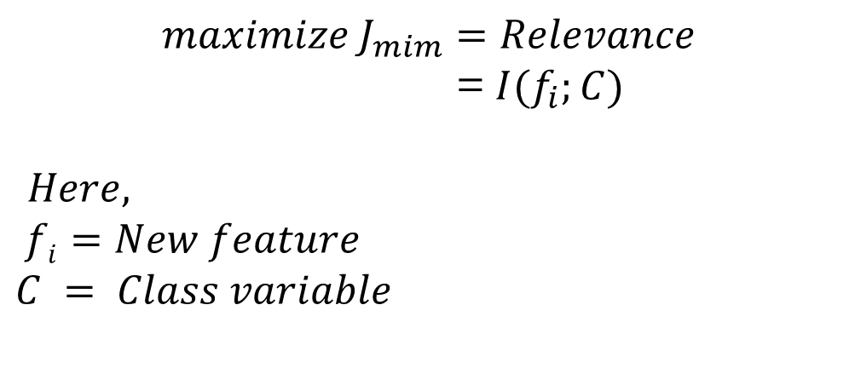
Mutual Information Maximization (MIM)
Reject skin color
Skin Color | Height | Class
Fair | 6 | F
Fair | 6.5 | F
Fair | 7 | B
Fair | 7.5 | B
Fair | 7 | B
$$maximize J_{mim}=Relevance$$
= $I(f_{i};C)$
$Here,$
$$fi=New feature$$
$$C = Class variable$$

Slide 10
Feature Selection Based On Mutual Information
Skin Color | Height | Weight | Class
Fair | 6 | 55 | F
Fair | 6.5 | 60 | F
Fair | 7 | 80 | B
Fair | 7.5 | 85 | B
Fair | 7 | 82 | B
Height >=7
Weight>=80
[4]
Basketball Player (B)
Height <7
Weight <80
Weight convey same information as height
[5]
Football Player (F)

Slide 11
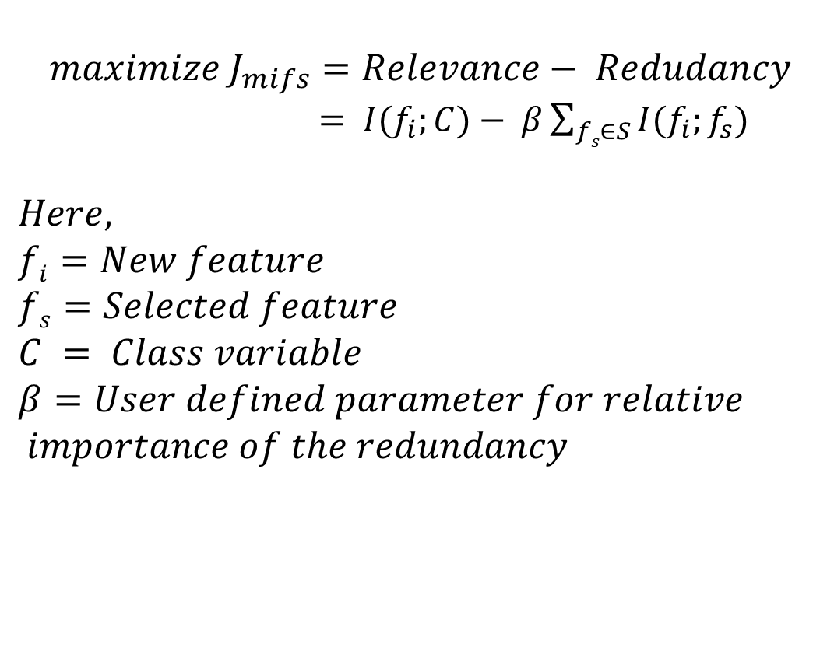
Mutual Information Feature Selection(MIFS)
Skin Color | Height | Weight | Class
Fair | 6 | 55 | F
Fair | 6.5 | 60 | F
Fair | 7 | 80 | B
Fair | 7.5 | 85 | B
Fair | 7 | 82 | B
$$maximize J_{mifs}=Relevance− Redudancy$$
$= I(f_{i};C)− β\sum_{fs∈S}{I(f_{i};f_{s})}$
$$Here,$$
$$fi=New feature$$
$$fs=Selected feature$$
$$C = Class variable$$
$$β=User defined parameter for relative$$
$$importance of the redundancy$$

Slide 12
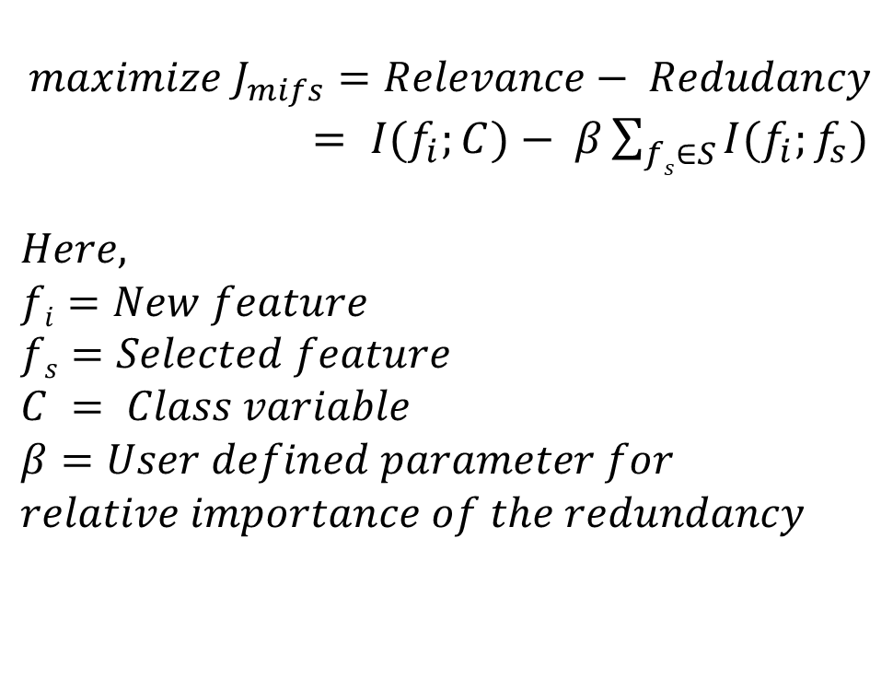
Mutual Information Feature Selection(MIFS)
Skin Color | Height | Weight | Class
Fair | 6 | 55 | F
Fair | 6.5 | 60 | F
Fair | 7 | 80 | B
Fair | 7.5 | 85 | B
Dark | 7 | 82 | B
Irrelevant |  | Redundant
$$maximize J_{mifs}=Relevance− Redudancy$$
$= I(f_{i};C)− β\sum_{fs∈S}{I(f_{i};f_{s})}$
$$Here,$$
$$fi=New feature$$
$$fs=Selected feature$$
$$C = Class variable$$
$$β=User defined parameter for$$
$$relative importance of the redundancy$$

Slide 13
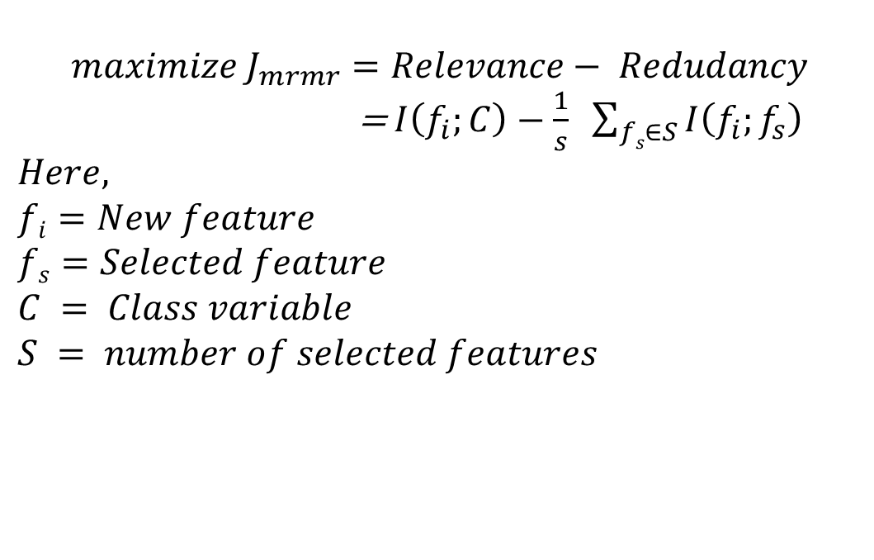
Minimal-Redundancy-Maximal-Relevance (MRMR)[8]
Height | Class
6 | F
6.5 | F
7 | B
7.5 | B
7 | B
$$maximize J_{mrmr}=Relevance− Redudancy$$
=$I\left(f_{i};C\right)−\frac{1}{s} \sum_{fs∈S}{I\left(f_{i};f_{s}\right)}$
$$Here,$$
$$fi=New feature$$
$$fs=Selected feature$$
$$C = Class variable$$
$$S = number of selected features$$

Slide 14
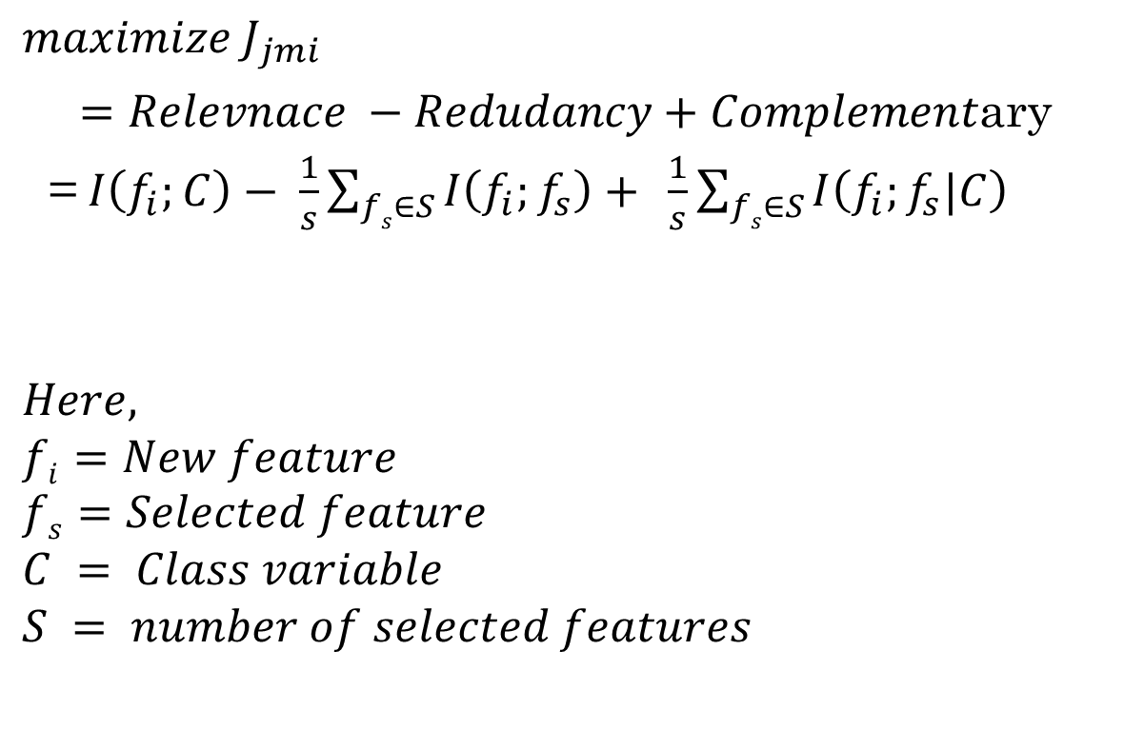
JOINT MUTUAL INFORMATION (JMI)
Height | Weight | Class
6 | 60 | F
6.5 | 65 | F
7 | 80 | B
7.2 | 85 | B
7 | 88 | B
6.5 | 82 | B
7.3 | 62 | F
$$maximize J_{jmi}$$
$=Relevnace −Redudancy+Complement$ary
=$I\left(f_{i};C\right)− \frac{1}{s}\sum_{fs∈S}{I\left(f_{i};f_{s}\right)+ }\frac{1}{s}\sum_{fs∈S}{I\left(f_{i};f_{s}|C\right)}$
$$Here,$$
$$fi=New feature$$
$$fs=Selected feature$$
$$C = Class variable$$
$$S = number of selected features$$

Slide 15
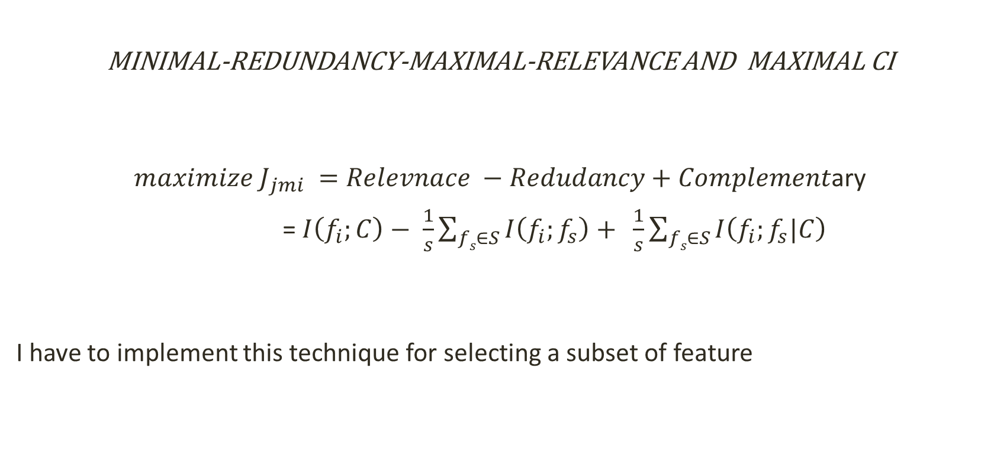
Selection Technique
MINIMAL-REDUNDANCY-MAXIMAL-RELEVANCE AND MAXIMAL CI
$maximize J_{jmi} =Relevnace −Redudancy+Complement$ary
=$I\left(f_{i};C\right)− \frac{1}{s}\sum_{fs∈S}{I\left(f_{i};f_{s}\right)+ }\frac{1}{s}\sum_{fs∈S}{I\left(f_{i};f_{s}|C\right)}$
I have to implement this technique for selecting a subset of feature

Slide 16
Progress
Marginal probability
https ://github.com/arman18/SPL-1/blob/master/Merginal_Probability.c
Joint probability
https://github.com/arman18/SPL-1/blob/master/Joint_Probability.c
Entropy
https://github.com/arman18/SPL-1/blob/master/estentropy.c
Conditional entropy
https://github.com/arman18/SPL-1/blob/master/estcondentropy.c
Joint entropy
https://github.com/arman18/SPL-1/blob/master/estjointentropy.c
Mutual information
https://github.com/arman18/SPL-1/blob/master/estmutualinfo.c
Conditional mutual information
Discretization of feature
https://github.com/arman18/SPL-1/blob/master/discritization2.c

Slide 17
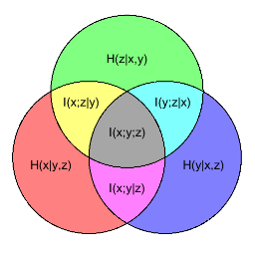
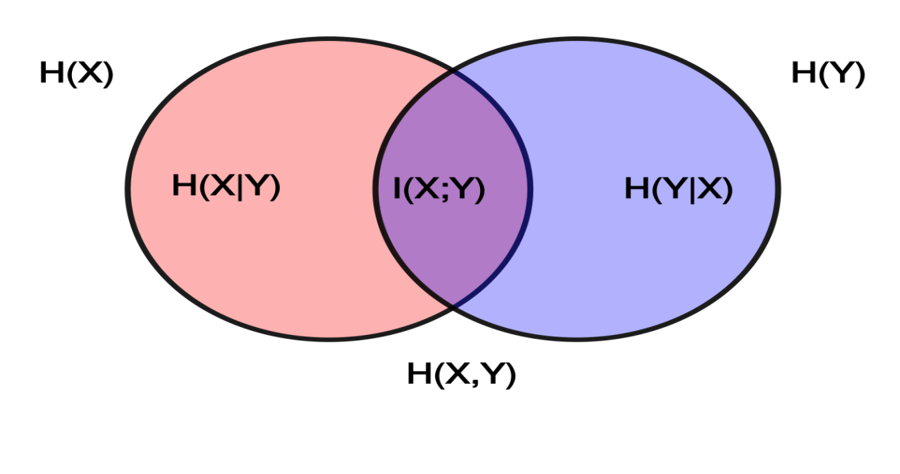
Image
Here,
H(X) = Entropy
H(Y|X) = conditional entropy
I(X,Y) = mutual information
I(Y|X) = conditional mutual information

Slide 18
Additional work
MATLAB:
MATLAB is a high-performance language
C in MATLAB:
How to receive argument from MATLAB
How to process them
How to return value
Use those C function by MATLAB

Slide 19
Publication
"Feature Selection and Discretization based on Mutual Information." Imaging, Vision & Pattern Recognition (icIVPR), 2017 IEEE International Conference on. IEEE, Dhaka, Bangladesh, February 13, 2017. [Best Paper Award]

Slide 20
References
[1] http://www.authorsnest.org/drafting-a-solid-outline/, Accessed : 28-05-2017
[2] http://serialmetrics.com/blog/what-is-machine-learning-feature-selection/, Accessed : 28-05-2017
[3] https://www.frsd.k12.nj.us/Page/9239 , Accessed : 28-05-2017
[4] http://clipartall.com/clipart/8413-clipart-basketball-player.html , Accessed : 28-05-2017
[5] https://clipartion.com/free-clipart-20945/ , Accessed : 28-05-2017
[6]Lewis, David D. "Feature selection and feature extraction for text categorization." Proceedings of the workshop on Speech and Natural Language. Association for Computational Linguistics, 1992
[7] Battiti, Roberto. "Using mutual information for selecting features in supervised neural net learning." IEEE Transactions on neural networks 5.4 (1994): 537-550.
[8] Peng, Hanchuan, Fuhui Long, and Chris Ding. "Feature selection based on mutual information criteria of max-dependency, max-relevance, and min-redundancy." IEEE Transactions on pattern analysis and machine intelligence 27.8 (2005): 1226-1238.
[9] Yang, H., and John Moody. "Feature selection based on joint mutual information." Proceedings of international ICSC symposium on advances in intelligent data analysis. 1999.

