Slide 1
Problem Understanding and Objective
Clinical Document Intelligence Hub · Arman
The brief. Clinical and administrative staff read intake forms, discharge summaries, lab reports and physician notes by hand to pull out the same handful of facts. It is slow, inconsistent, and error-prone.
18
fields extracted
per document
Where I think the real problem sits. Extraction accuracy is not the hard part. Trust is. A structured field with no provenance still forces the reviewer to re-read the document to check it — which is exactly the manual work we claimed to remove. And a field that is confidently wrong is worse than one that is missing.
4
document types
supported
32
document corpus,
exact gold labels
Objective. Document → verified structured record → triaged action. Every field carries a confidence and the source span it came from. Anything that cannot be verified is withheld and routed to a human, never displayed as though it were checked.
21
clinical rules,
every flag traceable
Firstsource Proof of Concept submission
Notes:
The brief asks for extraction from clinical documents. I want to flag the framing I chose up front: I treated this as a trust problem rather than an accuracy problem. If a reviewer can't check a field without re-reading the source, the automation hasn't removed the work. That single decision drives the whole architecture you'll see on the next slide.

Slide 2
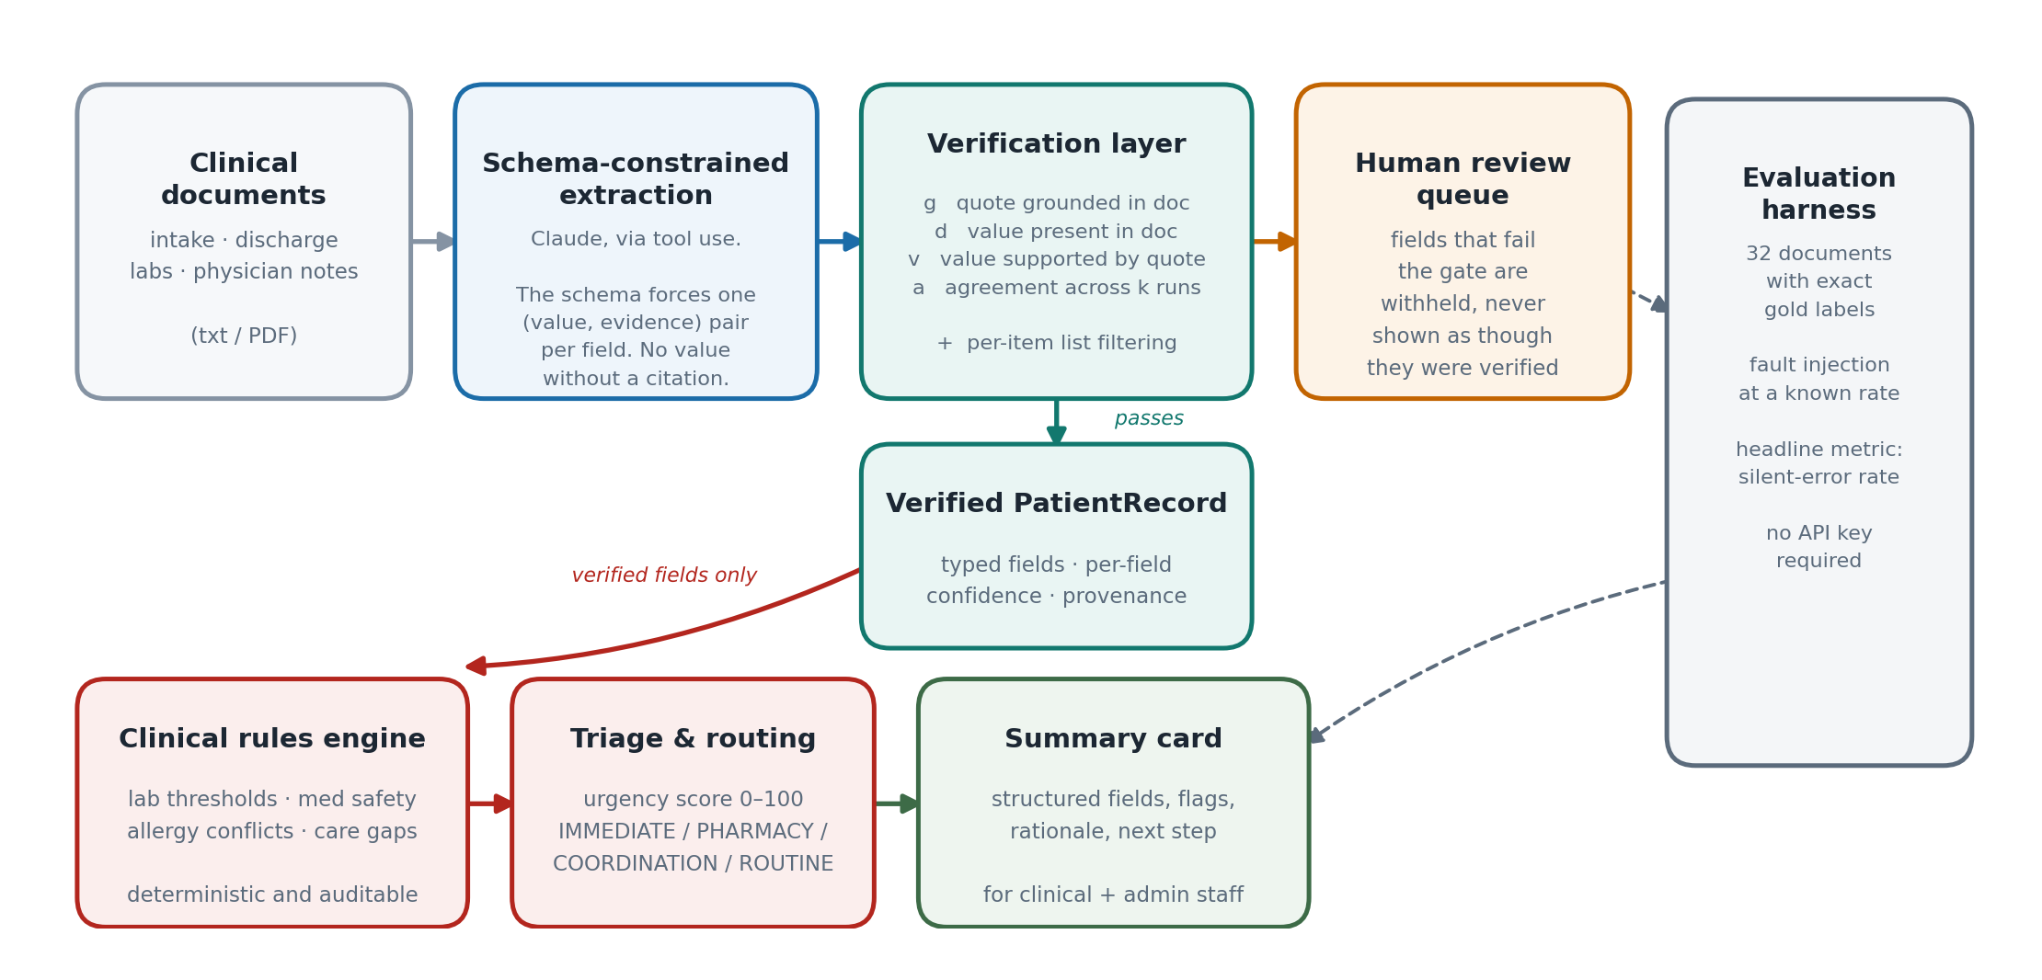
Solution Architecture and Design Flow
The LLM extracts. Verification gates. Rules decide. Each stage does only what it is actually reliable at.
LLM Reading prose → fields
Verification Trusting a value
Rules Escalating a patient
Notes:
Three stages, deliberately separated by what each is reliable at. The LLM does reading comprehension — turning prose into fields — because regex cannot do that on a narrative note. The verification layer decides whether to believe the result, using checkable signals rather than the model's own opinion of itself. And triage is deterministic rules, not the LLM: deciding a potassium of 5.9 needs escalation is clinical policy, and policy has to be auditable and versionable. The LLM's failure mode there would be a plausible-sounding wrong urgency, which is the one that hurts patients.

Slide 3
Implementation Highlights
Confidence is computed from measurable signals, never asked for — verbalised LLM confidence is poorly calibrated.
Four signals behind every field
Measured, not asserted
g
grounding — is the evidence quote really in the document?
96.2%
fabrications caught
under fault injection (50 / 52)
d
presence — is the value in the document, independent of its quote?
0.0%
false block rate
0 of 143 clean fields withheld
v
support — is the value inside the quote it cites?
a
agreement — do k independent samples return the same value?
14.0%
baseline silent error
regex control arm, for comparison
confidence = 0.30·g + 0.25·d + 0.15·v + 0.30·a
The gate that does the work
cdi/verify.py
Named entities — patient, diagnosis, drug, allergen — hard-gate on presence. A name that is not in the text is an invention, full stop.
Numerics deliberately do not: 37.6 °C correctly extracts as 99.7 °F, and “one hundred and twelve” as 112. Neither literal appears in the document. Hard-gating those would punish the model for doing the conversion the schema asked for.
Lists are filtered per item. A medication list that is 4/5 correct is not 80% safe — the phantom fifth entry is the entire risk.
g = grounding_score(quote, doc)
d = presence_score(value, doc)
v = support_score(value, quote)
a = agreement_score(samples)
fabricated = (g < GATE) or (
d < GATE and not is_numeric(value))
if fabricated: UNGROUNDED # withhold
elif dropped: ABSTAINED # list invention
elif conf < T: ABSTAINED # low confidence
else: EXTRACTED # show it
Notes:
Two things worth pausing on. First, the model is never asked how confident it is — verbalised confidence is badly calibrated, so confidence here is computed from four things I can actually check. Second, the gate is asymmetric on purpose. For names and drugs, a value that isn't in the document is fabrication and gets blocked outright. For numbers it can't be, because a correct Celsius-to-Fahrenheit conversion produces a value that never appears in the text. Getting that wrong was one of my actual bugs — I'll cover it next.

Slide 4
Challenges and Learnings
Three of these were my own bugs, found by measurement rather than by reading the code again.
My corpus was marking its own homework
1
The first eval gave the regex baseline 99.4%. I had written both the templates and the regexes, so they matched by construction. I added 15 free-prose narrative documents — spelled-out numbers, Celsius, no field labels. The baseline fell to 86% and missed 177 fields. A benchmark you author yourself flatters you until you deliberately attack it.
The grounding gate had a hole
2
A fabricated patient name passed verification: the quote “Patient Name : <wrong name>” fuzzy-matched the real line because the boilerplate prefix carried the score. Checking the quote is not the same as checking the value. Adding a direct value-in-document test is what actually catches invention.
Correct answers were being rejected
3
Hard-gating numerics on presence punished the model for doing the unit conversion the schema asked for. The fix was to make the gate asymmetric — hard for named entities, soft for numerics — and to match spelled-out numbers and Celsius equivalents explicitly.
You cannot measure a hallucination-catcher with an extractor that cannot hallucinate
4
The regex baseline only copies or fails, so it showed the verification layer doing nothing. Rather than assert the layer works, I injected synthetic hallucinations at a known rate — real quote, subtly wrong value — and measured a 96.2% catch rate with zero false blocks. No API key needed to reproduce it.
The learning that changed the most: picking silent error rate over accuracy as the headline metric reshaped the system more than any model choice did. Once the number you optimise punishes confident wrongness rather than silence, abstention stops being a failure and becomes a feature.
Notes:
I'd rather show the bugs than a clean story. The first one is the one I'd want a reviewer to push on: if you generate your own evaluation data, you will flatter yourself, and the only defence is to deliberately build the part of the corpus your approach is worst at. The narrative documents exist precisely because regex handles them badly and I needed the comparison to be honest.

Slide 5
Demo Summary and Next Steps
Worked example — one discharge summary
What runs today
Four traps in the source document, all handled: prior-visit vitals ignored · family-history condition excluded · discontinued drug excluded · 10 risk flags raised
streamlit run app.py
python -m cdi.summarize <document>
python run_eval.py
python run_eval.py --arm anthropic --k 3
CRITICAL Amoxicillin prescribed against a documented penicillin allergy
CRITICAL Metformin contraindicated at eGFR 24
The baseline arm, the full evaluation harness and the UI all run with no API key. The fault-injection result is reproducible on any machine in one command.
HIGH Discharged with no follow-up, on a high-risk diagnosis
→ Routed: IMMEDIATE CLINICAL REVIEW, urgency 100/100
If I had another week
Set the threshold, don't pick it
Field-level escalation
Fit abstention against an explicit cost ratio for a missed field vs. a wrong one, rather than a hand-chosen 0.70.
Route only the low-confidence fields to a stronger model instead of re-running the whole document.
A corpus I didn't write
Cross-document reconciliation
Re-measure on a public de-identified set and report the delta honestly — my numbers are on synthetic data.
Compare an intake form against its discharge summary and flag contradictions between them.
Arman · README, evaluation report and full source in the submitted repository
Notes:
The worked example on the left is the case for the system: both critical findings are plainly visible in the source document, and neither is visible to a human skimming four pages under time pressure. On next steps, the one I'd actually do first is the threshold — 0.70 is currently a judgement call, and it should be derived from what the organisation decides a missed field costs relative to a wrong one.

