Slide 1
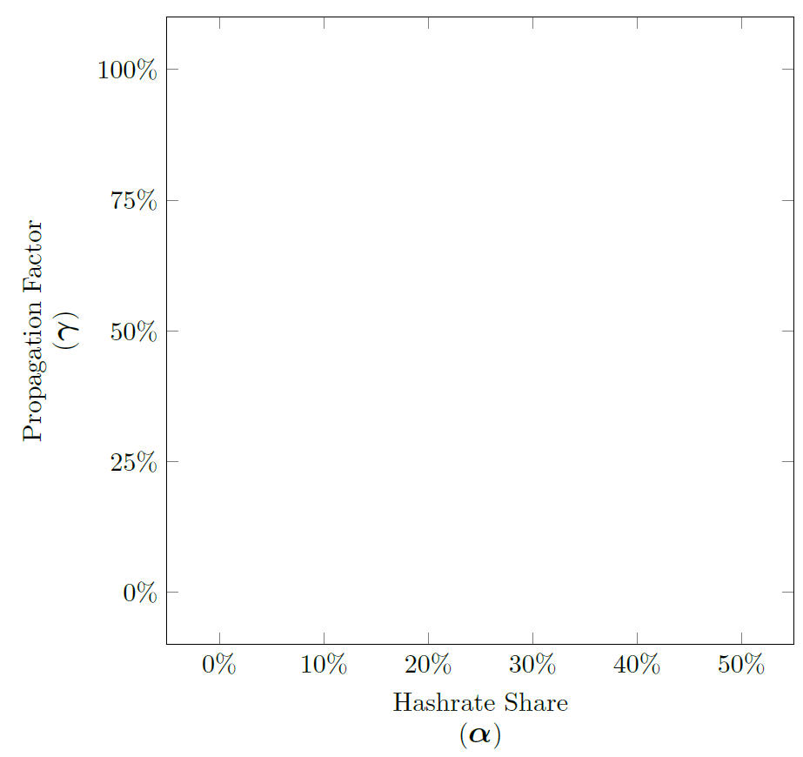







6
5
4
Number of Difficulty Changes
3
2
1
0
Propagation Factor
(γ)
H
S
L
T2
T3
T4
E
Hashrate Share
(α)

Slide 2







6
5
4
Number of Difficulty Changes
3
2
H
S
L
T2
T3
T4
E
1
0
Propagation Factor
(γ)
Hashrate Share
(α)

Slide 3
6
5
4
Number of Difficulty Changes
3
2
1
0
Propagation Factor
(γ)
H
S
L
T2
T3
T4
E
Hashrate Share
(α)

