Slide 1
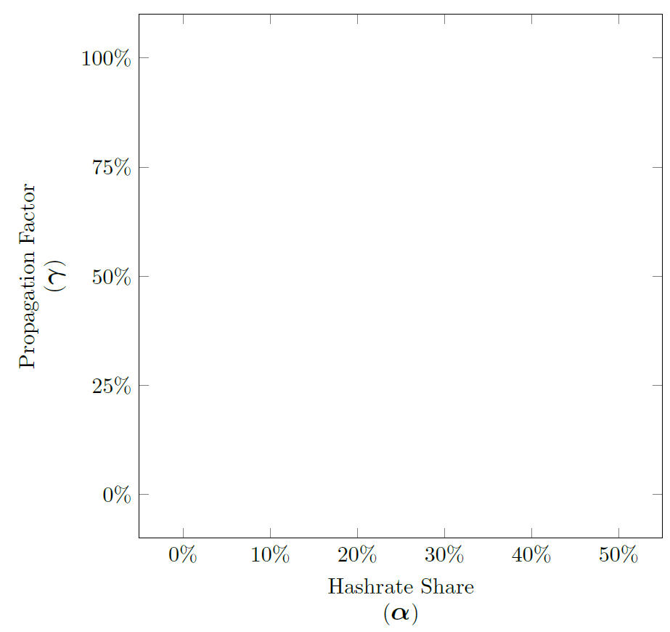


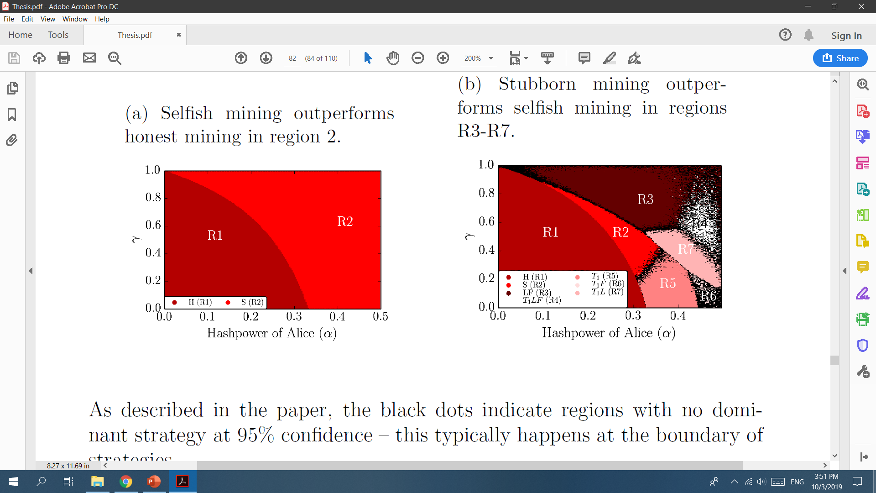
Peer-to-Peer Network Simulation
Finite-State Machine Simulation
Expected

