Slide 1
Fairness
Fairlearn exploration

Slide 2
Bids to impression
Probability of winning the auction should be independent from the city
Otherwise, some cities are more likely to be shown ads which creates a asymmetry based on the location

Slide 3
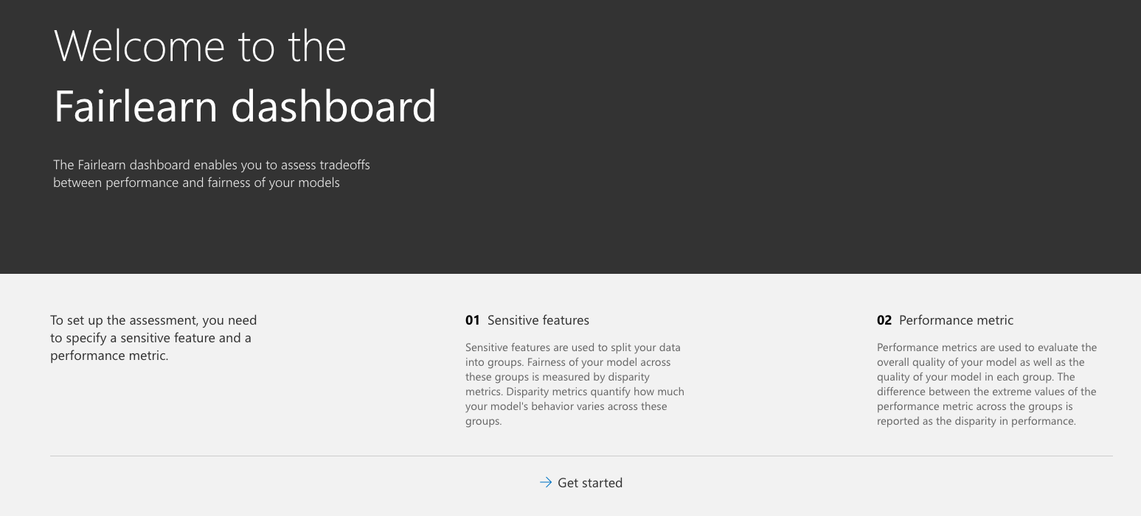
Fairlearn Dashboard
2.

Slide 4
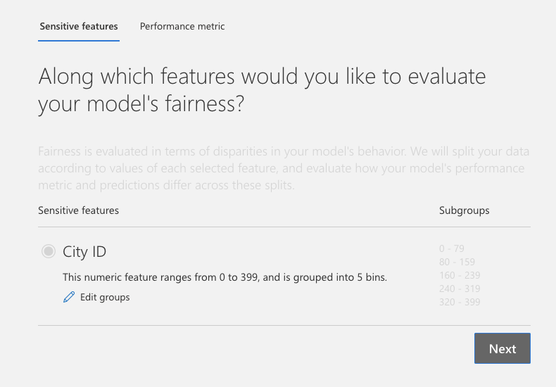
Sensitive Features

Slide 5
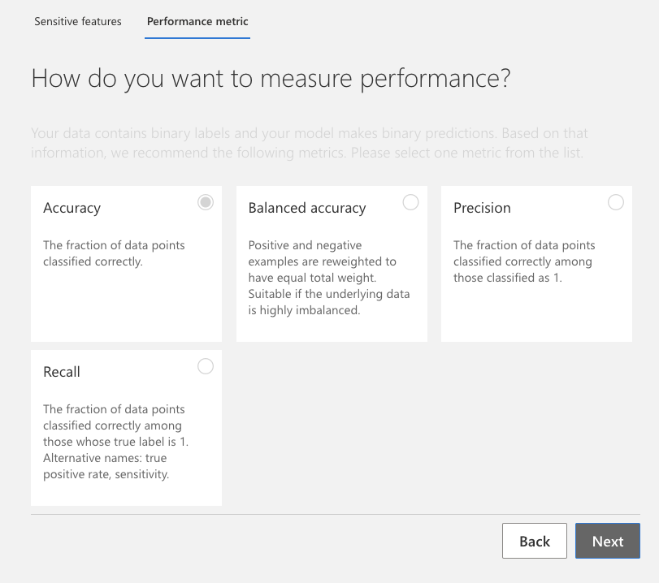
2. Performance Metrics

Slide 6
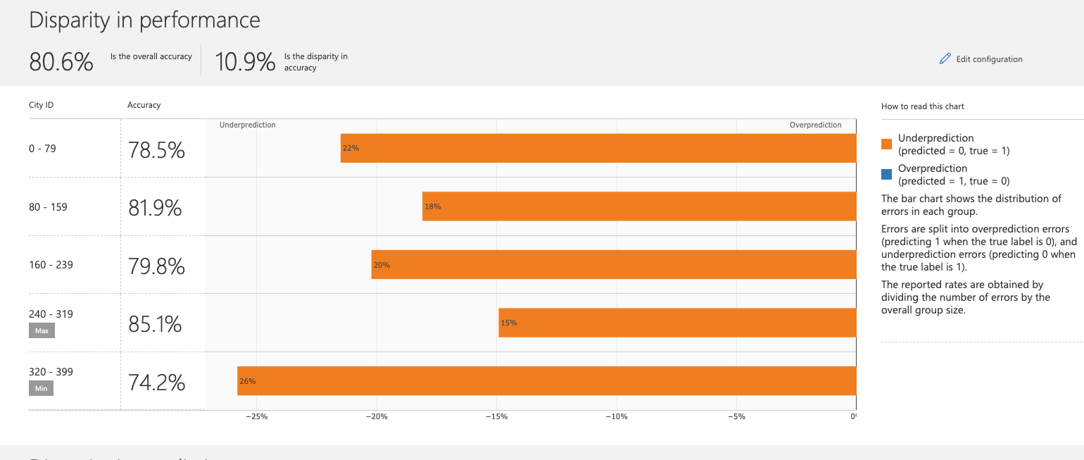
Results: high disparity in accuracy

