Slide 1

Athena: AI-Powered Campus Query Bot
A centralized AI assistant that gives students verified, grounded answers from their institution's own knowledge base — no more searching across scattered websites, PDFs, and social media.
Query Bot
Natural-language questions, AI answers grounded in verified institutional data
Campus Navigation
Interactive 2D map — find classrooms, departments, and venues instantly
Academics
Courses, faculty, syllabi, timetables, and CGPA calculator in one place
Societies & Reminders
Consolidated club info, announcements, and personalized date reminders

Slide 2
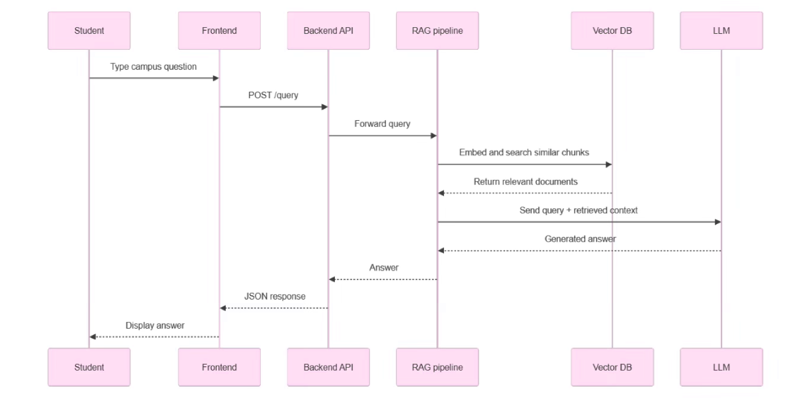
Query Bot Workflow
A 7-step RAG pipeline transforms a student's question into a verified, institution-grounded answer.
01
Student asks question
Via the web interface in natural language
02
Frontend → Django API
Query sent to backend for processing
03
RAG Pipeline embeds query
Sentence Transformers convert text to vector
04
Semantic search in pgvector
Finds most relevant document chunks
05
Context + query → GPT-4o-mini
LLM generates a grounded, verified answer
06
Answer delivered
Location queries rendered on the 2D campus map

Slide 3
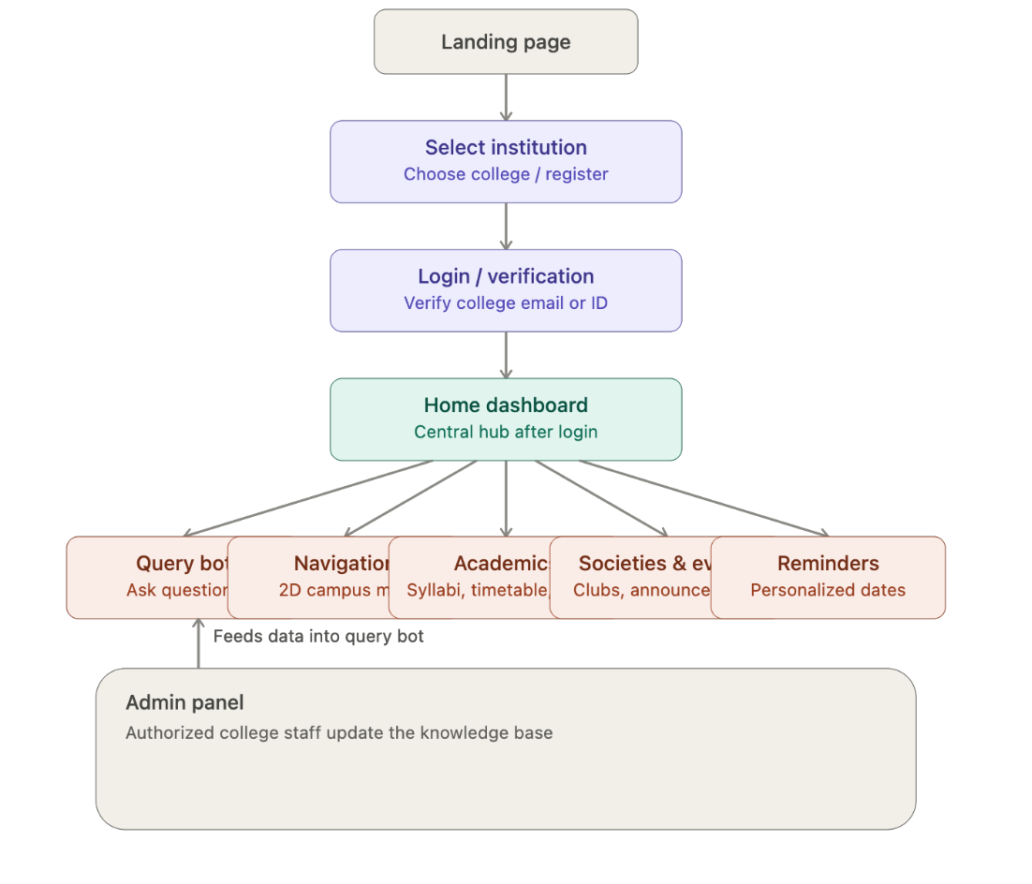



How the Project Works
Technology Stack
Frontend
Backend
Database
React.js (Vite) + Tailwind CSS — responsive student & admin UI
Django + DRF — auth, API, and RAG pipeline orchestration
PostgreSQL + pgvector — stores embeddings for semantic search
LLM & Embeddings
Deployment
Vercel (frontend) · Render / Railway (backend & database)
Sentence Transformers + OpenAI GPT-4o-mini + PyMuPDF
Every answer is grounded in retrieved institutional data — Athena never responds without verified context.

Slide 4






What Makes Athena Different?
Athena is not just another chatbot — it's a system-level integration purpose-built for educational institutions.
Grounded Answers — Zero Hallucinations
Multi-College Scalability
Each college maintains its own independent knowledge base — onboarding a new institution requires no platform changes.
Every response is verified against institutional data, unlike generic ChatGPT which can fabricate information.
Student Verification
Easy Updates — No Retraining
Institutional email verification ensures only legitimate students access college-specific data.
Admins update the knowledge base via Django Admin; the LLM never needs to be retrained when data changes.
Semantic Search
Campus-Specific Integration
RAG pipeline finds relevant info even when phrased differently — far superior to keyword search portals.
Navigation, academics, societies, and reminders — all unified in one platform, not just a chatbot.

Slide 5



THANK YOU

