Slide 1
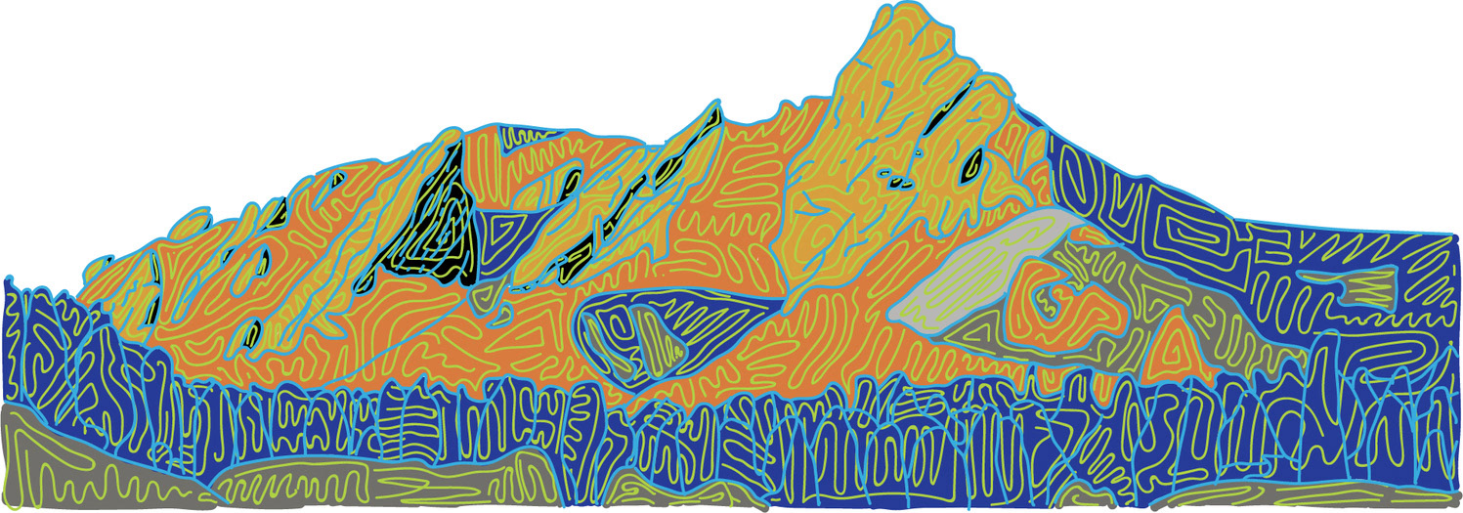

Embedded Device Service
Armando Pinales
ECEN 5033 – DevOps in the Cloud
University of Colorado Boulder

Slide 2

Overview
Introduction
Proposed Solution
Architecture
Video Demo
Future Work

Slide 3
Introduction
What is this?
Platform for monitoring IoT device data.
Must be viewable through web browser.
Bullet 3

Slide 4
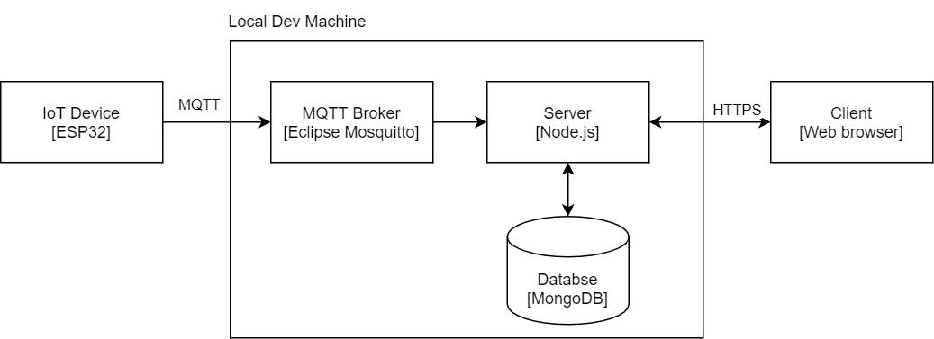
Proposed Solution
Bullet 1
Bullet 2
Bullet 3

Slide 5
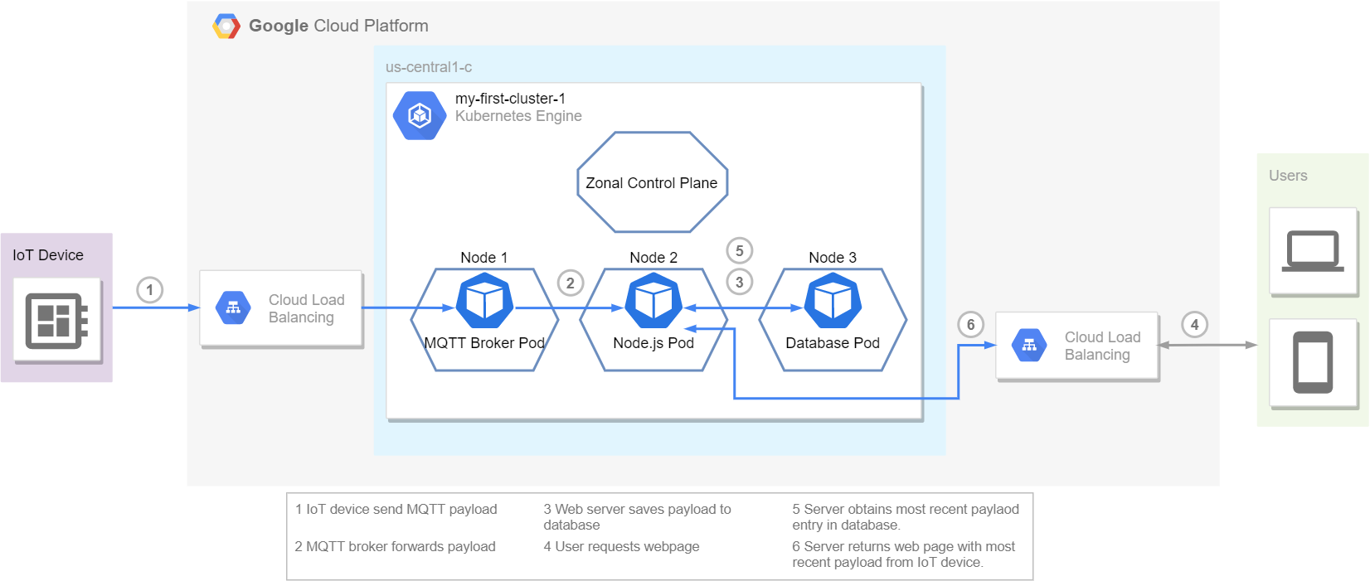
Architecture

Slide 6
Architecture
Lead text here…
Bullet 1
Bullet 2

Slide 7
Video Demo
Bullet 1
Bullet 2
Bullet 3

Slide 8
Future Work
Lead text here…
Bullet 1
Bullet 2
Bullet 3

Slide 9
Questions
Bullet 1
Bullet 2
Bullet 3

Slide 10
Citations
[1] https://www.behance.net/gallery/75855977/Drawing-Flatirons
Bullet 2
Bullet 3

