Slide 1


Embedded Device Service
Armando Pinales
ECEN 5033 – DevOps in the Cloud
University of Colorado Boulder

Slide 2

Overview
Introduction
Proposed Solution
Architecture
CI/CD
Live Demo
Future Work

Slide 3
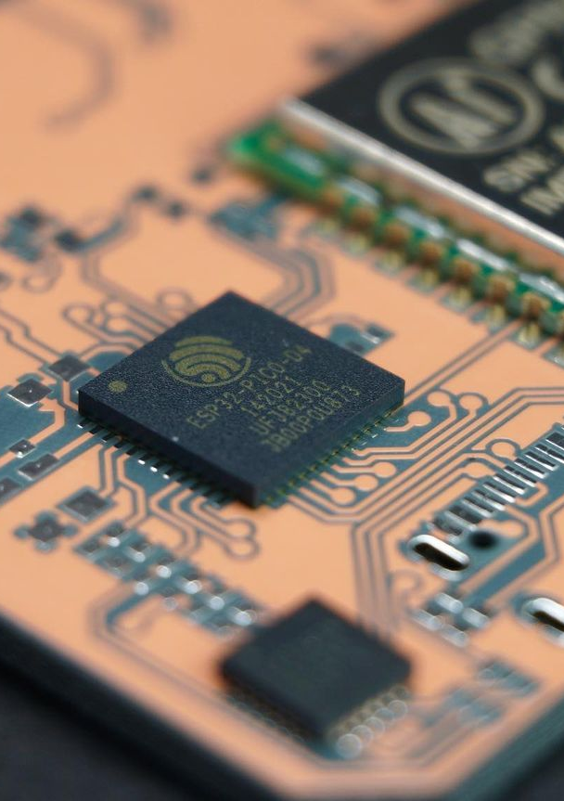
Introduction
Embedded Device Service?
Platform for remotely monitoring IoT device data
Accessible from any device with web browser
Built using K8s and hosted on Google Cloud

Slide 4
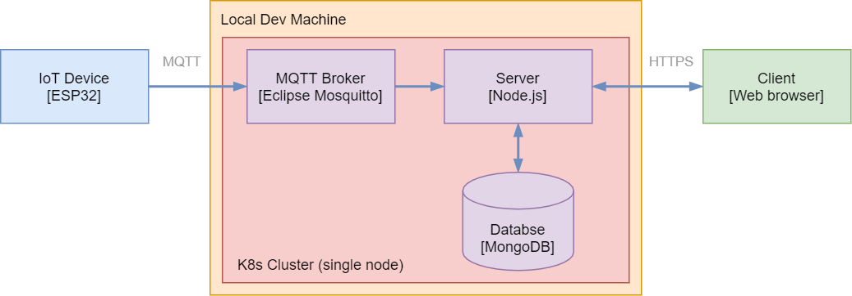
Proposed Solution
Simplified view of local/dev machine solution architecture.

Slide 5



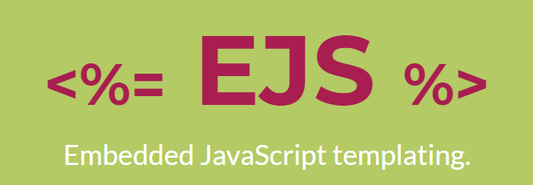
Architecture
Server
Implemented in JavaScript (JS)
Other Technologies Utilized:
Node.js (backend JS runtime environment)
Express (backend web app framework)
EJS (templating engine)
Running in Node Docker image

Slide 6


Architecture
Database and MQTT Broker
Database: mongoDB
MQTT Broker: Eclipse Mosquitto
Each running in their respective official Docker image.

Slide 7
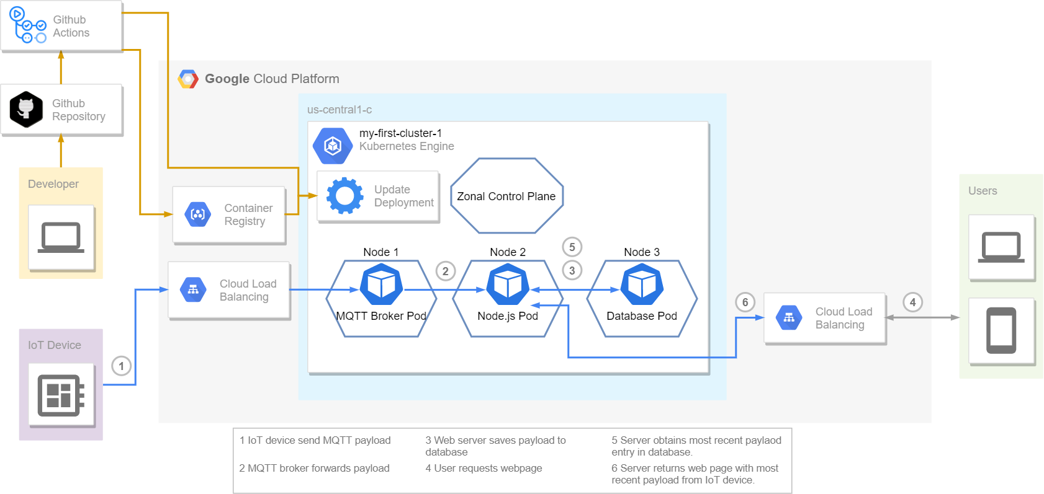
Architecture

Slide 8


Architecture
Kubernetes
“Google Kubernetes Engine (GKE) provides a managed environment for deploying, managing, and scaling your containerized applications using Google infrastructure. The GKE environment consists of multiple machines (specifically, Compute Engine instances) grouped together to form a cluster.”
- GKE Overview

Slide 9


CI/CD
Github and Github Actions
“GitHub Actions makes it easy to automate all your software workflows, now with world-class CI/CD. Build, test, and deploy your code right from GitHub. Make code reviews, branch management, and issue triaging work the way you want.”
- github.com/features/actions

Slide 10
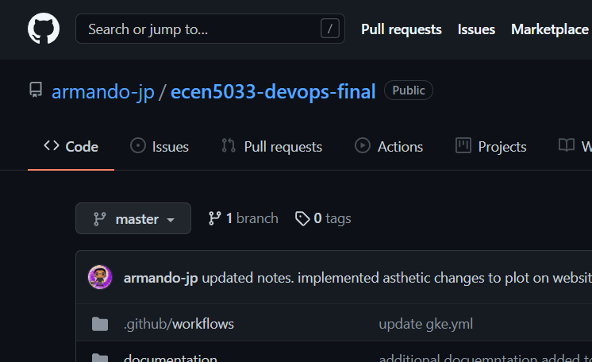
CI/CD

Slide 11
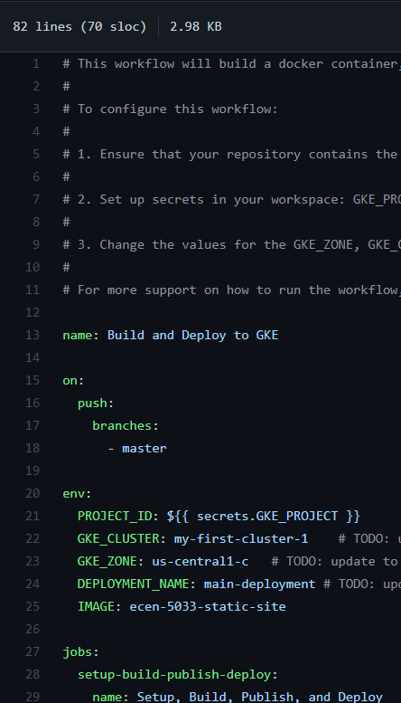
CI/CD
c

Slide 12
CI/CD

Slide 13
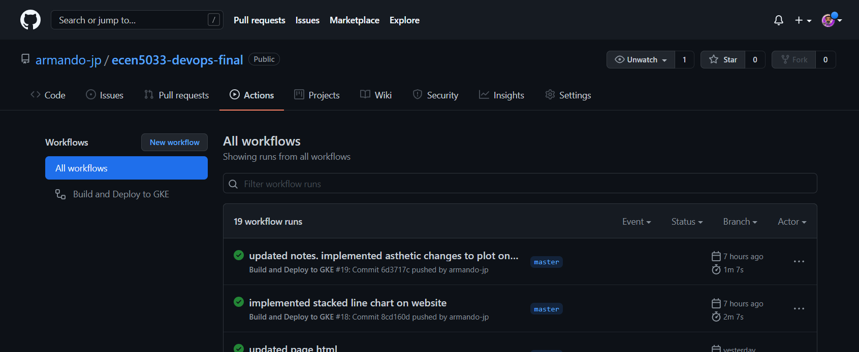
CI/CD

Slide 14
Demo
Show web page
Show CI/DI (update # of containers / update webpage contents)

Slide 15
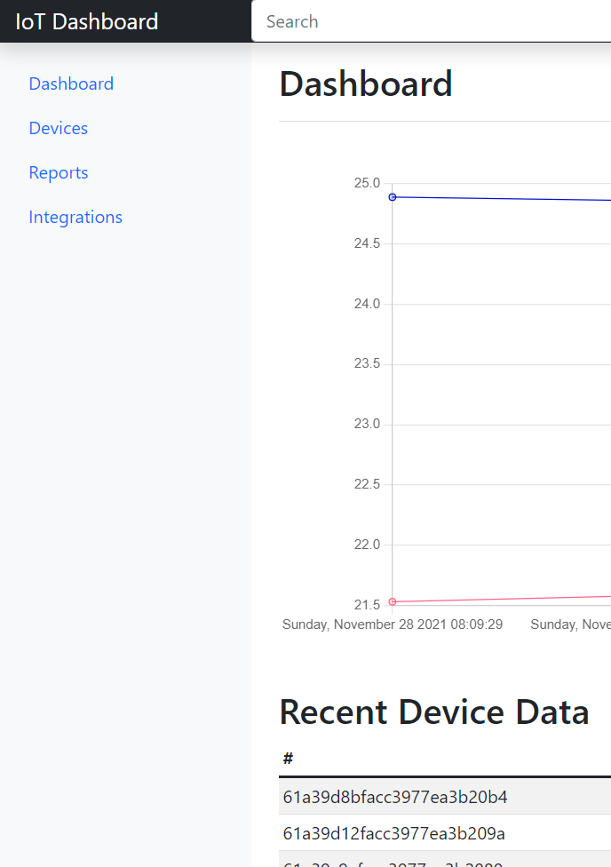
Future Work
Next up
User authentication (sign-in) to limit access to potentially sensitive data
Remote device authentication
Real time data/chart update (React?)
Implement tests for CI/DI pipeline

Slide 16
Questions

Slide 17
Citations
[1] https://www.behance.net/gallery/75855977/Drawing-Flatirons
Website IP: http://34.71.145.113/
Code Repo: https://github.com/armando-jp/ecen5033-devops-final

