Slide 1
Implementation Project
by Armando Navarro and John Sanchez

Slide 2
Algorithms Implemented
Apriori – Frequent Itemset Mining
ID3 – Classification
X-means - Clustering

Slide 3
Apriori
Parameters
Minimum support (required)
Children per node
Maximum bucket size

Slide 4
Apriori Class Diagram

Slide 5
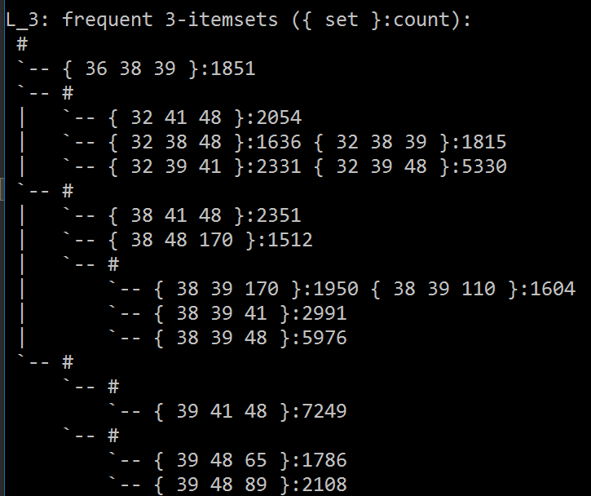
Apriori Output
Input: Belgium retail market
Min Sup: 1500
Children: 5
Bucket Size: 3

Slide 6
ID3
Parameters
Param 1 (required)
Param 2
Param 3

Slide 7
ID3 Output
Input: Some Input
Parameters
Other Info
Whatever

Slide 8
X-means
Parameters
Param 1 (required)
Param 2
Param 3

Slide 9
X-Means Output
Input: Some Input
Parameters
Other Info
Whatever

