Slide 1
Implementation Project
by Armando Navarro and John Sanchez

Slide 2
Algorithms Implemented
Apriori – Frequent Itemset Mining
ID3 – Classification
X-means - Clustering

Slide 3
Apriori
Parameters
Minimum support (required)
Children per node
Maximum bucket size

Slide 4
Apriori Class Diagram

Slide 5
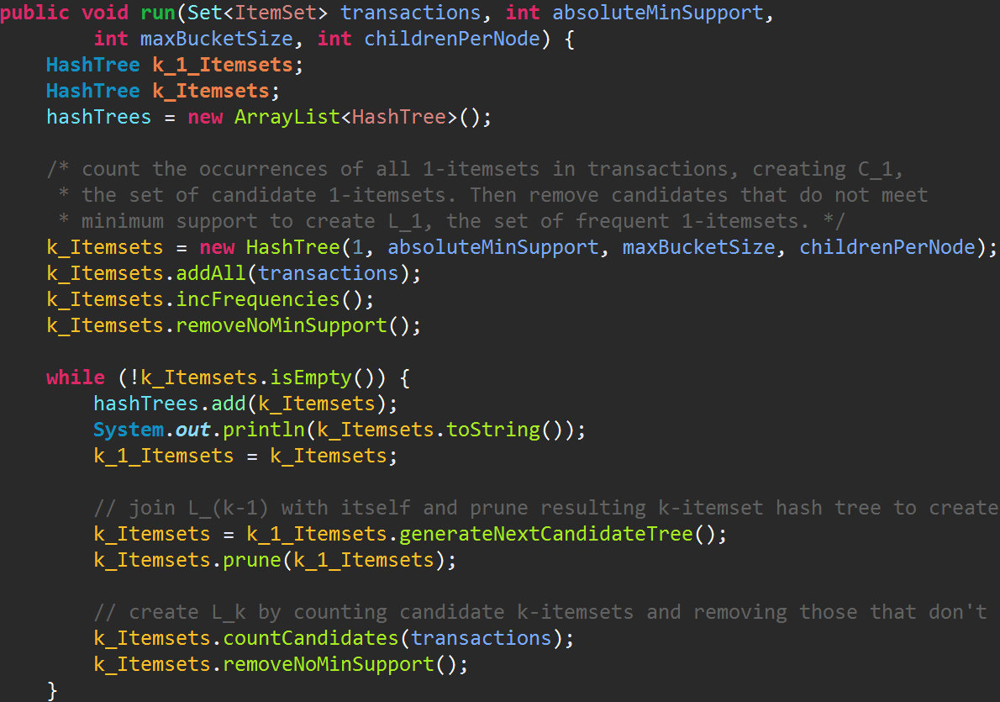
Apriori Algorithm

Slide 6
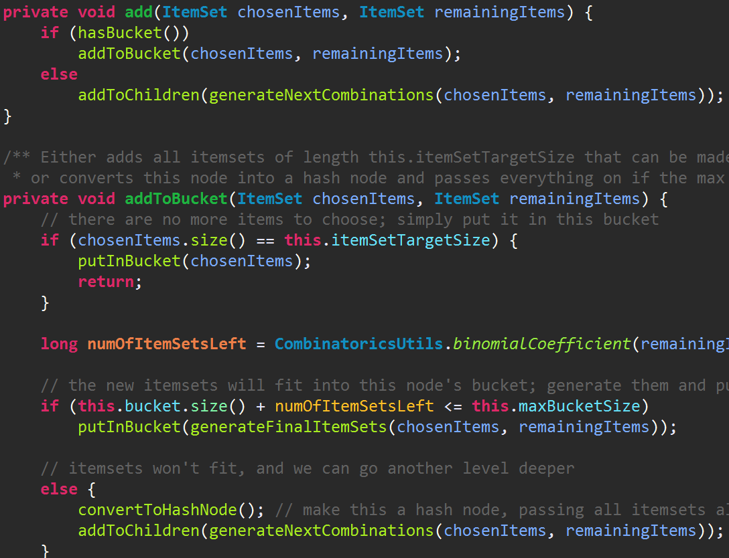
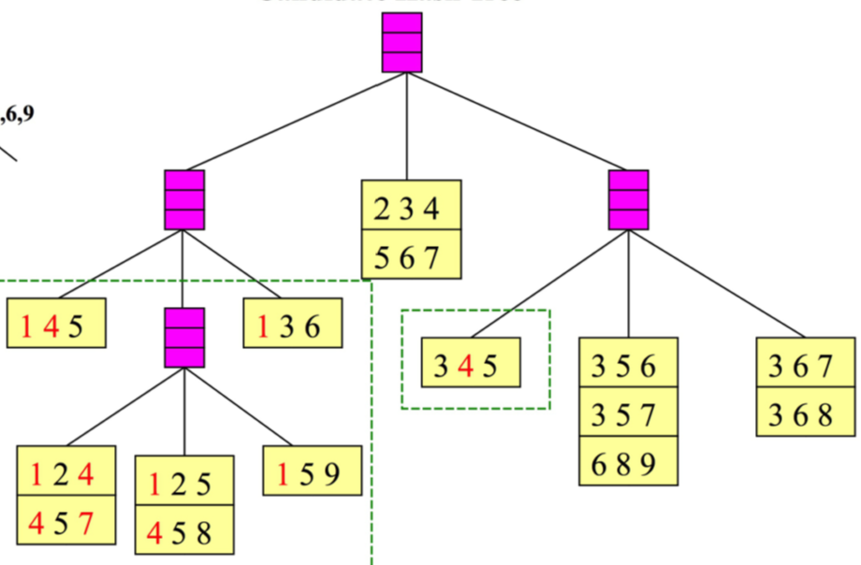
Apriori: Node Add

Slide 7
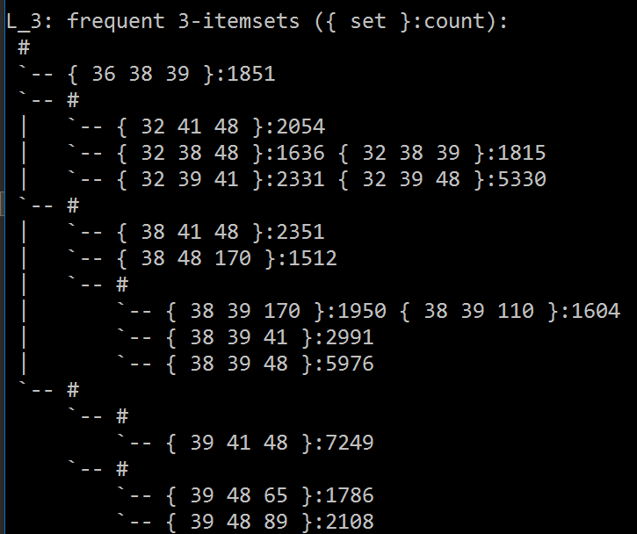
Apriori Output
Input: Belgium retail market
Min Sup: 1500
Children: 5
Bucket Size: 3

Slide 8
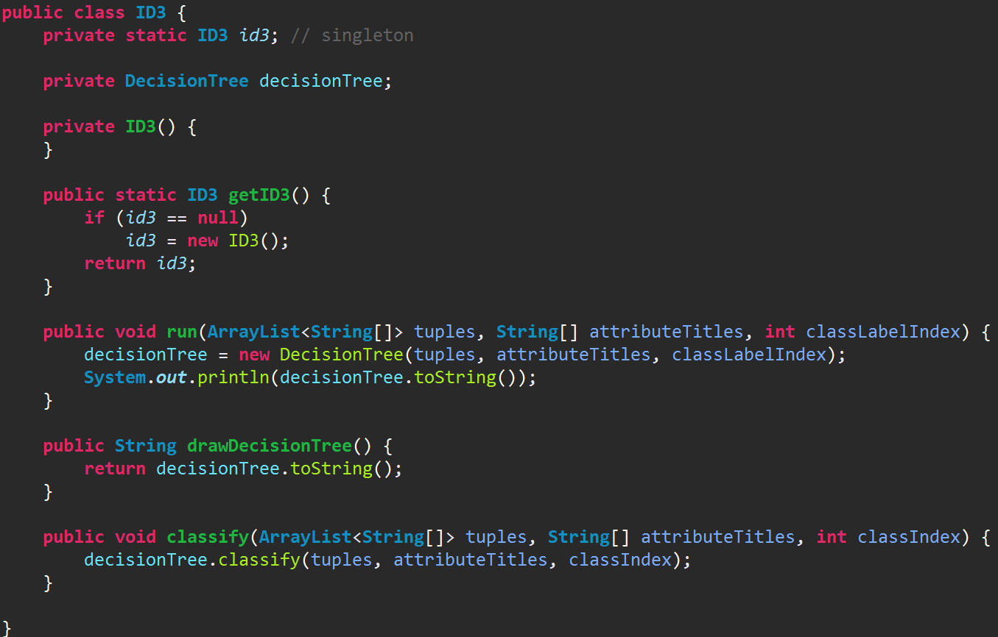
ID3 Class

Slide 9
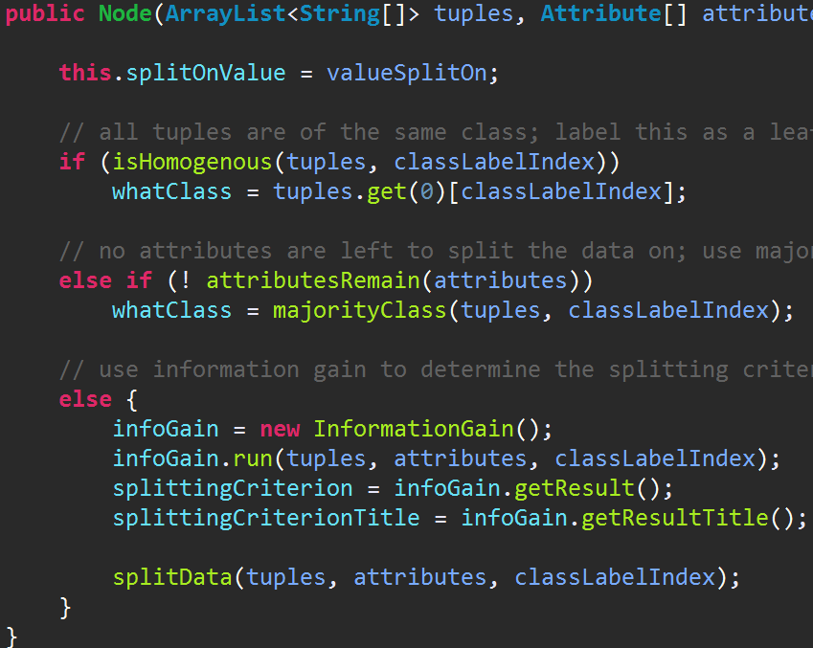
ID3 Algorithm

Slide 10
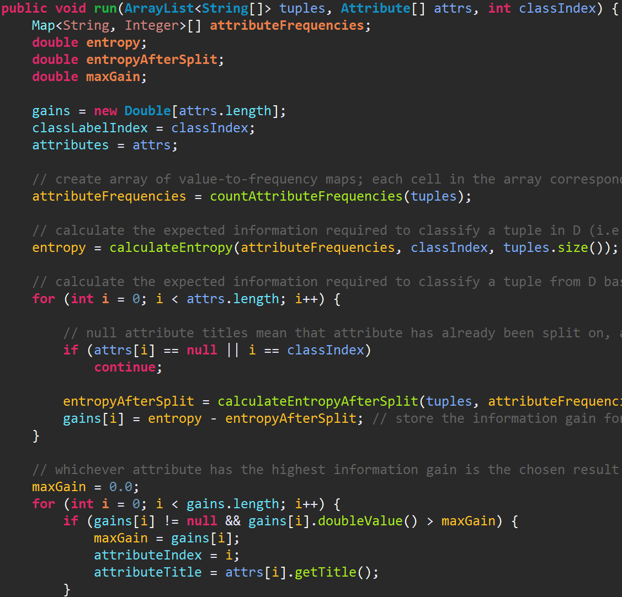
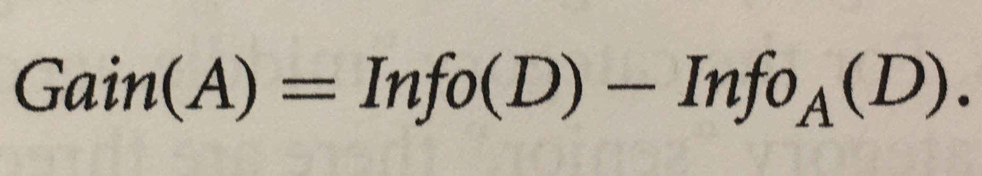
Information Gain
Info(D) = entropy
Info_{A}(D) = entropyAfterSplit

Slide 11
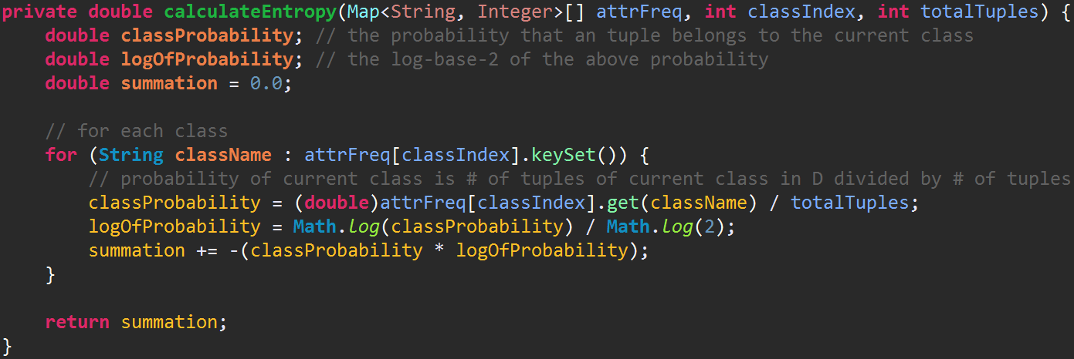
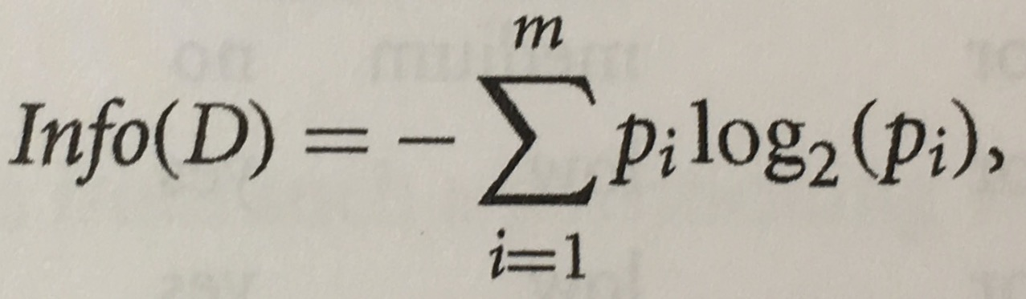
Information Gain

Slide 12
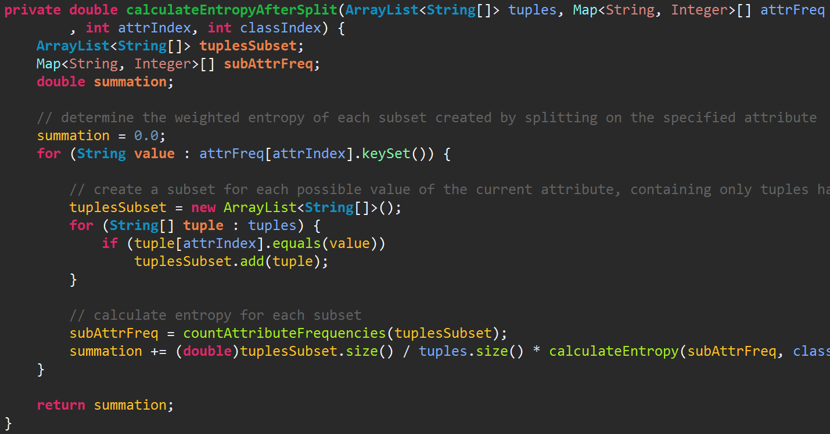
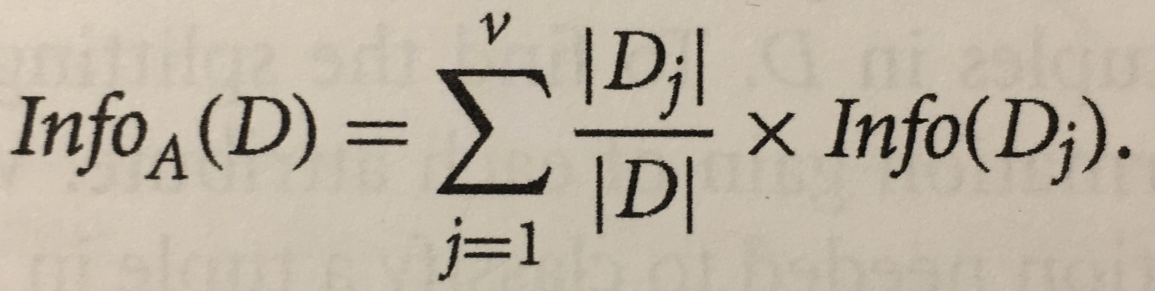
Information Gain

Slide 13
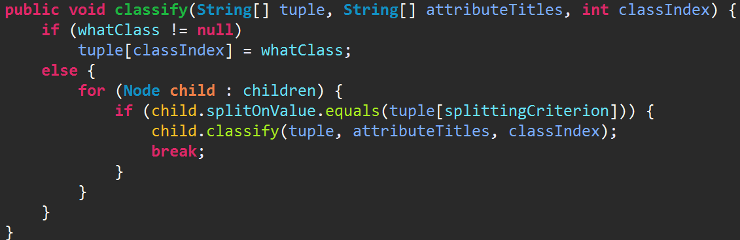
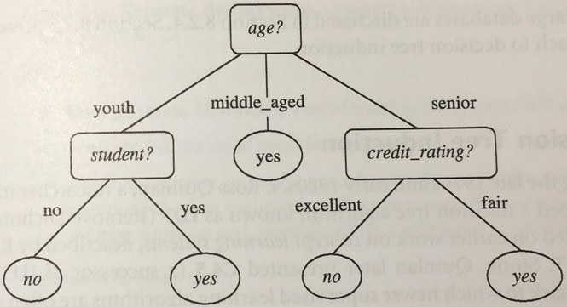
Node: Classify

Slide 14
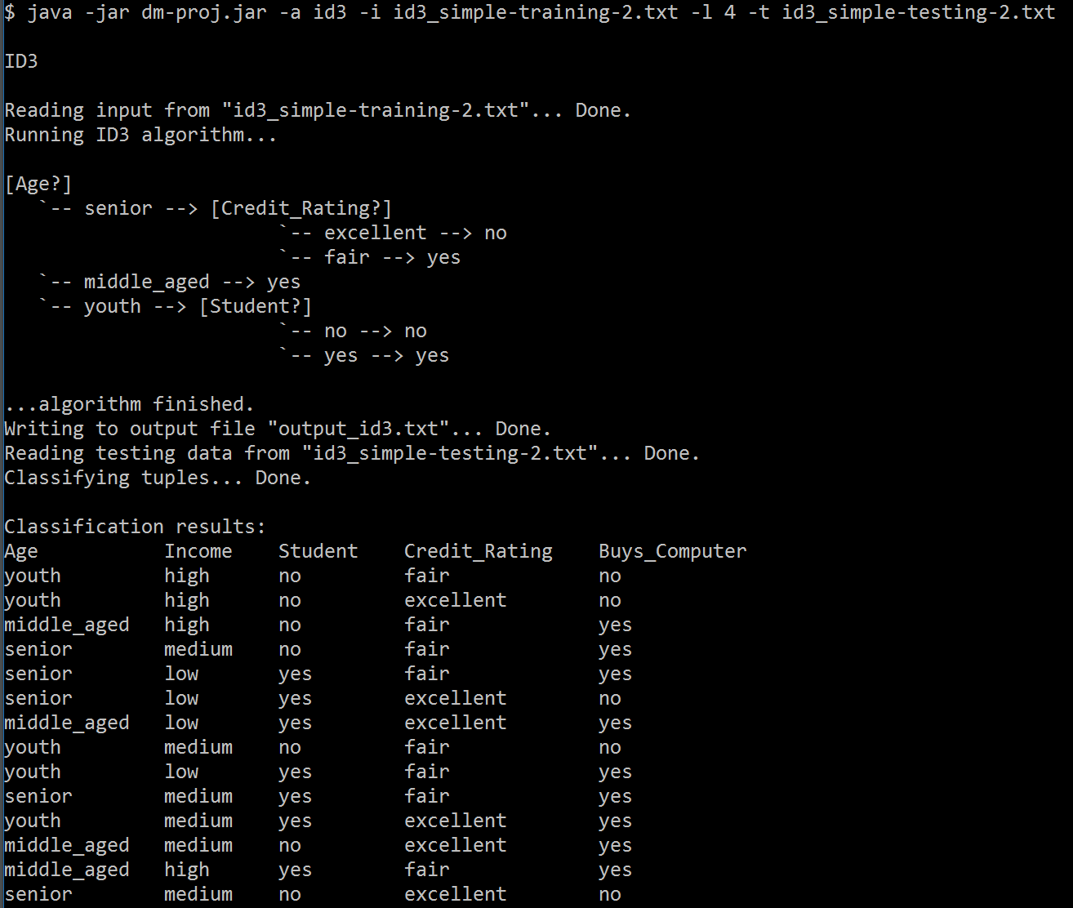

ID3 Output
Input: Student Loan Data
Parameters
Class Index: 4

Slide 15
X-means
Parameters
Dataset
Range true K is in
Max number of K mean loops, optional

Slide 16
What X-means Does
Improves on K-Means by letting K be a range of numbers
Helps the problem of finding only the local minima
Can be sped up using K-D trees

Slide 17
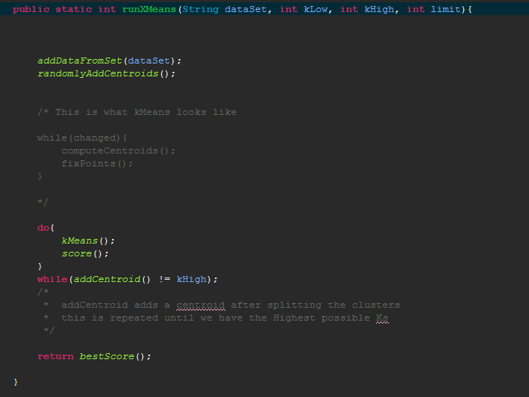
What X-means Does

Slide 18
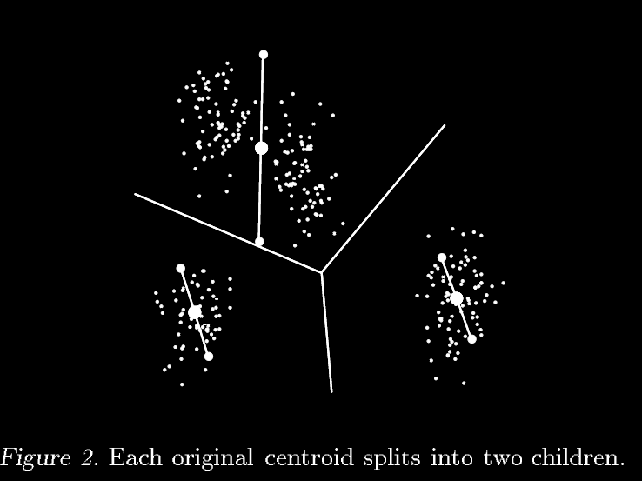
addCentroid()

Slide 19
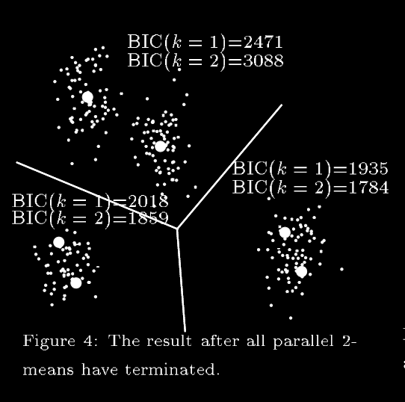
addCentroid()

Slide 20
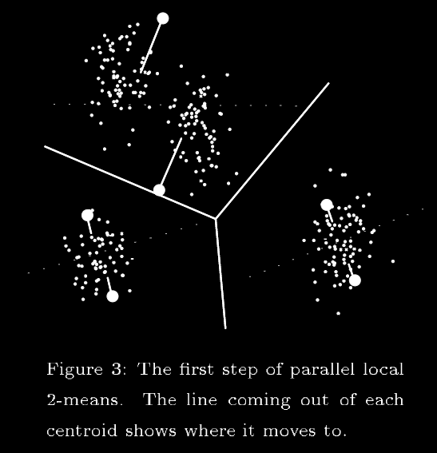
addCentroid()

Slide 21
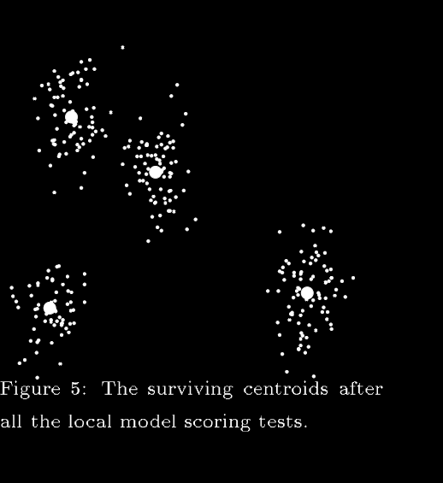
addCentroid()
GOTO: loop Top

Slide 22
K-d Trees
The current X-means works well on small data sets but still doesn’t scale well
Use K-D trees (Work in progress)

Slide 23
Sources
X-Means: Extending k-means with Efficient estimation of the number of clusters by Dan Pelleg and Andrew Moore

