Slide 1
Implementation Project
by Armando Navarro and John Sanchez

Slide 2
Algorithms Implemented
Apriori – Frequent Itemset Mining
ID3 – Classification
X-means - Clustering

Slide 3
Apriori
Parameters
Minimum support (required)
Children per node
Maximum bucket size

Slide 4
Apriori Class Diagram

Slide 5
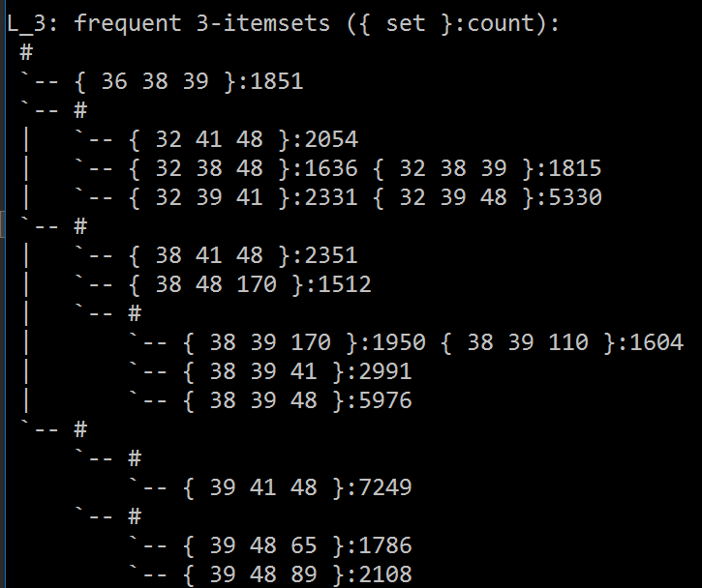
Apriori Output
Input: Belgium retail market
Min Sup: 1500
Children: 5
Bucket Size: 3

Slide 6
ID3
Parameters
Param 1 (required)
Param 2
Param 3

Slide 7
ID3 Output
Input: Some Input
Parameters
Other Info
Whatever

Slide 8
X-means
Parameters
Dataset
Range true K is in
Max number of K mean loops, optional

Slide 9
What X-means Does
Improves on K-Means by letting K be a range of numbers
Helps the problem of finding only the local minima
Can be sped up using K-D trees

Slide 10
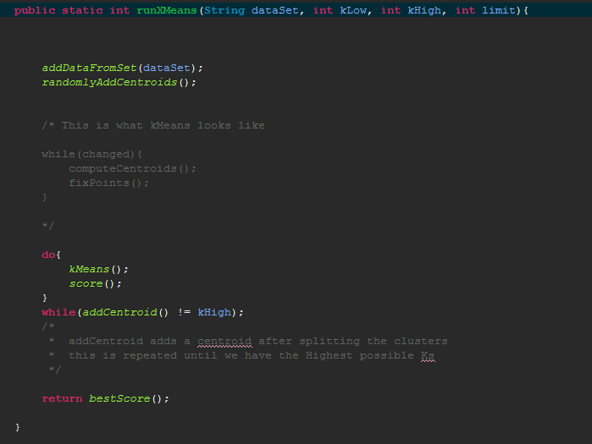
What X-means Does

Slide 11
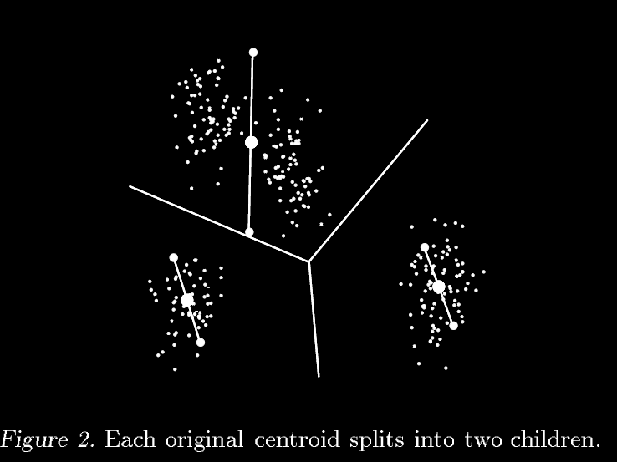
addCentroid()

Slide 12
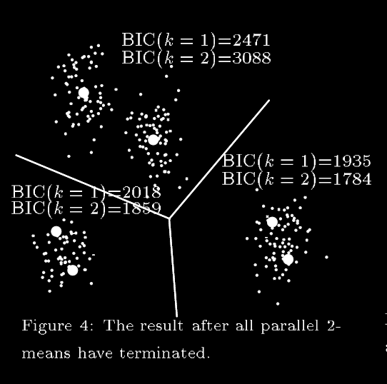
addCentroid()

Slide 13
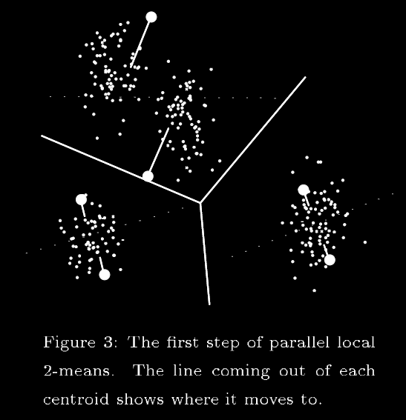
addCentroid()

Slide 14
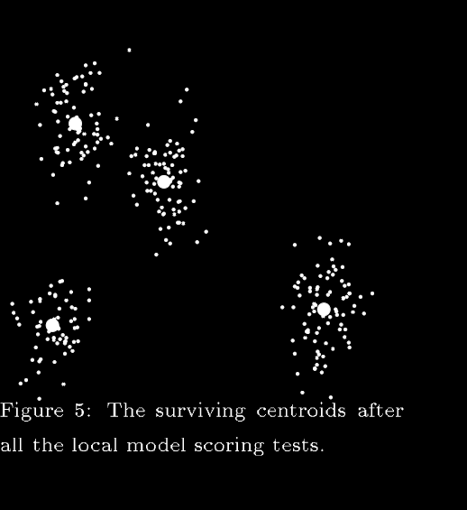
addCentroid()
GOTO: loop Top

Slide 15
K-d Trees
The current X-means works well on small data sets but still doesn’t scale well
Use K-D trees (Work in progress)

Slide 16
Sources
X-Means: Extending k-means with Efficient estimation of the number of clusters by Dan Pelleg and Andrew Moore

