Slide 1


Neural Networks
Presentation of the CryptoNets project: Applying Neural Networks to Encrypted Data
Dipartimento di Ingegneria Informatica
automatica e gestionale Antonio Ruberti
Armando Nania
José Luis Bustamante

Slide 2
Introduction
In recent times, awareness of the importance of privacy has grown in the world
The progress of the machine learning algorithms is due in part to the open participation provided by the free databases
In some fields, however, such as medicine and finance, it is important to keep sensitive data secret

Slide 3
Introduction
This prevents the use of models such as neural networks, although these fields of study would benefit greatly from their use
Therefore we need a model that allows us to combine data privacy with the accuracy shown by neural networks...

Slide 4
Related Work
Some papers have addressed the similar problem of training a model using encrypted data
These methods are called privacy preserving data-mining (Agrawal & Srikant, 2000), and a possible solution is given by differential privacy (Dwork, 2011)
In this project, however, we will focus only on the inference phase!

Slide 5
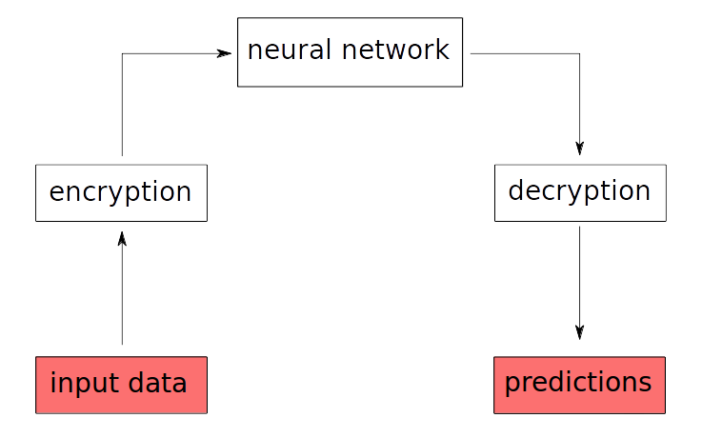
The CryptoNet protocol
The proposed protocol: an overlook

Slide 6
Homomorphic encryption
Normally a cryptographic function does not allow the manipulation of the encrypted data, and works like this:
Homomorphic encryption, on the other hand, preserves the algebraic structure of sum and product. That is:

Slide 7
FV Algorithm
The FV algorithm is an isomorphism between polynomial rings
is the plain polynomials ring, while is the encrypted polynomials ring
The three parameters q, n and t must be chosen wisely, since a choice of the parameter t too high or too low prevents the algorithm from working
n and q must be chosen accordingly to t

Slide 8
FV Algorithm: Keys
The secret key is
The public key is
There are l + 1 evaluation keys. The i-th key is given by

Slide 9
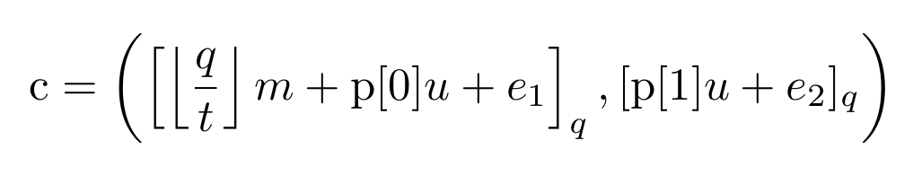
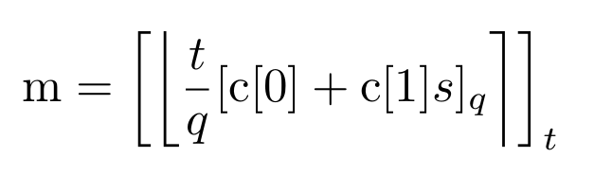
FV Algorithm: Encryption/Decryption
A message m is encrypted by computing
It can be decrypted like this

Slide 10
FV Algorithm: Sum and Product
The sum of two encrypted messages is obtained simply by computing a element wise addition between the arrays
The product is more complicated: the number of elements of the output array is strictly greater than each one of the input arrays
Using the process called "relinearization", it is possible to use the evaluation keys to bring the size of the array back to 2

Slide 11
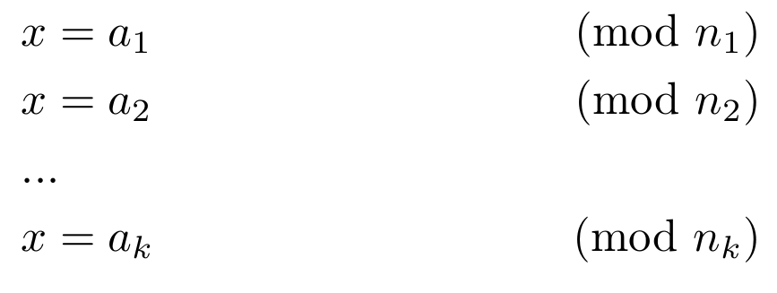
Chinese remainder theorem
Dating back to the 3rd century CE, it says that given k pairwise coprime numbers (with
), we can break down a number x like this:

Slide 12
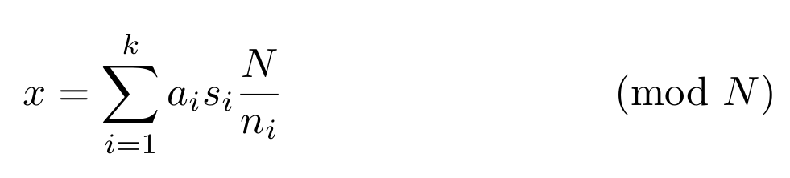
Chinese remainder theorem
Starting from the resulting set of numbers, it is possible to reconstruct x in this way:
Important: the Chinese reminder theorem also preserves the algebraic structure of sum and product
It is therefore possible to use this mathematical tool in our project

Slide 13
The Network
The only operations allowed are sum and product
Therefore the quadratic function was used as the activation function
The sigmoid function in the last layer is dropped in the inference phase
The network has been trained for 50 epochs, using a training set of 55,000 handwritten digit images and a batch size of 100. The accuracy achieved is 98.43% at this stage

Slide 14
The CryptoNet protocol
The proposed protocol: an overlook

Slide 15
Mismatch between Data Type
There is a compatibility problem: the FV algorithm is an isomorphism between polynomial rings, while the neural network manipulates real numbers
We need a proper encoding!
The numbers in input, as well as network parameter numbers, are scaled and rounded
But the biases must be scaled more than the other numbers

Slide 16
Scaling the weights
0.3
0.1
0.32
0.2
3
1
5
2
30
1
32
2

Slide 17
The t parameter
The encoding, in order to work, needs the input numbers to be integers modulo t
This, however, sets limits on two things: large numbers and negative numbers

Slide 18
The t parameter
8
12
8
2
mod 10
-2
5
8
5
mod 10

Slide 19
The t parameter: Negative Numbers
The only operation

Slide 20
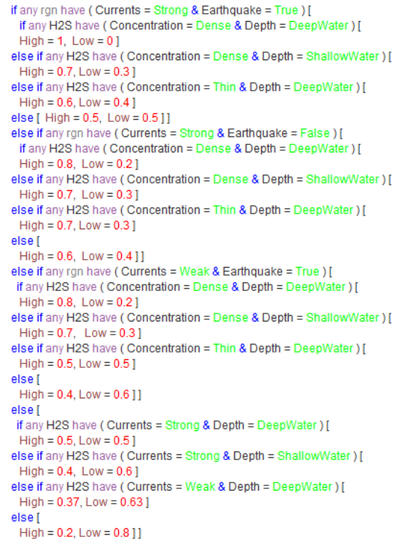
Results
In the image, the joint probability distribution of emergency level provided by marine experts
These probabilities quantitatively describe the severity of the emergency
The probability information is then annotated using OWL constructs

Slide 21
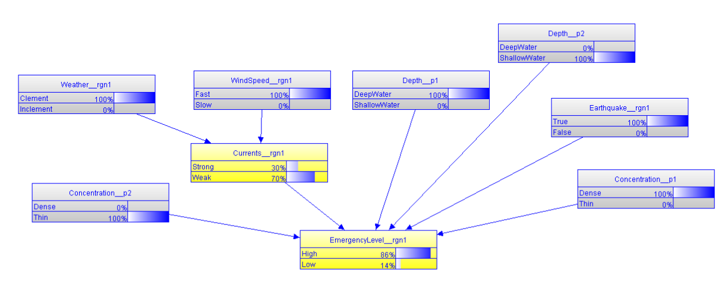
Results
Exploiting the information gathered by the sensors and thanks to SWARMs ontology's capability to support MEBN reasoning, it can be inferred that the inspected sea region is quite serious with a probability of 86%

Slide 22
Conclusions
To enable heterogeneous underwater robots with a common understanding of information, it is necessary to introduce an ontology to ensure that all parties can communicate
This type of network has shown to overcome state-of-the-art accuracy results, requiring less parameters and less computation
It scale naturally to hundreds of layers, while exhibiting no optimization difficulties or overfitting

Slide 23
Thank you!

