Slide 1

Box Office Quick Start
Go to altarena.audience1st.com (or select from Favorites)
If top of screen shows “logged in as...”, click Logout button and then log in as yourself
Generate Box office report (door list): click Reports
Walkup sales (cash or credit): click Walkup Sales
Season Subscriber w/o reservation: click Customers & Reservations
Armando’s cell: 650 279 5289
3
5
2
4

Slide 2
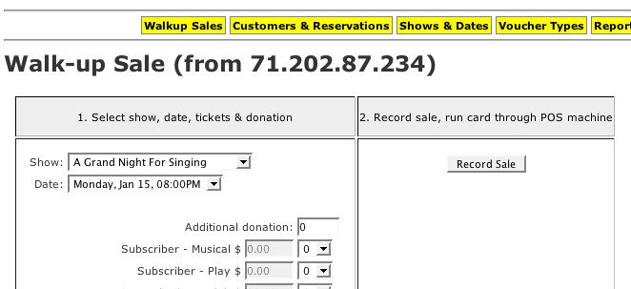
Walkup Sale
Select show, date, any addl. donation
Select quantity of each ticket type
Click “Record Sale”
Accept cash/check, or run CC on swipe machine
1
3
2

Slide 3
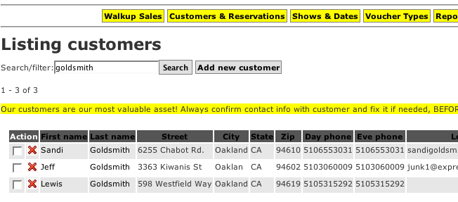
Season Subscriber w/o Reservation (1)
Click “Customers & Reservations”
Use Search feature to find customer
Click on name of correct customer
2
1
3

Slide 4
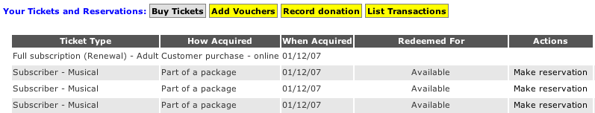
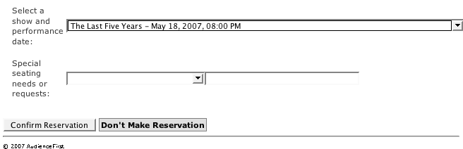
Season Subscriber w/o Reservation (2)
Click “Make Reservation” next to any “Available” voucher
Select show date and click “Confirm”
1
2

Slide 5
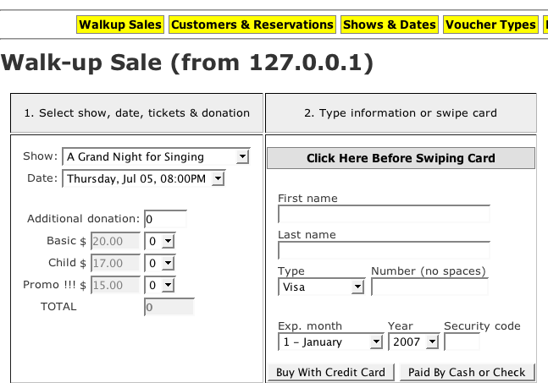
Walkup Sale - Cash/Check
1. Select show, date, # tickets of each type
2. Accept cash/check, click Paid By Cash or Check

Slide 6
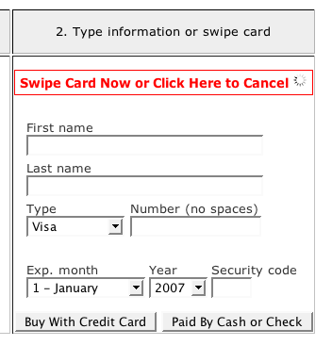
Walkup Sale - Credit Card
2. When you see this message, swipe card
1. Click to activate swipe reader

Slide 7
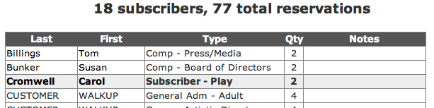
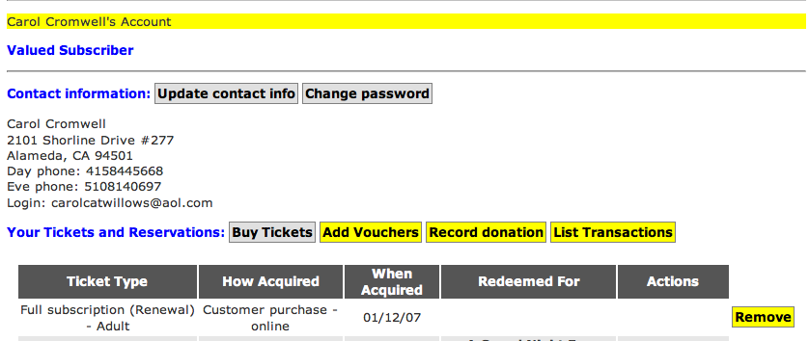
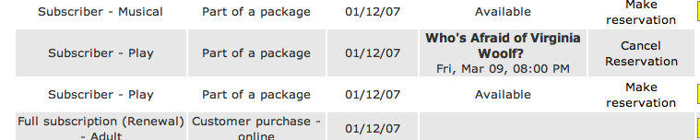
Season Subscriber Cancel/No-show
1. Click* first or last name of no-show in boxoffice report (or otherwise locate customer record)
* Hint: if you hold Shift key while clicking, customer record will open in a new window. When done, you can close that new window and the boxoffice report will still be visible in your original window.
2. Locate no-show reservation and click “Cancel Reservation”

