Slide 1


ATTENTION these are all HANDS drawn
using Powerpoint basic shapes
(eg: rectangles, circles, triangles)
!
ATTENTION I used th following ICONs
From the Powerpoint ICON library
!
_______
_______
_______
_______
_______
Now it’s
YOUR turn
Subfunctions
only beyond this point

Slide 2
FULL
car

Slide 3

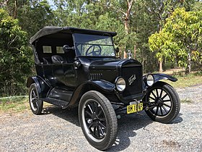
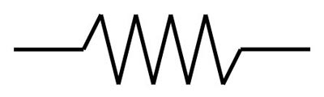




Y
D
LEFT (L)
C
X
BACK (b)
RIGHT (R)
Z
B
FRONT (f)
A
A
C
B
$$U_{fLG}$$
$$U_{bLG}$$
$$U_{bRG}$$
$$U_{fRG}$$
Photograph taken from:
https://en.wikipedia.org/wiki/Ford_Model_T

Slide 4







$$θ$$
D
Y
$$y_{c}$$
C
X
Z
$$ψ$$
B
$$y_{fL}$$
A
$$y_{bL}$$
$$y_{bR}$$
$$y_{fR}$$

Slide 5





$$θ$$
D
Y
$$y_{c}$$
C
X
Z
$$ψ$$
B
$$y_{fL}$$
A
$$y_{bL}$$
$$y_{bR}$$
$$U_{fLG}$$
$$y_{fR}$$
$$U_{bLG}$$
$$U_{bRG}$$
$$U_{fRG}$$
$$L_{b} + L_{f}$$

Slide 6







$$θ$$
D
Y
$$y_{c}$$
C
X
Z
$$ψ$$
B
$$y_{fL}$$
A
C
A
B
$$y_{bL}$$
$$y_{bR}$$
$$y_{fR}$$

Slide 7
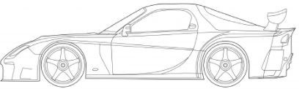
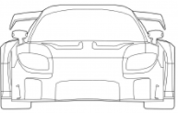









$$θ$$
D
PITCHING
Y
C
$$y_{c}$$
X
$$θ$$
Z
$$ψ$$
B
$$y_{fL}$$
A
$$y_{bL}$$
ROLLING
$$y_{bR}$$
$$y_{fR}$$
$$ψ$$

Slide 8








$$L_{f}$$
$$L_{L}$$
B
$$L_{b}$$
Y
$$L_{R}$$
X
Y
Z
C
$$θ$$
$$ψ$$
B
A
$$θ$$
$$ψ$$
PITCHING
ROLLING

Slide 9




$$L_{f}$$
B
$$L_{b}$$
Y
X
Y
$$θ$$
LEFT (L)
C
A
BACK (b)
X
FRONT (f)
RIGHT (R)
$$L_{L}$$
A
B
Z
$$L_{R}$$
Y
Z
C
$$ψ$$
B

Slide 10




















XY - AB
Y
B
PITCHING
X
$$θ$$
$$U_{c}$$
A
$$L_{b}$$
$$L_{f}$$
$$k_{fR}$$
$$y_{c}$$
A
B
$$k_{bR}$$
$$U_{fR}$$
$m_{c}$ , $I_{cZ}$
$$U_{bR}$$
$$k_{bR}$$
$$k_{fR}$$
$$y_{fR}$$
$$y_{bR}$$
$$m_{bR}$$
$$m_{fR}$$
$$k_{bRG}$$
$$k_{fRG}$$
$$U_{fRG}$$
$$U_{bRG}$$

Slide 11














XY - DC
Y
C
PITCHING
X
$$θ$$
$$U_{c}$$
D
$$L_{b}$$
$$L_{f}$$
$$k_{fL}$$
$$y_{c}$$
D
C
$$k_{bL}$$
$$U_{fL}$$
$m_{c}$ , $I_{cZ}$
$$U_{bL}$$
$$k_{bL}$$
$$k_{fL}$$
$$y_{fL}$$
$$y_{bL}$$
$$m_{bL}$$
$$m_{fL}$$
$$k_{bLG}$$
$$k_{fLG}$$
$$U_{fLG}$$
$$U_{bLG}$$

Slide 12
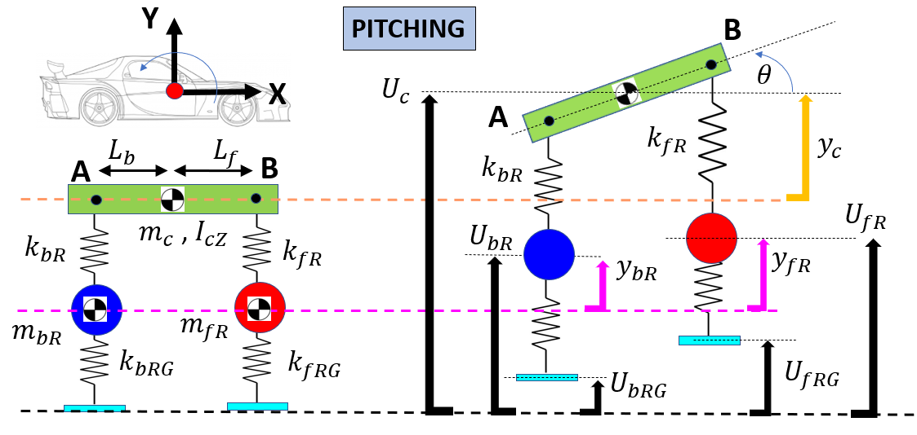
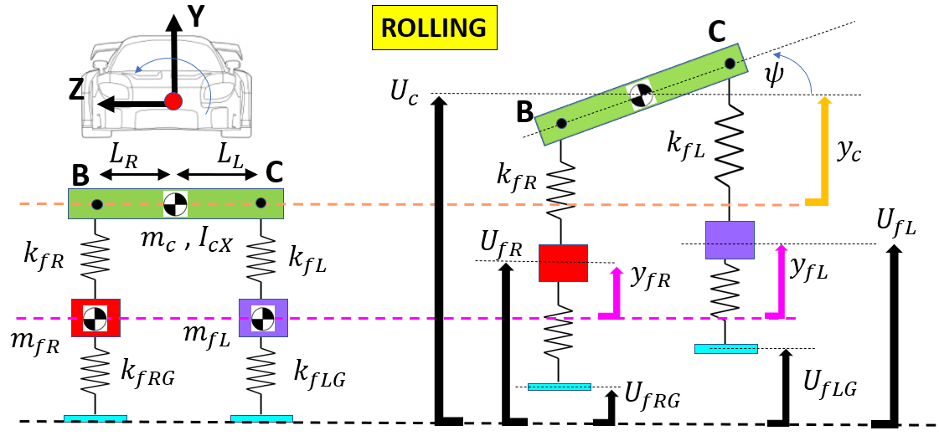
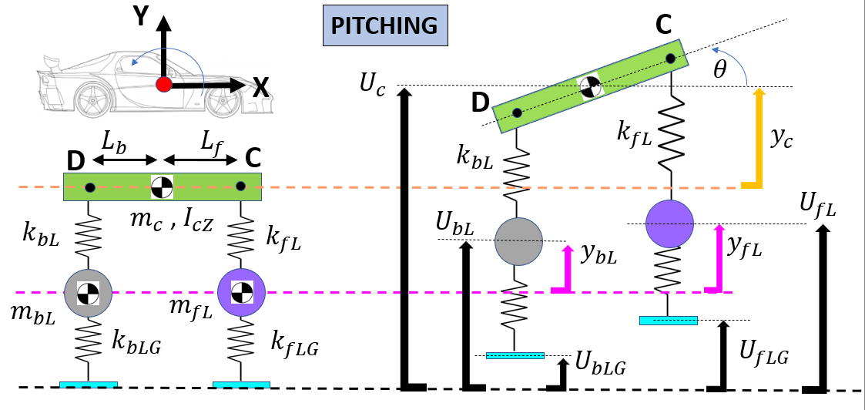
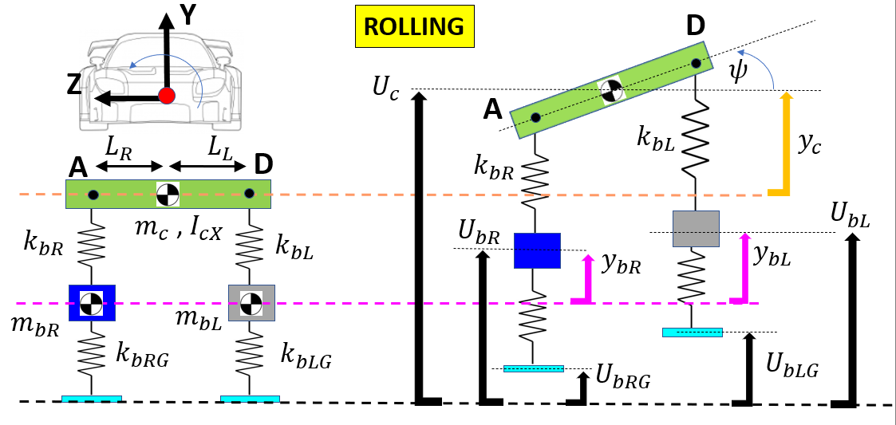

Slide 13


















YZ - BC
Y
ROLLING
C
Z
$$ψ$$
$$U_{c}$$
B
$$L_{R}$$
$$L_{L}$$
$$k_{fL}$$
$$y_{c}$$
B
C
$$k_{fR}$$
$$U_{fL}$$
$m_{c}$ , $I_{cX}$
$$U_{fR}$$
$$k_{fR}$$
$$k_{fL}$$
$$y_{fL}$$
$$y_{fR}$$
$$m_{fR}$$
$$m_{fL}$$
$$k_{fRG}$$
$$k_{fLG}$$
$$U_{fLG}$$
$$U_{fRG}$$

Slide 14













YZ - AD
Y
D
ROLLING
Z
$$ψ$$
$$U_{c}$$
A
$$L_{R}$$
$$L_{L}$$
$$k_{bL}$$
$$y_{c}$$
A
D
$$k_{bR}$$
$$U_{bL}$$
$m_{c}$ , $I_{cX}$
$$U_{bR}$$
$$k_{bR}$$
$$k_{bL}$$
$$y_{bL}$$
$$y_{bR}$$
$$m_{bR}$$
$$m_{bL}$$
$$k_{bRG}$$
$$k_{bLG}$$
$$U_{bLG}$$
$$U_{bRG}$$

Slide 15
















D
C
Y
$$F_{D}$$
X
A
B
$$F_{C}$$
$$F_{A}$$
$$F_{B}$$
$$F_{A}$$
$$F_{B}$$
$$F_{D}$$
$$F_{C}$$
$$m_{bR}$$
$$m_{fR}$$
$$m_{bL}$$
$$m_{fL}$$
$$F_{bR}$$
$$F_{fR}$$
$$F_{bL}$$
$$F_{fL}$$

Slide 17
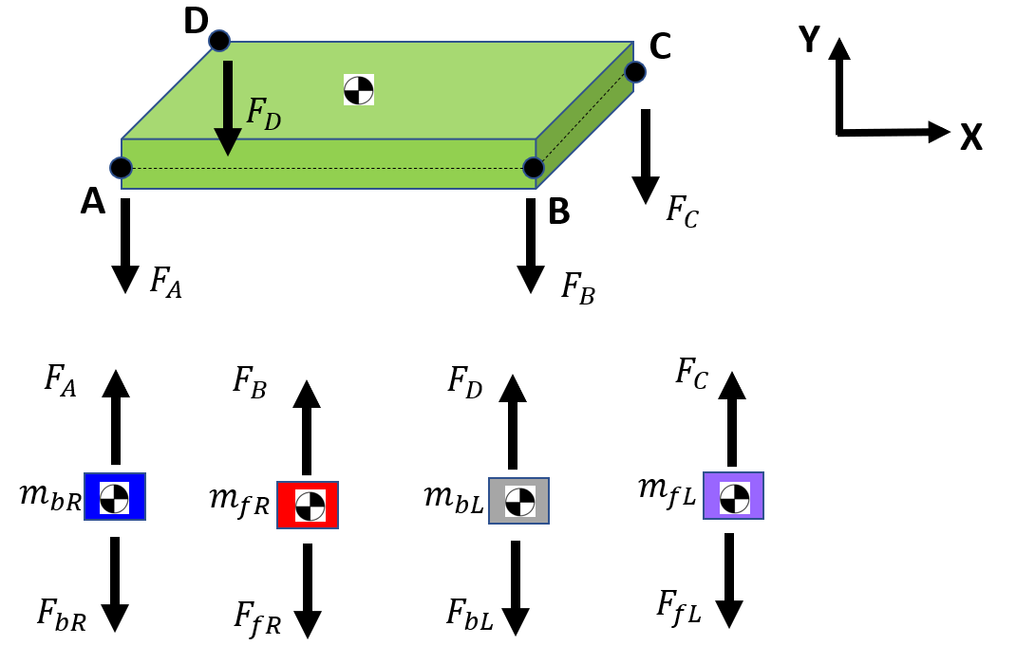

Slide 18




$$L_{f}$$
$$L_{L}$$
B
$$L_{b}$$
Y
$$L_{R}$$
Y
X
B
Z
C
A
$${(F}_{B} +{ F}_{C})$$
$${(F}_{D} +{ F}_{C})$$
$$θ$$
$$ψ$$
PITCHING
$${(F}_{A} +{ F}_{B})$$
$${(F}_{A} +{ F}_{D})$$
ROLLING

Slide 19












$$Y_{a}$$
$$Y_{B}$$
$$Y_{G}$$
$$Y_{a}$$
$$R1Z(θ_{Z})$$
$$ψ$$
$$R2X(ψ_{X})$$
$$X_{a}$$
$$θ$$
$$X_{G}$$
$$Z_{a}$$
$$Z_{B}$$

Slide 20
ROAD stuff

Slide 21





$$x_{offset}$$
$$P$$
$$P$$
$$L_{x}$$
U
X
$$H_{y}$$

Slide 22
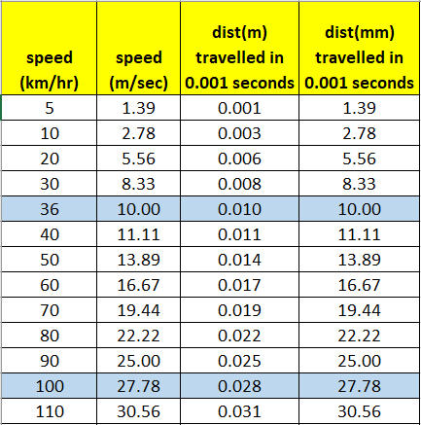

Slide 23



$$m$$
$$y$$
$$k, c$$
U

Slide 24
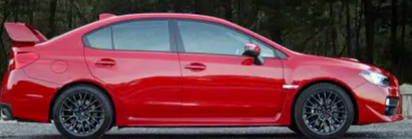








$$x_{offset}$$
$$P$$
$$P$$
$$m$$
$$y_{car}$$
$$L_{x}$$
U
$$k, c$$
$$H_{y}$$
X
U

Slide 25
$$m$$
$$y_{car}$$
U
$$k, c$$
X
U

Slide 26







$$x_{offset}$$
$$P$$
$$m$$
$$y$$
$$L_{x}$$
U
$$H_{y}$$
$$k, c$$
X
U

Slide 27
$$θ$$
D
Y
$$y_{c}$$
C
X
Z
$$ψ$$
B
$$y_{fL}$$
A
$$y_{bL}$$
$$y_{bR}$$
$$U_{fLG}$$
$$y_{fR}$$
$$U_{bLG}$$
$$U_{bRG}$$
$$U_{fRG}$$
$$L_{b} + L_{f}$$

Slide 28
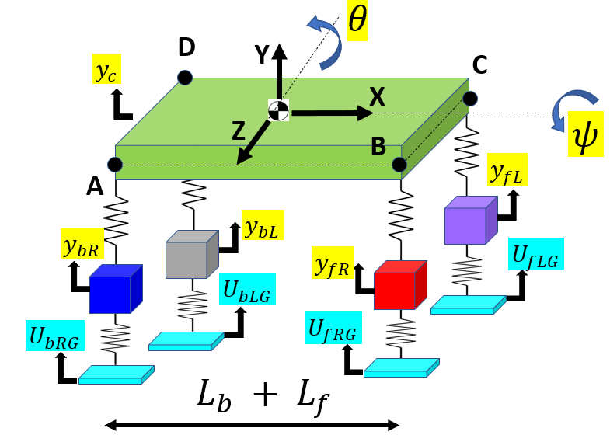
$$x_{offset}$$
$$P$$
$$P$$
$$L_{x}$$
U
X
$$H_{y}$$

Slide 29
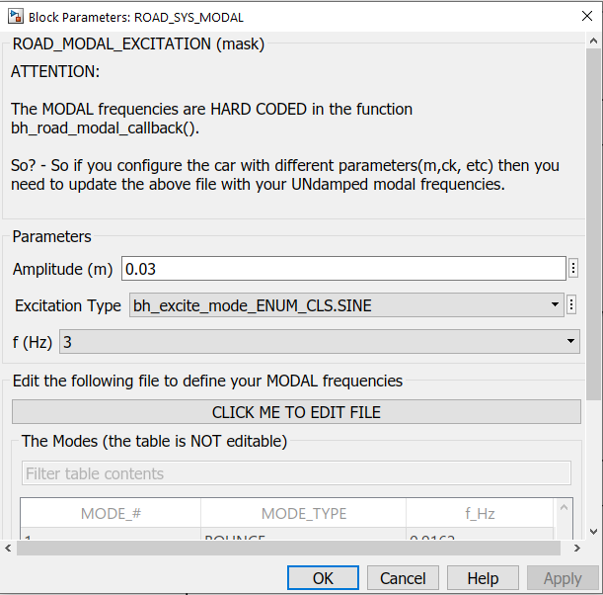
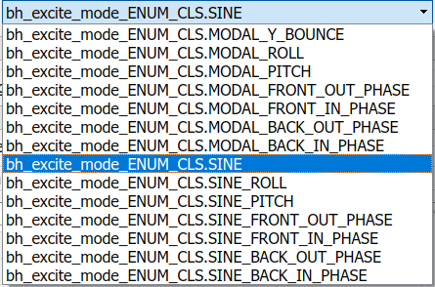
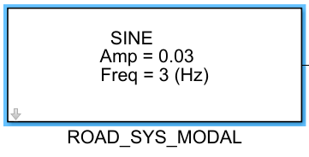

Slide 30
Excitations at the MODAL frequencies
Excitations NOT at the MODAL frequencies

Slide 31
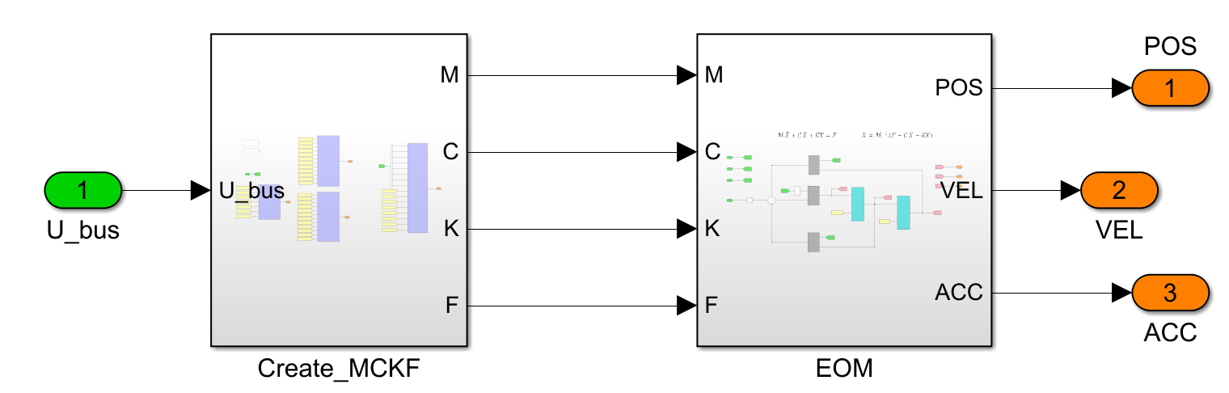

Slide 32
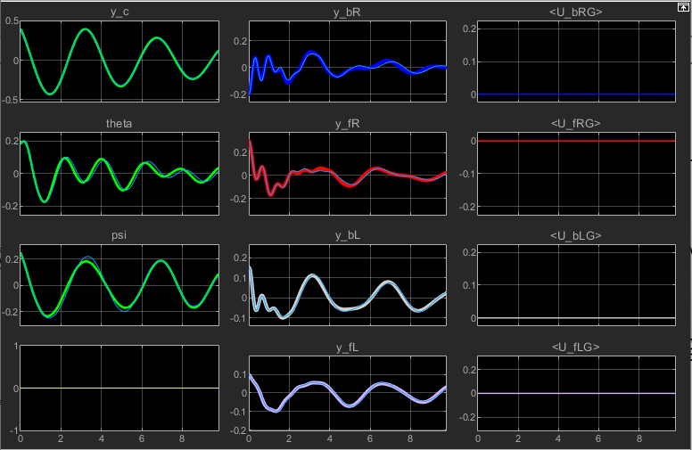

Slide 33
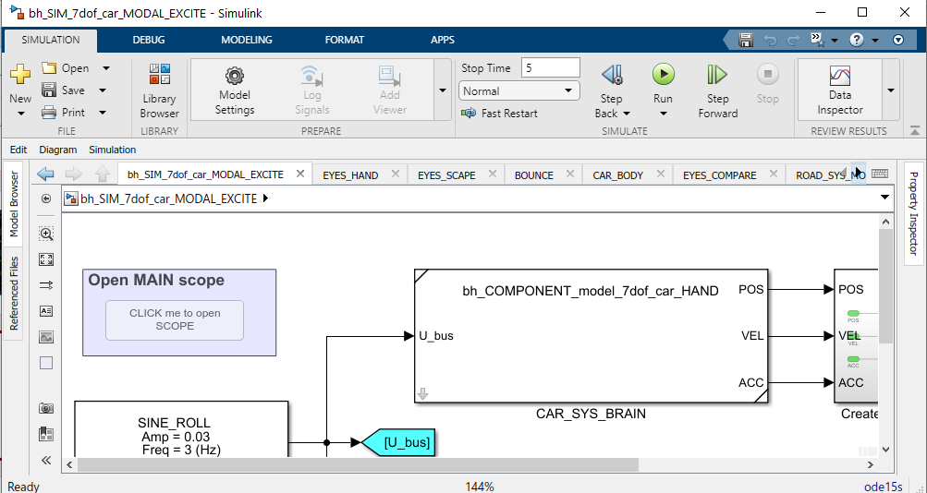
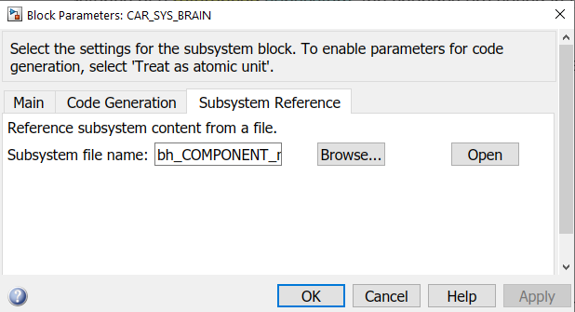
The Full Simulation model file is:
bh_SIM_7dof_car_MODAL_EXCITE.slx
The Subsystem Reference Block
You specify the Subsystem Reference FILE
bh_COMPONENT_model_7dof_car_HAND.slx

Slide 34
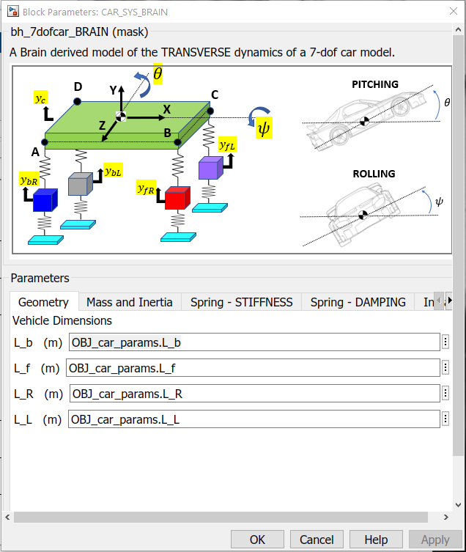
The Full Simulation model file is:
bh_SIM_7dof_car_MODAL_EXCITE.slx
Each instance of the Subsystem Reference BLOCK has a dialogue parameter GUI – just like “regular” Simulink blocks.

Slide 35
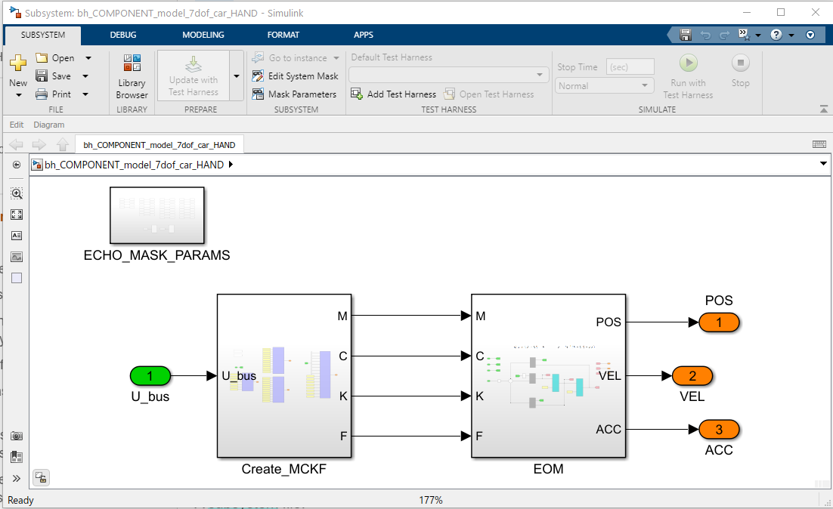
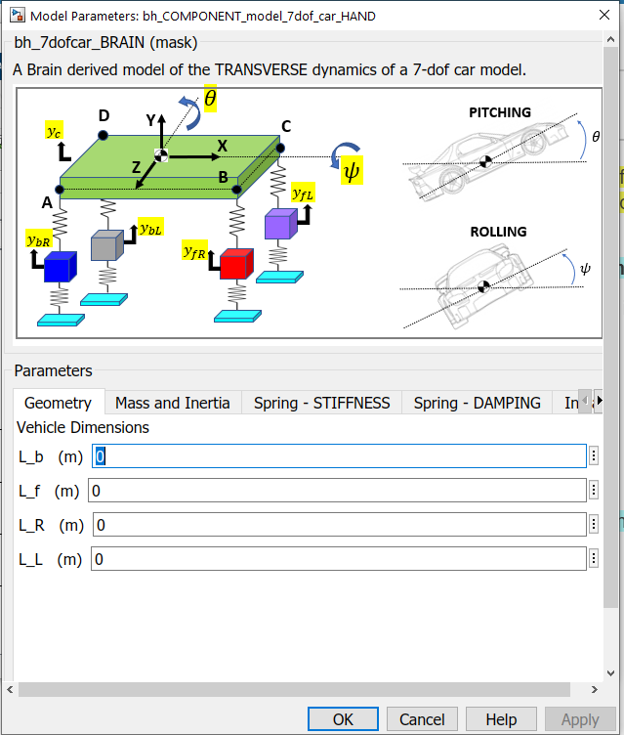
The Subsystem Reference FILE:
bh_COMPONENT_model_7dof_car_HAND.slx
Design a Mask GUI
For the Subsystem
Default values.
Will be redefined in Models

Slide 36
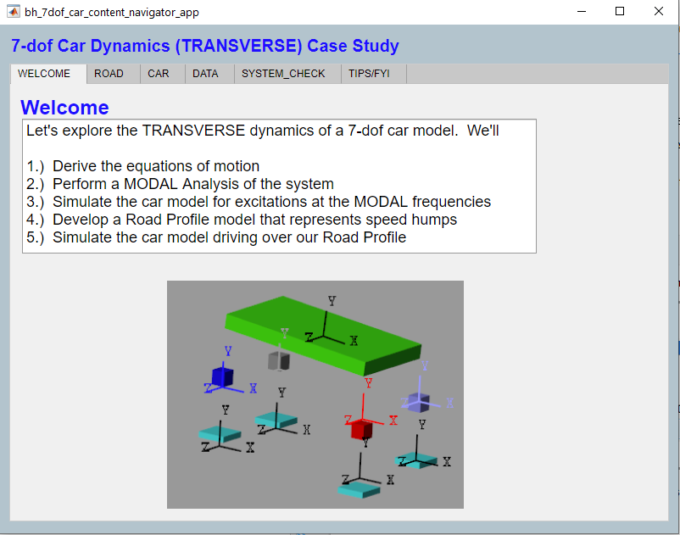
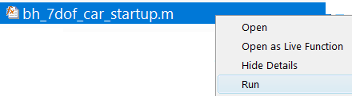

Slide 37
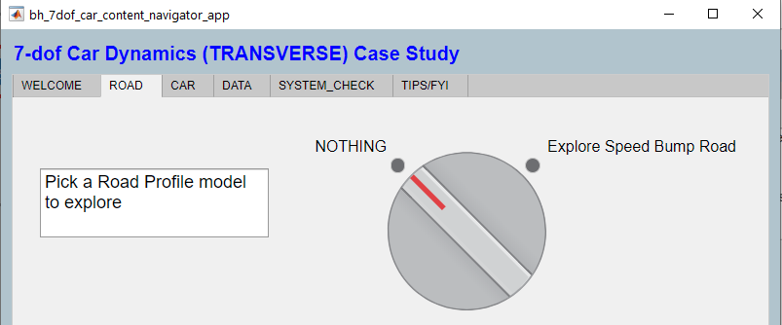

Slide 38
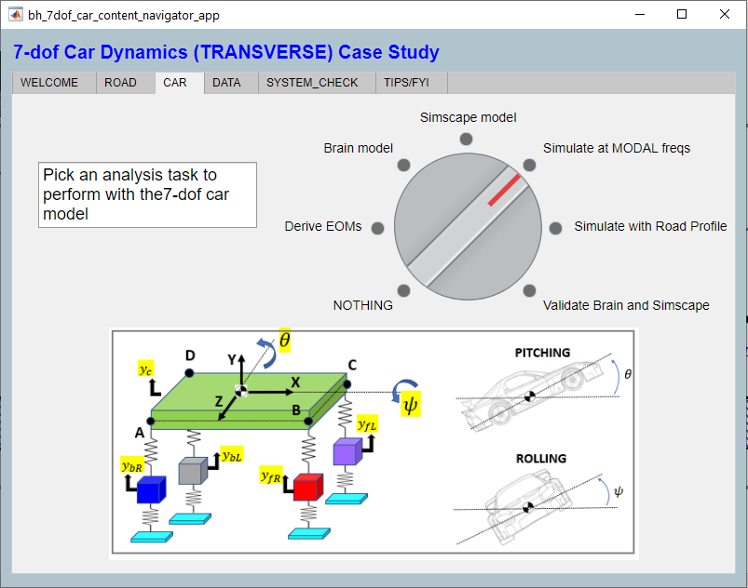
Part 2
Part 1a and b
Part 3

Slide 40
Levelrider stuff

Slide 41


















D
$$F_{bLe}$$
C
Y
A
$$F_{D}$$
X
B
$$F_{C}$$
$$F_{fLe}$$
$$F_{bRe}$$
$$F_{A}$$
$$F_{fRe}$$
$$F_{B}$$
$$F_{fLe}$$
$$F_{A}$$
$$F_{bRe}$$
$$F_{B}$$
$$F_{fRe}$$
$$F_{D}$$
$$F_{bLe}$$
$$F_{C}$$
$$m_{bR}$$
$$m_{fR}$$
$$m_{bL}$$
$$m_{fL}$$
$$F_{bR}$$
$$F_{fR}$$
$$F_{bL}$$
$$F_{fL}$$

Slide 42
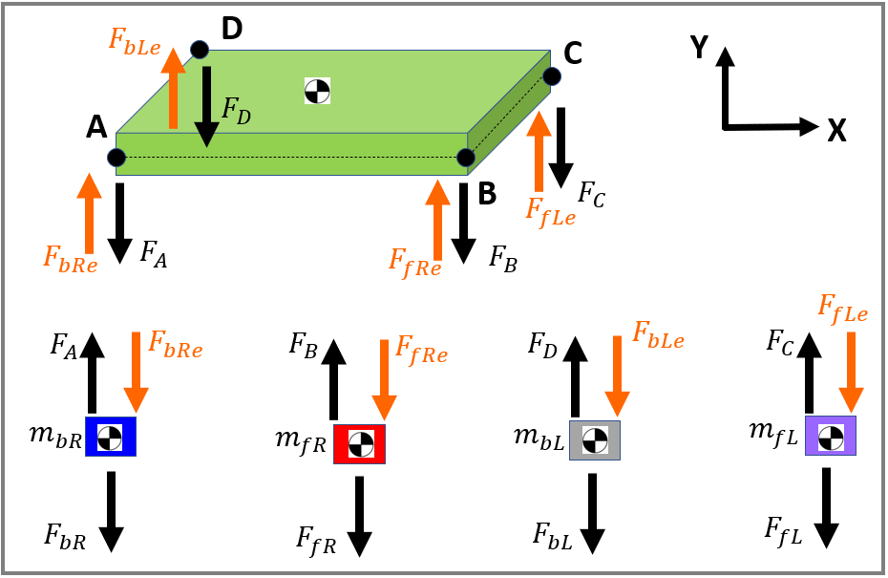

Slide 43
$$L_{f}$$
$$L_{L}$$
B
$$L_{b}$$
Y
$$L_{R}$$
Y
X
B
Z
C
A
$${(F}_{B} +{ F}_{C})$$
$${(F}_{D} +{ F}_{C})$$
$$θ$$
$$ψ$$
PITCHING
$${(F}_{A} +{ F}_{B})$$
$${(F}_{A} +{ F}_{D})$$
ROLLING

Slide 44







$${(F}_{fRe}+F_{fLe})$$
$$L_{L}$$
$$L_{f}$$
$${(F}_{fLe}+F_{bLe})$$
B
$$L_{R}$$
Y
$$L_{b}$$
Y
X
B
$${(F}_{fRe}+F_{bRe})$$
$${(F}_{bRe}+F_{bLe})$$
C
$${(F}_{B} +{ F}_{C})$$
Z
$${(F}_{D} +{ F}_{C})$$
A
$$θ$$
$$ψ$$
PITCHING
$${(F}_{A} +{ F}_{B})$$
$${(F}_{A} +{ F}_{D})$$
ROLLING

Slide 45








$$L_{f}$$
$$L_{L}$$
B
$$L_{b}$$
Y
$$L_{R}$$
Y
X
B
Z
C
A
$$F_{BC}$$
$$F_{DC}$$
$$θ$$
$$ψ$$
$$F_{AB}$$
PITCHING
$$F_{AD}$$
ROLLING
$${F_{BC}= (F}_{B} +{ F}_{C} −{ F}_{fRe} −F_{fLe})$$
$${F_{AB}=(F}_{A} +{ F}_{B} − F_{bRe} −F_{fRe})$$
$${F_{AD}=(F}_{A} +{ F}_{D} − F_{bRe} −F_{bLe})$$
$${F_{DC}=(F}_{D} +{ F}_{C}− F_{bLe} −F_{fLe})$$

Slide 46
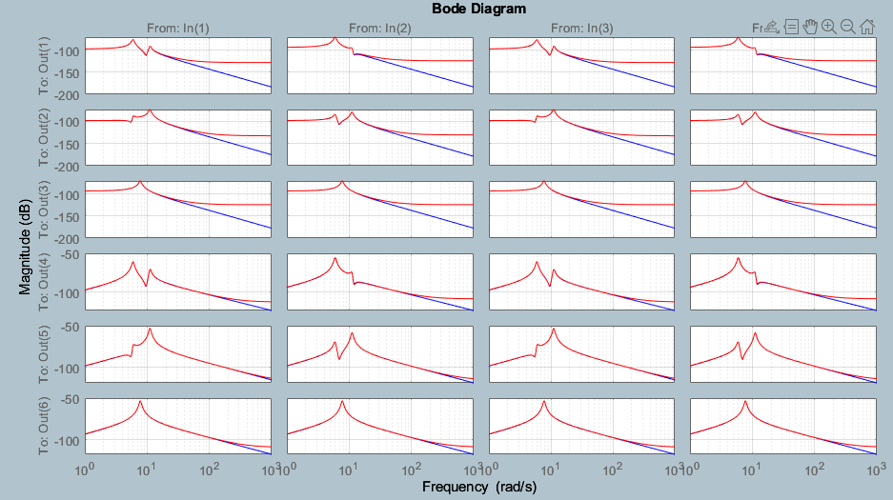






HIGH ORDER system
LOWER ORDER system
$$U_{4×1}$$
$$Y_{6×1}$$
$$U_{4×1}$$
$$Y_{6×1}$$
$${\dot{Z}}_{14×1}$$
$${\dot{Z}}_{??×1}$$
Does the REDUCED
LOWER order system capture “enough”
of the original HIGHER order system’s dynamics

Slide 47
