Slide 1





ATTENTION these are all HANDS drawn
using Powerpoint basic shapes
(eg: rectangles, circles, triangles)
!
ATTENTION I used th following ICONs
From the Powerpoint ICON library
Now it’s
YOUR turn
!
_______
_______
_______
_______
_______
Now it’s
YOUR turn

Slide 3
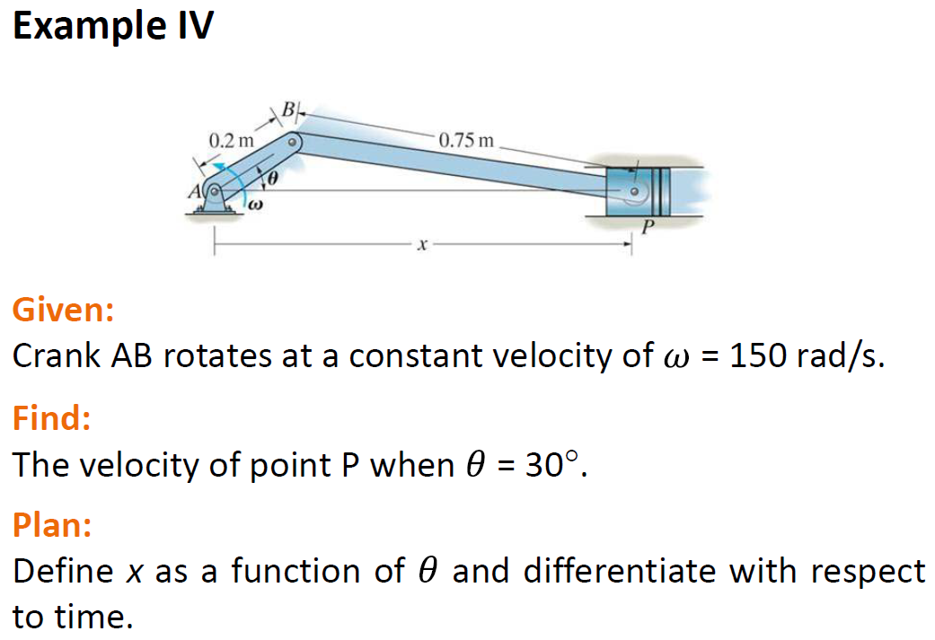

Slide 4
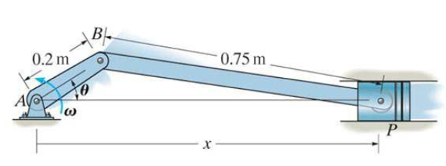

Slide 5
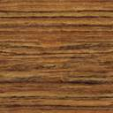




B
B
P
Y
Y
A
P
A
$$θ$$
$$φ$$
$$θ$$
$$φ$$
X
X

Slide 6


B
Y
P
B
$$θ$$
$$φ$$
A
X
P

Slide 7
B
Y
P
B
$$θ$$
A
X
P

Slide 8







$$Y_{B}$$
$$Y_{W}$$
B
+
B
$$φ$$
$$X_{B}$$
$$X_{W}$$
$$Y_{P}$$
P
P
$$X_{P}$$

Slide 9
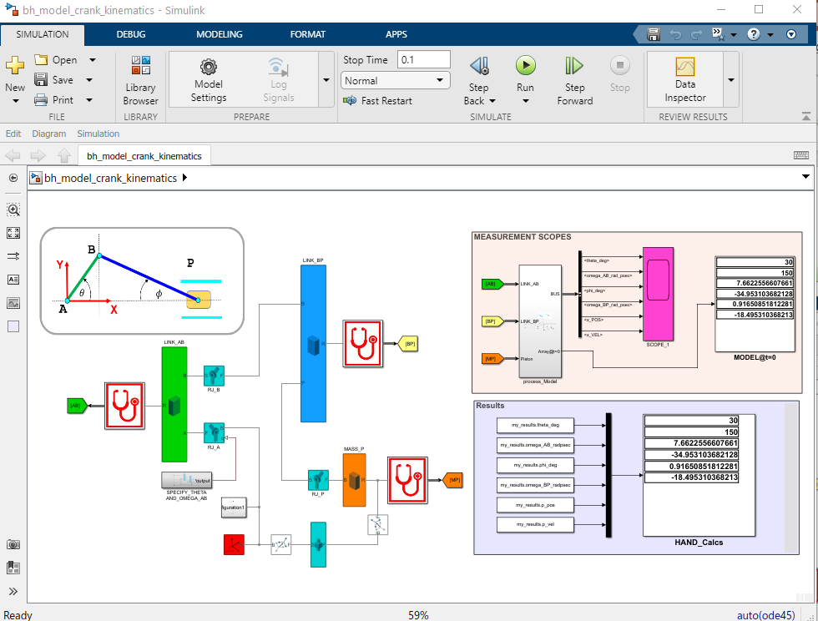

Slide 11
B
Y
A
P
$$θ$$
$$φ$$
X

Slide 12













$$\left|V_{B}\right|.sin⁡(β)$$
$$\left|V_{B}\right|.sin⁡(β)$$
$$V_{B}$$
$$β$$
$$\left|V_{B}\right|.cos⁡(β)$$
B
B
B
$$φ$$
$$\frac{π}{2} = β + θ$$
$$\left|V_{B}\right|.cos⁡(β)$$
$$ω_{BP}$$
$$V_{PY}$$
Y
Y
A
$$θ$$
A
$$V_{PX}$$
$$θ$$
$$φ$$
X
X
P

Slide 15
B
Y
P
$$θ$$
$$φ$$
A
X

Slide 16














$$Y$$
+
$$X$$
B
Y
$$L_{1}$$
$$L_{2}$$
$$τ_{A}$$
P
$$F_{P}$$
$$m_{2}$$
A
$$θ$$
$$φ$$
$$m_{1}$$
$$I_{G2}$$
$$m_{P}$$
X
$$I_{A1}$$

Slide 17








$$φ$$
B
$$φ$$
$$L_{1}$$
$$\frac{L_{2}}{2}$$
$$G_{1}$$
$$G_{2}$$
$$θ$$
$$φ$$
P
A
C

Slide 18










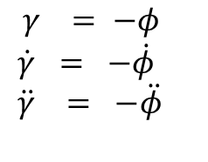










$$R_{BY}$$
$γ = −φ$
$$\dot{γ} = −\dot{φ} \\ \ddot{γ} = −\ddot{φ}$$
$$R_{BX}$$
+
$$R_{BX}$$
B
B
NOTE:
Only Forces in the X-direction are shown on $m_{P}$
+
$$φ$$
$γ$
$$R_{AY}$$
$$R_{BY}$$
+
$$F_{P}$$
P
$$φ$$
$$R_{PX}$$
$$b_{A}.\dot{θ}$$
$$m_{1}.g$$
$$m_{2}.g$$
$$θ$$
$$b_{P}.{\dot{x}}_{P}$$
A
P
$$R_{PX}$$
$$R_{AX}$$
$$τ_{A}$$
$$R_{PY}$$

Slide 19


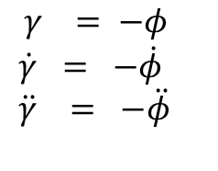


$$R_{BY}$$
$γ = −φ$
$$\dot{γ} = −\dot{φ} \\ \ddot{γ} = −\ddot{φ}$$
$$R_{BX}$$
+
$$m_{P}.g$$
$$R_{BX}$$
B
B
$$R_{PY}$$
+
$γ$
$$R_{AY}$$
$$φ$$
$$R_{BY}$$
+
$$F_{P}$$
P
$$φ$$
$$R_{PX}$$
$$b_{A}.\dot{θ}$$
$$m_{1}.g$$
$$m_{2}.g$$
$$θ$$
$$b_{P}.{\dot{x}}_{P}$$
A
P
$$R_{PX}$$
$$R_{AX}$$
$$τ_{A}$$
$$R_{PY}$$
$$N_{P}$$

Slide 20












Piston motion
B
Y
Y
$$V$$
P
P
B
$$θ$$
$$θ$$
A
A
X
S
X
$$U$$
P
$$m_{P}.g$$
$$x_{p}$$
$$R_{PY}$$
$$u_{p}$$
P
$$F_{P}$$
$$R_{PX}$$
$$b_{P}.{\dot{u}}_{p}$$
$$N_{P}$$

Slide 21






$$m_{P}.g$$
Piston motion
$$R_{PY}$$
$$F_{P}$$
P
$$R_{PX}$$
Y
$$b_{P}.{\dot{x}}_{P}$$
A
X
$$N_{P}$$

Slide 23









$$x=A \backslash b$$
$$L_{i} , b_{i} , {m_{i} , I}_{i}$$
$$A$$
Compute
A and b
$$x= \left(\begin{aligned}\ddot{θ} \\ R_{AX} \\ R_{AY} \\ R_{BX} \\ R_{BY} \\ R_{PX} \\ R_{PY} \\ N_{P}\end{aligned}\right)$$
$$\frac{1}{s}$$
$$\frac{1}{s}$$
$$b$$
$$\left(\ddot{θ}\right)$$
$$\left(\dot{θ}\right)$$
$$\left(θ\right)$$
$τ_{A}$ , $F_{P}$
$$\dot{q}(0)$$
$$q(0)$$
$$f(θ,\dot{θ},\ddot{θ})$$
$$(φ,\dot{φ},\ddot{φ})$$

Slide 24
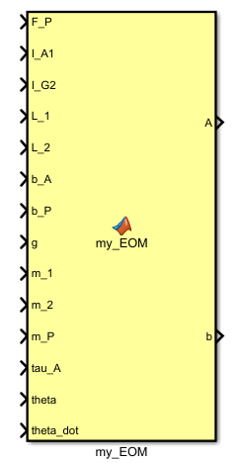


$$x=A \backslash b$$
$$L_{i} , b_{i} , {m_{i} , I}_{i}$$
$$A$$
Compute
A and b
$$x= \left(\begin{aligned}\ddot{θ} \\ R_{AX} \\ R_{AY} \\ R_{BX} \\ R_{BY} \\ R_{PX} \\ R_{PY} \\ N_{P}\end{aligned}\right)$$
$$\frac{1}{s}$$
$$\frac{1}{s}$$
$$\left(\ddot{θ}\right)$$
$$\left(\dot{θ}\right)$$
$$\left(θ\right)$$
$τ_{A}$ , $F_{P}$
$$\dot{q}(0)$$
$$q(0)$$
$$b$$
$$f(θ,\dot{θ},\ddot{θ})$$
$$(φ,\dot{φ},\ddot{φ})$$

Slide 26
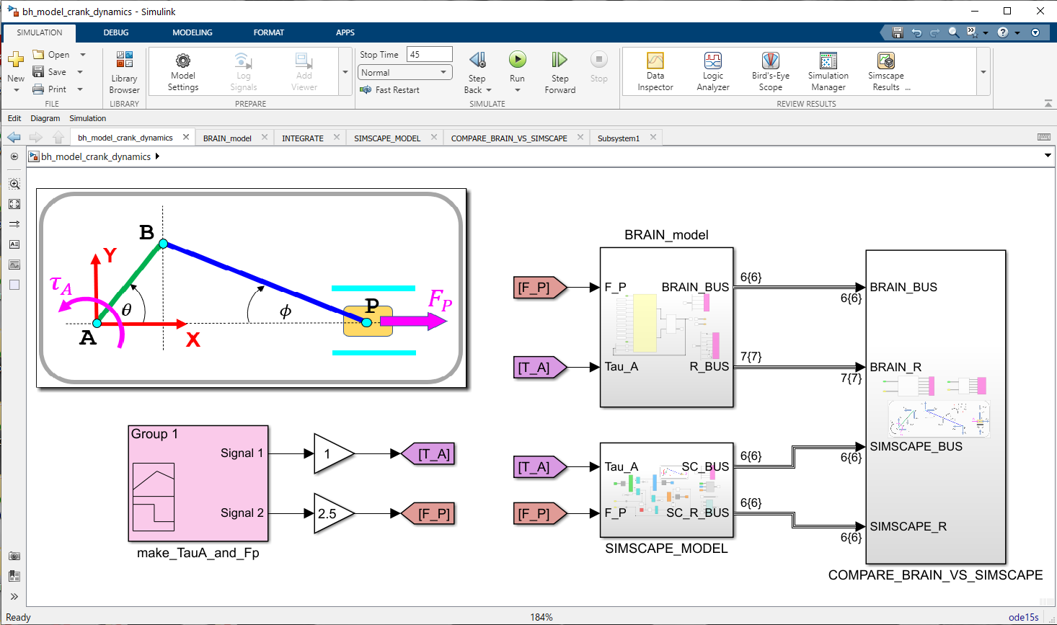
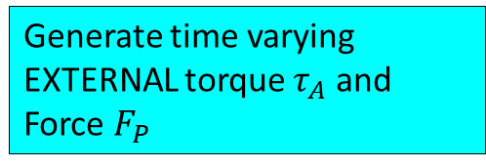
Click this to Simulate
The BRAIN derived model
Compare results from the 2 models
Generate time varying EXTERNAL torque $τ_{A}$ and Force $F_{P}$
The Simscape model

Slide 27
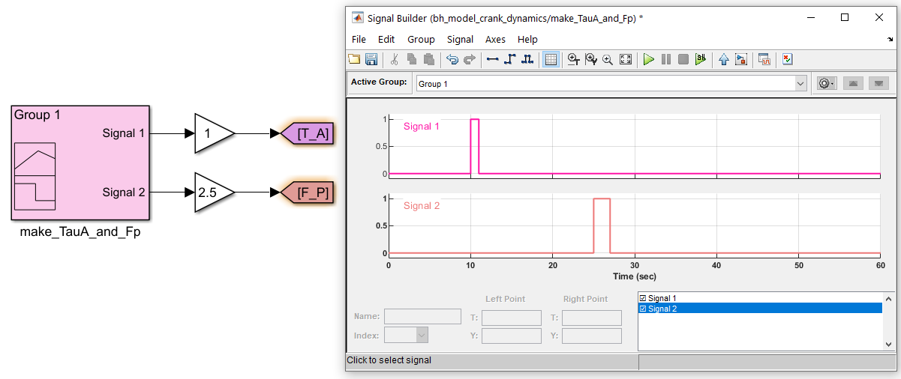

Slide 28
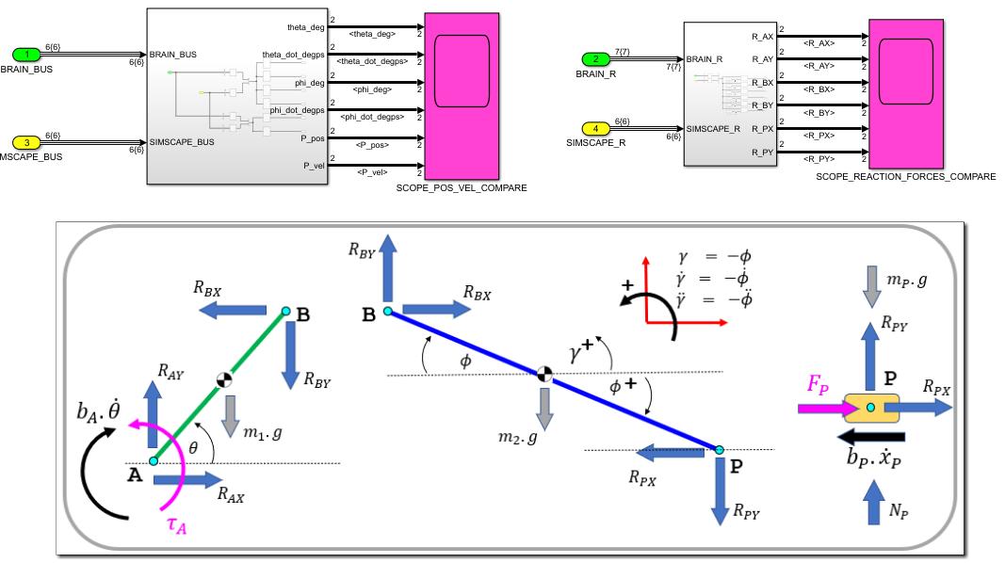

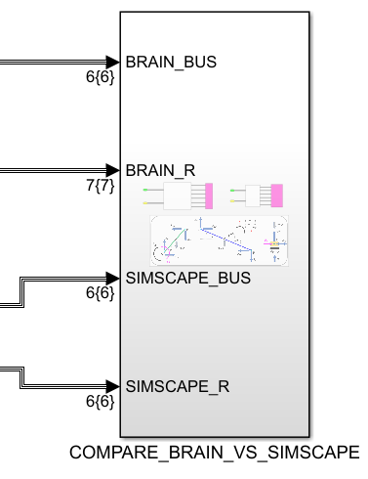


Slide 29
Click this to Simulate
The BRAIN derived model
Compare results from the 2 models
Generate time varying EXTERNAL torque $τ_{A}$ and Force $F_{P}$
The Simscape model

Slide 30
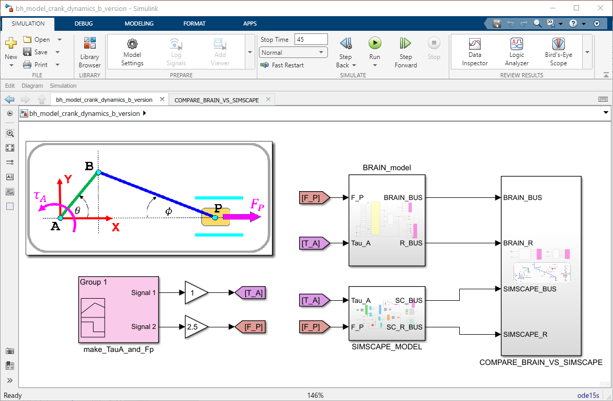

Click this to Simulate
The BRAIN derived model
Compare results from the 2 models
Generate time varying EXTERNAL torque $τ_{A}$ and Force $F_{P}$
The Simscape model

