Slide 1
Icons

Slide 2

ATTENTION these are all HANDS drawn
using Powerpoint basic shapes
(eg: rectangles, circles, triangles)
!
ATTENTION I used th following ICONs
From the Powerpoint ICON library
!
_______
_______
_______
_______
_______
Now it’s
YOUR turn

Slide 3
FTCS

Slide 4
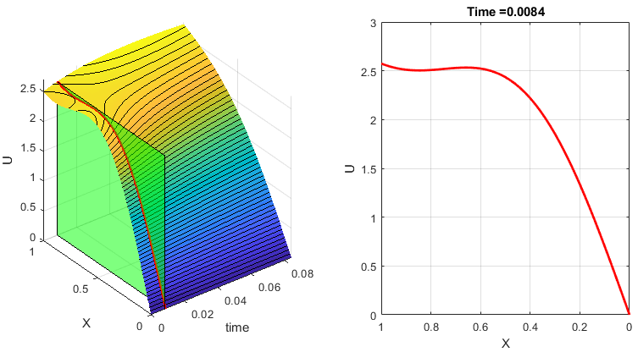

Slide 5








$$t_{0}$$
$$t_{1}$$
$$t_{2}$$
$$t_{Nt}$$
t
$$x_{0}$$
$$x_{1}$$
$$x_{2}$$
$$x_{Nx}$$
X

Slide 6
$$t_{0}$$
$$t_{1}$$
$$t_{2}$$
$$t_{Nt}$$
t
$$x_{0}$$
$$x_{1}$$
$$x_{2}$$
$$x_{Nx}$$
X

Slide 7
pdepe

Slide 8








$$x_{0}$$
$$x_{1}$$
$$x_{2}$$
$$x_{Nx}$$
t
$$t_{0}$$
$$t_{1}$$
$$t_{2}$$
$$t_{Nt}$$
X

Slide 9


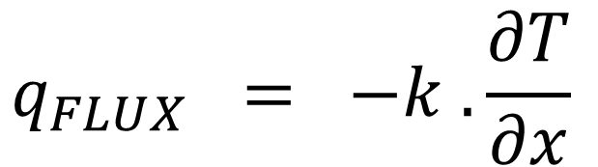


$$q_{FLUX} = −k .\frac{∂T}{∂x}$$
E3
E4
$$T(x,t)$$
E2
X
X = 0
E1
X = 1
$$T\left(0,t\right)=0$$
$$\frac{∂T}{∂x} =1$$
$$x=1$$

Slide 10




E3
E4
$$U(x,t)$$
E2
X
X = 0
E1
X = 1
$$U\left(0,t\right)=0$$
$$\frac{∂U}{∂x} =1$$
$$x=1$$

