Slide 1
Icons

Slide 2

ATTENTION these are all HANDS drawn
using Powerpoint basic shapes
(eg: rectangles, circles, triangles)
!
ATTENTION I used the following ICONs
From the Powerpoint ICON library
!
_______
_______
_______
_______
_______
Now it’s
YOUR turn
Subfunctions
only beyond this point

Slide 3


Slide 4
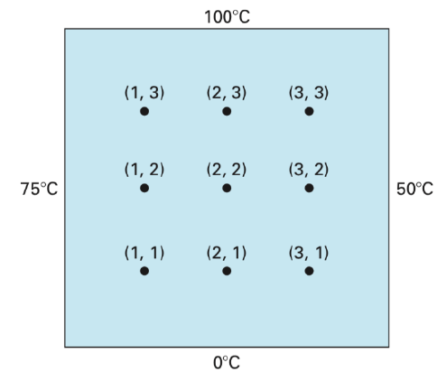
a
Y
a
X

Slide 5

$$T_{i,j} = T(x_{i}, y_{j})$$
a
(0,4)
(1,4)
(2,4)
(3,4)
(4,4)
Y
(0,3)
(4,3)
(0,2)
(4,2)
a
(0,1)
(4,1)
X
(0,0)
(1,0)
(2,0)
(3,0)
(4,0)

Slide 6

(0,4)
(1,4)
(2,4)
(3,4)
(4,4)
$$T_{i,j} = T(x_{i}, y_{j})$$
(0,3)
(4,3)
Y
(0,2)
(4,2)
X
(0,1)
(4,1)
(0,0)
(1,0)
(2,0)
(3,0)
(4,0)

Slide 7
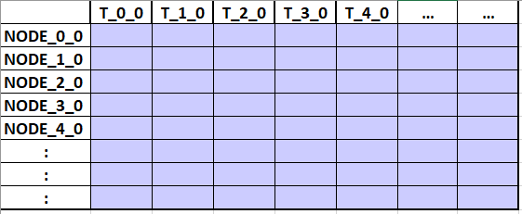

Slide 8




































$$T(x_{0},y_{0})$$
$$T(x_{1},y_{0})$$
$$T(x_{2},y_{0})$$
…
$$x_{0}$$
$$x_{1}$$
$$x_{2}$$
$$x_{N}$$
$$T(x_{N},y_{0})$$
$$T(x_{0},y_{1})$$
$$y_{0}$$
$$T(x_{1},y_{1})$$
$$T(x_{0},y_{0})$$
$$T(x_{1},y_{0})$$
$$T(x_{2},y_{0})$$
$$T(x_{N},y_{0})$$
$$T(x_{2},y_{1})$$
$$y_{1}$$
$$T(x_{0},y_{1})$$
$$T(x_{1},y_{1})$$
$$T(x_{2},y_{1})$$
$$T(x_{N},y_{1})$$
…
$$T(x_{N},y_{1})$$
$$y_{2}$$
$$T(x_{0},y_{2})$$
$$T(x_{1},y_{2})$$
$$T(x_{2},y_{2})$$
$$T(x_{N},y_{2})$$
$$T(x_{0},y_{2})$$
$$T(x_{1},y_{2})$$
$$y_{N}$$
$$T(x_{2},y_{2})$$
$$T(x_{0},y_{N})$$
$$T(x_{1},y_{N})$$
$$T(x_{2},y_{N})$$
$$T(x_{N},y_{N})$$
…
$$T(x_{N},y_{2})$$
…
…

Slide 9
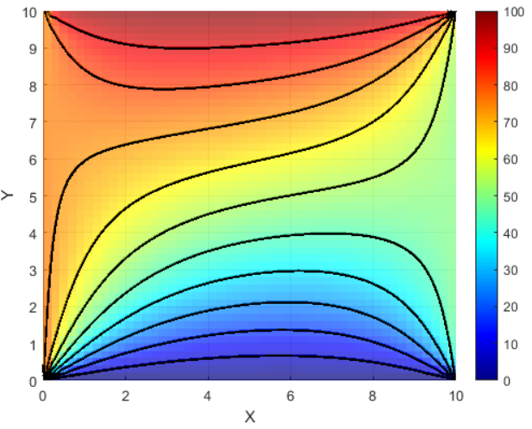
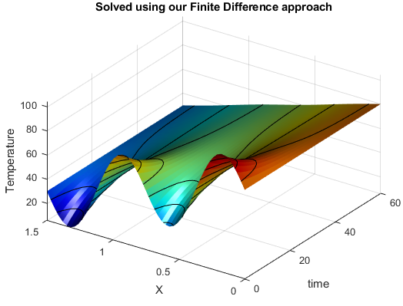

Slide 10
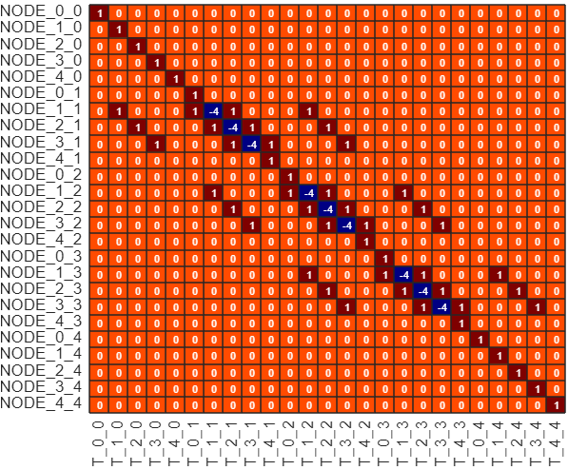
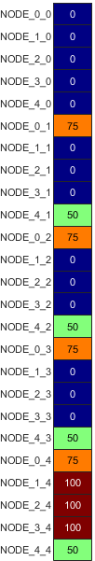
(0,4)
(1,4)
(3,4)
(4,4)
A
rhs
(2,4)
(0,3)
(4,3)
(4,2)
(0,2)
(0,1)
(4,1)
(2,0)
(0,0)
(1,0)
(3,0)
(4,0)

Slide 11
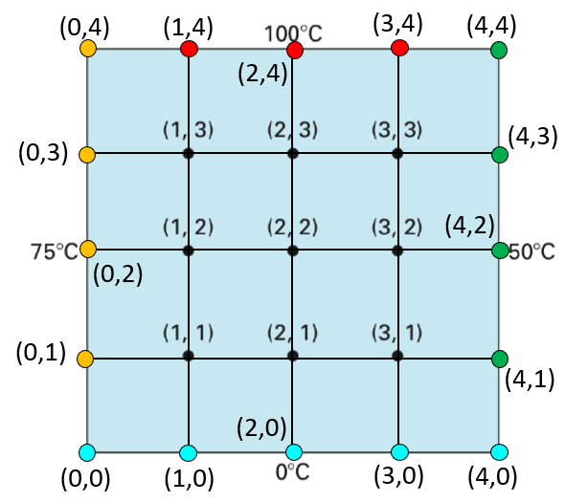
A
rhs

Slide 12













$$h=∆x$$
$$x_{0}$$
$$x_{1}$$
$$x_{2}$$
$$x_{3}$$
$$x_{4}$$
$$x_{n−1}$$
$$x_{n}$$
1
2
3
4
n
X
$x_{0}$= 0
$x_{n}$= L
$$T\left(0,t\right)=80$$
$$T(x,t)$$
$$T\left(L,t\right)=30$$

Slide 13


$$h=∆x$$
$$x_{0}$$
$$x_{1}$$
$$x_{2}$$
$$x_{3}$$
$$x_{4}$$
$$x_{n−1}$$
$$x_{n}$$
1
2
3
4
n
X
$x_{0}$= 0
$x_{n}$= L
$$T\left(0,t\right)=T_{LEFT}$$
$$T(x,t)$$
$$T\left(L,t\right)=T_{RIGHT}$$

Slide 14








$$t_{0}$$
$$t_{1}$$
$$t_{2}$$
…..
$$t_{Nt}$$
t
$$x_{0}$$
LEFT
Boundary
Condition
$$x_{1}$$
$$x_{2}$$
…..
Values to be computed
$$x_{Nx}$$
X
RIGHT
Boundary
Condition
Initial
Conditions

Slide 15
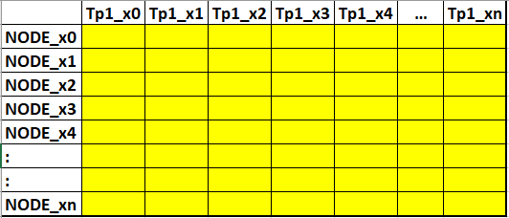








PART_1: Assemble the A matrix
PART_2: Perform Time stepping Loop:
$$t_{0}$$
$$t_{1}$$
$$t_{2}$$
…..
$$t_{Nt}$$
A
t
$$x_{0}$$
$$x_{1}$$
$$x_{2}$$
…..
$$x_{Nx}$$
X

Slide 16
CRANK Nicholson

Slide 17
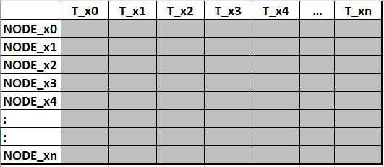
PART_1: Assemble the A and B matrices
PART_2: Perform Time stepping Loop:
$$t_{0}$$
$$t_{1}$$
$$t_{2}$$
…..
$$t_{Nt}$$
A
t
$$x_{0}$$
$$x_{1}$$
$$x_{2}$$
…..
B
$$x_{Nx}$$
X

