Slide 2
!

Slide 3
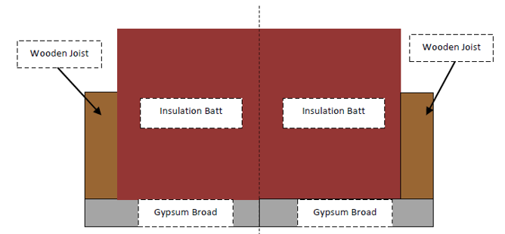
xLc
xLb
xLc
yLb
yLc
yLa
xLa

Slide 4
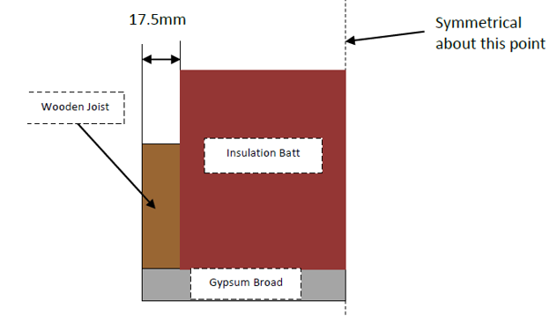
xLc
xLb
yLb
Y
yLc
yLa
X
O

Slide 5
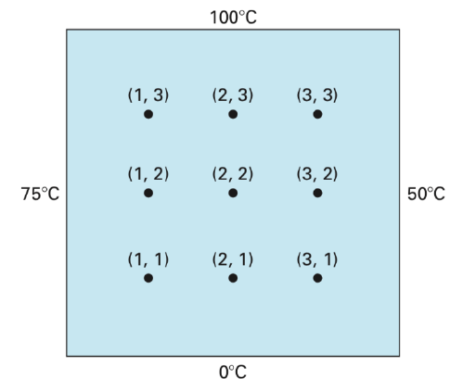
Y
X

Slide 6

(0,4)
(1,4)
(2,4)
(3,4)
(4,4)
$$T_{i,j} = T(x_{i}, y_{j})$$
(0,3)
(4,3)
Y
(0,2)
(4,2)
X
(0,1)
(4,1)
(0,0)
(1,0)
(2,0)
(3,0)
(4,0)

Slide 7











Y
$$T_{m,n−1}$$
X
$$T_{m−1,n}$$
$$T_{m,n}$$
$$T_{m+1,n}$$
${\dot{Q}}_{N}$
${\dot{Q}}_{S}$
$$T_{m+1,n−1}$$
${\dot{Q}}_{E}$
${\dot{Q}}_{W}$
$$T_{m−1,n−1}$$
$$T_{m,n−1}$$

Slide 8







xLC
Y
$$h_{ROOF}$$
X
$$T_{ROOF}$$
BATT
xLB
$$k_{C}$$
yLC
JOIST
yLB
$$k_{B}$$
yLA
$$k_{A}$$
CEILING
O
xLA
$$h_{CEIL}$$
$$T_{CEIL}$$

Slide 9


Y
$$h_{ROOF}$$
X
$$T_{ROOF}$$
$$k_{C}$$
$$k_{B}$$
$$k_{A}$$
$$h_{CEIL}$$
$$T_{CEIL}$$

Slide 10
B-block

Slide 11














G_BLK_B_INTERNAL
Y
$$h_{ROOF}$$
X
$$T_{ROOF}$$
$$T_{m,n+1}$$
$$k_{C}$$
${\dot{Q}}_{N}$
$$k_{B}$$
${\dot{Q}}_{W}$
${\dot{Q}}_{E}$
$$T_{m−1,n}$$
$$T_{m+1,n}$$
${\dot{Q}}_{S}$
$$T_{m,n−1}$$
$$k_{A}$$
$$h_{CEIL}$$
$$T_{CEIL}$$

Slide 12







G_BLK_B_NW
Y
$$h_{ROOF}$$
X
$$T_{ROOF}$$
${\dot{Q}}_{NC}$
$$T_{m,n}$$
$$T_{m+1,n}$$
$$k_{C}$$
${\dot{Q}}_{E}$
${\dot{Q}}_{S}$
$$k_{B}$$
$$T_{m,n−1}$$
$$k_{A}$$
$$h_{CEIL}$$
$$T_{CEIL}$$

Slide 13














G_BLK_B_N
$$h_{ROOF}$$
Y
$$T_{ROOF}$$
X
$$k_{C}$$
${\dot{Q}}_{NC}$
$$T_{m−1,n}$$
$$T_{m,n}$$
$$T_{m+1,n}$$
$$k_{B}$$
${\dot{Q}}_{E}$
${\dot{Q}}_{W}$
${\dot{Q}}_{S}$
$$T_{m,n−1}$$
$$k_{A}$$
$$h_{CEIL}$$
$$T_{CEIL}$$

Slide 14




G_BLK_B_NE
Y
$$h_{ROOF}$$
X
$$T_{ROOF}$$
$$T_{m,n+1}$$
${\dot{Q}}_{NC}$
$$k_{C}$$
${\dot{Q}}_{N}$
${\dot{Q}}_{WC}$
${\dot{Q}}_{E}$
$$T_{m−1,n}$$
$$T_{m+1,n}$$
$$k_{B}$$
${\dot{Q}}_{W}$
${\dot{Q}}_{S}$
$$T_{m,n−1}$$
$$k_{A}$$
$$h_{CEIL}$$
$$T_{CEIL}$$

Slide 15
G_BLK_B_E
Y
$$h_{ROOF}$$
X
$$T_{ROOF}$$
$$T_{m,n+1}$$
$$k_{C}$$
${\dot{Q}}_{N}$
${\dot{Q}}_{W}$
${\dot{Q}}_{E}$
$$T_{m−1,n}$$
$$T_{m+1,n}$$
$$k_{B}$$
${\dot{Q}}_{S}$
$$T_{m,n−1}$$
$$k_{A}$$
$$h_{CEIL}$$
$$T_{CEIL}$$

Slide 16
G_BLK_B_SE
Y
$$h_{ROOF}$$
X
$$T_{ROOF}$$
$$T_{m,n+1}$$
$$k_{C}$$
${\dot{Q}}_{N}$
${\dot{Q}}_{W}$
${\dot{Q}}_{E}$
$$T_{m−1,n}$$
$$T_{m+1,n}$$
$$k_{B}$$
${\dot{Q}}_{S}$
$$T_{m,n−1}$$
$$k_{A}$$
$$h_{CEIL}$$
$$T_{CEIL}$$

Slide 17
G_BLK_B_S
Y
$$h_{ROOF}$$
X
$$T_{ROOF}$$
$$T_{m,n+1}$$
$$k_{C}$$
${\dot{Q}}_{N}$
${\dot{Q}}_{W}$
${\dot{Q}}_{E}$
$$T_{m−1,n}$$
$$T_{m+1,n}$$
$$k_{B}$$
${\dot{Q}}_{S}$
$$T_{m,n−1}$$
$$k_{A}$$
$$h_{CEIL}$$
$$T_{CEIL}$$

Slide 18

G_BLK_B_SW
Y
$$h_{ROOF}$$
X
$$T_{ROOF}$$
$$T_{m,n+1}$$
$$k_{C}$$
${\dot{Q}}_{N}$
${\dot{Q}}_{E}$
$$T_{m,n}$$
$$T_{m+1,n}$$
$$k_{B}$$
${\dot{Q}}_{S}$
$$T_{m,n−1}$$
$$k_{A}$$
$$h_{CEIL}$$
$$T_{CEIL}$$

Slide 19
G_BLK_B_W
Y
$$h_{ROOF}$$
X
$$T_{ROOF}$$
$$T_{m,n+1}$$
$$k_{C}$$
${\dot{Q}}_{N}$
${\dot{Q}}_{E}$
$$T_{m,n}$$
$$T_{m+1,n}$$
$$k_{B}$$
${\dot{Q}}_{S}$
$$T_{m,n−1}$$
$$k_{A}$$
$$h_{CEIL}$$
$$T_{CEIL}$$

Slide 20
C-block

Slide 21
G_BLK_C_INTERNAL
Y
$$h_{ROOF}$$
X
$$T_{ROOF}$$
$$T_{m,n+1}$$
$$k_{C}$$
${\dot{Q}}_{N}$
$$k_{B}$$
${\dot{Q}}_{W}$
${\dot{Q}}_{E}$
$$T_{m−1,n}$$
$$T_{m+1,n}$$
${\dot{Q}}_{S}$
$$T_{m,n−1}$$
$$k_{A}$$
$$h_{CEIL}$$
$$T_{CEIL}$$

Slide 22

G_BLK_C_W
Y
$$h_{ROOF}$$
X
$$T_{ROOF}$$
$$T_{m,n+1}$$
$$k_{C}$$
${\dot{Q}}_{N}$
${\dot{Q}}_{WC}$
${\dot{Q}}_{E}$
$$T_{m,n}$$
$$T_{m+1,n}$$
$$k_{B}$$
${\dot{Q}}_{S}$
$$T_{m,n−1}$$
$$k_{A}$$
$$h_{CEIL}$$
$$T_{CEIL}$$

Slide 23

G_BLK_C_NW
Y
$$h_{ROOF}$$
X
$$T_{ROOF}$$
${\dot{Q}}_{NC}$
$$T_{m,n}$$
$$T_{m+1,n}$$
$$k_{C}$$
${\dot{Q}}_{WC}$
${\dot{Q}}_{E}$
${\dot{Q}}_{S}$
$$k_{B}$$
$$T_{m,n−1}$$
$$k_{A}$$
$$h_{CEIL}$$
$$T_{CEIL}$$

Slide 24
G_BLK_C_N
$$h_{ROOF}$$
Y
$$T_{ROOF}$$
X
$$k_{C}$$
${\dot{Q}}_{NC}$
$$T_{m−1,n}$$
$$T_{m,n}$$
$$T_{m+1,n}$$
$$k_{B}$$
${\dot{Q}}_{E}$
${\dot{Q}}_{W}$
${\dot{Q}}_{S}$
$$T_{m,n−1}$$
$$k_{A}$$
$$h_{CEIL}$$
$$T_{CEIL}$$

Slide 25





G_BLK_C_NE
Y
$$h_{ROOF}$$
X
$$T_{ROOF}$$
${\dot{Q}}_{NC}$
$$T_{m−1,n}$$
$$k_{C}$$
$$T_{m,n}$$
${\dot{Q}}_{WC}$
${\dot{Q}}_{S}$
$$k_{B}$$
$$T_{m,n−1}$$
$$k_{A}$$
$$h_{CEIL}$$
$$T_{CEIL}$$

Slide 26

G_BLK_C_E
Y
$$h_{ROOF}$$
X
$$T_{ROOF}$$
$$T_{m,n+1}$$
$$k_{C}$$
${\dot{Q}}_{N}$
${\dot{Q}}_{W}$
$$T_{m−1,n}$$
$$k_{B}$$
${\dot{Q}}_{S}$
$$T_{m,n−1}$$
$$k_{A}$$
$$h_{CEIL}$$
$$T_{CEIL}$$

Slide 27
G_BLK_C_SE
Y
$$h_{ROOF}$$
X
$$T_{ROOF}$$
$$T_{m,n+1}$$
$$k_{C}$$
${\dot{Q}}_{N}$
${\dot{Q}}_{W}$
$$T_{m−1,n}$$
$$k_{B}$$
${\dot{Q}}_{S}$
$$T_{m,n−1}$$
$$k_{A}$$
$$h_{CEIL}$$
$$T_{CEIL}$$

Slide 28
G_BLK_C_S
Y
$$h_{ROOF}$$
X
$$T_{ROOF}$$
$$T_{m,n+1}$$
$$k_{C}$$
${\dot{Q}}_{N}$
${\dot{Q}}_{W}$
${\dot{Q}}_{E}$
$$T_{m−1,n}$$
$$T_{m+1,n}$$
$$k_{B}$$
${\dot{Q}}_{S}$
$$T_{m,n−1}$$
$$k_{A}$$
$$h_{CEIL}$$
$$T_{CEIL}$$

Slide 29
A-block

Slide 30
G_BLK_A_INTERNAL
Y
$$h_{ROOF}$$
X
$$T_{ROOF}$$
$$T_{m,n+1}$$
$$k_{C}$$
${\dot{Q}}_{N}$
$$k_{B}$$
${\dot{Q}}_{W}$
${\dot{Q}}_{E}$
$$T_{m−1,n}$$
$$T_{m+1,n}$$
${\dot{Q}}_{S}$
$$T_{m,n−1}$$
$$k_{A}$$
$$h_{CEIL}$$
$$T_{CEIL}$$

Slide 31





G_BLK_A_SW
Y
$$h_{ROOF}$$
X
$$T_{ROOF}$$
$$k_{C}$$
$$T_{m,n+1}$$
$$k_{B}$$
${\dot{Q}}_{N}$
${\dot{Q}}_{E}$
$$T_{m+1,n}$$
$$k_{A}$$
${\dot{Q}}_{SC}$
$$h_{CEIL}$$
$$T_{CEIL}$$

Slide 32
G_BLK_A_W
Y
$$h_{ROOF}$$
X
$$T_{ROOF}$$
$$T_{m,n+1}$$
$$k_{C}$$
${\dot{Q}}_{N}$
${\dot{Q}}_{E}$
$$T_{m,n}$$
$$T_{m+1,n}$$
$$k_{B}$$
${\dot{Q}}_{S}$
$$T_{m,n−1}$$
$$k_{A}$$
$$h_{CEIL}$$
$$T_{CEIL}$$

Slide 33




G_BLK_A_S
Y
$$h_{ROOF}$$
X
$$T_{ROOF}$$
$$T_{m,n+1}$$
$$k_{C}$$
${\dot{Q}}_{N}$
${\dot{Q}}_{W}$
${\dot{Q}}_{E}$
$$k_{B}$$
$$T_{m−1,n}$$
$$T_{m+1,n}$$
${\dot{Q}}_{SC}$
$$k_{A}$$
$$h_{CEIL}$$
$$T_{CEIL}$$

Slide 34





G_BLK_A_SE
Y
$$h_{ROOF}$$
X
$$T_{ROOF}$$
$$k_{C}$$
$$T_{m,n+1}$$
$$k_{B}$$
${\dot{Q}}_{N}$
$$T_{m−1,n}$$
${\dot{Q}}_{W}$
${\dot{Q}}_{SC}$
$$k_{A}$$
$$h_{CEIL}$$
$$T_{CEIL}$$

Slide 35
G_BLK_A_E
Y
$$h_{ROOF}$$
X
$$T_{ROOF}$$
$$T_{m,n+1}$$
$$k_{C}$$
${\dot{Q}}_{N}$
${\dot{Q}}_{W}$
$$T_{m−1,n}$$
$$k_{B}$$
${\dot{Q}}_{S}$
$$T_{m,n−1}$$
$$k_{A}$$
$$h_{CEIL}$$
$$T_{CEIL}$$

