Slide 1

ATTENTION these are all HANDS drawn
using Powerpoint basic shapes
(eg: rectangles, circles, triangles)
!
ATTENTION I used th following ICONs
From the Powerpoint ICON library
!
_______
_______
_______
_______
_______
Now it’s
YOUR turn
Subfunctions
only beyond this point

Slide 2
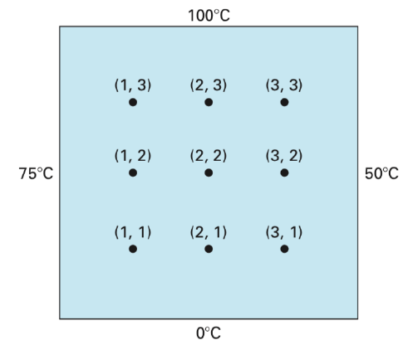
Y
X

Slide 3

(0,4)
(1,4)
(2,4)
(3,4)
(4,4)
$$T_{i,j} = T(x_{i}, y_{j})$$
(0,3)
(4,3)
Y
(0,2)
(4,2)
X
(0,1)
(4,1)
(0,0)
(1,0)
(2,0)
(3,0)
(4,0)

Slide 4
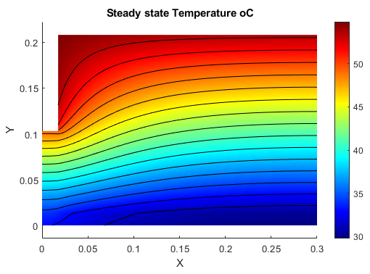
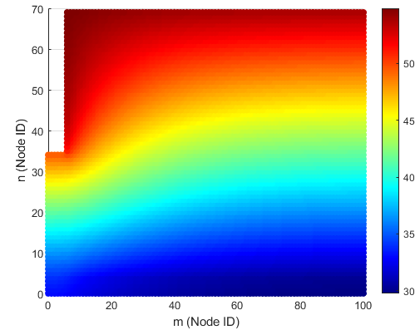

Slide 5










NODE Co-ordinates
(1, $N_{Y}$)
(2, $N_{Y}$)
(3, $N_{Y}$)
$$(0,N_{Y})$$
$$(N_{X},N_{Y})$$
Y
~
~
X
(0,3)
$$(N_{X},3)$$
NORTH
EAST
(0,2)
$$(N_{X},2)$$
$$T_{i,j}$$
WEST
SOUTH
Is the Temperature at
Node (i,j)
(0,1)
$$(N_{X},1)$$
~
~
(0,0)
(1,0)
(2,0)
(3,0)
$$(N_{X},0)$$

Slide 6
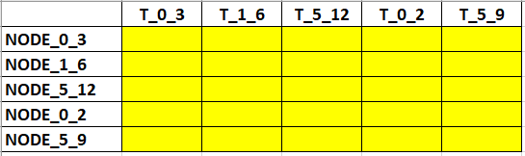
An example A_sys matrix

Slide 9
Roof Cavity
Living Room

Slide 10
Roof Cavity
Wooden joists
Ceiling sheet
(eg: gypsum)
Insulation Bat
Living Room

Slide 11
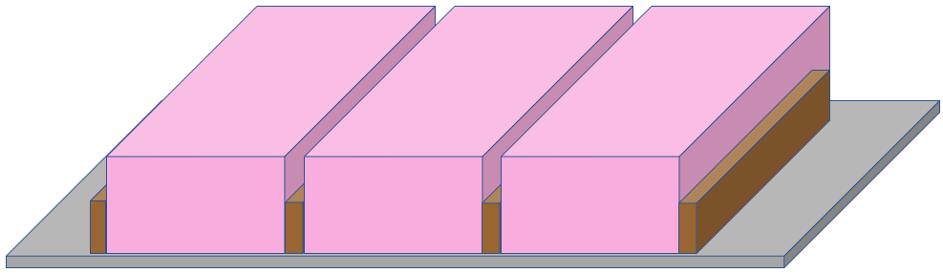
Roof Cavity
Wooden joists
Insulation Bat
Ceiling sheet
(e.g.: gypsum)
Living Room

Slide 12
Roof Cavity
Wooden joists
Insulation Bat
Ceiling sheet
(e.g.: gypsum)
Living Room

Slide 13
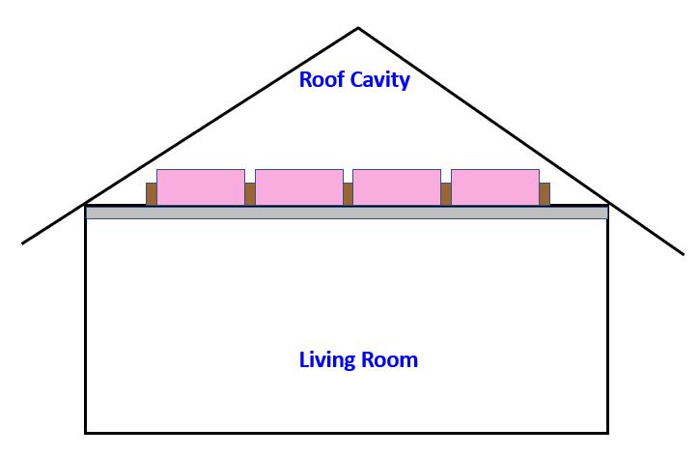
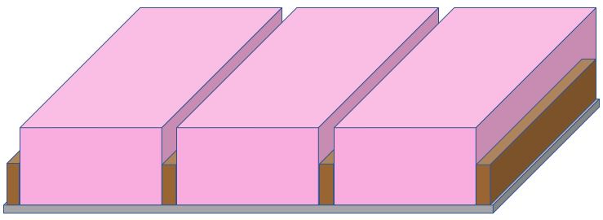



Y
X
$$Z_{ROOM}$$
$$X_{LA}$$
$$X_{ROOM}$$

Slide 14




$$T_{ROOF}$$
$$Z_{ROOM}$$
$$X_{ROOM}$$
$$T_{CEIL}$$

Slide 15











Y
$$T_{m,n−1}$$
X
$$T_{m−1,n}$$
$$T_{m,n}$$
$$T_{m+1,n}$$
${\dot{Q}}_{N}$
${\dot{Q}}_{S}$
$$T_{m+1,n−1}$$
${\dot{Q}}_{E}$
${\dot{Q}}_{W}$
$$T_{m−1,n−1}$$
$$T_{m,n−1}$$

Slide 16














NODES
$$T_{m,n+1}$$
$$T_{m−1,n+1}$$
$$T_{m,n+1}$$
$$T_{m+1,n+1}$$
$$T_{m−1,n}$$
$$T_{m+1,n}$$
$$T_{m−1,n}$$
$$T_{m+1,n}$$
$$T_{m,n}$$
$$T_{m,n}$$
$$T_{m,n−1}$$
$$T_{m−1,n−1}$$
$$T_{m,n−1}$$
$$T_{m+1,n−1}$$

Slide 17










NODES
FACES
Y
HEAT FLOW
X
$$T_{m,n+1}$$
$$T_{m,n+1}$$
${\dot{Q}}_{NC}$
NORTH
${\dot{Q}}_{N}$
$$T_{m−1,n}$$
$$T_{m+1,n}$$
${\dot{Q}}_{WC}$
${\dot{Q}}_{E}$
WEST
EAST
$$T_{m+1,n}$$
$$T_{m−1,n}$$
$$T_{m,n}$$
${\dot{Q}}_{W}$
SOUTH
${\dot{Q}}_{S}$
$$T_{m,n−1}$$
$$T_{m,n−1}$$

Slide 18







xLC
Y
$$h_{ROOF}$$
X
$$T_{ROOF}$$
BATT
xLB
$$k_{C}$$
yLC
JOIST
yLB
$$k_{B}$$
yLA
$$k_{A}$$
CEILING
O
xLA
$$h_{CEIL}$$
$$T_{CEIL}$$

Slide 19


xLC
Y
$$h_{ROOF}$$
X
$$T_{ROOF}$$
BATT
xLB
$$k_{C}$$
yLC
JOIST
yLB
$$k_{B}$$
yLA
$$k_{A}$$
CEILING
O
xLA
$$h_{CEIL}$$
$$T_{CEIL}$$

Slide 20

xLC
Y
$$h_{ROOF}$$
X
$$T_{ROOF}$$
BATT
xLB
$$k_{C}$$
yLC
JOIST
yLB
$$k_{B}$$
$$T_{i,j}= T( i.∆x , j.∆y )$$
yLA
$$k_{A}$$
CEILING
O
xLA
$$h_{CEIL}$$
$$T_{CEIL}$$

Slide 21







Y
$$h_{ROOF}$$
X
$$T_{ROOF}$$
$$k_{C}$$
$$k_{B}$$
$$k_{A}$$
$$h_{CEIL}$$
$$T_{CEIL}$$

Slide 22




$$h_{ROOF}$$
Y
$$T_{ROOF}$$
X
$$k_{C}$$
$$k_{B}$$
$$k_{A}$$
$$h_{CEIL}$$
$$T_{CEIL}$$

Slide 23
G_BLK_C_N
23 different NODE types
$$h_{ROOF}$$
Y
$$T_{ROOF}$$
G_BLK_C_N
G_BLK_C_NE
X
$$k_{C}$$
$$k_{B}$$
G_BLK_C_INTERNAL
$$k_{A}$$
G_BLK_A_S
$$h_{CEIL}$$
$$T_{CEIL}$$

Slide 24





$$X_{LA}$$
$$k_{A}$$
Y
${\dot{Q}}_{SC}$
X
$$h_{CEIL}$$
$$T_{CEIL}$$

Slide 25
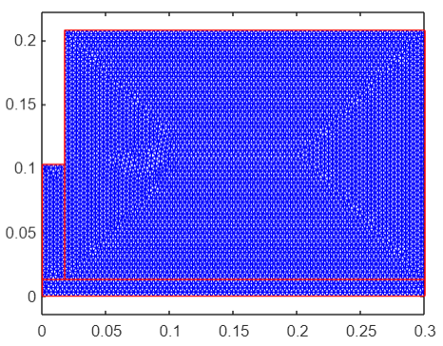

Slide 26
B-block

Slide 27














G_BLK_B_INTERNAL
Y
$$h_{ROOF}$$
X
$$T_{ROOF}$$
$$T_{m,n+1}$$
$$k_{C}$$
${\dot{Q}}_{N}$
$$k_{B}$$
${\dot{Q}}_{W}$
${\dot{Q}}_{E}$
$$T_{m−1,n}$$
$$T_{m+1,n}$$
${\dot{Q}}_{S}$
$$T_{m,n−1}$$
$$k_{A}$$
$$h_{CEIL}$$
$$T_{CEIL}$$

Slide 28







G_BLK_B_NW
Y
$$h_{ROOF}$$
X
$$T_{ROOF}$$
${\dot{Q}}_{NC}$
$$T_{m,n}$$
$$T_{m+1,n}$$
$$k_{C}$$
${\dot{Q}}_{E}$
${\dot{Q}}_{S}$
$$k_{B}$$
$$T_{m,n−1}$$
$$k_{A}$$
$$h_{CEIL}$$
$$T_{CEIL}$$

Slide 29














G_BLK_B_N
$$h_{ROOF}$$
Y
$$T_{ROOF}$$
X
$$k_{C}$$
${\dot{Q}}_{NC}$
$$T_{m−1,n}$$
$$T_{m,n}$$
$$T_{m+1,n}$$
$$k_{B}$$
${\dot{Q}}_{E}$
${\dot{Q}}_{W}$
${\dot{Q}}_{S}$
$$T_{m,n−1}$$
$$k_{A}$$
$$h_{CEIL}$$
$$T_{CEIL}$$

Slide 30




G_BLK_B_NE
Y
$$h_{ROOF}$$
X
$$T_{ROOF}$$
$$T_{m,n+1}$$
${\dot{Q}}_{NC}$
$$k_{C}$$
${\dot{Q}}_{N}$
${\dot{Q}}_{WC}$
${\dot{Q}}_{E}$
$$T_{m−1,n}$$
$$T_{m+1,n}$$
$$k_{B}$$
${\dot{Q}}_{W}$
${\dot{Q}}_{S}$
$$T_{m,n−1}$$
$$k_{A}$$
$$h_{CEIL}$$
$$T_{CEIL}$$

Slide 31
G_BLK_B_E
Y
$$h_{ROOF}$$
X
$$T_{ROOF}$$
$$T_{m,n+1}$$
$$k_{C}$$
${\dot{Q}}_{N}$
${\dot{Q}}_{W}$
${\dot{Q}}_{E}$
$$T_{m−1,n}$$
$$T_{m+1,n}$$
$$k_{B}$$
${\dot{Q}}_{S}$
$$T_{m,n−1}$$
$$k_{A}$$
$$h_{CEIL}$$
$$T_{CEIL}$$

Slide 32
G_BLK_B_SE
Y
$$h_{ROOF}$$
X
$$T_{ROOF}$$
$$T_{m,n+1}$$
$$k_{C}$$
${\dot{Q}}_{N}$
${\dot{Q}}_{W}$
${\dot{Q}}_{E}$
$$T_{m−1,n}$$
$$T_{m+1,n}$$
$$k_{B}$$
${\dot{Q}}_{S}$
$$T_{m,n−1}$$
$$k_{A}$$
$$h_{CEIL}$$
$$T_{CEIL}$$

Slide 33
G_BLK_B_S
Y
$$h_{ROOF}$$
X
$$T_{ROOF}$$
$$T_{m,n+1}$$
$$k_{C}$$
${\dot{Q}}_{N}$
${\dot{Q}}_{W}$
${\dot{Q}}_{E}$
$$T_{m−1,n}$$
$$T_{m+1,n}$$
$$k_{B}$$
${\dot{Q}}_{S}$
$$T_{m,n−1}$$
$$k_{A}$$
$$h_{CEIL}$$
$$T_{CEIL}$$

Slide 34

G_BLK_B_SW
Y
$$h_{ROOF}$$
X
$$T_{ROOF}$$
$$T_{m,n+1}$$
$$k_{C}$$
${\dot{Q}}_{N}$
${\dot{Q}}_{E}$
$$T_{m,n}$$
$$T_{m+1,n}$$
$$k_{B}$$
${\dot{Q}}_{S}$
$$T_{m,n−1}$$
$$k_{A}$$
$$h_{CEIL}$$
$$T_{CEIL}$$

Slide 35
G_BLK_B_W
Y
$$h_{ROOF}$$
X
$$T_{ROOF}$$
$$T_{m,n+1}$$
$$k_{C}$$
${\dot{Q}}_{N}$
${\dot{Q}}_{E}$
$$T_{m,n}$$
$$T_{m+1,n}$$
$$k_{B}$$
${\dot{Q}}_{S}$
$$T_{m,n−1}$$
$$k_{A}$$
$$h_{CEIL}$$
$$T_{CEIL}$$

Slide 36
C-block

Slide 37
G_BLK_C_INTERNAL
Y
$$h_{ROOF}$$
X
$$T_{ROOF}$$
$$T_{m,n+1}$$
$$k_{C}$$
${\dot{Q}}_{N}$
$$k_{B}$$
${\dot{Q}}_{W}$
${\dot{Q}}_{E}$
$$T_{m−1,n}$$
$$T_{m+1,n}$$
${\dot{Q}}_{S}$
$$T_{m,n−1}$$
$$k_{A}$$
$$h_{CEIL}$$
$$T_{CEIL}$$

Slide 38

G_BLK_C_W
Y
$$h_{ROOF}$$
X
$$T_{ROOF}$$
$$T_{m,n+1}$$
$$k_{C}$$
${\dot{Q}}_{N}$
${\dot{Q}}_{WC}$
${\dot{Q}}_{E}$
$$T_{m,n}$$
$$T_{m+1,n}$$
$$k_{B}$$
${\dot{Q}}_{S}$
$$T_{m,n−1}$$
$$k_{A}$$
$$h_{CEIL}$$
$$T_{CEIL}$$

Slide 39

G_BLK_C_NW
Y
$$h_{ROOF}$$
X
$$T_{ROOF}$$
${\dot{Q}}_{NC}$
$$T_{m,n}$$
$$T_{m+1,n}$$
$$k_{C}$$
${\dot{Q}}_{WC}$
${\dot{Q}}_{E}$
${\dot{Q}}_{S}$
$$k_{B}$$
$$T_{m,n−1}$$
$$k_{A}$$
$$h_{CEIL}$$
$$T_{CEIL}$$

Slide 40
G_BLK_C_N
$$h_{ROOF}$$
Y
$$T_{ROOF}$$
X
$$k_{C}$$
${\dot{Q}}_{NC}$
$$T_{m−1,n}$$
$$T_{m,n}$$
$$T_{m+1,n}$$
$$k_{B}$$
${\dot{Q}}_{E}$
${\dot{Q}}_{W}$
${\dot{Q}}_{S}$
$$T_{m,n−1}$$
$$k_{A}$$
$$h_{CEIL}$$
$$T_{CEIL}$$

Slide 41





G_BLK_C_NE
Y
$$h_{ROOF}$$
X
$$T_{ROOF}$$
${\dot{Q}}_{NC}$
$$T_{m−1,n}$$
$$k_{C}$$
$$T_{m,n}$$
${\dot{Q}}_{WC}$
${\dot{Q}}_{S}$
$$k_{B}$$
$$T_{m,n−1}$$
$$k_{A}$$
$$h_{CEIL}$$
$$T_{CEIL}$$

Slide 42

G_BLK_C_E
Y
$$h_{ROOF}$$
X
$$T_{ROOF}$$
$$T_{m,n+1}$$
$$k_{C}$$
${\dot{Q}}_{N}$
${\dot{Q}}_{W}$
$$T_{m−1,n}$$
$$k_{B}$$
${\dot{Q}}_{S}$
$$T_{m,n−1}$$
$$k_{A}$$
$$h_{CEIL}$$
$$T_{CEIL}$$

Slide 43
G_BLK_C_SE
Y
$$h_{ROOF}$$
X
$$T_{ROOF}$$
$$T_{m,n+1}$$
$$k_{C}$$
${\dot{Q}}_{N}$
${\dot{Q}}_{W}$
$$T_{m−1,n}$$
$$k_{B}$$
${\dot{Q}}_{S}$
$$T_{m,n−1}$$
$$k_{A}$$
$$h_{CEIL}$$
$$T_{CEIL}$$

Slide 44
G_BLK_C_S
Y
$$h_{ROOF}$$
X
$$T_{ROOF}$$
$$T_{m,n+1}$$
$$k_{C}$$
${\dot{Q}}_{N}$
${\dot{Q}}_{W}$
${\dot{Q}}_{E}$
$$T_{m−1,n}$$
$$T_{m+1,n}$$
$$k_{B}$$
${\dot{Q}}_{S}$
$$T_{m,n−1}$$
$$k_{A}$$
$$h_{CEIL}$$
$$T_{CEIL}$$

Slide 45
A-block

Slide 46
G_BLK_A_INTERNAL
Y
$$h_{ROOF}$$
X
$$T_{ROOF}$$
$$T_{m,n+1}$$
$$k_{C}$$
${\dot{Q}}_{N}$
$$k_{B}$$
${\dot{Q}}_{W}$
${\dot{Q}}_{E}$
$$T_{m−1,n}$$
$$T_{m+1,n}$$
${\dot{Q}}_{S}$
$$T_{m,n−1}$$
$$k_{A}$$
$$h_{CEIL}$$
$$T_{CEIL}$$

Slide 47





G_BLK_A_SW
Y
$$h_{ROOF}$$
X
$$T_{ROOF}$$
$$k_{C}$$
$$T_{m,n+1}$$
$$k_{B}$$
${\dot{Q}}_{N}$
${\dot{Q}}_{E}$
$$T_{m+1,n}$$
$$k_{A}$$
${\dot{Q}}_{SC}$
$$h_{CEIL}$$
$$T_{CEIL}$$

Slide 48
G_BLK_A_W
Y
$$h_{ROOF}$$
X
$$T_{ROOF}$$
$$T_{m,n+1}$$
$$k_{C}$$
${\dot{Q}}_{N}$
${\dot{Q}}_{E}$
$$T_{m,n}$$
$$T_{m+1,n}$$
$$k_{B}$$
${\dot{Q}}_{S}$
$$T_{m,n−1}$$
$$k_{A}$$
$$h_{CEIL}$$
$$T_{CEIL}$$

Slide 49




G_BLK_A_S
Y
$$h_{ROOF}$$
X
$$T_{ROOF}$$
$$T_{m,n+1}$$
$$k_{C}$$
${\dot{Q}}_{N}$
${\dot{Q}}_{W}$
${\dot{Q}}_{E}$
$$k_{B}$$
$$T_{m−1,n}$$
$$T_{m+1,n}$$
${\dot{Q}}_{SC}$
$$k_{A}$$
$$h_{CEIL}$$
$$T_{CEIL}$$

Slide 50





G_BLK_A_SE
Y
$$h_{ROOF}$$
X
$$T_{ROOF}$$
$$k_{C}$$
$$T_{m,n+1}$$
$$k_{B}$$
${\dot{Q}}_{N}$
$$T_{m−1,n}$$
${\dot{Q}}_{W}$
${\dot{Q}}_{SC}$
$$k_{A}$$
$$h_{CEIL}$$
$$T_{CEIL}$$

Slide 51
G_BLK_A_E
Y
$$h_{ROOF}$$
X
$$T_{ROOF}$$
$$T_{m,n+1}$$
$$k_{C}$$
${\dot{Q}}_{N}$
${\dot{Q}}_{W}$
$$T_{m−1,n}$$
$$k_{B}$$
${\dot{Q}}_{S}$
$$T_{m,n−1}$$
$$k_{A}$$
$$h_{CEIL}$$
$$T_{CEIL}$$

Slide 52
Manually Labelled NODES

Slide 53
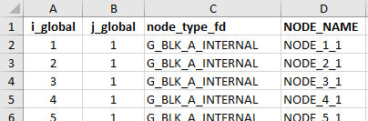
GLOBAL node i, j
Node TYPE
Node NAME

Slide 54








G_BLK_C_N
${\dot{Q}}_{NC}$
$$T_{m−1,n}$$
$$T_{m,n}$$
$$T_{m+1,n}$$
Y
${\dot{Q}}_{E}$
X
${\dot{Q}}_{W}$
${\dot{Q}}_{S}$
$$T_{m,n−1}$$

Slide 55
NO Insulation

Slide 56






xLB
Y
$$h_{ROOF}$$
$$T_{ROOF}$$
X
JOIST
yLB
$$k_{B}$$
xLC
yLA
$$k_{A}$$
CEILING
O
xLA
$$h_{CEIL}$$
$$T_{CEIL}$$

Slide 57
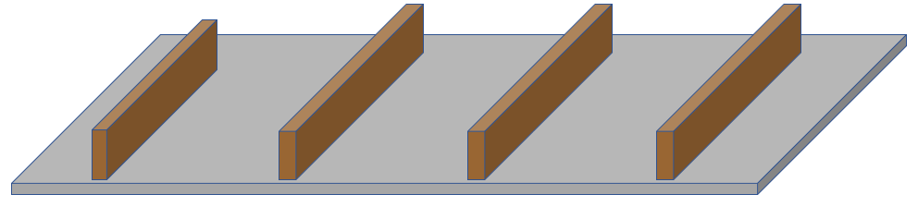
Roof Cavity
Wooden joists
Ceiling sheet
(e.g.: gypsum)
Living Room

