Slide 1




CINECA AGENTIC PLATFORM
An Enterprise-Grade Multi-Tenant AI Orchestrator with MCP Tools and Secure Graph Querying
Department:
Information Engineering, Electronics and Telecommunications
University Advisor:
Prof. Maria De Marsico
University Co-Advisors: Prof. Marco Raoul Marini
Dr. Valerio Venanzi
University:
Sapienza University of Rome
Academic Year:
2025/2026
Author:
Arman Feili
Company:
CINECA
Cineca Advisors: Dr. Giuseppe Melfi
Dr. Marco Puccini
All rights relating to this teaching material and its contents are reserved by Sapienza and its authors (or teachers who produced it). Personal use of the same by the student for study purposes is permitted. Its dissemination, duplication, assignment, transmission, distribution to third parties or to the public is absolutely prohibited under penalty of the sanctions applicable by law.

Slide 2
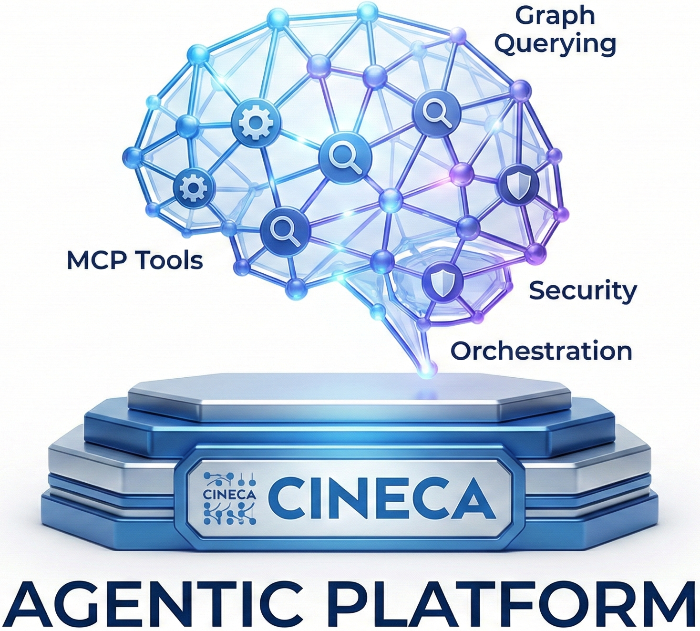
TABLE OF CONTENT
Overview of the presentation structure
Production Gap
System Workflow & Platform Architecture
What Was Delivered
UI, Security & API Layer
Job Execution & Orchestrator
LLM Providers, MCP Tools & Data Layer
Background Tasks & Observability
Validation, Results & Comparison
Conclusion & Future Work

Slide 3
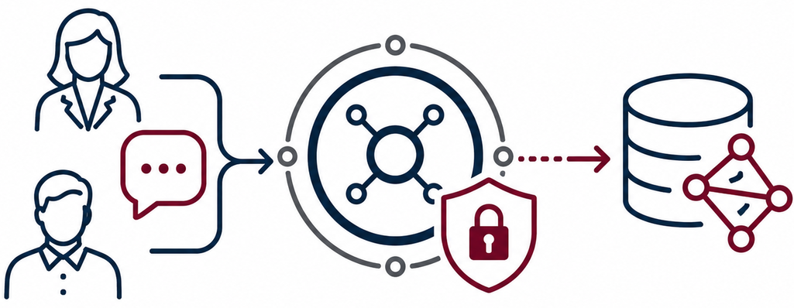
PROBLEM & MOTIVATION
Production gap
The problem
Users need natural-language access to graph data, but current tools are too technical and not secure.
Most users cannot write Cypher to access Graph data.
Researchers often depend on developers to access it.
This creates delays and keeps data locked.
Simple chatbots lack
Multi-step execution
Secure database and tool access
RBAC and tenant isolation
Audit logs and reproducible results
Solution
CINECA needs a platform that turns natural-language requests into secure, traceable, and reproducible graph actions, while staying scalable and flexible across LLM providers.

Slide 4
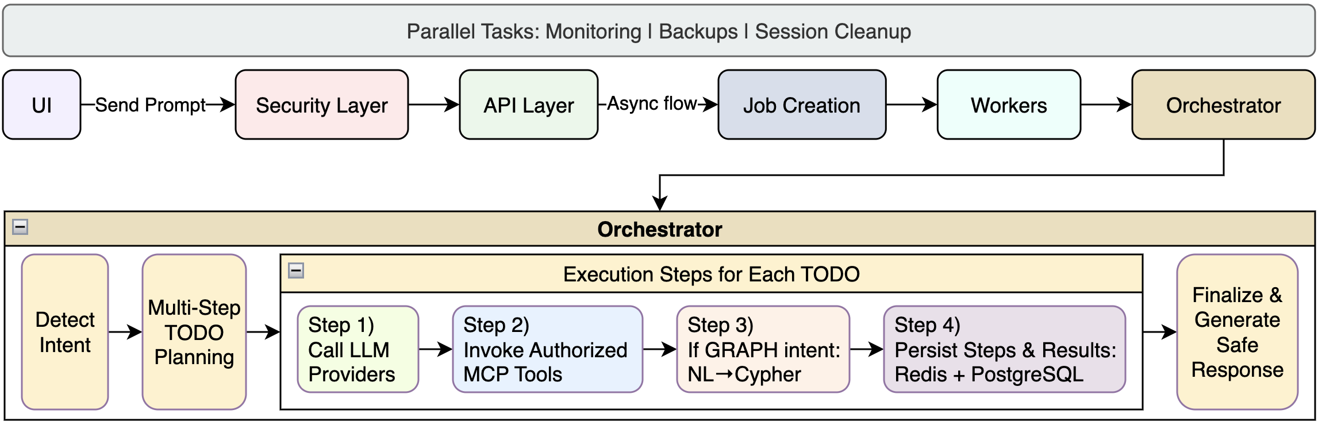
SYSTEM WORKFLOW
Platform Architecture

Slide 5
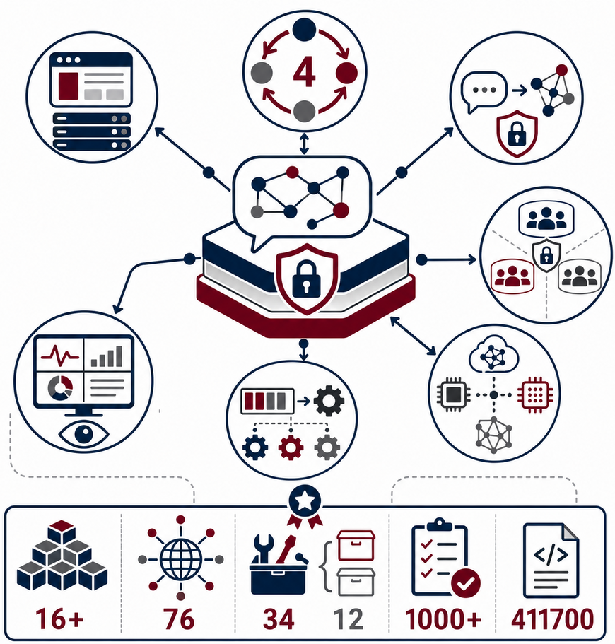
WHAT WAS DELIVERED
A production-ready agentic platform for secure natural-language access to graph data.
Core Delivery
Production Evidence
16+ components
76 endpoints
34 MCP tools / 12 categories
1,000+ tests
~411,700 LOC
4-phase orchestration
Full-stack platform
Secure NL→Cypher
Multi-tenant governance
Resilience and observability
Model-agnostic LLM support
Async jobs and workers

Slide 6
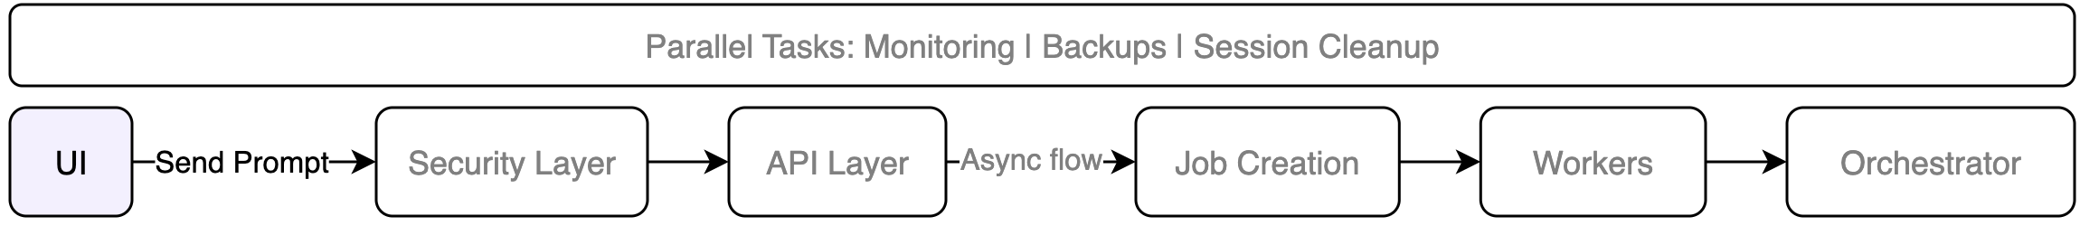
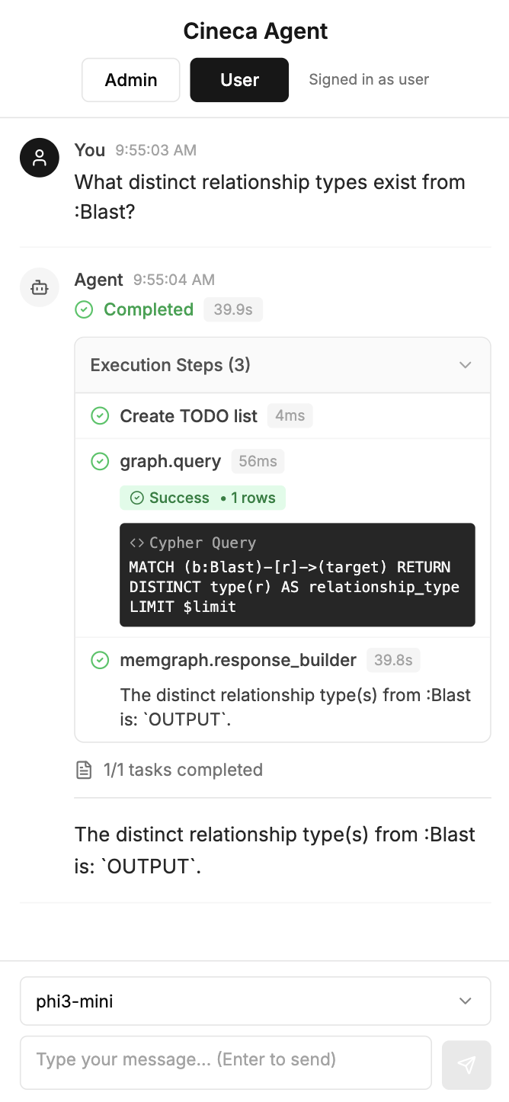
UI
Admin & User chatbot UI
Main Flow
Users sign in through an identity provider, receive a JWT, and access the platform through a secure gateway.
Agent Chat UI
Built with Next.js
Natural-language interaction
Authenticated backend requests
Live progress and execution steps
Final results and selected model
Identity & Access
OAuth 2.0 login & JWT-based authentication
Tenant, role, and permission check on every request (RBAC)
Role | agent-runs | jobs | tools | tenants | Graph (write)
admin | CRUD | CRUD | CRUD | CRUD | ✓
user | CR | CRD | R | ✗ | ✗

Slide 7
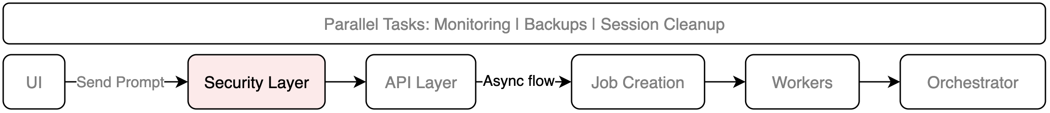
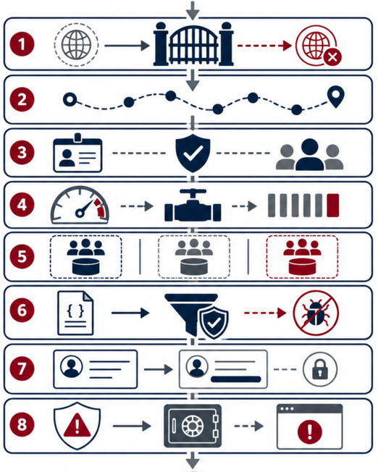
SECURITY LAYER
8 protection layers before business logic
Request Protection Layers
1. CORS Handler Trusted origins only
2. Trace Context End-to-end request tracking
3. JWT Auth + RBAC Verified identity and permissions
4. Rate Limiter Abuse and overload protection
5. Tenant Resolver Multi-tenant data isolation
6. Input Guard Request validation and injection blocking
7. Output Guard Response sanitization and PII redaction
8. Error Handler Safe, standardized error responses

Slide 8
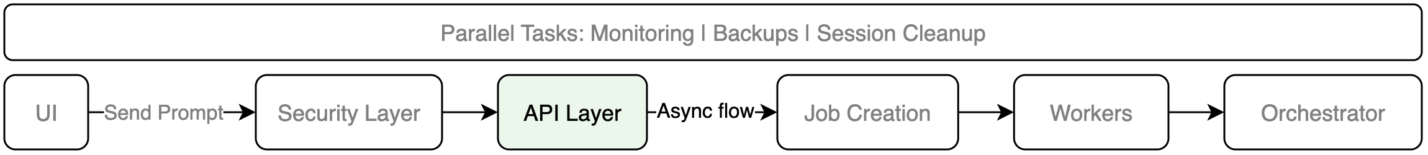
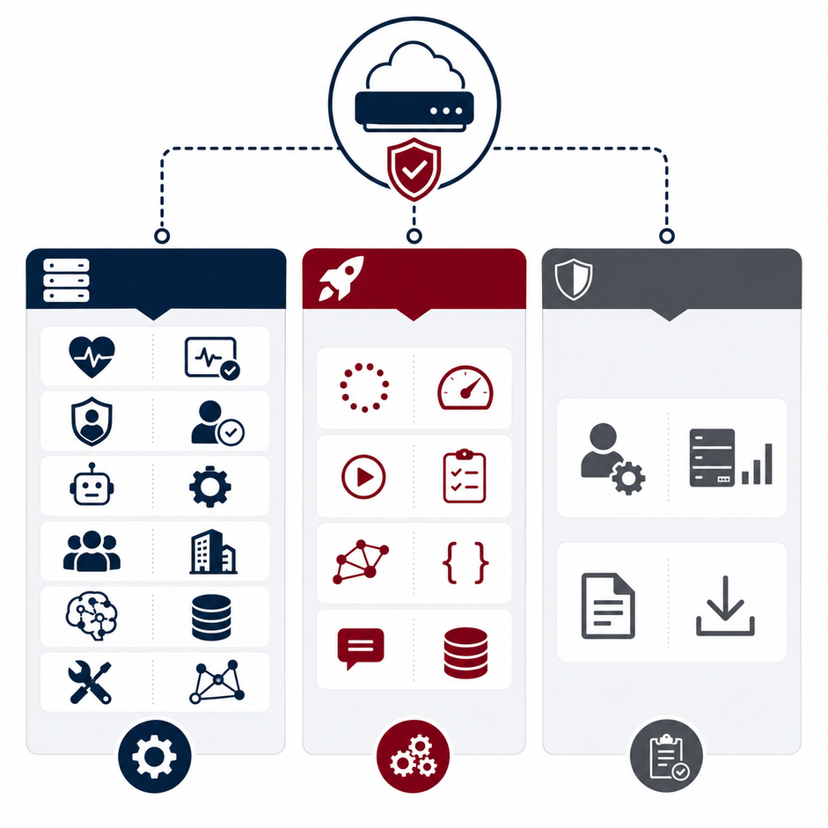
API LAYER - ROUTERS
76 endpoints
Core Platform APIs
Health checks — service and dependency status
Authentication — token validation and user identity
Agents — agent definitions and configuration
Tenants — tenant settings, limits, and feature control
Models — LLM provider and model management
Tools — MCP tool discovery and invocation
Execution APIs
Jobs — async tasks, progress streaming, cancellation
Agent runs — run lifecycle, status, results, cancellation
Graph — Cypher and NL→Cypher execution
Sessions — conversation and runtime context
Operational APIs
Admin — maintenance, cache control, system stats
Export — runs, job results, and audit logs
Core
Execution
Operational

Slide 9
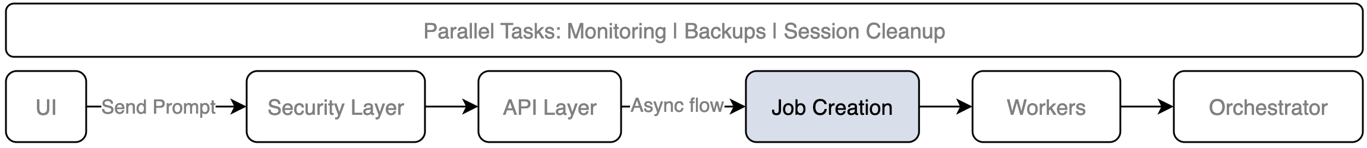
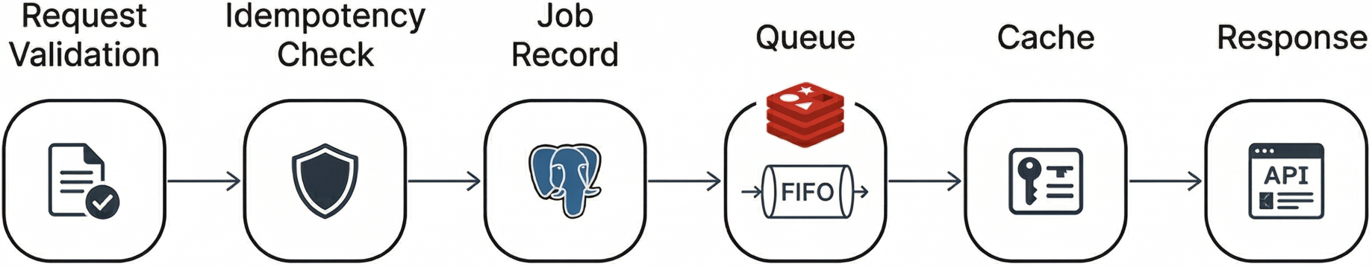
JOB CREATION
Safe intake for long-running tasks
Creation Flow
Request validation — required fields and payload structure
Idempotency check — duplicate prevention on retries
Durable job record — PostgreSQL job with status = queued
Redis queueing — job ID pushed for worker execution
Fast retry cache — idempotency key → job ID
Async response — HTTP 202 Accepted with job ID and status

Slide 10
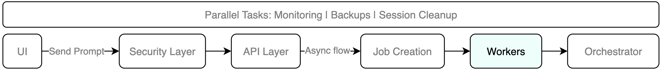
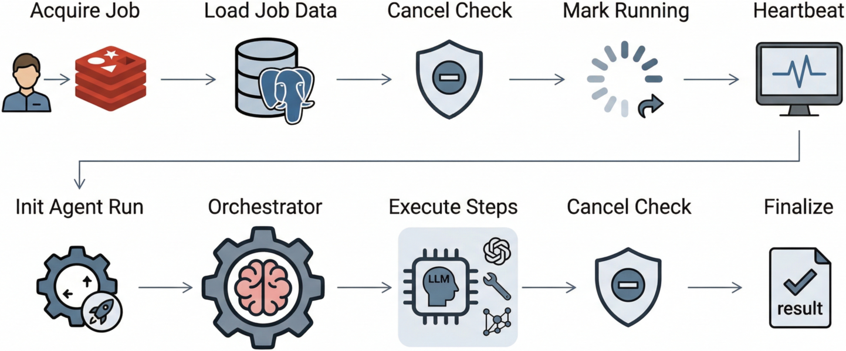
WORKERS
Reliable job execution
Worker Lifecycle
1. Acquire queued job → exclusive Redis ownership
2. Load job metadata → PostgreSQL as source of truth
3. Check cancellation → skip safely if already cancelled
4. Mark as running → auditable status transition
5. Start heartbeat → stuck-worker detection
Agent Run Execution
6. Initialize AgentRun → link job and run records
7. Run orchestrator → step-by-step workflow execution
8. Execute and persist LLM / tool / graph steps
9. Stream live updates → progress events to the UI
10. Finalize safely → output guards, metrics, final status

Slide 11
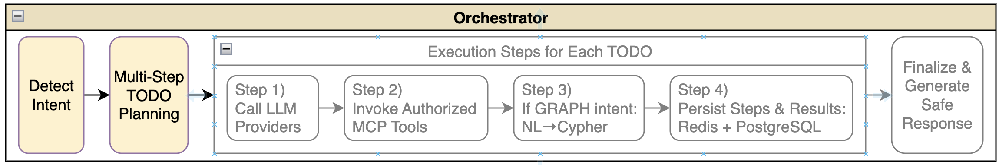
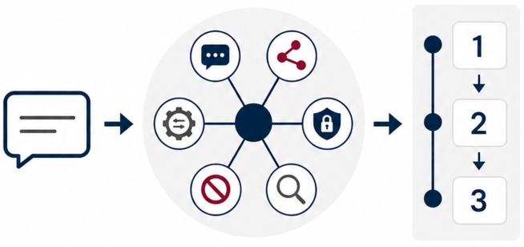
ORCHESTRATOR (Part 1/3)
Intent detection & Multi-step planning
Phase 1 — Intent Classification
1 LLM call for classification
Intent Types:
CHAT — conversational response
GRAPH — NL→Cypher query
SECURITY — permission and access questions
ADMIN — administrative actions
DANGEROUS — refused safely
EXPLAIN — analysis without execution
Phase 2 — TODO Planning
Multi-step task decomposition
Context-aware planning
Schema and tool awareness
Structured action sequence
Example flow: query → analyze → summarize

Slide 12
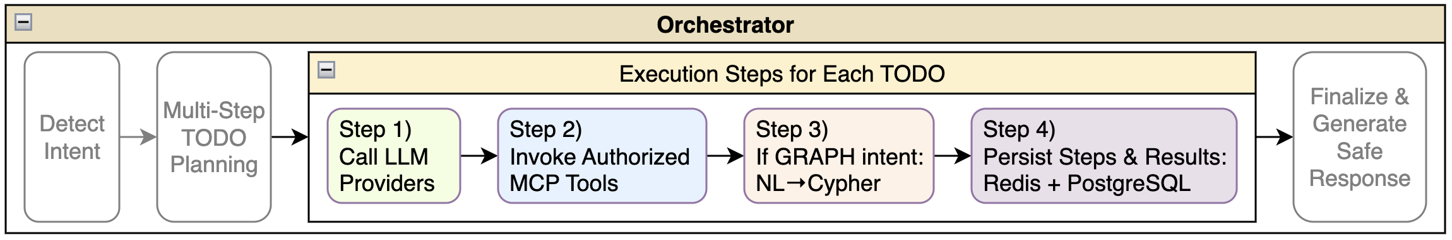
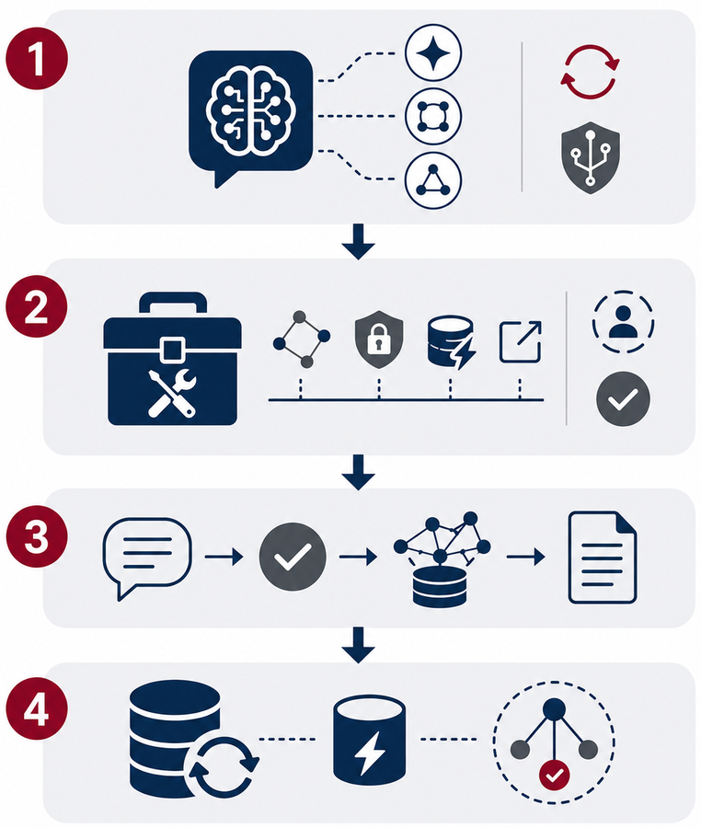
ORCHESTRATOR (Part 2/3)
Step Execution
Phase 3: Step-by-Step Execution
1. Call LLM providers
Planning, checking, and response generation
Retries, fallbacks, and circuit breakers
2. Invoke MCP tools
Graph, security, cache, export, and system actions
Session-aware tool execution
Permission checks and runtime context
3. Graph pipeline
NL→Cypher generation, validation, execution, and summarization
4. Progress persistence
PostgreSQL for traceability and recovery
Redis for caching, runtime coordination, and cancellation checks

Slide 13
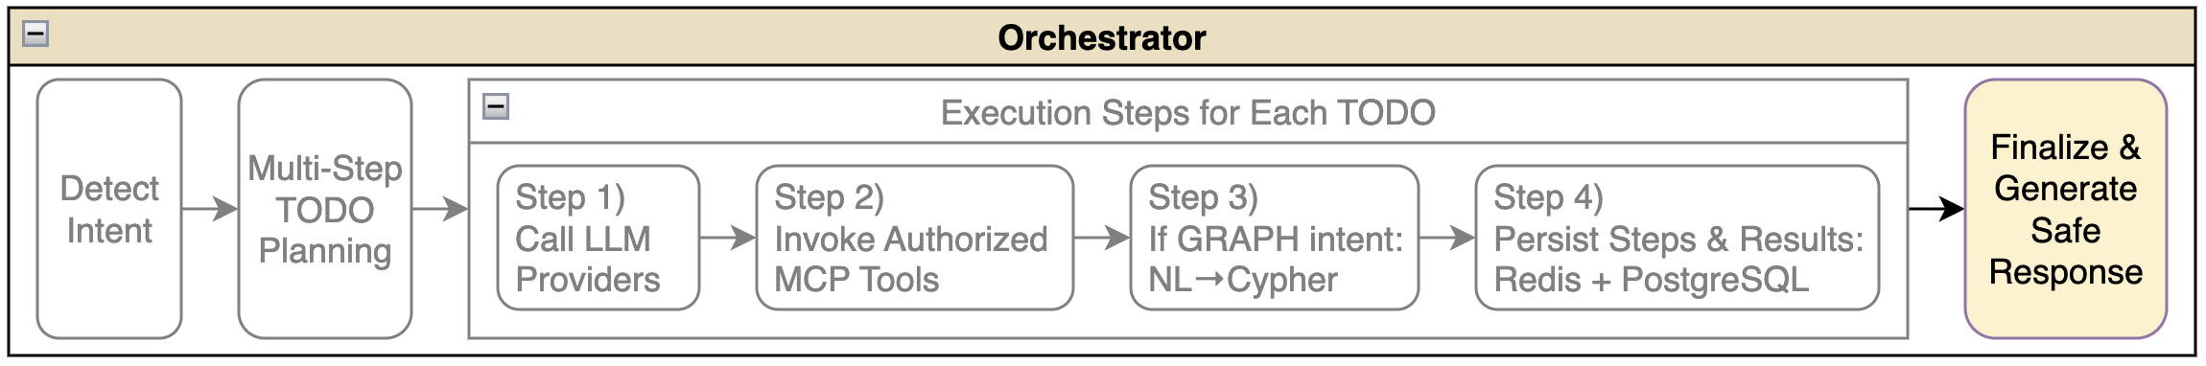
ORCHESTRATOR (Part 3/3) Finalization & Safe Response Generation
Safety checks Sensitive data removal and unsafe content filtering
Final state persistence Status, output, and metrics saved to PostgreSQL
Observability data Metrics and traces for dashboards, debugging, and monitoring
Phase 4: Final Output Pipeline - structured, persisted, safe, and observable
Response assembly Completed step outputs combined into one answer
Fallback handling Cached or default response when needed
Output normalization Consistent text and optional JSON format
{
"goal": "Find collaborating institutions",
"steps": [step1, step2, step3],
"outputs": ["Found 5 institutions..."],
"todos": [completed_todo1, completed_todo2],
"metrics": { "duration_ms": 2340, "tokens": 1850 }
}

Slide 14
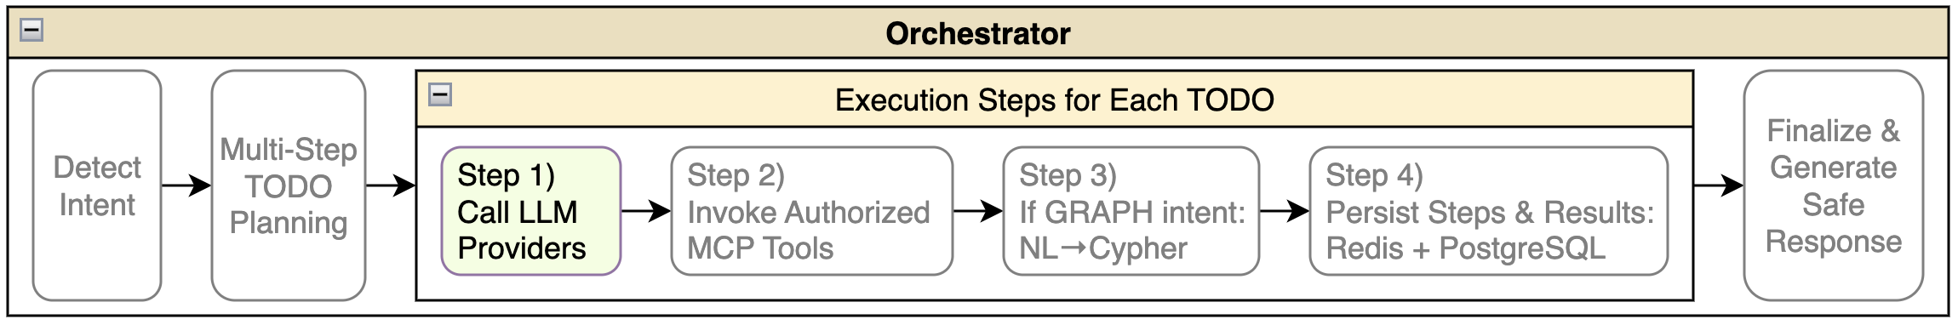
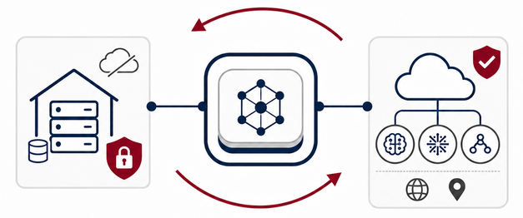
LLM PROVIDERS Model Selection
Provider Options
Local models — Ollama, self-hosted open models
Cloud models — OpenAI, Azure OpenAI, compatible providers
Provider flexibility — same platform logic, different model backends
No vendor lock-in — switch providers without changing orchestration logic
Why It Matters
Data control
Lower cost options
Offline or private deployment
Managed cloud quality
Enterprise compliance
Regional hosting
Model Selection Hierarchy:
Request-level override
↓ (if not set)
Session-level default
↓ (if not set)
Tenant-level default
↓ (if not set)
Global platform default

Slide 15
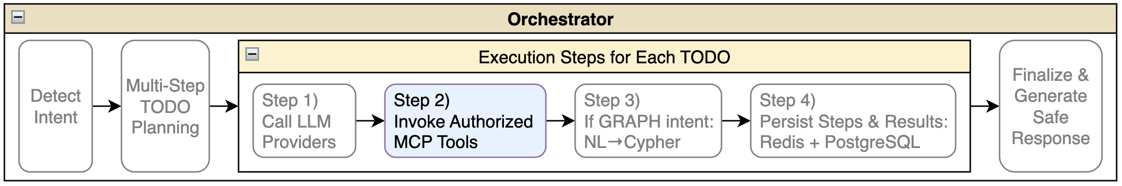
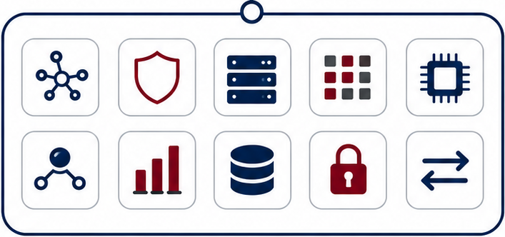

MCP RUNTIME & TOOLS 34 tools across 12 categories
Core Runtime Ideas
Tool registry — schemas, scopes, limits
Permission checks — RBAC before execution
Schema validation — structured and safe inputs
Audited execution — every tool call recorded
Controlled results — safe outputs returned to the agent
Tool Invocation Flow
Request → Validate → Authorize → Execute → Audit → Return
Main Tool Categories
Graph — Memgraph, schema, Cypher
Security — identity, permissions, access checks
System — health, metrics, configuration
Catalog — tools, resources, schemas
Model — list, inspect, warm up, switch
Agent — context, history, session state
Analytics — aggregations and visualization data
Admin — restricted operations
ETL / CRUD / Export — import, update, export

Slide 16
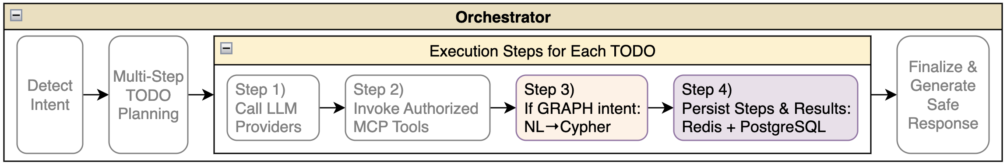
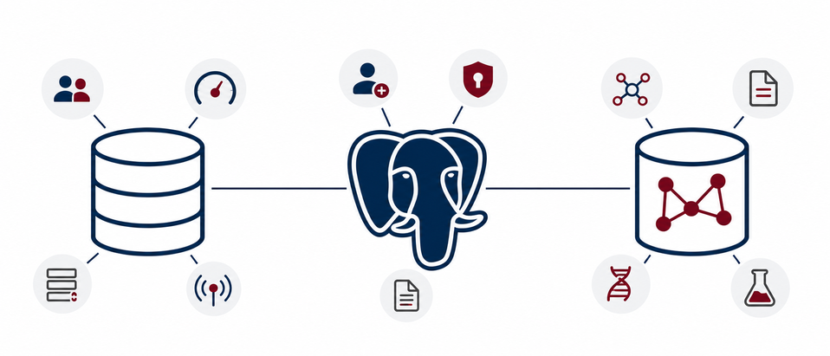
DATA LAYER REDIS, POSTGRESQL, MEMGRAPH
Redis — Real-Time Runtime State
Cache and sessions
Tenant and model defaults
Rate limits
Job queues and progress events
Cancellation and idempotency
Circuit-breaker state
PostgreSQL — Durable Platform State
Tenants, sessions, runs, steps, jobs
Job events and tool invocations
Model and provider configuration
Encrypted secrets
Audit logs
Idempotency records
Memgraph — Bioinformatics Graph State
Connected graph entities
Users, institutions, tasks, files, datasets
Genes, proteins, pathways, workflows, results
Relationships: WORKS_AT, RUNS, INPUT, OUTPUT
Cypher queries and graph metadata

Slide 17
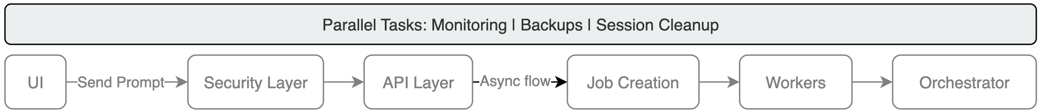
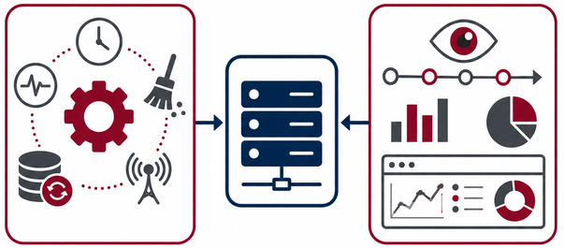
BACKGROUND TASKS Monitoring | Backups | Session Cleanup
Background Automation
APScheduler
Health checks
Session and cache cleanup
Completed job cleanup
Daily backups
Provider monitoring
Circuit-breaker updates
Observability Stack
OpenTelemetry — end-to-end traces
Prometheus — platform and worker metrics
Grafana — dashboards and operational views
Operational Value
System health visibility
Slow request diagnosis
Failed tool detection
Provider health monitoring
Queue depth and cost tracking
Recovery and debugging support

Slide 18
VALIDATION & RESULTS End-to-end verification
How was the platform validated?
1,000+ automated tests for core logic and E2E workflows
Verified lifecycle, async execution, streaming, cancellation, RBAC, tenancy, and guards
Full NL→Graph path tested: Natural language → GRAPH intent → Cypher generation → safety validation → Memgraph execution → final answer
Example:
"Count Blast nodes grouped by presence of blast_version"
1. Classify intent → GRAPH
2. Generate Cypher→
MATCH (b:Blast) RETURN b.blast_version IS NOT NULL AS has_blast_version, count(b) AS count ORDER BY has_blast_version DESC
3. Validate → ✓ Read-only ✓ Tenant ✓ Depth ✓ Timeout
4. Cypher Execution → Returns 1 row
5. Summarize → "In total, there are 39 Blast nodes in the database. All containing the blast_version attribute."

Slide 19
COMPARISON WITH STATE OF THE ART
Why Cineca Agentic Platform
Platform | Full Stack | Agentic Planning | Governed Tools | Enterprise Security | Graph NL→Cypher | Observability | Summary
CAP | ✓ | ✓ | ✓ | ✓ | ✓ | ✓ | Integrated production platform
Temporal | ✗ | ✗ | ✗ | ✓ | ✗ | ✓ | strong workflows, not agent platforms
LangGraph | ✗ | ✓ | ~ | ✗ | ~ | ~ | Strong agent framework, limited platform controls
OpenAI Agents SDK | ✗ | ✓ | ~ | ✗ | ~ | ~ | Fast agent development, Lacks integrated security layer
Semantic Kernel | ✗ | ✓ | ~ | ~ | ~ | ~ | Enterprise AI middleware, Partial support across platform capabilities
n8n | ✓ | ~ | ~ | ~ | ✗ | ~ | Visual workflow automation, Not designed for governed agent orchestration
Main takeaway:
CAP combines agent execution, tools, jobs, graph access, security, and observability in one platform.
✓ = Native support
~ = Partial / requires customization
✗ = Not supported

Slide 20
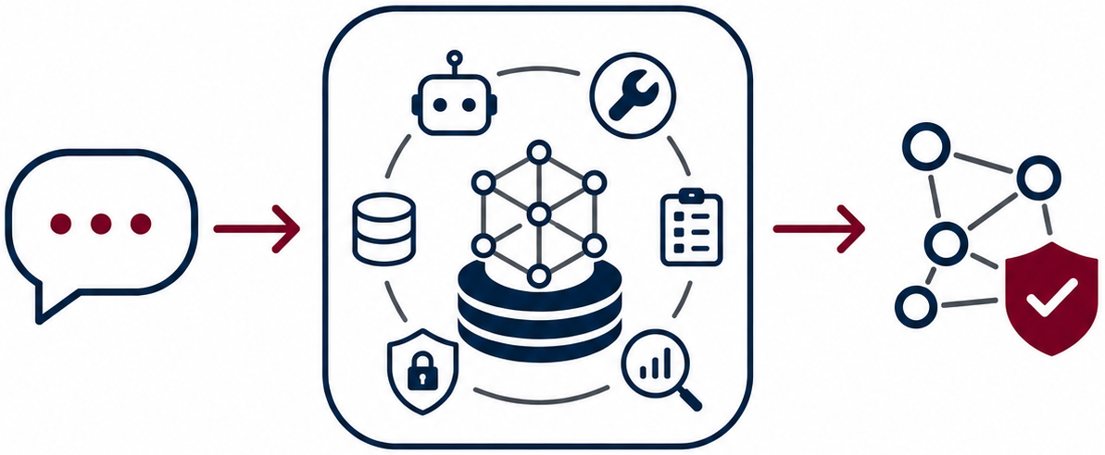
CONCLUSION + FUTURE WORK
From natural language to safe, traceable graph actions
Key Contribution
Built a multi-tenant AI orchestration platform
Unified agents, MCP tools, async jobs, secure graph access, and observability
Enabled governed, auditable, and reproducible natural-language graph actions
Future Work
Lightweight Ask Mode
Broader prompt handling
Stronger checkpointing and deterministic re-runs
Smarter scheduling with priorities, quotas, and backpressure

Slide 21
THANK YOU FOR YOUR ATTENTION
Feel free to ask any question

Slide 22
BACKUP SLIDES

Slide 23
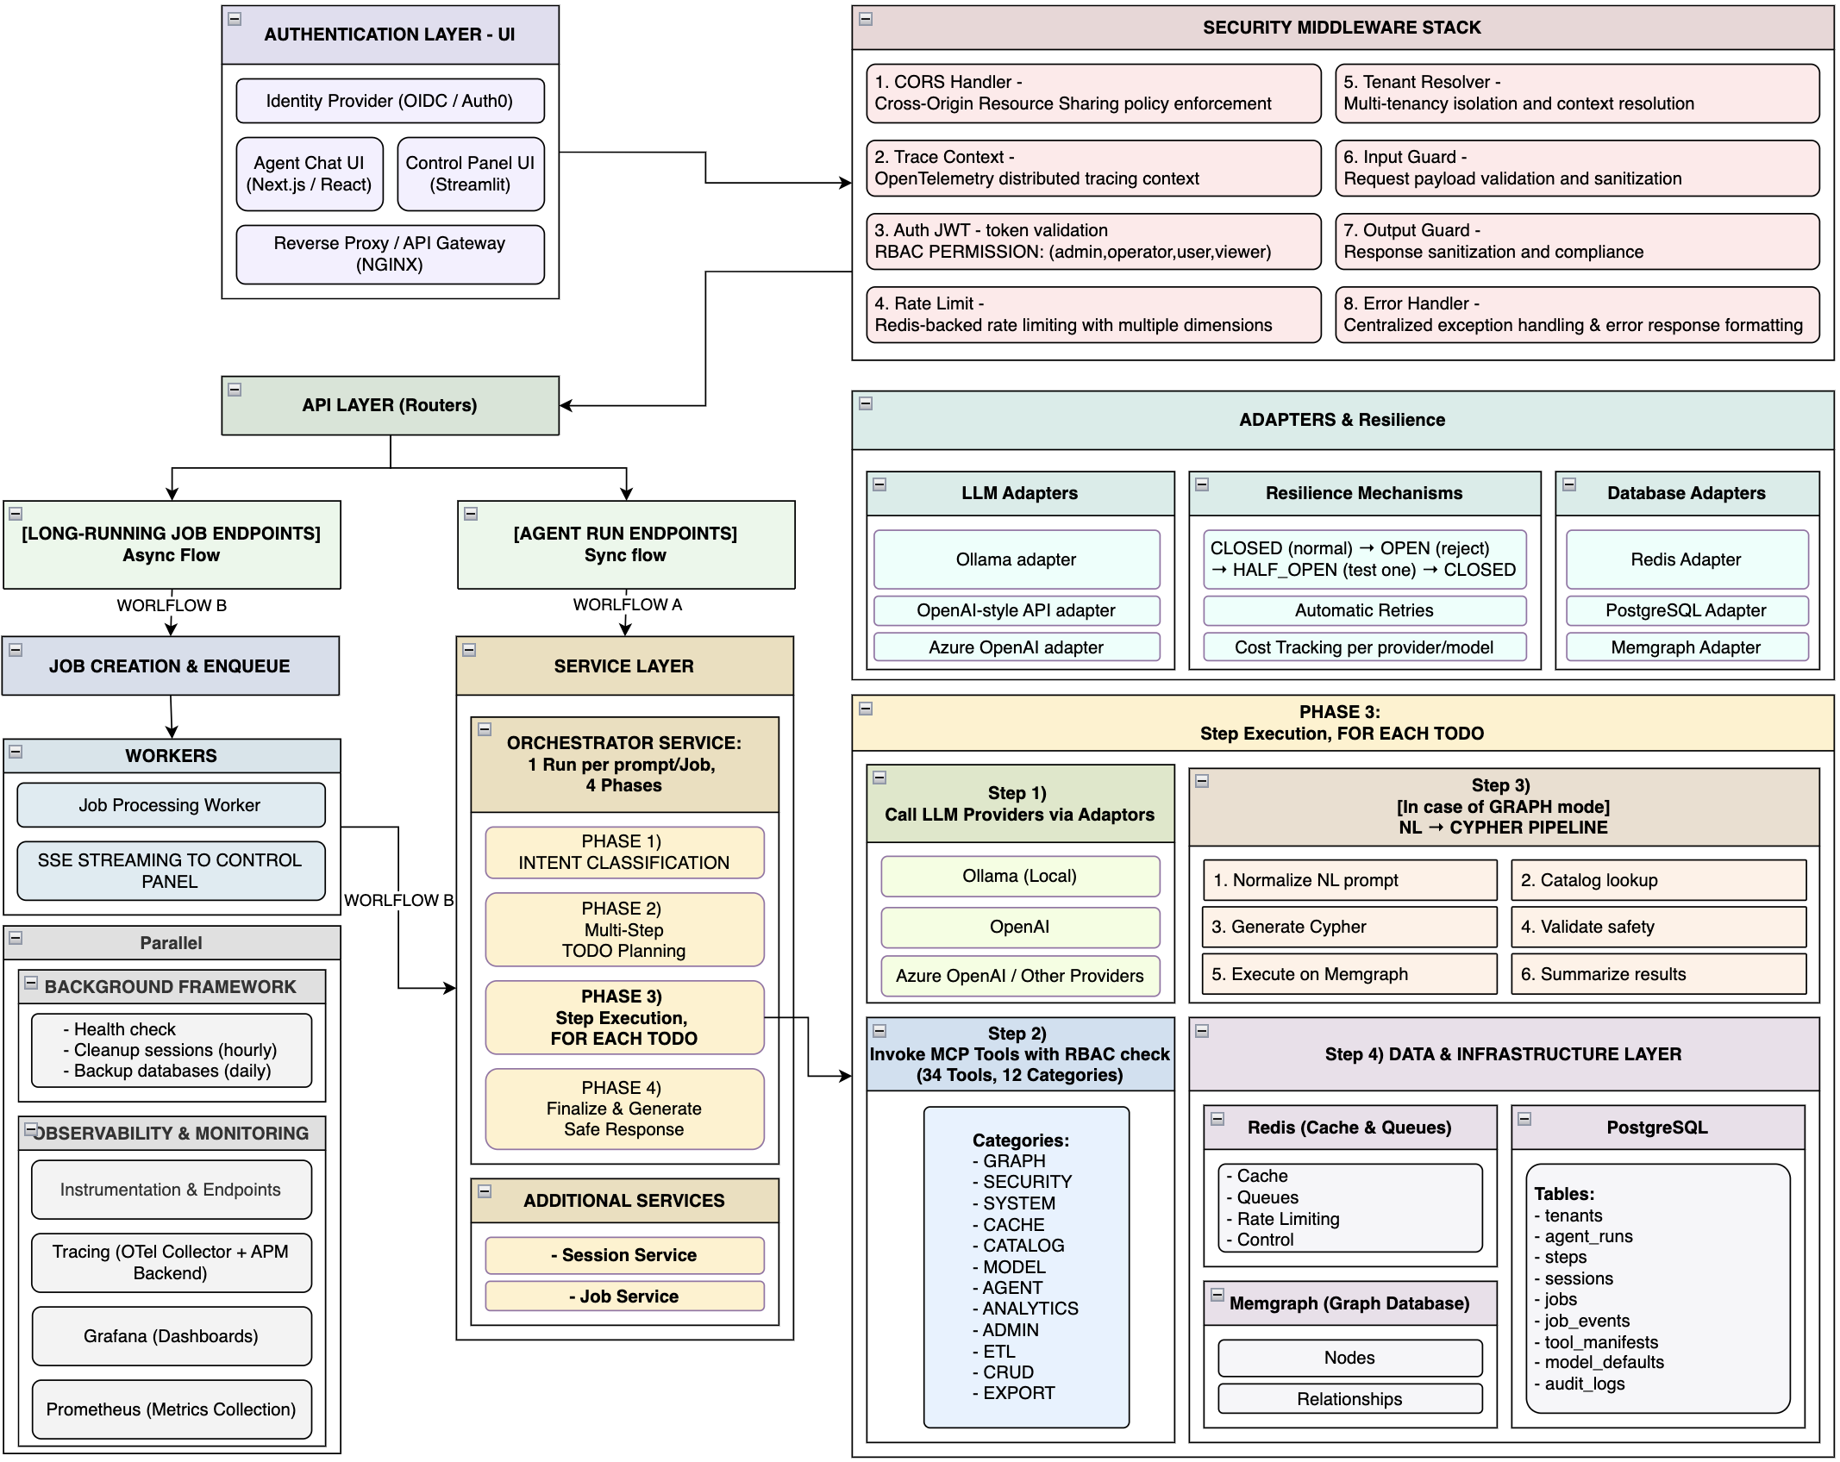
Backup Slides - Detailed System Architecture

Slide 24
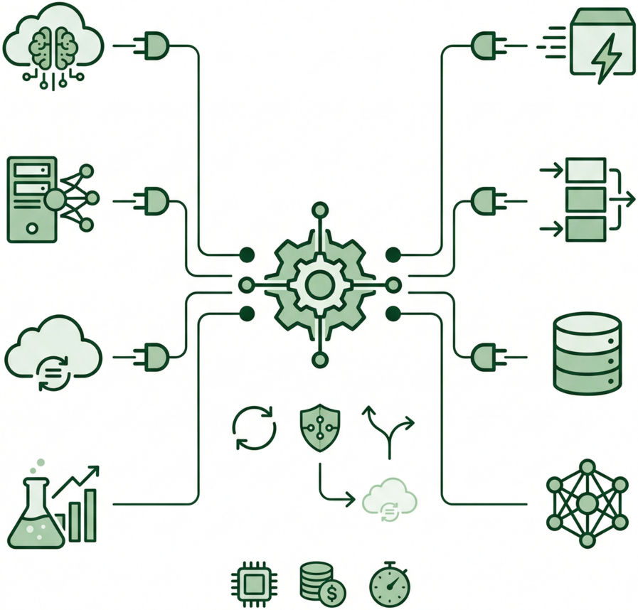
ADAPTERS + RESILIENCE
Flexible integrations with automatic failure handling
Swappable Adapters
Vendor-independent business logic
Unified LLM interface
Ollama, OpenAI, Azure, stub/demo providers
Unified database access
Redis, PostgreSQL, Memgraph adapters
Backend changes without orchestrator rewrites
Resilience Mechanisms
Retries with backoff
Circuit breakers
Provider fallback
Fail-fast behavior
Closed → Open → Half-open recovery
Operational Tracking
Token usage
Cost tracking
Latency measurement
Monitoring and budgeting

