Slide 1




CINECA AGENTIC PLATFORM
An Enterprise-Grade Multi-Tenant AI Orchestrator with MCP Tools and Secure Graph Querying
Department:
Information Engineering, Electronics and Telecommunications
University Advisor:
Prof. Maria De Marsico
University Co-Advisors: Prof. Marco Raoul Marini
Dr. Valerio Venanzi
University:
Sapienza University of Rome
Academic Year:
2025/2026
Author:
Arman Feili
Company:
CINECA
CINECA Advisors: Dr. Giuseppe Melfi
Dr. Marco Puccini
All rights relating to this teaching material and its contents are reserved by Sapienza and its authors (or teachers who produced it). Personal use of the same by the student for study purposes is permitted. Its dissemination, duplication, assignment, transmission, distribution to third parties or to the public is absolutely prohibited under penalty of the sanctions applicable by law.
Notes:
Hi good morning, I’m Arman Feili, and today I want to talk about the thesis project that I did in Cineca, which was Cineca Agentic Platform: An entriprise-grade Multi-Tenant AI Orchestrator with MCP tools and Secure Graph Querying.

Slide 2

TABLE OF CONTENTS
Presentation structure
Production Gap
What Was Delivered
System Workflow & Platform Architecture
UI, Security & API Layer
Job Execution & Orchestrator
Validation, Results & Comparison
Conclusion & Future Work
Q&A
Notes:
Here are the step by step categories and titles that I’m gonna talk about in this presentation.

Slide 3
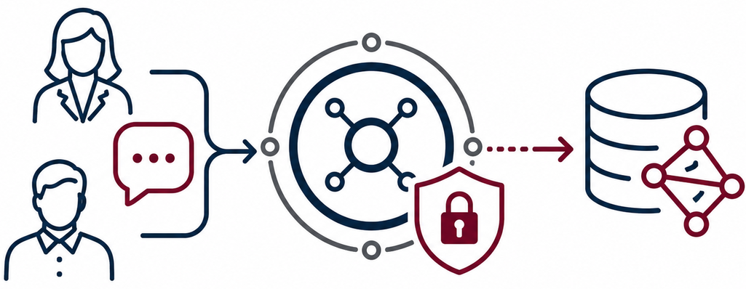
PROBLEM & MOTIVATION
Production gap
The problem
Users need to access the Bioinformatic graph data, but they might not know how to write Cypher commands.
They might depend on developers to access it.
This creates delays and keeps data locked.
There is a need for a secured and not too technical tool.
Solution
CINECA needs an agentic platform that turns natural-language requests into secure, traceable, and reproducible graph commands, while staying scalable and flexible across LLM providers.
Why an Agentic Platform?
Because simple chatbots lack:
Multi-step execution
Secure database and tool access
RBAC and tenant isolation
Notes:
Let’s start with the Production Gap
The problem that I had to fix in this project was that,
Users might want to have access to the Graph Data bases, but they cannot write Cypher commands
So they are depended on developers that it causes delay.
Also current tools are too technical or not quite secured.
The solution to this gap is an Agnetic system that can converts Natural language to Cypher command, in a secure, traceable, and reproducible way,
Which is scalable and flexible with different LLM providers.
But Why Agentic?
Because the simple chatbots, doesn’t have Multi-step execution, or RBAC and Tenant isolation

Slide 4
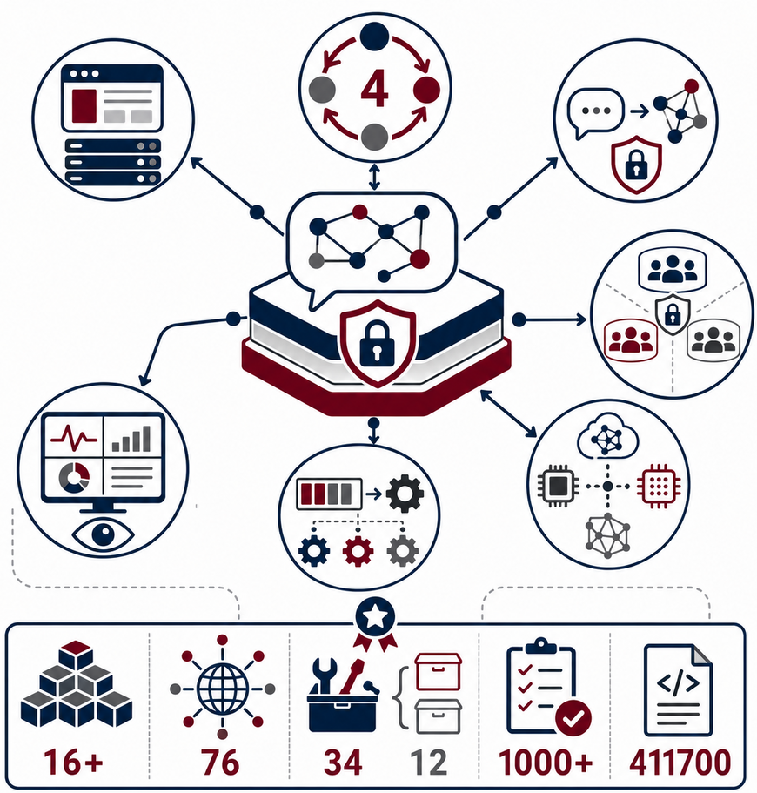
WHAT WAS DELIVERED
A production-ready agentic platform for secure natural-language access to graph data.
Core Delivery
4-phase orchestration
Full-stack platform
Secure NL→Cypher pipeline
Multi-tenant isolation support
Monitoring System
Multi-model support for LLM
Async jobs and workers
Docker Components Endpoints MCP tools Tests Lines of Code
Notes:
In this Agentic platform I delivered:
a full stack platform,
a 4 step orchestrator,
A secured NL to Cypher pipeline
Multi Tenant isolation
Multi LLM model support
Async jobs and workers
It has 16 docker components, 76 API endpoints, 34 MCP tools in 12 categories, more than 1000 unit tests, and around 4 hundred thousands lines of code.

Slide 5
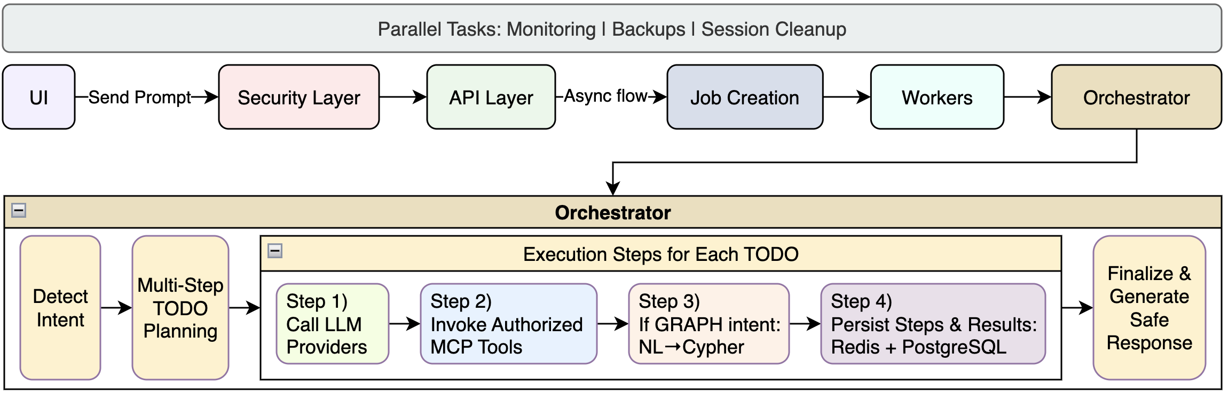
SYSTEM WORKFLOW
Platform Architecture
Notes:
Here we have a full system workflow from the beginning to the end of the process.
First we have the UI, where the user sends the prompt,
and then we have an 8 layer security layer, that I’m gonna discuss about it later,
Then we have API layer. That is responsible sending the prompt via request and receiving the responses,
Then we have the Job Creation, that is added to a queue, and then
Each worker will try to run each job sequentially,
Then we have the orchestrator, as the main process of the app
In the orchestrator, we first detect the intention of the prompt,
Then based on that intention, we create a multi-step planning as TODOs,
For each todo, we have a loop of calling LLM, invoking related MCP tools with RBAC chech,
and then if the intention was generating the cypher, it will convert NL to Cypher
And then store the steps and results,
And eventually generates the final response.
We’re gonna talk more about these steps in details in next steps.

Slide 6
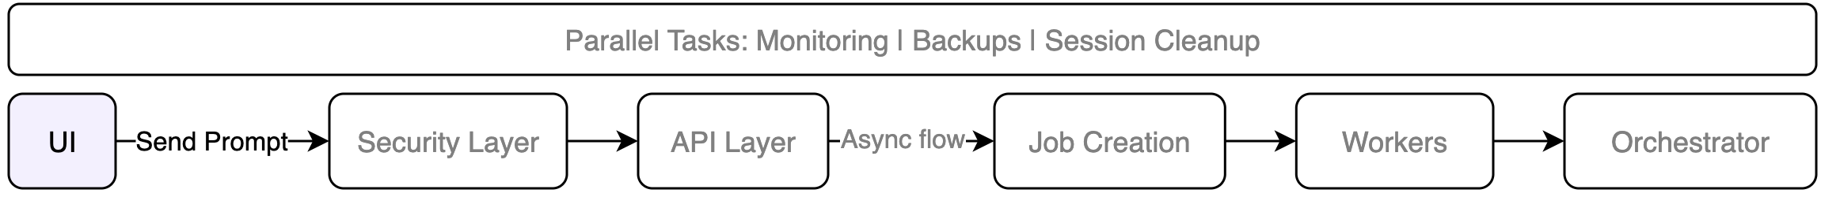
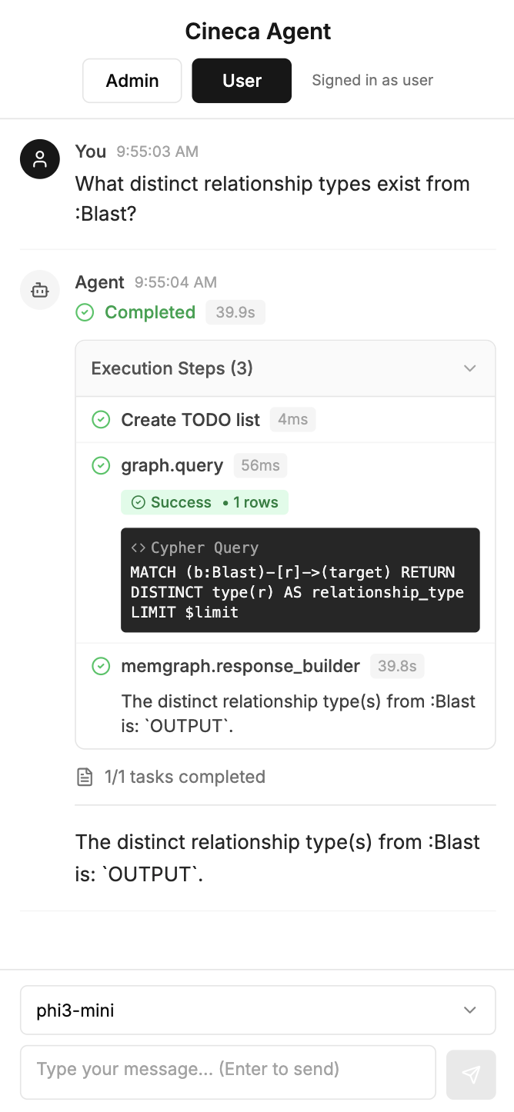
UI
Admin & User chatbot UI
Main Flow Users log in, choose model, send the prompt, see the live progress and the result.
Agent Chat UI
Built with Next.js
Have a text box and selected model
Shows live progress and execution steps
Give final result
Identity & Access
Uses OAuth 2.0 as a 3rd party service for defining roles and scopes
Does JWT-based Authentication and Authorization
Control Tenant, role, and permissions through RBAC
Role | agent-runs | jobs | tools | tenants | Graph (write)
admin | CRUD | CRUD | CRUD | CRUD | ✓
user | CR | CRD | R | ✗ | ✗
Notes:
Ok, let’s dive in to the first step
First, we have the UI, here is where the user sends the prompt as a request.
The system will receive the Json Web Token (JWT), and do the Authorization and Authentication
It is built in NextJs
Have a chat box for Natural language interaction
Shows live. Progress and execution steps
Gives the final result and the selected model.
It uses OAuth 2.0 as a 3rd party service for defining roles and scopes
It does JWT Aithentication and Authorization
And it defines Tenant, role, and permissions

Slide 7
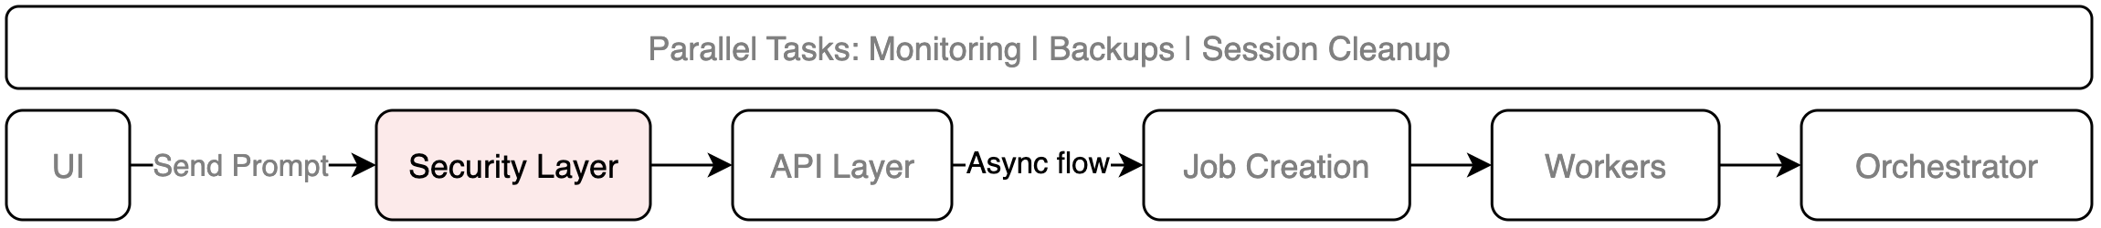
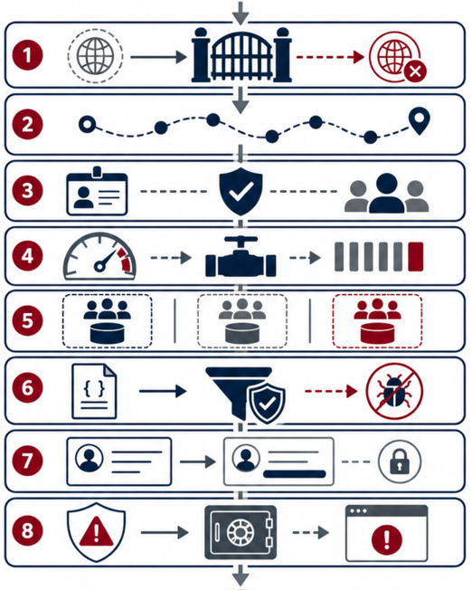
SECURITY LAYER
8 safeguards before business logic
Request Protection Layers
1. CORS Policy
Trusted origin URLs only
2. Trace Context
Adds trace ID for tracking
3. JWT + RBAC
Access control for Admin/User
4. Rate Limiting
Requests-per-minute control
5. Tenant Resolution
Organisation-level data isolation
6. Input Validation
Blocks unsafe requests and DB injection
7. Output Protection
Sensitive data removal
8. Standard Error Handling
Standardized safe error responses
Notes:
Then we have an 8. layer security level
CORS, is for checking the only trusted origins and urls
We also add a trace id for tracking each request since the start to the end of the pipeline
JWT for Role based Access Control (RBAC)
Rate Limiting for not too much requests
We have Tenant isolation, to isolate database access for the model and the users
We have Input validation to avoid Database Injection and dangerous prompts and requests
We have Output check for sensitive data control and removal
We have a standard Error handling structure for the errors and logging system

Slide 8
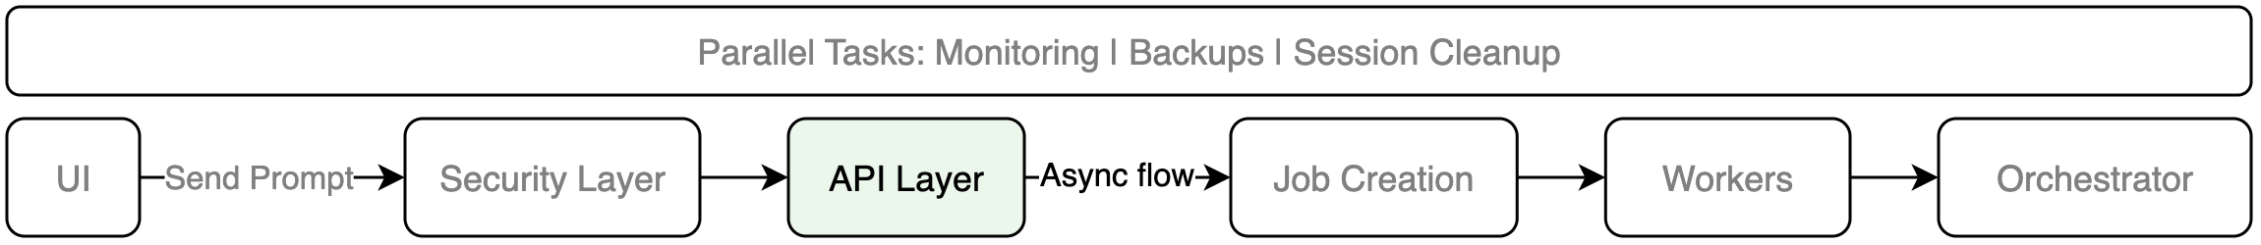
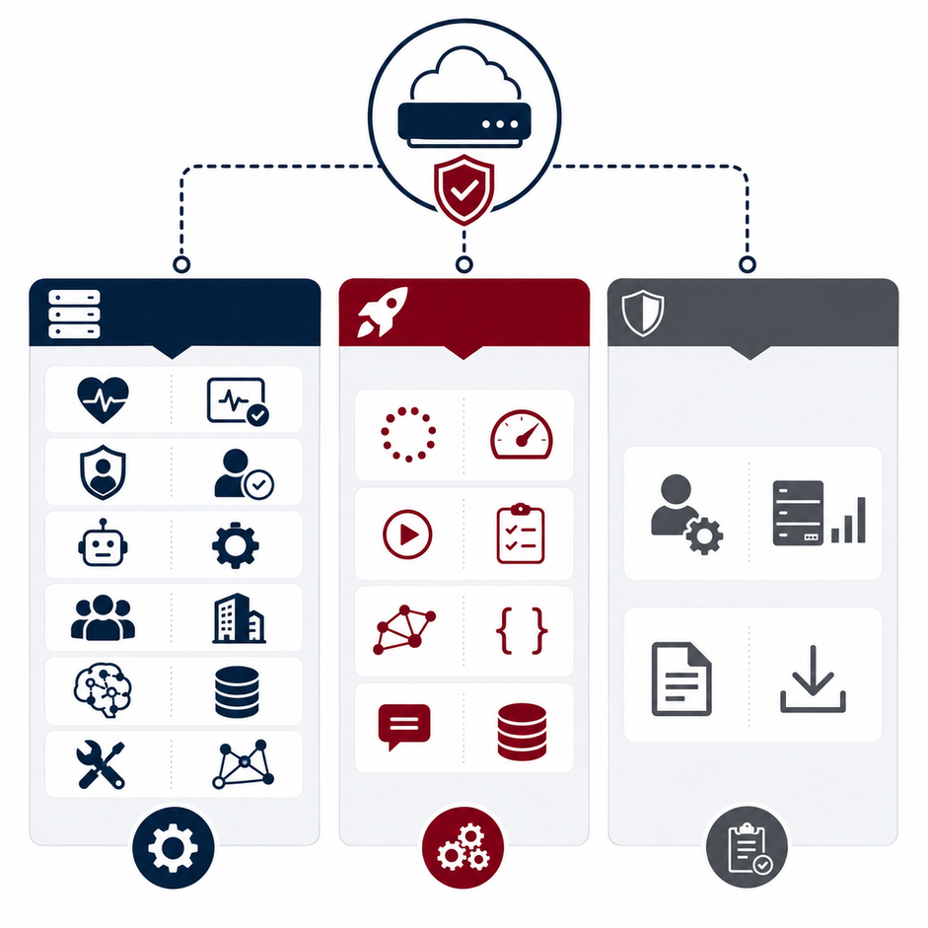
API LAYER - ROUTERS
76 endpoints
Core Platform APIs
Health → Checking the health of the system
Authentication → Validating JWT and roles of the users
Agents → Managing agent settings
Tenants → controlling tenant DB isolation and limits
Models → Choosing LLM providers and models
Tools → Invoking different MCP tools
Execution APIs
Jobs → Creating and seeing async jobs and progress
Orchestrator → Running Agent, Check status, and results
Graph → Executing Cypher commands
Sessions → managing conversation and runtime context
Operational APIs
Admin → Monitoring system and stats
Export → Exporting runs, job results, and logs
Core
Execution
Operational
Notes:
In the API layer, we have around 76 API endpoints in different categories
We have endpoints for…

Slide 9
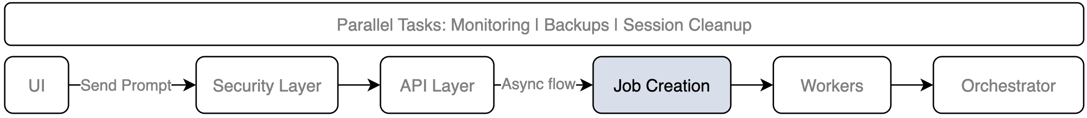
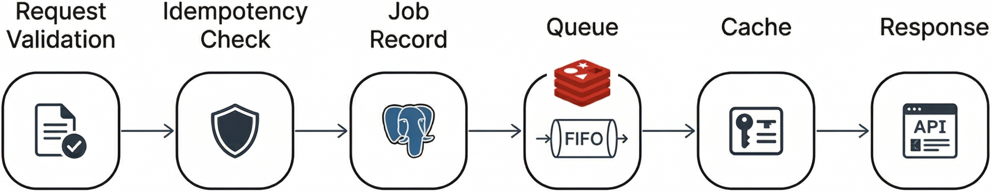
JOB CREATION
Long-running async task creation
For each request we create an async job in a Redis queue:
Request Validation → Checks required fields and payload structure
Idempotency Check → Prevents duplicate jobs during retries
Durable Job Record → Stores the job in PostgreSQL with status queued
Redis Queueing → Pushes the job ID to Redis queue for worker execution
Retry Cache → If job already existed, returns the existing job ID
Async Response → Returns HTTP 202 for Created or Accepted job ID and current status

Slide 10
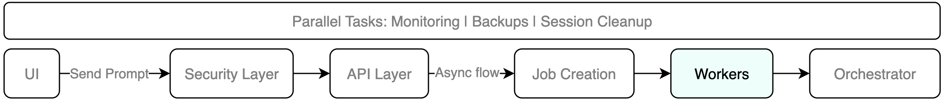
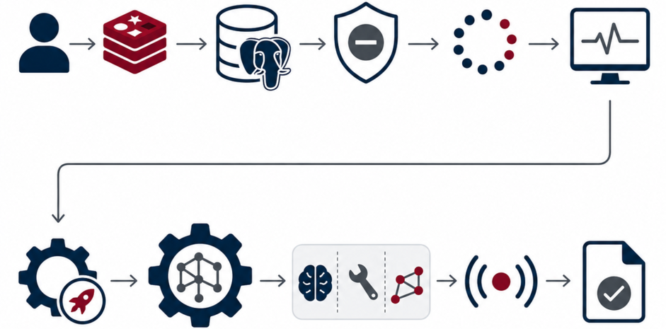
WORKERS
Job Processing Engine
Worker Lifecycle
Pull Job → locks a queued job in Redis for one worker
Load Job Data → reads job details from PostgreSQL
Cancel Check → if user cancels, it stops safely
Update Status → records the job status
Heartbeat → Every 30s, detects stuck workers
Agent Run Execution
Init Agent Run → Start the Agent for the job
Orchestrator → executes the workflow step by step
Store Steps → stores output of each step
Live Progress → sends live updates to the UI (SSE)
Finalize Job → applies guards, metrics, and final status

Slide 11
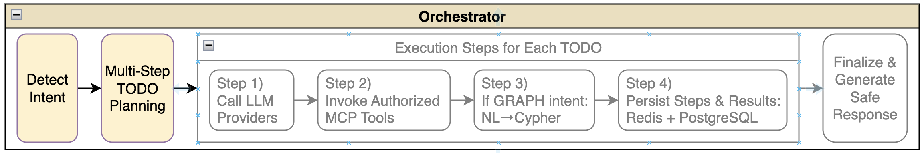
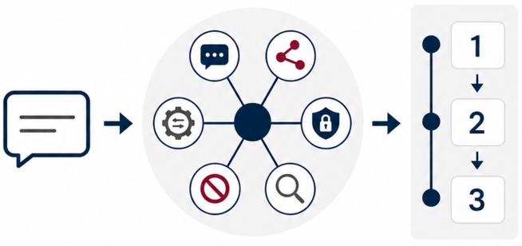
ORCHESTRATOR (Part 1/3)
Intent detection & Multi-step planning
Phase 1: Intent Classification One LLM call classifies the request.
CHAT → Conversational answer
GRAPH → NL→Cypher query
SECURITY → Access and permission request
ADMIN → Administrative action
DANGEROUS → Unsafe request, safely refused
EXPLAIN → Analysis without execution
Phase 2: TODO Planning
The orchestrator turns the request into a clear execution plan.
Breaks the request into smaller actions
Uses session context and previous messages
Selects relevant schema and MCP tools
Orders the actions before execution
Example: generate cypher → Run query in graph DB → analyze results → summarize answer

Slide 12
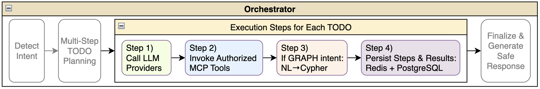
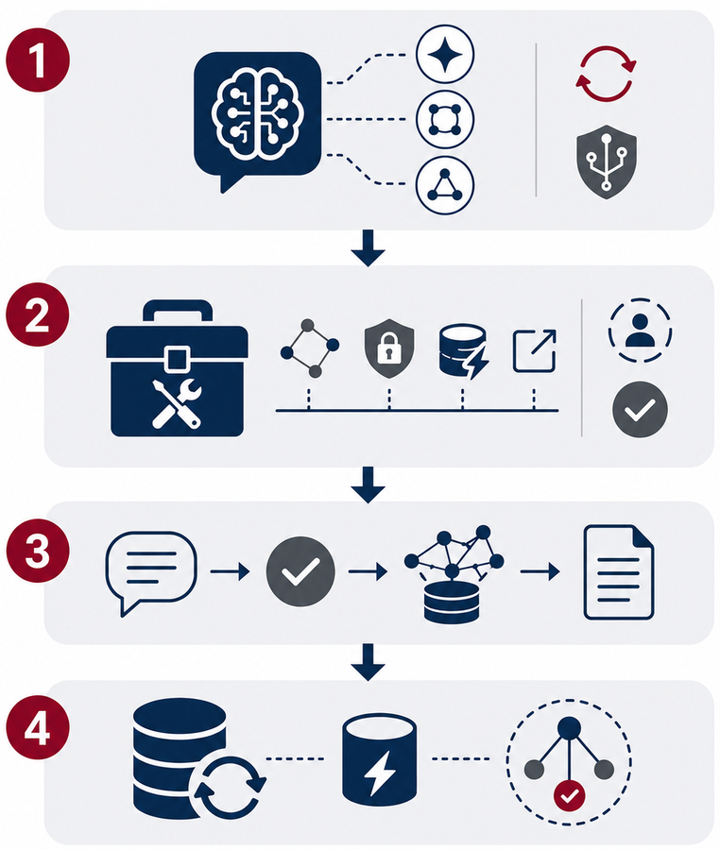
ORCHESTRATOR (Part 2/3)
Step Execution
Phase 3: Step-by-Step Execution of each TODO
Call the LLM Provider (Ollama / OpenAI)
Responsible for executing the process.
Retries → retry failed LLM calls
Fallbacks → switch provider/model if needed
Circuit breakers → pause failing providers
Invoke the right MCP Tool for each TODO item
Tools: graph, security, cache, export, system
Before using each tool, role, tenant, and permissions are checked
Graph Pipeline (If intention is GRAPH)
NL→Cypher generation, validation, execution, summarization
Persist Steps & Runtime State
PostgreSQL → Tenants, jobs, runs, steps, inputs/outputs, timings, errors, final status, model configs
Redis → Job queues, locks, heartbeats, cache sessions, progress events, cancellation flags
Memgraph → Bioinformatics entities (Users, Institutions, Blast, Fasta) and their relationships.

Slide 13
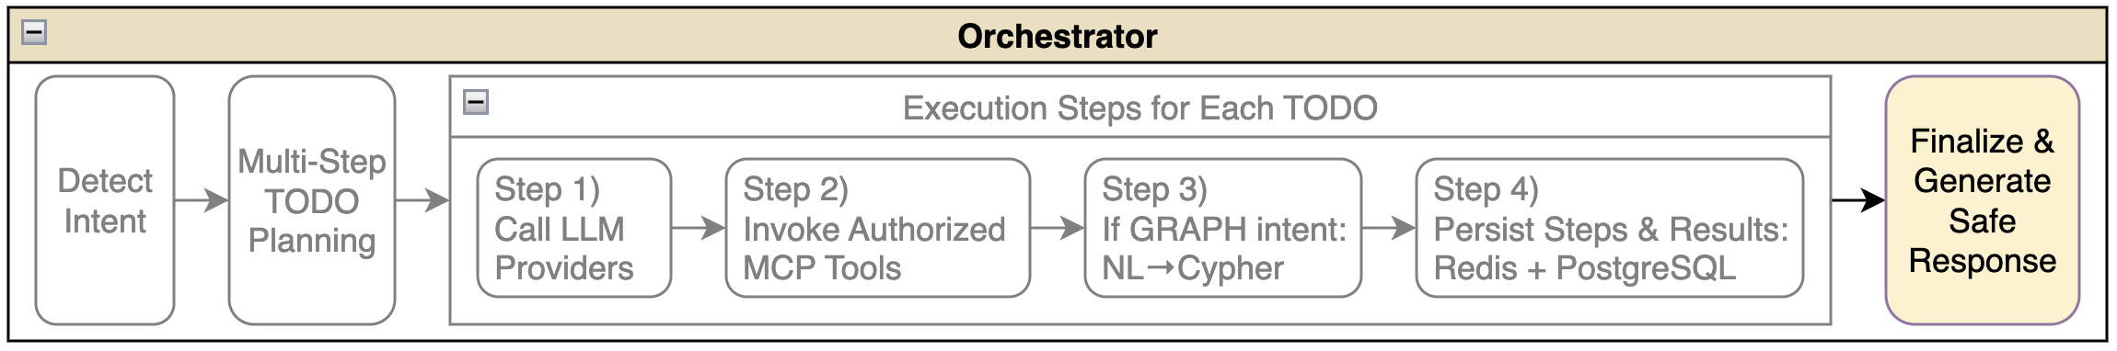
ORCHESTRATOR (Part 3/3)
Finalization & Safe Response Generation
Phase 4: Final Output Pipeline The orchestrator turns completed steps into a safe, consistent, and traceable final response.
Assemble Step Outputs → Combines step outputs into one final answer
Fallback Handling → Uses cached or default responses if generation fails
Output Normalization → Converts the result into readable text and optional structured JSON
Output Safety Checks → Removes sensitive data and filters unsafe content
Final Persistence → Saves final status, output, and metrics in PostgreSQL
Observability Data → Records metrics and traces for monitoring (Prometheus, Grafana)
{
"goal": "Find collaborating institutions",
"steps": ["query_graph", "analyze_results", "summarize_answer"],
"output": "Found 5 collaborating institutions.",
"metrics": { "duration_ms": 2340, "tokens": 1850 }
}

Slide 14
VALIDATION & RESULTS
End-to-end verification
Validation Coverage
1,000+ automated tests → for core logic, API routes, jobs, RBAC, tenancy, and orchestration
Security checks tested → read-only enforcement, tenant isolation, RBAC, unsafe query blocking
Async execution tested → job creation, streaming, cancellation, retries, and final status persistence
Full NL→Cypher path verified:
Natural language → GRAPH intent → Cypher → validation → Memgraph Execution → final answer
Real Example:
User Request:
"Count Blast nodes grouped by presence of blast_version"
1. Intent Classification → GRAPH
2. Cypher Generation → read-only query created:
MATCH (b:Blast) RETURN b.blast_version IS NOT NULL AS has_blast_version,
count(b) AS count ORDER BY has_blast_version DESC
3. Safety Validation → ✓ Safety Validate → ✓ Read-only ✓ Tenant-safe ✓ RBAC ✓ Timeout-protected
4. Memgraph Execution → returns 1 grouped row
5. Final Summary → "In total, there are 39 Blast nodes, all containing blast_version attribute."

Slide 15
COMPARISON WITH RELATED FRAMEWORKS
Why existing frameworks were not enough
Platform | Full Stack | Agentic Planning | Governed Tools | Enterprise Security | Graph NL→Cypher | Observability | Summary
CAP | ✓ | ✓ | ✓ | ✓ | ✓ | ✓ | Complete platform for secure, observable graph-agent execution
Temporal | ✗ | ✗ | ✗ | ✓ | ✗ | ✓ | Durable workflow engine without native agent or graph capabilities
LangGraph | ✗ | ✓ | ~ | ✗ | ~ | ~ | Strong agent orchestration; APIs, security, and operations are external
OpenAI Agents SDK | ✗ | ✓ | ~ | ✗ | ~ | ~ | Fast agent development; platform governance must be added
Semantic Kernel | ✗ | ✓ | ~ | ~ | ~ | ~ | Flexible AI orchestration; deployment is external
n8n | ✓ | ~ | ~ | ~ | ✗ | ~ | Strong visual automation; limited for secure graph-agent workloads
Main takeaway:
CAP combines agent orchestration, durable jobs, governed tools, secure graph access, multi-tenancy, and observability into one platform.
✓ = Native support
~ = Partial / requires customization
✗ = Not supported

Slide 16
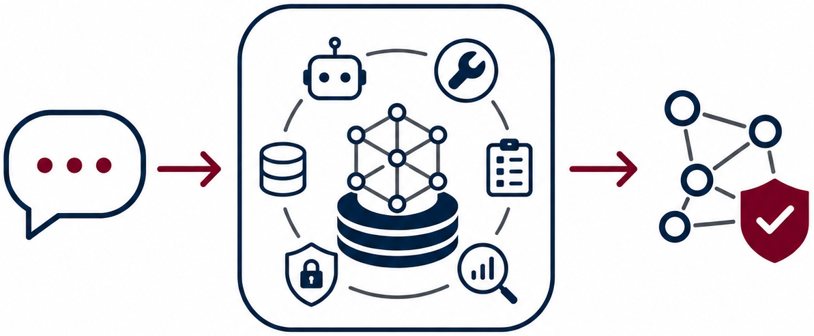
CONCLUSION + FUTURE WORK
From natural language to safe, traceable graph actions
Key Contribution
This thesis developed a multi-tenant AI platform that turns natural-language requests into safe, controlled, and traceable graph actions.
The platform connects:
Agents for multi-step reasoning and execution
MCP tools for controlled platform actions
Async jobs for long-running tasks
Secure graph access for validated NL→Cypher queries
Observability for tracing, monitoring, and debugging
Future Work
Add a lightweight Ask Mode for simple Q&A
Improve handling of unclear, mixed, or risky prompts
Recover interrupted workflows from the last completed step
Manage job queues with priorities, tenant limits, and overload protection Example: short chat jobs can run before long export jobs

Slide 17
THANK YOU FOR YOUR ATTENTION
Feel free to ask any questions

Slide 18
BACKUP SLIDES

Slide 19
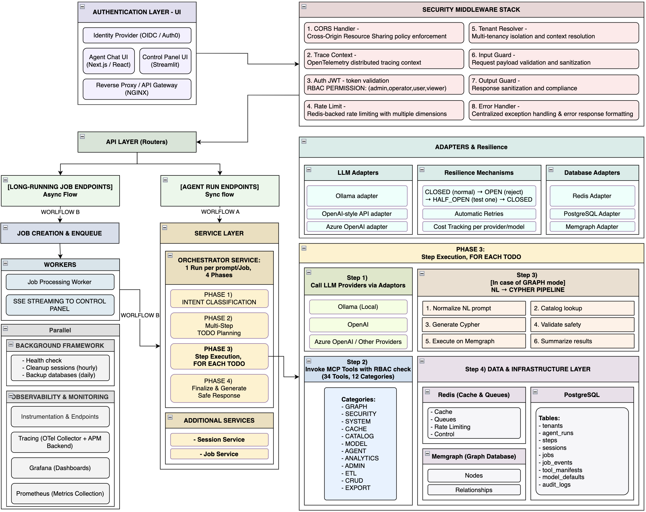
Backup Slides - Detailed System Architecture

Slide 20
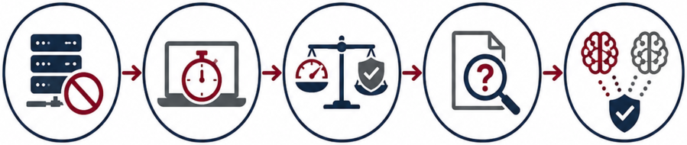
LIMITATIONS Evaluation constraints and future validation needs
HPC Availability → CINECA/HPC evaluation was planned but unavailable
Limited Scenarios → Testing used only a limited set of scenarios
Local Model Latency → Powerful local models were too slow on a laptop
Long Runtime → Multi-step runs could take over 20 minutes
Model Trade-off → A lightweight model balanced speed and accuracy
Prompt Handling → Unclear or risky prompts need better handling
Clarification Logic → Clarification logic and safe defaults need refinement
LLM Variability → Different models may generate different plans or queries
Residual Risk → Validation reduces this risk, but cannot remove it fully

Slide 21
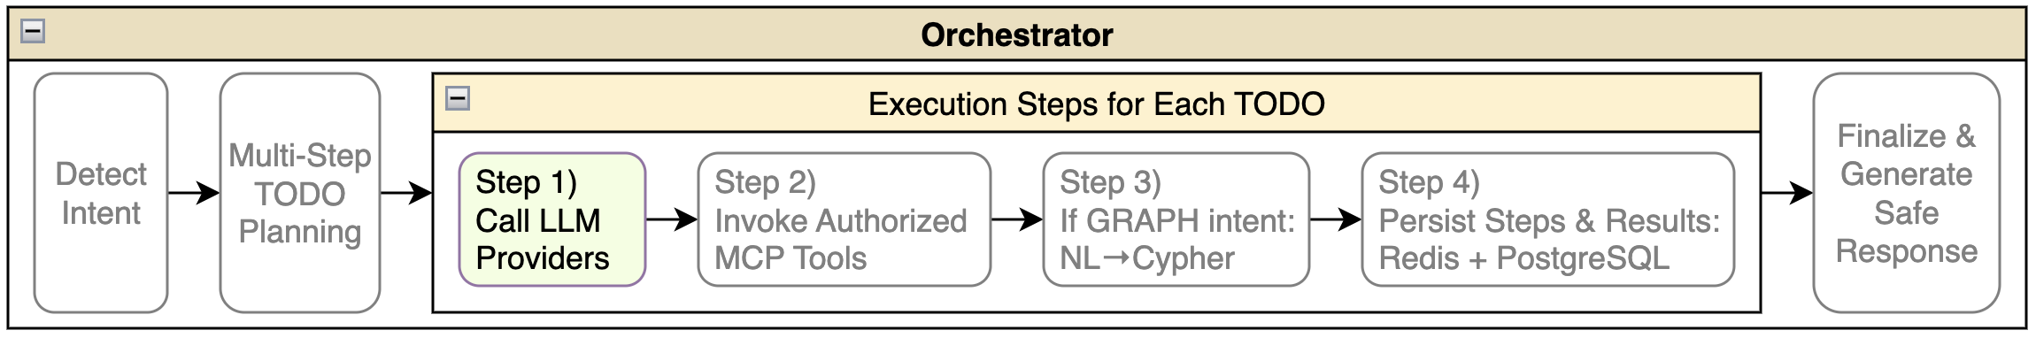
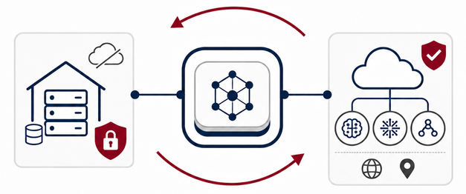
LLM PROVIDERS
Model Selection
Provider & Deployment Options
Local → Ollama-based execution for data control and lower external API costs
Cloud → OpenAI / Azure OpenAI for managed, high-quality models
Flexible Logic → switch providers without changing the orchestrator
Local Models → Phi-3, Mistral, LLaMA, Qwen, Gemma models
Model Selection Order
The platform uses the most specific model setting available, then falls back step by step to broader defaults.
Request → Session → Tenant → Global Default

Slide 22
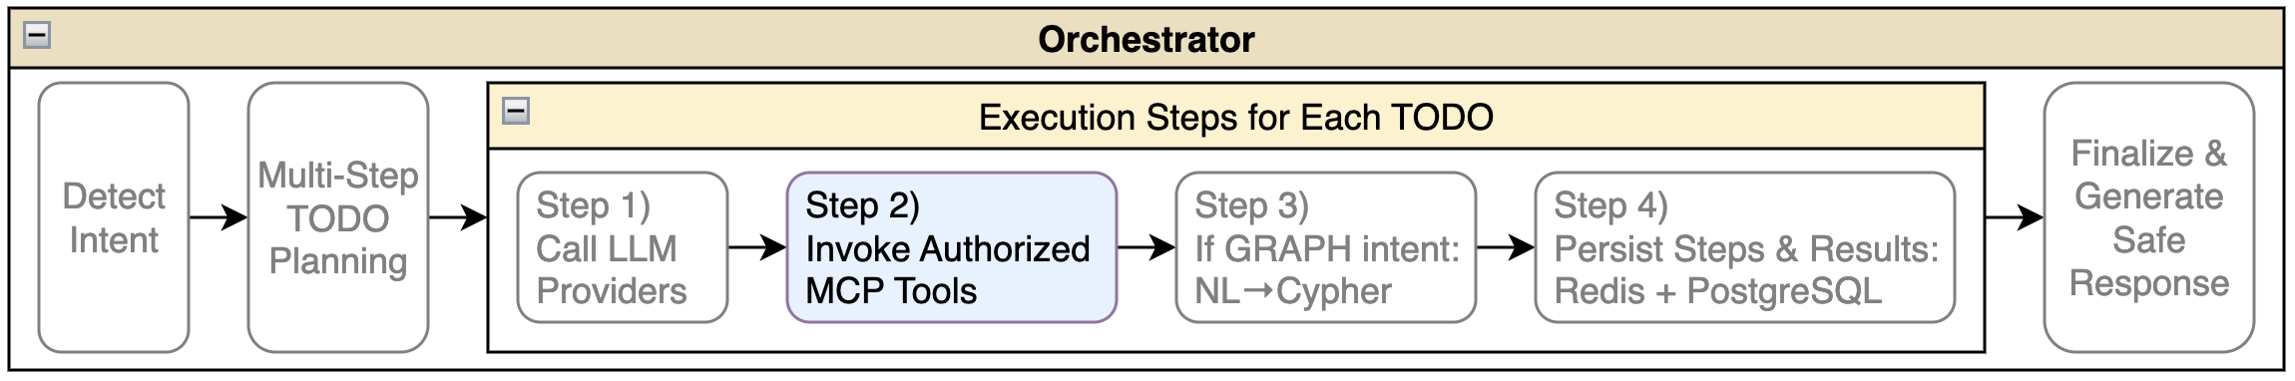

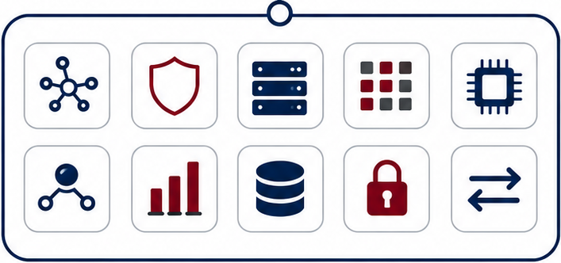
MCP RUNTIME & TOOLS
34 tools across 12 categories
Runtime Controls
Registry → stores tool definitions, schemas, scopes, and limits
Access → checks RBAC, tenant context, and tool permissions
Validation → verifies inputs before execution
Audit → records tool calls, results, errors, and timing
Output → returns structured outputs to the agent
Invocation Flow
Request → Validate → Authorize → Execute → Audit → Return
Main Tool Families
Graph → Memgraph schema, Cypher execution, graph queries
Security → identity, permissions, and access checks
System & Catalog → health, metrics, configuration, and tool discovery
Model & Agent → model operations, context, history, and session state
Analytics → summarizes graph results and prepares data for charts
Admin / ETL / CRUD / Export → restricted operations, data import, update, and export

Slide 23
MCP RUNTIME & TOOLS
34 tools across 12 categories
MCP
MCP provides a permission-aware and traceable execution layer between the agent and the platform.
Every MCP tool is registered, validated, authorized, and audited before execution.
Categories
Graph → Query Memgraph, generate Cypher, inspect schema, and explain query plans.
Security → Check identity, roles, scopes, permissions, and restricted operations.
System → Monitor platform health, metrics, configuration, workers, and queues.
Cache → Read, store, delete, and invalidate cached Redis results.
Catalog → Discover tools, resources, graph entities, and available platform metadata.
Model → List, inspect, warm up, and switch between available LLM providers.
Agent → Manage context, interaction history, and session-level state.
Analytics → Run analytical queries, aggregations, ratios, and chart-ready outputs.
Admin → Manage indexes, constraints, and admin-only database operations.
ETL → Import, export, and transform graph data in bulk.
CRUD → Create, update, and delete graph nodes with permission checks.
Export → Convert query results into CSV, JSON, or Cypher formats.

Slide 24
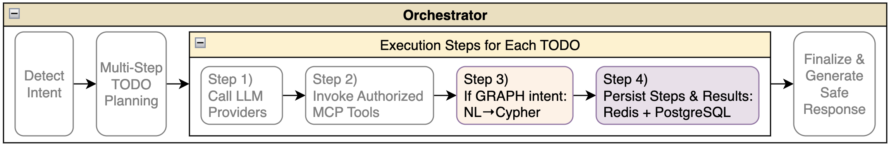
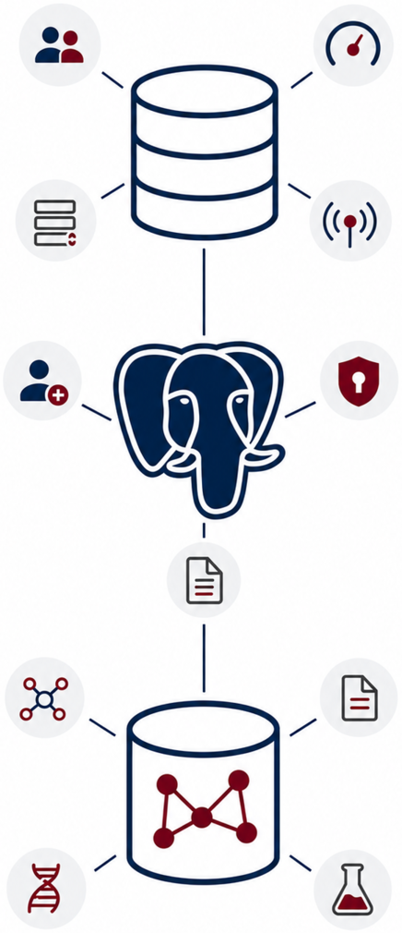
DATA LAYER
Redis, PostgreSQL, Memgraph
Redis → Fast Runtime State
Caches sessions, tenant settings, and model defaults
Manages rate limits, job queues, and progress events
Stores cancellation flags, idempotency keys, and circuit-breaker state
PostgreSQL → Durable Platform State
Stores tenants, sessions, runs, steps, and jobs
Records job events, tool calls, audit logs, and encrypted secrets
Manages model/provider configuration and idempotency records
Memgraph → Graph Domain Data
Stores users, institutions, commands, files, and bioinformatics artifacts
Represents BLAST analyses, sequences, and FASTA/XML files
Connects entities through WORKS_AT, RUNS, INPUT, and OUTPUT relationships

Slide 25
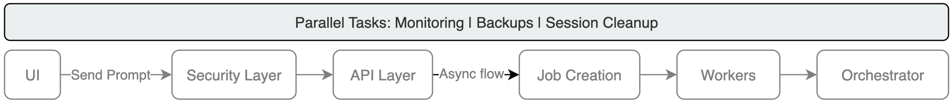
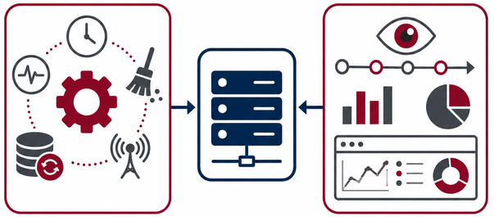
BACKGROUND TASKS
Monitoring | Backups | Session Cleanup
Scheduled APScheduler Jobs
Every 30s → Health Check → checks PostgreSQL, Redis, Memgraph, and LLM providers
Every 60s → Provider Monitoring → tracks LLM health, metrics, and circuit breakers
Hourly → Cleanup → removes expired sessions, cache, old jobs, and orphan runs
Daily → Backup → saves PostgreSQL, Redis, Memgraph, and audit snapshots
Observability Stack
OpenTelemetry → records request traces and shows time spent in LLM calls, DB queries, tools, and jobs
Prometheus → stores metrics for latency, errors, queues, tokens, and provider health over time
Grafana → visualizes metrics and traces for monitoring, debugging, and cost tracking
Operational Value
Detects failures and provider issues early
Finds slow requests and failed tools
Tracks queues, costs, recovery, and debugging

Slide 26
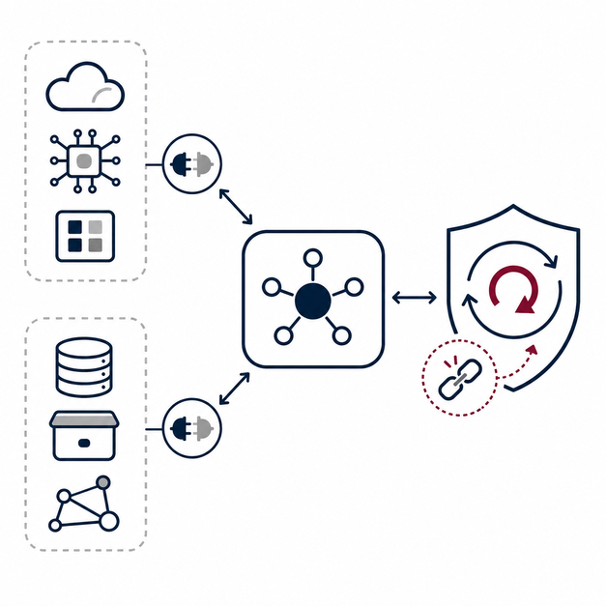
ADAPTERS
Adapters let the platform switch providers or databases without changing the orchestrator.
Swappable Adapters
Adapters let the platform switch providers or databases without changing the orchestrator.
LLM adapters → Ollama, OpenAI, Azure OpenAI
Provider independence → business logic stays the same
Database adapters → Redis, PostgreSQL, and Memgraph
Backend flexibility → The orchestrator remains unchanged
Robustness Mechanisms
Retries with backoff → retry failed calls with increasing delay
Provider fallback → switch to another provider if one fails
Circuit breakers → pause unstable providers
Fail-fast behavior → skip broken services quickly
Recovery flow → [CLOSED → OPEN → HALF_OPEN → CLOSED]

Slide 27
API - ENDPOINTS IN DETAIL
Main endpoint groups and responsibilities
Endpoint | Description
/v1/health | Checks if the platform is running, ready, and fully started. Reports PostgreSQL, Redis, and Memgraph status.
/v1/auth | Verifies user identity and validates OIDC/JWT authentication tokens.
/v1/agents | Manages agent definitions, prompt templates, and behavior settings.
/v1/tenants | Manages tenant organizations, default models, rate limits, quotas, and enabled features.
/v1/models | Registers LLM providers, configures models, API keys, and tenant defaults.
/v1/tools | Discovers MCP tools, reads tool schemas, and invokes tools with validated inputs.
/v1/jobs | Creates long-running async jobs, streams progress, and cancels running jobs.
/v1/agent-runs | Starts, tracks, retrieves, and cancels agent execution runs.
/v1/graph | Executes direct Cypher queries and validated NL→Cypher graph queries.
/v1/sessions | Manages chat sessions, conversation history, and runtime context.
/v1/batch | Handles bulk requests, such as multiple agent runs or tool calls in one request.
/v1/admin | Runs restricted admin actions such as cache clearing, maintenance, migrations, and system stats.
/v1/internal | Provides restricted diagnostics, configuration checks, and internal debugging tools.
/v1/export | Exports agent runs, job results, and audit logs in CSV or JSON format.
Arman Feili

