Slide 1



CINECA AGENTIC PLATFORM
Enterprise-Grade AI Agent Orchestration Platform Connecting Multi-Tenant Architecture, MCP Tools, and Secure Graph Querying
Author:
Arman Feili
Advisor:
Prof. Marco Raoul Marini
Co-Advisors:
Dr. Valerio Venanzi
Dr. Giuseppe Melfi
Dr. Marco Puccini
University:
Sapienza University of Rome
Department:
Information Engineering, Electronics and Telecommunications
Company:
CINECA
Academic Year:
2025/2026
All rights relating to this teaching material and its contents are reserved by Sapienza and its authors (or teachers who produced it). Personal use of the same by the student for study purposes is permitted. Its dissemination, duplication, assignment, transmission, distribution to third parties or to the public is absolutely prohibited under penalty of the sanctions applicable by law.

Slide 2
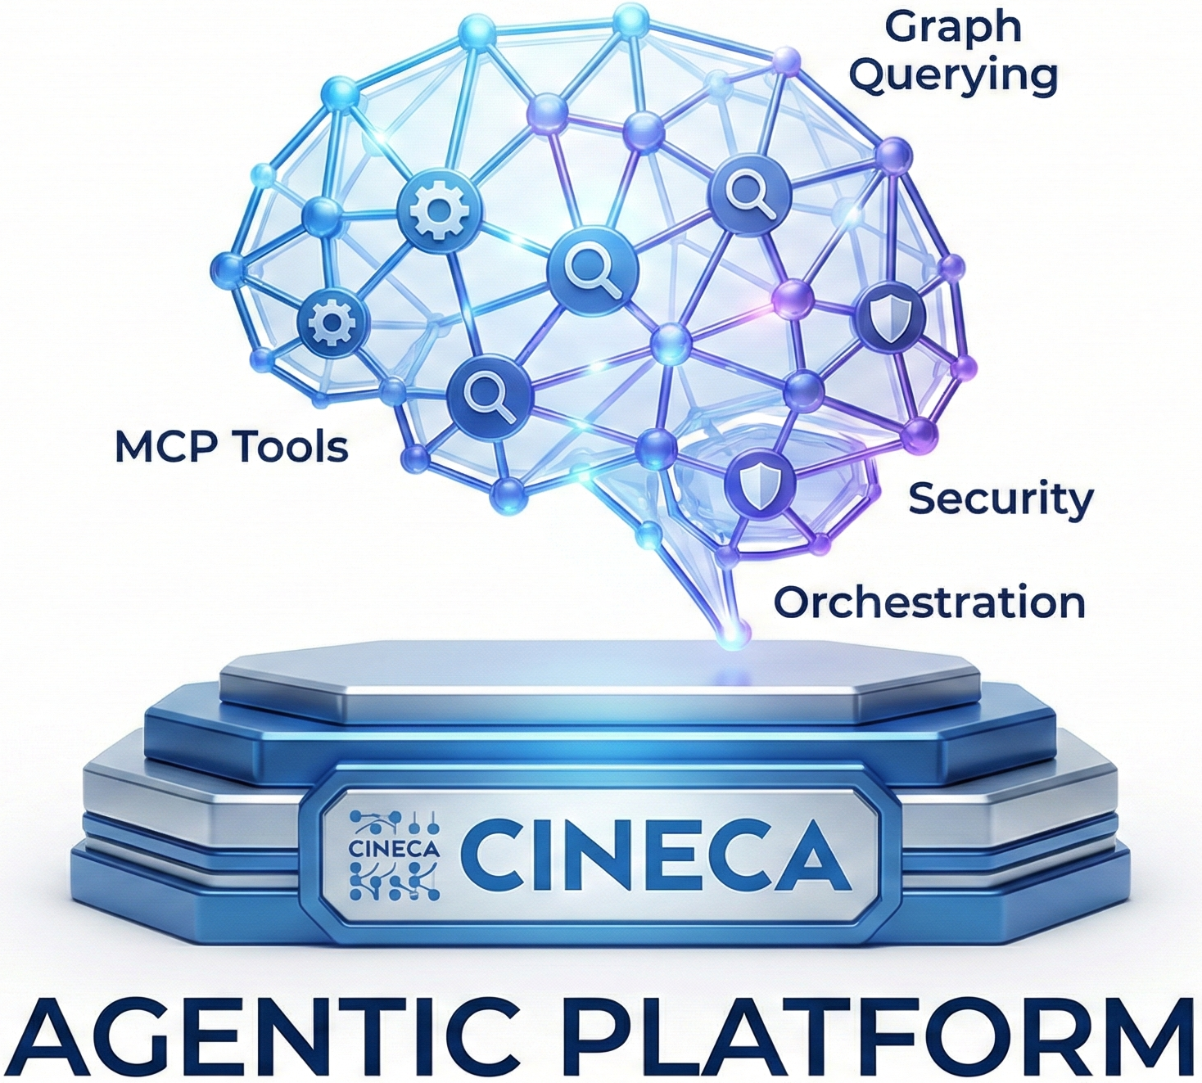
INDEX
Production Gap
What was delivered
Project Scale (Production Proof)
Stakeholders & Use Cases
Authentication Layer & UI
Security Middleware Stack
API Layer - Routers
API Layer - Workflows A & B
Job Creation
Workers (Job Processing Engine)
Agent.run Job Handler (Full Orchestration Pipeline)
Service Layer - Orchestrator
LLM Providers (Model-Agnostic Architecture)
MCP Runtime & Tools
NL-to-Cypher Pipeline (Graph Mode)
Data Layer - Redis, PostgreSQL, Memgraph
Adapters
Resilience Framework
Background Framework (APScheduler)
Observability
Phase 4 Completion - Agent Run (Workflow A)
Phase 4 Completion - Job Completion (Workflow B)
Conclusion
Future Works
Thanks / Q&A
Arman Feili

Slide 3
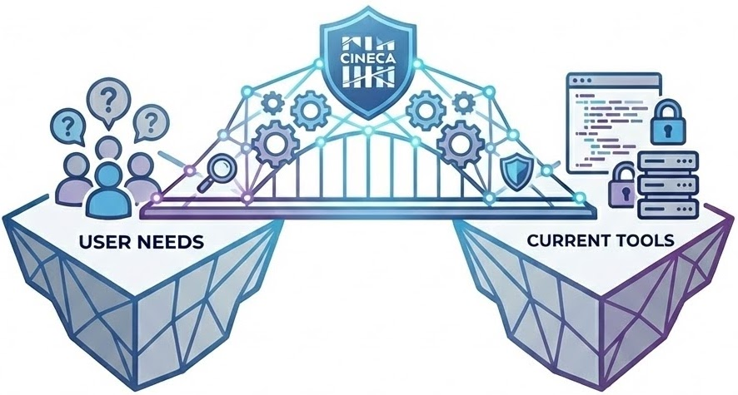
PRODUCTION GAP
The gap between what users need and what current tools provide.
The Problem
Most users can’t write Cypher, so they rely on developers to access and analyze graph data. This creates delays and technical bottlenecks, data stays locked behind complexity.
Why Simple Chatbots Don’t Work
Basic chatbots can't handle real tasks.
They:
Only answer one question at a time, no multi-step planning.
Can’t query databases or run actual jobs.
Lack security (no RBAC or tenant isolation).
Don’t log actions, no audit trail.
Produce inconsistent outputs, no reproducibility or traceability.
Why This Matters for CINECA
Remove developer bottlenecks: researchers query graph data directly using natural language.
Secure and compliant: RBAC, tenant isolation, and full audit logs ensure safe multi-tenant use and governance.
Scalable and reliable: agent workflows and background jobs handle complex tasks at scale.
Reproducible results: clear step tracking and outputs make results explainable.
Lower cost, full control: run models locally (e.g., Ollama) to cut API costs and keep data inside CINECA.
Flexible and future-ready: switch LLM providers (OpenAI, Azure, Ollama) without code changes—new models plug in easily.
Arman Feili

Slide 4
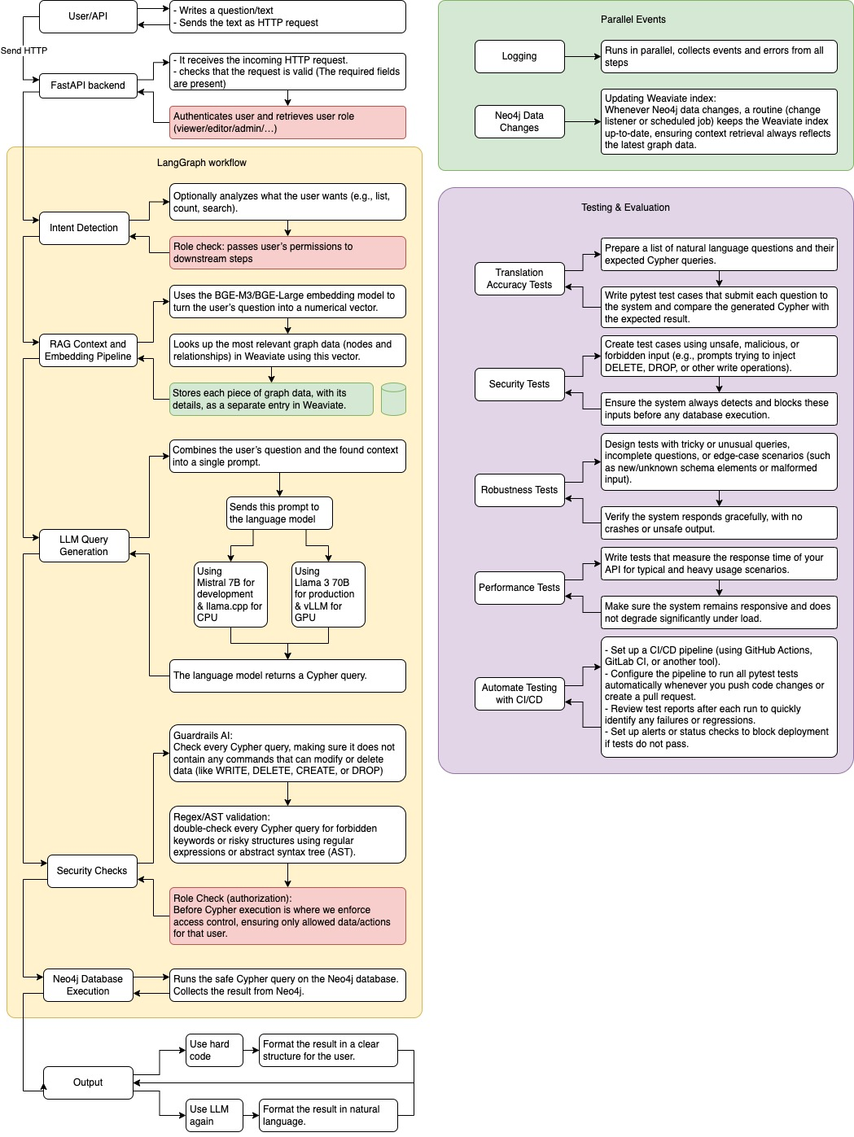
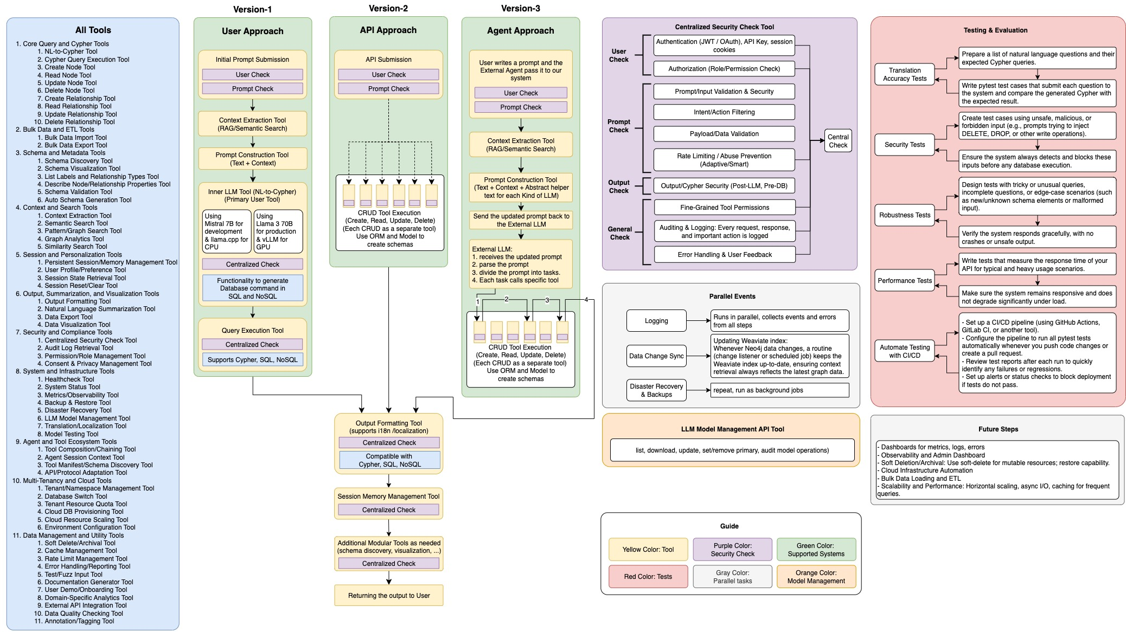
ARCHITECTURE – FIRST DESIGNS
Showing Evolutions in Six months
Arman Feili

Slide 5
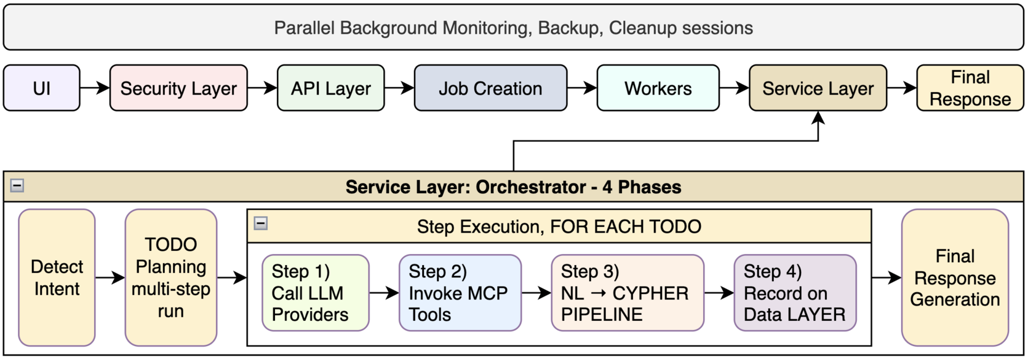
ARCHITECTURE - FINAL
At a Glance
Arman Feili

Slide 6
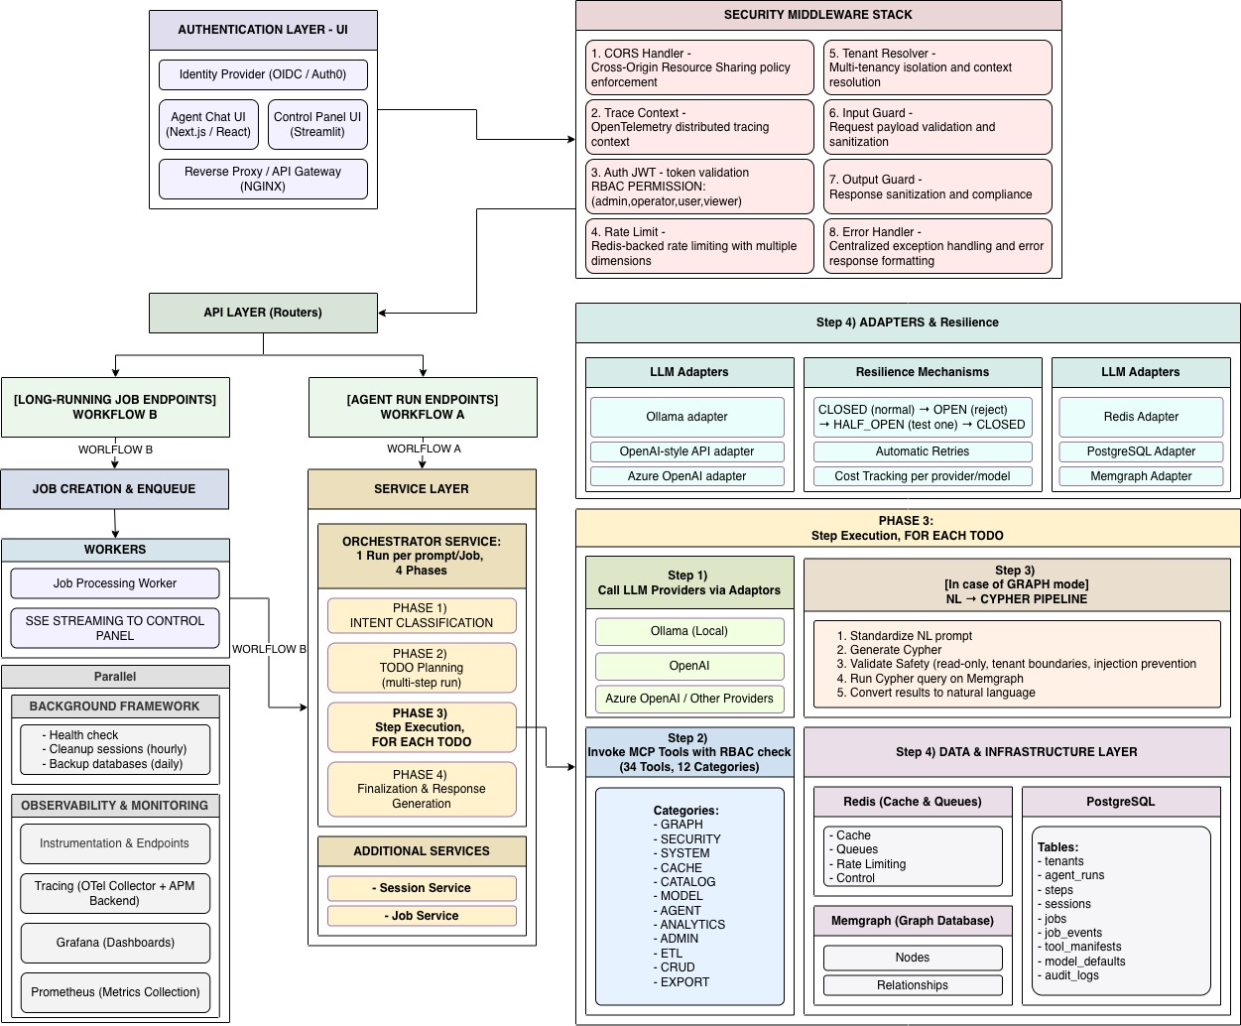
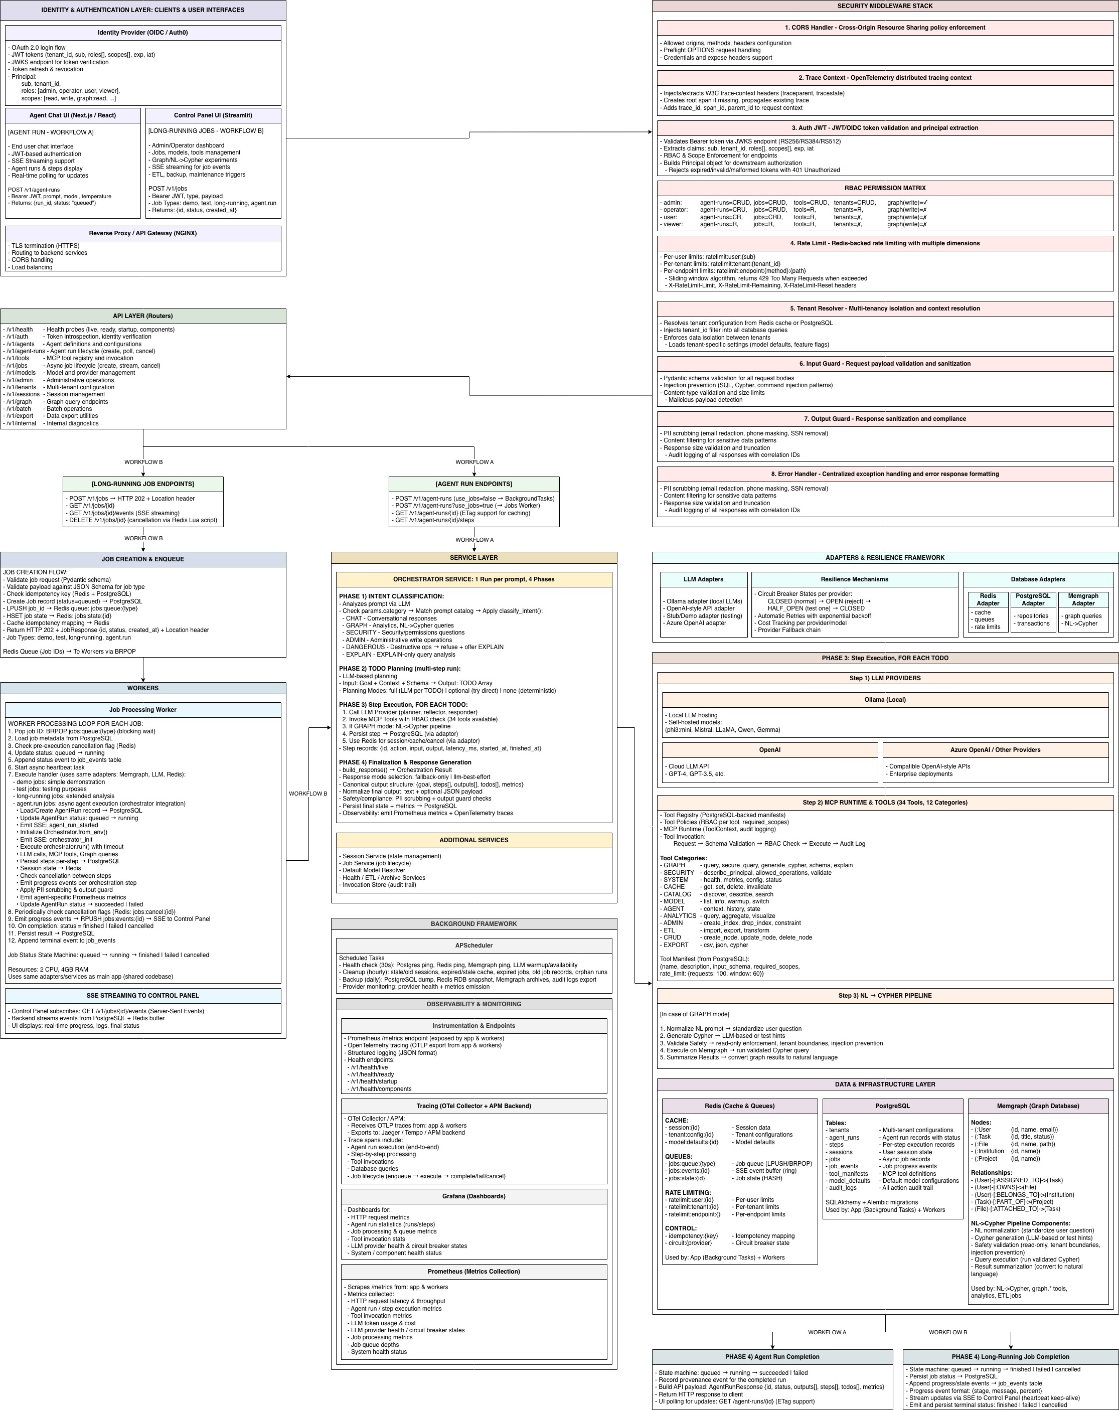
ARCHITECTURE - FINAL
Simplified
Arman Feili

Slide 7
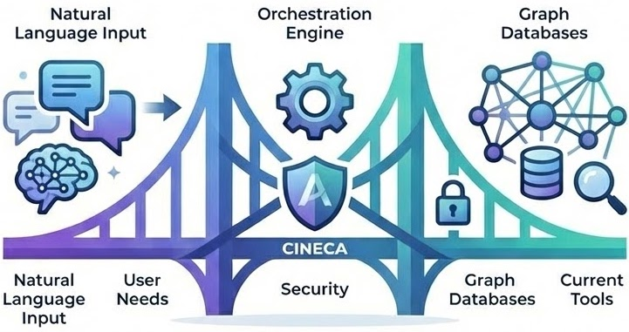
WHAT WAS DELIVERED
A complete, production-ready agentic platform for NL access to graph databases.
Full Stack Production-Grade Platform:
End-to-end agentic system:s NL input → tool-executed, auditable, reproducible workflows.
Chat UI (Next.js, JWT, SSE), Admin UI (Streamlit), NGINX (TLS, CORS), 75+ API endpoints, async workers (Redis + SSE).
Orchestration Engine:
4 phases: Intent → TODO Plan → LLM+Tool Steps → Safe Final Output.
Graph Mode (NL→Cypher): GRAPH intent → Normalize → Lookup → Cypher → 6-level validation → Memgraph exec.
MCP + Tools:
34 tools, 12 categories (Graph, Model, ETL…), with RBAC, schema checks, audit logs, rate limits.
Security & Governance:
JWT, RBAC, tenant filtering, rate limits, Pydantic guards, PII filter, error trace ID—multi-tenant safe.
Data Layer (3 DBs):
Redis (cache, queues), PostgreSQL (jobs, logs, secrets), Memgraph (Cypher, lineage).
LLM Agnostic:
Switch OpenAI / Azure / Ollama; provider per request/session/tenant. No lock-in, local/offline support.
Resilience + Background Jobs:
Retries, circuit breakers, provider fallback, APScheduler: cleanup, backups, health checks.
Observability: Traces (OpenTelemetry), Metrics (Prometheus), Dashboards (Grafana: jobs, tools, LLMs, health).
Arman Feili

Slide 8
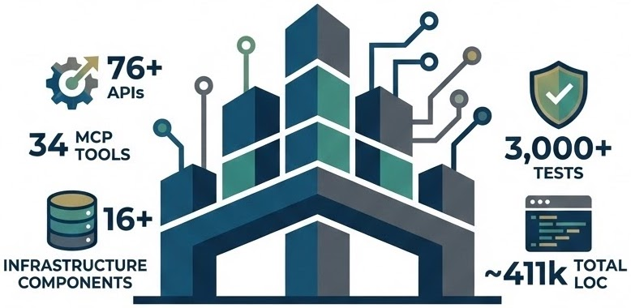
PROJECT SCALE
Proving the platform is production-grade, not a demo.
Key Stats
76 API endpoints across 16 FastAPI routers categories
34 implemented MCP tools across 17 capability categories
16+ infrastructure components (databases, queues, tracing, rate limits, gateways, etc.)
3,000+ automated tests (unit, integration, security, orchestration logic)
~411,700 total lines of code across all formats
Repo Composition (by file type)
Docs: 500+
Source code: 1,450+
Tests: 780+
Scripts: 100+
Configs: 400+
Test coverage includes:
Unit tests (core logic, utilities, policies)
Integration tests (DBs, LLM adapters, MCP runtime)
Security tests (auth, RBAC, scopes, rate limits, guards)
End-to-end and workflow tests (agent runs, jobs, streaming)Resilience and failure-mode tests (fallbacks, retries, breakers)
Language Breakdown (by LOC)
Python: ~57.8%
Markdown: ~22.6%
TeX: ~6.4%
JSON/CSV/YAML: ~7.2%
Other (Shell, TSX): ~6%
Arman Feili

Slide 9
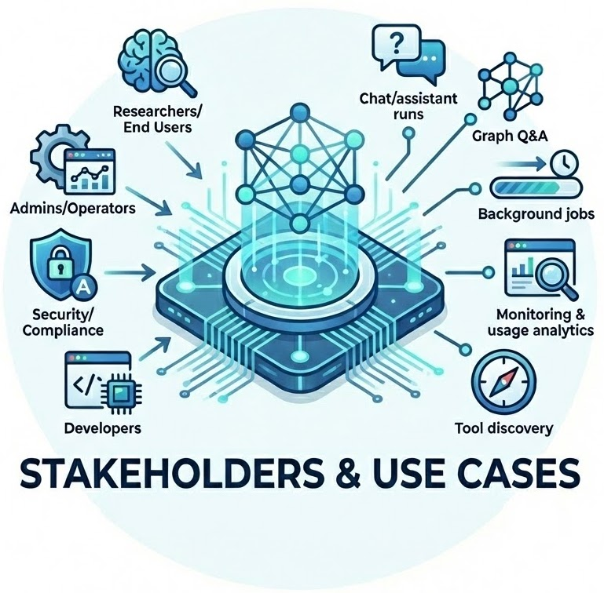
STAKEHOLDERS & USE CASES
Who Uses the Platform and What They Actually Do.
Stakeholders
Researchers / End Users → Ask questions, trigger runs, trace outputs, reproduce results.
Admins / Operators → Monitor runs and jobs, manage tools/models, enforce policies.
Security / Compliance Teams → Audit tool usage, enforce scopes, verify controls.
Developers → Add new tools, integrate LLM providers, extend APIs.
Core Use Cases (UC1–UC5)
UC1: Chat/assistant runs
Prompt an agent, receive a safe structured result.
UC2: Graph Q&A (NL→Cypher)
Ask questions over Memgraph; validated Cypher is safely executed.
UC3: Background jobs / long tasks
Run long processes with persistence, SSE progress updates, and cancellation support.
UC4: Monitoring & usage analytics
Inspect job status, execution logs, tool usage metrics, and system health.
UC5: Tool discovery / controlled expansion
Discover tools with schema and permissions, governed by tenant scope and roles.
Arman Feili

Slide 10
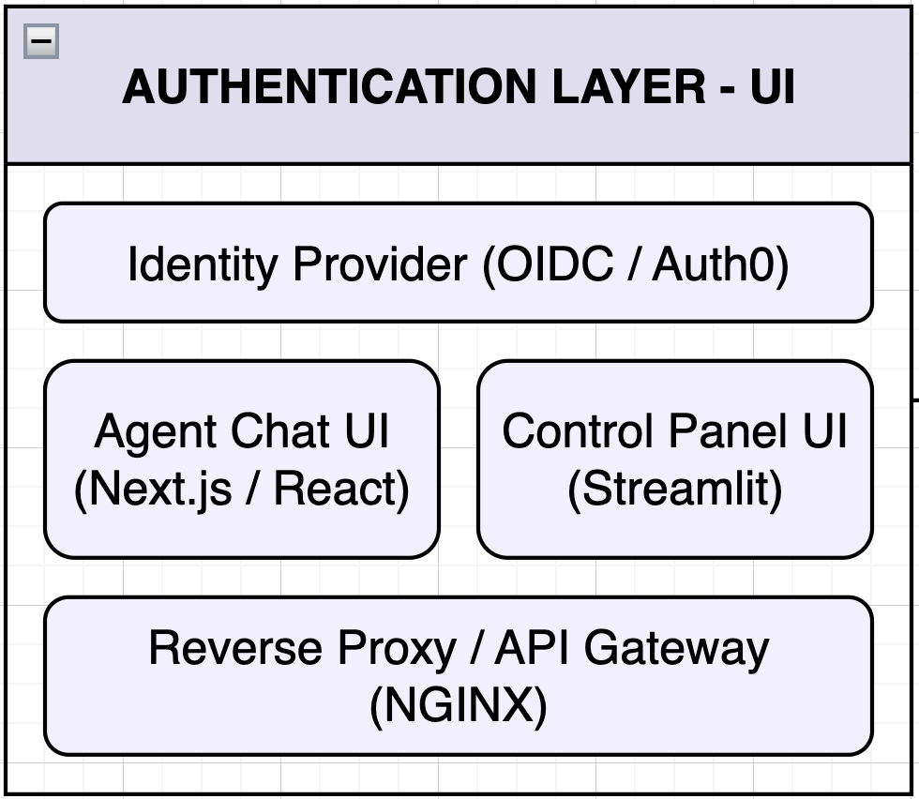
AUTHENTICATION LAYER & UI
Users authenticate via Identity Provider, get JWTs, and use two UIs behind a secure reverse proxy.
Identity Provider - Users authenticate (OAuth 2.0):
JWT tokens carry user identity and permissions:
Sub: unique user identifier | tenant_id: organization the user belongs to
Roles: what the user can do (admin, operator, user, viewer)
Scopes: {user:me, admin:all, tools:invoke:basic, tools:invoke:all, graph:read, graph:write}
JWKS endpoint serves public keys for token checks; tokens support refresh and revocation.
Agent Chat UI (Next.js) - Workflow A
End-user interface for chatting with AI agents | Authenticates users via JWT tokens
Supports real-time streaming via Server-Sent Events (SSE)
Displays agent run progress and individual steps, and status updates until completion
Input: JWT, prompt, model, temp → Output: { run_id, status }
Control Panel UI (Streamlit) - Workflow B
Admin and operator dashboard for platform management
Manages jobs, models, tools, tenant, and streams job progress via SSE in real-time
Triggers ETL pipelines, backups, and maintenance tasks
Input: Bearer JWT, job type, payload, Job Types: demo, test, long-running, agent.run → Output: {id, status, created_at}
Reverse Proxy / API Gateway (NGINX)
Terminates TLS/HTTPS connections securely, Routes incoming requests to appropriate backend services
Handles CORS (Cross-Origin Resource Sharing) and Load balances traffic across multiple backend instances
Authentication: Users log in via OAuth 2.0 and receive a JWT with identity, tenant, roles, scopes. This token is verified on every API call.
Authorization: RBAC enforces access. Roles and scopes show what actions users can perform (viewer = read-only, admin = full access).
Arman Feili

Slide 11
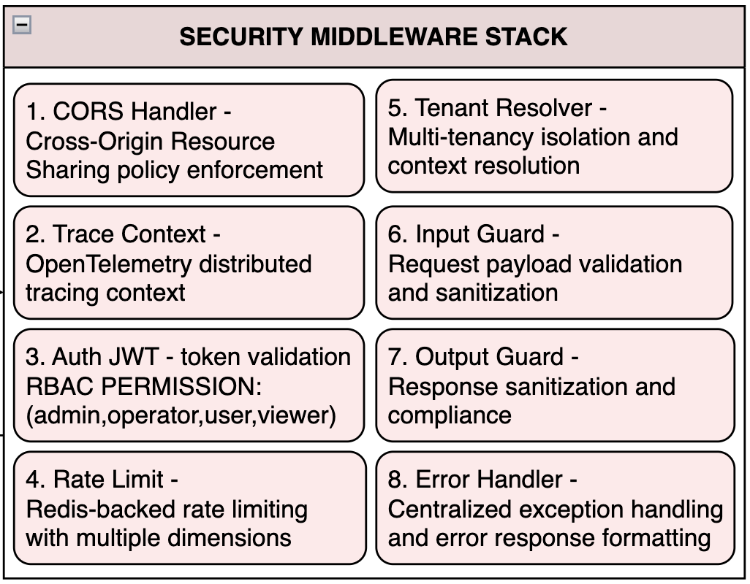
SECURITY MIDDLEWARE STACK (Part 1/3)
Every request passes through 8 Security middleware layers before reaching the business logic.
1. CORS Handler
Configures allowed origins, methods, and headers for cross-origin requests
Handles preflight OPTIONS requests automatically
Supports credentials and custom expose headers
Example: A request from https://chat.cineca.it is allowed, but a request from https://malicious-site.com is blocked.
2. Trace Context (OpenTelemetry)
Injects/extracts W3C trace headers (traceparent, tracestate)
Creates root span if missing; propagates existing traces
Adds trace_id, span_id, parent_id to request context
Example:
A user's chat request gets trace_id: abc123, which follows the request through the API, orchestrator, Memgraph, and back. All visible in Grafana.
3. Auth JWT (OAuth 2.0) with RBAC
Rejects invalid/expired tokens → 401 Unauthorized
Example: A viewer tries to delete an agent run → gets 403 Forbidden
Role | agent-runs | jobs | tools | tenants | Graph (write)
admin | CRUD | CRUD | CRUD | CRUD | ✓
operator | CRU | CRUD | R | R | ✗
user | CR | CRD | R | ✗ | ✗
viewer | R | R | R | ✗ | ✗
4. Rate Limiter (Redis-backed)
Controls number of requests users can make.
Returns 429 Too Many Requests when limits are exceeded. | Tracks limits at three levels: user, tenant, and endpoint
Sends headers back the number of remaining requests → (X-RateLimit-Limit, X-RateLimit-Remaining, X-RateLimit-Reset)
Example:
User exceeds 100 requests/minute → receives 429 Too Many Requests with header X-RateLimit-Reset: 45 (seconds until reset).
Arman Feili

Slide 12
SECURITY MIDDLEWARE STACK (Part 2/3)
Every request passes through 8 Security middleware layers before reaching the business logic.
5. Tenant Resolver
Identifies which organization the request belongs to
Loads tenant config from Redis cache (or PostgreSQL fallback)
Automatically filters all database queries by tenant_id
Ensures users can only access their own organization's data
Applies tenant-specific settings. A config like model defaults
Example:
User from tenant_id: cineca_bioinformatics only sees bioinformatics ‘s data, and never data from other organizations.
6. Input Guard
Validates all incoming data before it enters the system.
Uses Pydantic schemas to verify data structure and types.
Applies injection attack detection by scans for malicious patterns like:
SQL injection (DROP TABLE, UNION SELECT), Cypher injection (graphDB attacks), Shell commands (; rm -rf /)
Checks request headers and limits oversized payloads that could crash the system
Detects and matches unusual patterns or broken data structures that indicate potential attacks
Example:
A prompt containing "; DROP TABLE users;-- is detected as SQL injection and rejected with 400 Bad Request.
Arman Feili

Slide 13
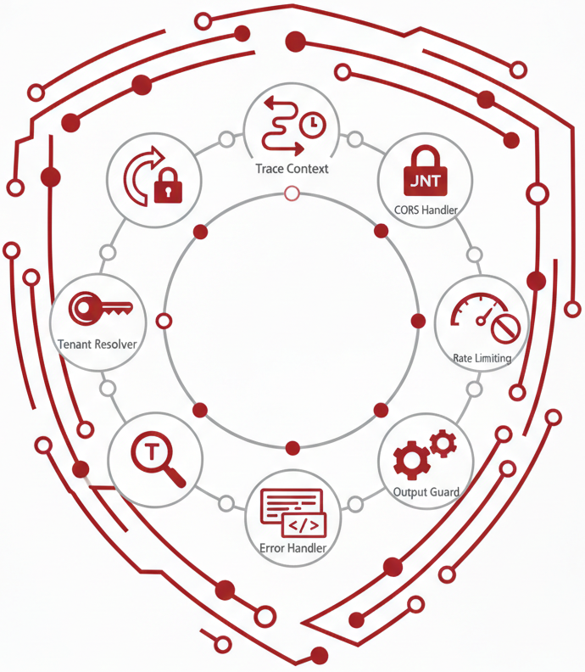
SECURITY MIDDLEWARE STACK (Part 3/3)
Every request passes through 8 Security middleware layers before reaching the business logic.
7. Output Guard
Detect sensitive data before sending responses (emails, phones, SSNs)
Filters patterns that might leak internal information
Enforces maximum response size to prevent memory issues and truncates oversized responses.
Logs all responses with correlation IDs for auditing
Example:
An LLM response containing user@email.com is automatically redacted to [EMAIL REDACTED] before reaching the client.
8. Error Handler
Catches all exceptions in one place for consistent handling
Returns standardized error responses across the API
Hides internal details to prevent information leakage
Attaches correlation IDs so errors can be traced in logs
Records all errors for security auditing and debugging
Example:
A PostgreSQL connection timeout occurs → instead of exposing:
psycopg2.OperationalError: connection refused at 10.0.1.5:5432,
the client receives:
{"error": "Service temporarily unavailable", "correlation_id": "req-xyz789"}.
Arman Feili

Slide 14
API LAYER - Routers
The platform exposes 75 endpoint routes organized into 16 versioned API groups, each for specific domain.
Endpoint | Description
/v1/health | Health Probes → Kubernetes-compatible endpoints for liveness (is the process running?) → readiness (can it serve requests?), and startup (has initialization completed?) → Includes per-component status for PostgreSQL, Redis, and Memgraph.
/v1/auth | Authentication → Token introspection and identity verification via OIDC/JWT claims.
/v1/agents | Agent Configuration → CRUD operations for agent definitions, prompt templates, and behavior settings.
/v1/tenants | Multi-tenancy management → create new tenant organizations, configure tenant-specific settings (default models, rate limits), set usage quotas, and enable/disable features per tenant
/v1/models | LLM provider management → register models, configure API keys, set default models per tenant
/v1/tools | MCP tool registry → Discover available tools, retrieve input schemas, and invoke tools with validated parameters.
/v1/jobs | Manages long-running async jobs → create jobs, stream real-time progress via SSE, and cancel running jobs
/v1/agent-runs | Execution Lifecycle → Controls agent execution lifecycle, start a new run, poll for status updates, retrieve results, or cancel mid-execution
/v1/graph | Graph Database Interface → Execute Cypher queries directly or via NL-to-Cypher translation.
/v1/sessions | Conversation session management → create sessions, store chat history, manage context windows
/v1/batch | Batch operations for bulk processing → process multiple agent runs/tool invocations in a single request
/v1/admin | Administrative operations → clear caches, database migrations, run maintenance tasks, view system stats
/v1/internal | Internal diagnostics and debugging → view internal state, check configuration, run diagnostics (restricted to admins)
/v1/export | Data export → download agent runs, job results, or audit logs in CSV or JSON format
Arman Feili

Slide 15

API LAYER – Workflows A & B
The platform supports two execution paths for agent processing, each with dedicated API endpoints.
WORKFLOW A: Agent Run Endpoints
POST /v1/agent-runs | Start synchronous execution → By default (use_jobs=false), runs in-process via FastAPI BackgroundTasks. Fast startup, but tied to the API server lifecycle.
POST /v1/agent-runs?use_jobs=true | Start async execution → Routes to the Jobs Worker for fault-tolerant processing. Survives API restarts and supports horizontal scaling.
GET /v1/agent-runs/{id} | Retrieve run details → Returns status, outputs, metrics, and TODO items. Supports ETag headers for efficient client-side caching and conditional requests.
GET /v1/agent-runs/{id}/steps | Retrieve execution trace → Returns the step-by-step breakdown: each LLM call, tool invocation, graph query, with inputs, outputs, and timing.
WORKFLOW B: Long-Running Job Endpoints
POST /v1/jobs | Create a new job → Returns HTTP 202 Accepted immediately. Response includes a Location header pointing to the job resource for tracking. Job is enqueued to Redis for async processing.
GET /v1/jobs/{id} | Retrieve job status → Returns current state (queued, running, finished, failed, cancelled) along with metadata, timestamps, and results when complete.
GET /v1/jobs/{id}/events | Stream real-time updates → Opens an SSE (Server-Sent Events) connection to receive live progress updates, heartbeats, and final completion events as the job executes.
DELETE /v1/jobs/{id} | Cancel a running job → Sets a cancellation flag atomically via Redis Lua script. Worker checks this flag between steps and terminates gracefully.
Arman Feili

Slide 16
JOB CREATION
Client submits a long-running task → system ensures reliability, idempotency, and prevents duplicates.
1. Request Validation
Validates request against Pydantic schema (required fields, correct types)
Validates payload against job-type-specific JSON Schema
Example: agent.run requires { prompt, user_id, tenant_id }
2. Idempotency Check
Looks up idempotency key in Redis (cache) and PostgreSQL (durable)
If found → returns existing job response, preventing duplicates
Example: Client retries after timeout → same job returned, not duplicated
3. Job Record Creation
Creates new Job record in PostgreSQL with status = queued
PostgreSQL = source of truth (jobs persists even if Redis is down)
Example: INSERT INTO jobs (id, status, payload) VALUES (uuid, 'queued', {...})
Supported Job Types:
demo: Simple queue testing | test: Validation purposes
long-running: Extended batch processing
agent.run: Full orchestration (LLM + tools + graph)
4. Redis Queue Enqueue
LPUSH job ID to type-specific queue: jobs:queue:{type}
Example: jobs:queue:agent.run for agent execution jobs
Workers consume via BRPOP in FIFO order
Job state is also cached via HSET at key jobs:state:{id} for fast access
Example: LPUSH jobs:queue:agent.run "job-123" → HSET jobs:state:job-123 {...}
5. Idempotency Cache
Stores idempotency key → job ID mapping in Redis to speed up future duplicate checks
Example: SET idempotency:abc123 → job-123 (with TTL)
6. HTTP Response
Returns HTTP 202 Accepted (acknowledging the job was accepted for processing, not completed)
Response body: JobResponse { id, status: "queued", created_at }
Includes a Location header pointing to /v1/jobs/{id} for status polling
Example: 202 Accepted + Location: /v1/jobs/job-123
Arman Feili

Slide 17
WORKERS (Job Processing Engine)
They are background processes that consume jobs from Redis queues, enabling fault-tolerant async execution.
1. Job Acquisition
Worker blocks on BRPOP jobs:queue:{type} → efficiently waits for new jobs without CPU waste
When a job ID arrives, worker has exclusive ownership (atomic pop guarantees no duplicates)
Example: BRPOP jobs:queue:agent.run 0 → returns "job-123" when available
2. Load Job Metadata
Fetches full job record from PostgreSQL (payload, type, tenant, user, timestamps)
PostgreSQL is the source of truth;
Redis queue only holds job IDs
Example: SELECT * FROM jobs WHERE id = 'job-123’
3. Pre-Execution Cancellation Check
Checks Redis key jobs:cancel:{id} before starting any work
If cancellation was requested while job was still queued → skip execution, mark as cancelled.
Example: User clicked "Cancel" in UI before worker picked up the job
4. Status Transition: queued → running
Updates job status in PostgreSQL and Redis state cache
Appends status_changed event to job_events table for audit trail
Notifies SSE subscribers that execution has begun
5. Heartbeat Task
Starts an async background task that periodically updates a Redis key (e.g., every 30s)
Allows the system to detect dead workers (if heartbeat stops, job is considered stuck)
Example: SETEX jobs:heartbeat:job-123 60 <timestamp> refreshed every 30s
6. Execute Job Handler
Once the worker has acquired a job and updated its status, it routes the job to the correct handler function based on the job type.
It supports Shared Codebase: The worker process runs the exact same code as the main API server. This means:
Same MemgraphClient for graph queries
Same LLMAdapter for calling language models
Same RedisClient for caching
Same security controls (PII scrubbing, output guards)
Arman Feili

Slide 18
AGENT.RUN JOB HANDLER (Full Orchestration Pipeline)
Executes complete AI agent workflows: LLM reasoning, tool invocations, graph queries, and security processing.
1. Initialize
Creates AgentRun record in PostgreSQL with status = running and links to job ID.
e.g. { id: "run-456", job_id: "job-123", status: "running" }
2. Emit Startup Events
Pushes SSE events (agent_run_started, orchestrator_init) so Control Panel shows immediate feedback
Users see progress before any LLM call is made
3. Orchestrate
Calls orchestrator.run(prompt, context, timeout) as the core execution engine.
4. Execute Steps
For each TODO step: makes LLM calls, invokes MCP tools, runs Memgraph queries (NL-to-Cypher)
Logs all actions (inputs, outputs, duration, token counts)
5. Persist Progress
Saves completed steps immediately to PostgreSQL, caches session state in Redis
Enables crash recovery, if worker dies, continue last saved step
6. Check Cancellation
Between each step, worker checks Redis key jobs:cancel:{id}
If set, worker stops after the current step (cooperative cancellation)
Completed steps are saved; remaining steps are skipped
Stopping mid-LLM-call would leave incomplete data
7. Emit Progress Events (UI displays a live progress)
Each orchestration step triggers an SSE event
Like: { step: 3, action: "tool_call", tool: "graph.query" }
Events pushed to Redis via RPUSH jobs:events:{id}
8. Post-Process
PIIScrubber: Redacts personally identifiable information (emails, phones)
OutputGuard: Filters patterns that might leak internal information
9. Emit Metrics (Enables dashboards, alerts, and cost tracking)
Publishes Prometheus metrics: agent_run_duration_seconds, success/failure counters, TODO count, llm_tokens_total
10. Finalize
Updates AgentRun.status (succeeded/failed), Saves result to PostgreSQL
Emits terminal SSE event: orchestration_complete with final output
Example: { status: "succeeded", response: "Found 5 institutions...", steps: 7, tokens: 2340 }
Arman Feili

Slide 19
SERVICE LAYER - Orchestrator Service (Part 1/3) The Service Layer contains business logic. the Orchestrator Service processes prompts through 4 phases.
PHASE 1: Intent Classification
The orchestrator analyzes the incoming prompt using an LLM to determine the intent category. This classification drives which execution path is taken.
How it works:
First checks if the prompt matches entries in a prompt catalog (predefined patterns)
If no match, calls classify_intent() using the LLM to determine category
Intent Categories:
CHAT → Conversational responses ("What is ML?")
GRAPH → NL-to-Cypher queries ("Which institutions collaborated?")
SECURITY → Permission/access questions ("Who has admin access?")
ADMIN → Administrative writes ("Create tenant ACME")
DANGEROUS → Destructive ops → refused, offers EXPLAIN instead ("Delete all data")
EXPLAIN → Query analysis without execution ("Explain what delete would do")
PHASE 2: TODO Planning
For multi-step tasks, the orchestrator uses LLM-based planning to decompose the goal into a TODO list, an ordered sequence of actions.
Inputs:
User's goal (the original prompt)
Conversation context (prior messages, session state)
Schema information (available tools, graph schema, permissions)
Output:
A TODO array:
[{ action: "query_graph", params: {...} }, { action: "summarize", params: {...} }]
Planning Modes:
full → LLM generates a detailed plan for each TODO item. Best for complex, multi-step tasks.
Example: "Analyze collaboration patterns and generate a report" → 5-step TODO plan
optional → Tries direct execution first; falls back to planning if needed. Good for simple-to-medium complexity.
Example: "What's the weather?" → direct response, no planning needed
none → Deterministic execution without LLM planning. Used for predefined workflows or catalog-matched prompts.
Example: Matched catalog entry → fixed execution path
Arman Feili

Slide 20
SERVICE LAYER - Orchestrator Service (Part 2/3) The Service Layer contains business logic. the Orchestrator Service processes prompts through 4 phases.
PHASE 3: Step Execution
Execute each TODO item, invoking LLMs, tools, and databases as needed.
For each step in the TODO plan, the orchestrator:
1. Call LLM Provider
Uses specialized LLM roles depending on the step:
Planner → decides what to do next
Reflector → evaluates intermediate results
Responder → generates user-facing output
LLM calls go through the resilient adapter layer (circuit breakers, retries, fallbacks)
2. Invoke MCP Tools
The platform provides 34 MCP tools across 17 categories
Before invocation, RBAC check verifies the user has the required scope
Tools include: graph queries, cache operations, security checks, data export, etc.
Example: graph.secure_query tool invoked with generated Cypher
3. Graph Mode Pipeline (if applicable)
For GRAPH intent, triggers the NL-to-Cypher pipeline:
Normalize natural language input
Generate Cypher query via LLM
Validate query safety (read-only, depth limits, tenant boundaries)
Execute on Memgraph
Build natural language response from results
4. Persist Step
Each completed step is immediately saved to PostgreSQL via the database adapter
Step record includes: { id, action, input, output, latency_ms, started_at, finished_at }
Enables audit trail, crash recovery, and step-by-step debugging
5. Use Redis
Session state → maintains conversation context across steps
Cache → stores intermediate results for efficiency
Cancellation flag → checked between steps for cooperative cancellation
Arman Feili

Slide 21
SERVICE LAYER - Orchestrator Service (Part 3/3) The Service Layer contains business logic. the Orchestrator Service processes prompts through 4 phases.
PHASE 4: Finalization & Response Generation: Assemble the final response with safety checks and observability.
1. Build Response
Calls build_response() to aggregate results from all steps.
Selects response mode based on execution outcome:
fallback-only → uses cached/default response if LLM failed
llm-best-effort → uses LLM-generated response with quality validation
2. Canonical Output Structure
{
"goal": "Find collaborating institutions",
"steps": [step1, step2, step3],
"outputs": ["Found 5 institutions..."],
"todos": [completed_todo1, completed_todo2],
"metrics": { "duration_ms": 2340, "tokens": 1850 }
}
3. Normalize Output
Structures final output as text (for display) + optional JSON payload (for programmatic use)
Ensures consistent format regardless of execution path
4. Safety & Compliance
PIIScrubber: Redacts personally identifiable information (emails, phones)
OutputGuard: Filters patterns that might leak internal information
Both checks run on every response before it reaches the user
5. Persist Final State
Saves complete agent run result to PostgreSQL (result_json column)
Updates status to succeeded or failed
Records final metrics for billing and analytics
6. Observability
Prometheus metrics → emits counters, histograms, gauges for monitoring dashboards
OpenTelemetry traces → distributed tracing spans for debugging and performance analysis
Enables alerting, capacity planning, and SLA tracking
Arman Feili

Slide 22
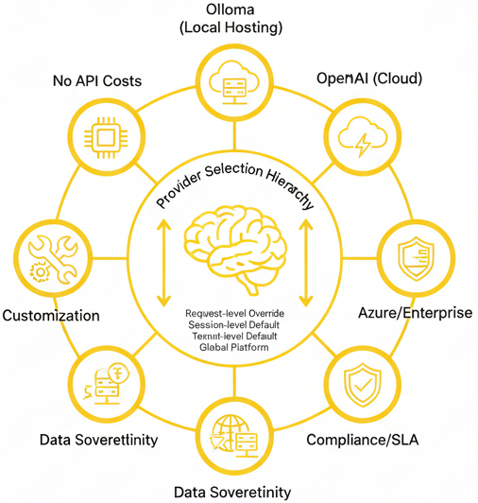
LLM PROVIDERS (Model-Agnostic Architecture) The platform works with any OpenAI-compatible API — local or cloud.
Ollama (Local Hosting)
A local LLM inference server that runs open-weight models on your own hardware.
Data sovereignty → prompts and responses never leave your infrastructure
No API costs → only pay for compute resources
Offline capable → works without internet connectivity
Customization → fine-tune models for domain-specific tasks
Supported Models:
Phi-3 Mini → Microsoft's small-but-capable model (3.8B parameters), optimized for reasoning
Mistral / Mixtral → High-quality open models from Mistral AI, excellent reasoning-to-size ratio
LLaMA 2/3 → Meta's open foundation models (7B–70B), widely adopted baseline
Qwen → Alibaba's multilingual models, strong on diverse languages
Gemma → Google's lightweight models, optimized for efficiency
OpenAI (Cloud)
Hosted API with state-of-the-art proprietary models
Benefits: Zero infrastructure, automatic updates, rich features
Models: GPT-4/4o/4 Turbo, GPT-3.5 Turbo
Azure OpenAI / Others
Enterprise-grade OpenAI access via Azure or compatible providers
Benefits: Compliance certs, regional data residency, SLA guarantees
Compatible: Azure OpenAI, Anthropic Claude, vLLM, text-generation-inference
Provider Selection Hierarchy
Request-level override
↓ (if not set)
Session-level default
↓ (if not set)
Tenant-level default
↓ (if not set)
Global platform default
This allows:
Users to override for specific requests
Teams to set their preferred provider
Platform admins to set organization-wide defaults
Arman Feili

Slide 23
MCP RUNTIME & TOOLS - 34 Tools, 12 Categories - (Part 1/5) Every Model Context Protocol (MCP) tool the agent can invoke is registered, validated, authorized, and audited.
Tool Registry → All tool definitions (manifests) stored in PostgreSQL (name, description, input schema, scopes, rate limits). Enables query available tools.
Tool Policies → RBAC per tool. JWT scopes checked before invocation → 403 if unauthorized.
MCP Runtime → ToolContext carries identity/permissions. All calls audited (inputs, outputs, caller, duration).
Tool Invocation Flow
User Request
↓
Input Structure Validation via JSON Schema
- If invalid input → 400 Bad Request
↓
RBAC Check (If caller has required scopes)
- If missing scope → 403 Forbidden
↓
Execute Tool (actual operation)
- If execution error → 500 with error details
↓
Log All Attempts, Even Failures
↓
Return Result
Tool Manifest (PostgreSQL Record)
{
"name": "graph.secure_query", # Unique tool identifier
"description": "Execute tenant-isolated Cypher query",
"input_schema": { # JSON Schema for parameter validation
"type": "object",
"properties": {
"cypher": { "type": "string" },
"params": { "type": "object" }
},
"required": ["cypher"]
},
"required_scopes": ["graph:read"], # Authorization
"rate_limit": { # Per-user, 100 requests per 60 seconds
"requests": 100,
"window": 60
}
}
Arman Feili

Slide 24
MCP RUNTIME & TOOLS - 34 Tools, 12 Categories - (Part 2/5) Every Model Context Protocol (MCP) tool the agent can invoke is registered, validated, authorized, and audited.
1) GRAPH: Query and interact with Memgraph
Tool | Description | Example
query | Execute raw Cypher | MATCH (b:Blast) RETURN count(b) → Returns count of all Blast nodes
secure_query | Cypher with tenant isolation | MATCH (b:Blast)-[:OUTPUT]->(f:File) RETURN b, f LIMIT 10 → Only returns data for caller's tenant
generate_cypher | NL-to-Cypher translation | "How many Blast nodes are there?" → Generates: MATCH (b:Blast) RETURN count(b)
schema | Get graph schema | Returns: Nodes: [Blast, BlastDb, BlastedSeq, File], Relationships: [OUTPUT, INPUT]
explain | Query plan without execution | "Profile the query that finds top Blast by outdegree" → Returns EXPLAIN output only
2) SECURITY — Inspect permissions and access control
Tool | Description | Example
describe_principal | Show current identity | Returns: { user_id: "u-123", tenant: "cineca", roles: ["operator"], scopes: ["graph:read"] }
allowed_operations | List permitted actions | "Do I have permission to run write queries?" → Returns: { graph:read: ✓, graph:write: ✗, admin:all: ✗ }
validate | Check specific operation | "Can I delete Blast nodes?" → Returns: { allowed: false, reason: "Missing scope: graph:write" }
3) SYSTEM — Platform health and configuration
Tool | Description | Example
health | Component status | Returns: { postgres: "healthy", redis: "healthy", memgraph: "healthy" }
metrics | Current metrics | Returns: { active_jobs: 3, agent_runs_today: 127, llm_tokens_used: 45000 }
config | View configuration | Returns: { default_model: "gpt-4o", rate_limit: 100/min, tenant: "cineca" }
status | Overall status | Returns: { api: "running", workers: 2, queue_depth: 5 }
Arman Feili

Slide 25
MCP RUNTIME & TOOLS - 34 Tools, 12 Categories - (Part 3/5)
Every Model Context Protocol (MCP) tool the agent can invoke is registered, validated, authorized, and audited.
4) CACHE — Redis cache operations
Tool | Description | Example
get | Read cached value | cache.get("blast_count") → Returns: 186 (cached from previous query)
set | Store value | cache.set("blast_count", 186, ttl=3600) → Caches result for 1 hour
delete | Remove key | cache.delete("blast_count") → Removes cached value
invalidate | Clear pattern | cache.invalidate("blast_*") → Clears all Blast-related cache entries
5) CATALOG — Tool and resource discovery
Tool | Description | Example
discover | List resources | Returns: { node_types: ["Blast", "BlastDb", "File"], tools: 34, models: 3 }
describe | Resource details | catalog.describe("Blast") → Returns properties: [blast_version, blasttype, dbname, status, ...]
search | Search catalogs | catalog.search("sequence") → Returns: [BlastedSeq, BlastSeq]
6) MODEL — LLM provider management
Tool | Description | Example
list | Available models | Returns: ["gpt-4o", "gpt-3.5-turbo", "phi3:mini (Ollama)"]
info | Model details | model.info("gpt-4o") → Returns: { context_window: 128k, cost: $0.01/1k tokens }
warmup | Pre-load model | model.warmup("phi3:mini") → Loads model into GPU memory for faster first response
switch | Change model | model.switch("gpt-3.5-turbo") → Sets as active model for this session
Arman Feili

Slide 26
MCP RUNTIME & TOOLS - 34 Tools, 12 Categories - (Part 4/5) Every Model Context Protocol (MCP) tool the agent can invoke is registered, validated, authorized, and audited.
7) AGENT — Agent state management
Tool | Description | Example
context | Current context | Returns last 5 messages + current graph schema + user permissions
history | Past interactions | Returns: [{ prompt: "Count Blast nodes", response: "186", timestamp: ... }]
state | Read/write state | agent.state.set("last_query_type", "graph") → Persists for session
8) ANALYTICS — Data analysis operations
Tool | Description | Example
query | Analytical query | "Which output type (File, BlastDb, BlastedSeq) is most frequently produced?" → Returns aggregated counts
aggregate | Compute aggregations | "Compute completeness ratio: Blast nodes having both blast_version and blasttype" → Returns: 78%
visualize | Generate viz data | Returns chart-ready JSON: { labels: ["File", "BlastDb"], values: [120, 66] }
9) ADMIN — Database administration (admin-only)
Tool | Description | Example
create_index | Add index | "Create an index on Blast(blast_version)" → CREATE INDEX ON :Blast(blast_version)
drop_index | Remove index | DROP INDEX ON :Blast(blast_version)
constraint | Add constraint | CREATE CONSTRAINT ON (b:Blast) ASSERT b.task_id IS UNIQUE
Arman Feili

Slide 27
MCP RUNTIME & TOOLS - 34 Tools, 12 Categories - (Part 5/5) Every Model Context Protocol (MCP) tool the agent can invoke is registered, validated, authorized, and audited.
10) ETL — Data import/export and transformation
Tool | Description | Example
import | Load data | etl.import("samples.csv", target="Sample") → Creates Sample nodes from CSV
export | Extract data | "Export the top 10 BlastedSeq with most inbound OUTPUT" → Returns downloadable dataset
transform | Transform data | "Set default value blast_version='N/A' for Blast where missing" → Bulk update
11) CRUD — Graph node operations
Tool | Description | Example
create_node | Create node | crud.create("Blast", { task_id: "task-001", status: "running" })
update_node | Update node | crud.update("Blast", { id: "blast-123" }, { status: "completed" })
delete_node | Delete node | "Delete Blast nodes with no OUTPUT edges" (admin-only, prompts for confirmation)
12) EXPORT — Output format conversions
Tool | Description | Example
csv | Export as CSV | Query results → blast_version,blasttype,status\n"2.12.0","blastn","success"\n...
json | Export as JSON | Query results → [{ "blast_version": "2.12.0", "blasttype": "blastn", ... }]
cypher | Export as Cypher | Nodes → CREATE (:Blast { blast_version: "2.12.0", blasttype: "blastn" })
Arman Feili

Slide 28
NL-to-CYPHER PIPELINE (Graph Mode) Once the orchestrator detects GRAPH intent, a 6-stage NL-to-Cypher pipeline is triggered.
6 Pipeline Stages
1. Normalize (Standardize input (Make all lowercase, remove fillers))
Example: "Hey, how many Blast nodes??" → "count blast nodes"
2. Catalog Lookup (Check for pre-validated pattern match)
If matched → use cached Cypher (fast, deterministic)
If not → proceed to LLM
3. Generate Cypher (LLM generates query using schema context)
Example:
"Which BlastedSeq has the most inbound OUTPUT?” → LLM Generates → MATCH (b:Blast)-[:OUTPUT]->(s:BlastedSeq) RETURN s, count(b) ORDER BY count DESC LIMIT 10
4. Validate (6-Layer)
Syntax check, Tenant boundary, Query depth, timeout, result size limits
Read-only enforcement (blocks DELETE, SET unless admin)
5. Execute (Run on Memgraph via graph.secure_query)
Tenant isolation enforced, timing metrics captured
6. Summarize
LLM converts results to natural language + structured data
Example:
Natural language: "The BlastedSeq with the most connections is 'BlastedSeq-001' with 15 inbound OUTPUT relationships from Blast nodes.”
Structured data: { node: "BlastedSeq-001", count: 15 }
End-to-End Example
"Show 5 Blast pairs outputting to same BlastedSeq"
1. Normalize → "blast pairs same blastedseq limit 5"
2. Catalog → No match → LLM
3. Generate →
MATCH (b1:Blast)-[:OUTPUT]->(s)<-[:OUTPUT]-(b2:Blast) WHERE b1<>b2 LIMIT 5
4. Validate → ✓ Read-only ✓ Tenant ✓ Depth ✓ Timeout
5. Execute → Returns 5 pairs
6. Summarize →
"Found 5 Blast pairs sharing BlastedSeq targets..."
Arman Feili

Slide 29
DATA LAYER – REDIS, POSTGRESQL, MEMGRAPH - (Part 1/4) There are 3-database architecture: Redis for speed, PostgreSQL for durability, Memgraph for relationships.
Database Comparison
Aspect | Redis | PostgreSQL | Memgraph
Role | Speed layer | Durability layer | Relationship layer
Use Case | Cache, queues, rate limits | State, audit, config | Graph queries, lineage
Data Model | Key-value + structures | Relational tables | Property graph
Query | Commands (GET, SET, LPUSH) | SQL | Cypher
Persistence | Optional (RDB/AOF) | Always (WAL, ACID) | Always (WAL)
Consistency | Eventual | Strong (ACID) | Strong (ACID)
Scaling | Horizontal (cluster) | Vertical (replicas) | Vertical
Latency | Sub-ms | Low ms | Low ms (in-memory)
Transactions | Limited (Lua scripts) | Full ACID | Full ACID
Memory | In-memory | Disk + cache | In-memory + disk
Platform Keys | session:*, jobs:queue:*, ratelimit:* | agent_runs, jobs, audit_logs | :Blast, :File, [:OUTPUT]
Failure Mode | Data loss if not persisted | Safe (WAL) | Safe (WAL)
Arman Feili

Slide 30
DATA LAYER – REDIS, POSTGRESQL, MEMGRAPH - (Part 2/4) Redis for Speed (Cache & Queues): In-memory data store for caching, queueing, and real-time coordination.
Cache (Fast Lookups)
Rate Limiting (Sliding Window)
Key Pattern | Purpose | Example
session:{id} | Session data | User context, conversation history
tenant:config:{id} | Tenant settings | Rate limits, default models
model:defaults:{id} | Model preferences | Per-user/tenant model choices
Key Pattern | Purpose
ratelimit:user:{id} | Per-user quotas (e.g., 100 req/min)
ratelimit:tenant:{id} | Per-org quotas
ratelimit:endpoint:{path} | Per-endpoint throttling
Cache (Fast Lookups)
Control (System Coordination)
Key Pattern | Purpose | Operations
jobs:queue:{type} | Job queue | LPUSH to enqueue, BRPOP to consume
jobs:events:{id} | SSE event buffer | Ring buffer for progress streaming
jobs:state:{id} | Job state | HASH with status, timestamps, metadata
Key Pattern | Purpose
idempotency:{key} | Prevents duplicate job creation
circuit:{provider} | Circuit breaker state for LLM providers
jobs:cancel:{id} | Cancellation flag for cooperative shutdown
Arman Feili

Slide 31
DATA LAYER – REDIS, POSTGRESQL, MEMGRAPH - (Part 3/4) PostgreSQL for durability: Relational database for durable state, audit trails, and transactional operations.
Core Tables
Table Names | Purpose | Key Fields | Details
tenants | Multi-tenant configs | id, name, admin_email, metadata | Tenant isolation. Unique lowercase name. Cascade deletes.
agent_runs | Execution records | id, session_id, status, result_json, todos, steps, metrics | Status: queued→running→succeeded/failed. ETags for caching.
agent_sessions | Conversation state | id, user_id, status, llm_preferences, tools, max_steps | Status: active→completed/cancelled. Configures tools & limits.
agent_steps | Per-step records | id, session_id, seq, type, input, output, status | Type: message/tool/system/error. Unique (session_id, seq).
jobs | Async job records | id, type, status, payload_json, result_json, idempotency_key | Status: queued→running→finished/failed. Idempotency + ETags.
job_events | Progress events | job_id, event_type, event_json, created_at | Append-only log. Used for SSE streams via to_sse_event().
tools | MCP tool definitions | name, version, input_schema, output_schema, owner_tenant_id | Versioned. JSON Schema validation. Unique (name, version).
tool_invocations | Tool execution audit | eid, tool_name, status, params_json, result_json, latency_ms | Status: pending→running→finished/failed. Idempotency support.
model_defaults | Default model selection | scope, tenant_id, instance_id | Hierarchy: request → session → tenant → global.
user_default_models | User model prefs | user_id, tenant_id, chat_instance_id | Per-user preferences. Unique (user_id, tenant_id).
providers | LLM provider registry | id, name, type, base_url, model, config_json | Type: openai_compatible/custom. Tenant or global scope.
provider_secrets | Encrypted API keys | provider_id, api_key_encrypted | Separate table. Encrypted at rest. 1:1 with provider.
audit_logs | Compliance trail | action, resource_type, resource_id, user_id, timestamp | Actions: create/update/delete. Indexed for fast queries.
idempotency_keys | Request dedup | key, owner_user_id, response_body, status_code | Prevents duplicates. Stores cached response for replay.
Arman Feili

Slide 32
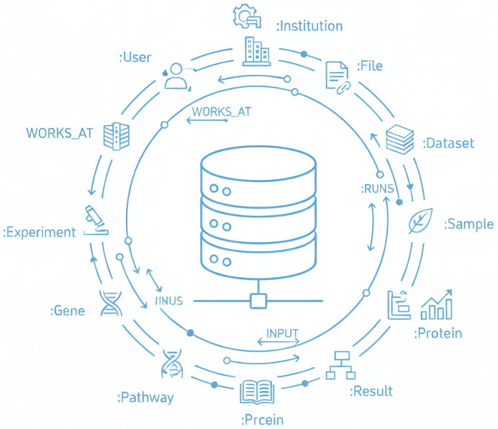
DATA LAYER – REDIS, POSTGRESQL, MEMGRAPH - (Part 4/4) Memgraph (Graph Database): Property graph database for bioinformatics data with native Cypher support.
Node Types (14 types):
Node Label | Key Properties | Description
:User | user_id, firstName, lastName, email | Platform users
:Institution | id, name, country, type | Research organizations
:Task | task_id, status, start, tags | Computational jobs (Blast, CreateDb, Bold, etc.)
:File | file_id, user_filename, size, extension | Data files (Fasta, BlastDb, Xml, BlastedSeq)
:Dataset | id, name, description, version | Data collections
:Sample | id, name, organism, tissue | Biological samples
:Experiment | id, name, protocol, date | Lab experiments
:Publication | id, doi, title, journal, year | Research papers
:Gene | id, symbol, name, chromosome | Genetic sequences
:Protein | id, name, sequence, function | Protein data
:Pathway | id, name, description | Biological pathways
:Tool | id, name, version, type | Analysis tools
:Workflow | id, name, steps, inputs | Pipeline definitions
:Result | id, type, metrics, timestamp | Analysis outputs
Relationship Types (4 types):
Relationship | Pattern | Properties
WORKS_AT | (User)-[:WORKS_AT]->(Institution) | since, role, department
RUNS | (User)-[:RUNS]->(Task) | when user executes a task
INPUT | (File)-[:INPUT]->(Task) | file consumed by task
OUTPUT | (Task)-[:OUTPUT]->(File) | file produced by task
Arman Feili

Slide 33
ADAPTERS
The platform connects to LLMs and databases through swappable adapters
LLM Adapters
The platform supports multiple LLM providers through a unified adapter interface.
Each adapter translates the platform's internal API to the provider's specific format.
If you want to switch from OpenAI to Azure, you just swap the adapter. The rest of the code stays the same
Adapter | Provider | Use Case
Ollama | Local (Phi-3, Mistral, LLaMA) | Data sovereignty, no costs, offline
OpenAI | GPT-4, GPT-3.5 | State-of-the-art, zero infra
Azure OpenAI | Azure-hosted | Enterprise compliance, SLA
Stub/Demo | Mock responses | Testing, CI/CD
Database Adapters
Using adapters means the orchestrator code just calls cache.get() or graph.query() without knowing the underlying implementation details. If you switch from Redis to Memcached, you only change the adapter, not the business logic.
Adapter | Functions | Description
Redis | cache.get/set, queue.push/pop, ratelimit.check, lock.acquire | In-memory infrastructure for caching (TTL), async job queues, rate limiting, and distributed locks.
PostgreSQL | repository.CRUD, transaction.begin/commit, query.execute | Durable relational persistence: ORM-based CRUD, ACID transactions, and raw SQL for complex queries.
Memgraph | graph.query, graph.secure_query, graph.nl_to_cypher, graph.schema | Graph data layer: raw and tenant-isolated Cypher queries, NL→Cypher translation, and schema introspection for context.
Arman Feili

Slide 34
RESILIENCE FRAMEWORK
The platform handles failures with backup plans instead of crashing.(Circuit breaker, Retries, Fallbacks)
Circuit Breaker: (Stop calling a broken service)
If an LLM provider becomes unavailable, stops sending it requests. Each provider has independent circuit breaker state stored in Redis (circuit:{provider}).
States:
CLOSED: Normal operation. Requests go through.
OPEN: Service is broken. Requests are immediately rejected without trying. Returns fallback instead.
HALF-OPEN: Waiting to test recovery. Allows one (or a few) request(s) through to check if the service is healthy again.
Example: If OpenAI returns 5 consecutive 500 errors, circuit opens → requests immediately fail-fast → after 60s, one test request allowed → if successful, circuit closes.
Retries:
If a request fails once, try again with an exponential delay (This prevents hammering a recovering service)
1st attept → 0s, 2nd attempt → 1s, 3rd attempt → 2s, 4th attempt → 4s, 5th attempt → 8s, …
Provider Fallback Chain
If the primary provider fails, the system automatically tries the next provider in the chain.
Request → Primary Provider (e.g., OpenAI GPT-4) → Fallback 1 (e.g., Azure OpenAI GPT-4) → failure → Fallback 2 (e.g., Ollama Mistral)
Cost Tracking:
Every LLM call is metered for billing and capacity planning.
Metric | What It Tracks | Why We Care
tokens_input | How many tokens in the prompt | Bigger prompts cost more
tokens_output | How many tokens in the response | Longer answers cost more
cost_usd | Estimated dollar cost | For billing and budgets
latency_ms | How long it took | For performance monitoring
Arman Feili

Slide 35
BACKGROUND FRAMEWORK - APScheduler
The platform runs scheduled background tasks using APScheduler
APScheduler is a Python job scheduler that executes tasks at fixed intervals without manual intervention.
Task | Frequency | What It Does
Health Check | Every 30 seconds | Pings all critical services (PostgreSQL, Redis, Memgraph) to detect failures early. Also checks LLM providers are responsive and warms up models.
Cleanup | Every hour | Removes stale data to prevent database bloat: expired sessions, old cache entries, completed/failed jobs older than retention period, orphaned agent runs.
Backup | Daily | Creates recovery snapshots: PostgreSQL pg_dump, Redis RDB snapshot, Memgraph archives, and exports audit logs for compliance.
Provider Monitoring | Every 60 seconds | Checks LLM provider health, updates circuit breaker states, and emits metrics for dashboards.
Arman Feili

Slide 36
OBSERVABILITY - (Part 1/2)
The platform provides full visibility into system behavior through metrics, traces, and logs.
Tracing (OpenTelemetry → APM Backend)
Every request is traced end-to-end with distributed tracing using OpenTelemetry.
How it works:
Request arrives → App creates trace span → Child spans for: LLM call, DB query, tool invocation → OTLP export to collector → Visualize in Jaeger / Tempo / Datadog
What It Captures:
Span | What It Captures
agent_run | Full execution from prompt to response
step_execution | Each TODO step within a run
tool_invocation | Every MCP tool call with inputs/outputs
db_query | PostgreSQL, Redis, Memgraph queries with timing
llm_call | LLM requests with model, tokens, latency
job_lifecycle | enqueue → execute → complete/fail/cancel
Why tracing?
When a request is slow, you can see exactly where time was spent — was it the LLM? The database? A specific tool?
Arman Feili

Slide 37
OBSERVABILITY - (Part 2/2)
The platform provides full visibility into system behavior through metrics, traces, and logs.
Prometheus
Prometheus scrapes metrics from the app and workers every 15 seconds.
Metric Category | Examples
HTTP | http_request_duration_seconds, http_requests_total (by endpoint, method, status)
Agent Runs | agent_run_duration_seconds, agent_run_total (by status: success/failed)
Steps | agent_step_duration_seconds, agent_step_total (by type: tool/llm/graph)
Tools | tool_invocation_duration_seconds, tool_invocation_total (by tool name)
LLM | llm_tokens_total, llm_cost_usd_total, llm_latency_seconds (by provider/model)
Circuit Breaker | circuit_breaker_state (0=closed, 1=open, 0.5=half-open)
Jobs | job_queue_depth, job_processing_duration_seconds, job_total (by status)
System | component_health (1=healthy, 0=unhealthy per component)
Grafana:
Pre-built Grafana dashboards visualize all metrics
Dashboard | Shows
HTTP Overview | Request rate, latency percentiles (p50/p95/p99), error rate
Agent Runs | Runs per minute, success rate, average duration, step breakdown
Job Processing | Queue depth, processing time, completion rate, failures
Tool Invocations | Most-used tools, latency by tool, error rates
LLM Providers | Provider health, circuit breaker states, token usage, costs
System Health | Component status (green/red), database connection pools, memory usage
Arman Feili

Slide 38
PHASE 4: COMPLETION - Agent Run (Workflow A)
For synchronous agent runs that execute in-process via BackgroundTasks.
State Machine:
queued → running → succeeded/failed
queued: Run created, waiting to start
running: Orchestrator is actively processing
succeeded: Completed successfully with output
failed: Error occurred during execution
Build API Payload:
Completion Steps:
Log and store the completion event with timestamp, duration, and outcome in agent_runs table.
Build API Payload
Return HTTP Response immediately → Status code: 200 OK (success) or 500 (failure)
Client Polling (if needed) → client polls GET /agent-runs/{id}
{
"id": "run-abc123",
"status": "succeeded",
"outputs": ["Found 5 institutions collaborating on..."],
"steps": [
{ "type": "llm", "action": "classify_intent", "latency_ms": 340 },
{ "type": "tool", "action": "graph.query", "latency_ms": 120 }
],
"todos": [
{ "action": "query_graph", "status": "completed" },
{ "action": "summarize", "status": "completed" }
],
"metrics": {
"duration_ms": 2340,
"tokens_input": 850,
"tokens_output": 420
}
}
Arman Feili

Slide 39
PHASE 4: COMPLETION - Long-Running Job Completion (Workflow B) - (Part 1/2)
For async jobs that run in a separate worker process.
State Machine:
queued → running → finished/failed/cancelled
queued: Job in Redis queue, waiting for worker
running: Worker picked it up, actively processing
finished: Completed successfully
failed: Error occurred
cancelled: User requested cancellation
Completion Steps:
1. Update PostgreSQL jobs table:
{status = 'finished',
completed_at = NOW(),
result_json = '{"response": "Found 5 institutions...", "tokens": 1850}’}
2. Record Events: Every state is recorded as an event in job_events table. Events are append-only (never deleted) for compliance
seq_id | event_type | event_json | created_at
1 | queued | {"queue": "agent.run"} | 10:00:00
2 | started | {"worker": "worker-1"} | 10:00:02
3 | progress | {"step": 1, "message": "Classifying intent"} | 10:00:03
4 | progress | {"step": 2, "message": "Executing graph query"} | 10:00:05
5 | progress | {"step": 3, "message": "Generating response"} | 10:00:08
6 | complete | {"status": "finished", "duration_ms": 8000} | 10:00:10
Arman Feili

Slide 40
PHASE 4: COMPLETION - Long-Running Job Completion (Workflow B) - (Part 2/2)
For async jobs that run in a separate worker process.
3. Progress Event Format
stage: Which phase: initialization, orchestration, finalization
message: Human-readable description of current action
percent: Progress bar value (0-100) for the UI
{"stage": "orchestration",
"message": "Executing step 3 of 5: graph.query",
"percent": 60}
4. Stream Updates via Server-Sent Events (SSE),
SSE is a way for the server to push updates to the client in real-time (one-way communication).
Server sends empty ping every 15s, to prevent connection timeout. Client displays progress bar and step-by-step log
How it works:
Client opens: GET /v1/jobs/{id}/events
Server sends:
event: started
data: {"status": "running"}
event: progress
data: {"message": "Step 2 of 5", "percent": 40}
event: progress
data: {"message": "Step 5 of 5", "percent": 95}
event: complete
data: {"status": "finished", "result": {...}}
5. Emit Terminal Status - Client knows to close the SSE connection and stop polling/listening
Final SSE event: { "event": "complete", "status": "finished", "result": {...}
Arman Feili

Slide 41
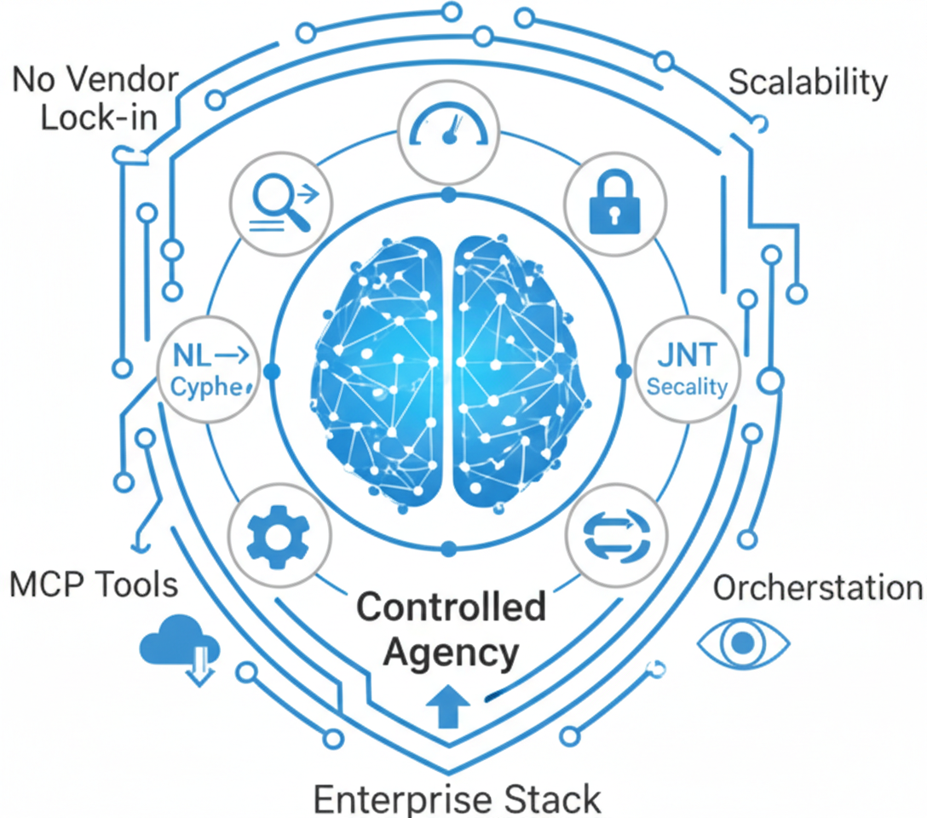
CONCLUSION
Closed the production gap
Closed the production gap:
NL → Cypher with safe, auditable, reproducible workflows, no dev bottleneck, no black-box risk.
Full enterprise stack delivered:
Secure UIs, gateway, orchestration, workers, and DBs, built for CINECA’s multi-tenant ops.
Controlled agency, not chat:
Agent runs plan & execute via MCP tools, with RBAC, tenant isolation, I/O guards, and safe NL→Cypher (normalize → lookup → gen → 6-check → exec → summarize).
Production-ready at scale:
76 FastAPI endpoints, 34 tools, Redis + Postgres + Graph DB, auto-tests, retries, fallbacks, circuit breakers.
Built-in observability:
Tracing (OpenTelemetry), metrics (Prometheus), dashboards (Grafana), for debugging, auditing, and cost tracking.
No vendor lock-in:
Plug in OpenAI, Azure, Ollama; select per request/session/tenant, supporting sovereignty & cost control.
Key contribution:
A secure, extensible NL-to-action platform, ready for tools/models/tenants expansion at Sapienza & CINECA.
Arman Feili

Slide 42
COMPARISON WITH SOTA
Capability-by-capability comparison of your CINECA Agentic Platform against Top-10 similar platforms
Platform | Full Stack (UI + API + Jobs) | Orchestration Durability (Retries, Resume) | Agent Planning Loop (Multi-Step Tools) | Tool Ecosystem & Schema Controls | Security & Governance (RBAC, Audit) | Graph NL→Cypher Support (Secure + Tenant-Aware) | Observability (Tracing, Metrics, LLM Logs) | LLM-Agnostic (Model Provider Independent) | License / Pricing | Typical Limitation Compared to CAP | Fit Score
CINECA Agentic Platform | ✔ Full-stack: UI + API + Jobs | ✔ Durable: retries + checkpoints | ✔ Built-in MCP loop engine | ✔ Native registry + schema audit | ✔ JWT, RBAC, tenancy, I/O guards | ✔ Built-in NL→Cypher with validation & tenancy | ✔ Full telemetry + LLM evals | ✔ Yes (OpenAI, Ollama, etc.) | Custom-built (Internal only) | — | ★ 5.0
Temporal | ✘ Engine only (no UI/tools) | ★ Best-in-class workflow durability | ✘ No agentic planning loop | ~ Pluginable tools (not MCP-native) | ✔ Fine-grained RBAC + auth options | ✘ No graph layer | ✔ Metrics + traces | ✔ Yes | Free OSS (MIT) + Paid Cloud | No agentic loop or UI; not a full platform | ★★ 4.0
Argo Workflows | ~ K8s-native stack | ✔ DAGs + Retry Semantics | ✘ No agent loop | ~ Container steps only | ~ Basic RBAC via K8s | ✘ No Cypher / graph features | ~ Limited metrics | ✔ Yes | Free OSS (Apache-2.0) | K8s-focused; lacks planning & tool UX | ★★ 3.5
LangGraph | ✘ Library only | ✔ Durable w/ state checkpointing | ✔ Agent loop with state machine model | ✔ Built-in agent tool patterns | ✘ No RBAC / audit; DIY needed | ~ Custom NL→Cypher possible | ~ Partial (via adapters) | ✔ Yes | Free OSS (MIT) | No orchestration stack; governance must be added manually | ★★ 4.0
OpenAI Agents SDK | ✘ SDK only | ~ Runtime-level retry only | ✔ SDK-defined agent planning | ✔ Typed tools as functions | ✘ No RBAC or tenancy | ~ Custom Cypher interface possible | ~ Logs via app code | ~ Partial (OpenAI-focused) | Free OSS (MIT) + Paid OpenAI API | No job system, no multi-tenant security | ★★ 3.5
Semantic Kernel | ✘ Middleware only | ~ Retry via plugins | ✔ Plugin-based agent orchestration | ✔ Tools + DI + planner interfaces | ~ Basic auth via host app | ~ Requires custom NL→Cypher logic | ~ Custom logs via adapters | ✔ Yes | Free OSS (MIT) | Middleware only; lacks orchestration/runtime infra | ★★ 3.5
LlamaIndex | ✘ RAG/agent SDK | ~ Partial retries | ✔ Tool-using planner + query agents | ✔ Strong RAG support | ✘ No RBAC, audit, tenancy | ~ External Cypher logic possible | ~ Logs via app code | ✔ Yes | Free OSS (MIT) + Paid Cloud | No durability, security, or orchestration stack | ★★ 3.0
Haystack | ✘ Library only | ~ Retryable components | ✔ Agent + tools (non-durable) | ✔ Tool abstraction + DSL | ✘ No auth/governance | ~ Cypher possible w/ custom nodes | ~ Basic logs | ✔ Yes | Free OSS (Apache-2.0) | Not production-grade orchestration | ★★ 3.0
n8n | ✔ GUI product + workflow UI | ✔ Retry + error steps | ~ Linear tool invocation (not agentic) | ✔ Large integration catalog | ~ Role-based app-level security | ✘ Not graph-native | ~ Workflow logs; no LLM eval | ✔ Yes | Free OSS (SUL) + Paid Cloud SaaS | Good for automation; lacks agentic structure | ★★ 2.5
Windmill | ✔ UI + job scripting platform | ✔ Durable jobs + cron | ✘ No agent loop | ✔ Script-based tool definitions | ✔ RBAC, SSO, auditing | ✘ Not graph-native | ~ Run logs and dashboards | ~ Partial (not LLM-centric) | Free OSS (AGPL mix) + Paid tiers | Good for internal workflows; lacks agent stack | ★★ 3.5
Langfuse | ✘ Observability layer only | ✘ No execution | ✘ No planning or tool use | ~ Eval schema for prompts/tools | ~ Some logging support | ✘ Not applicable | ✔ Best-in-class for LLM tracing | ✔ Yes | Free OSS (MIT Core) + Paid SaaS | Tracing/monitoring only; no workflow or orchestration | ★★ 3.0
Arman Feili

Slide 43
FUTURE WORKS
Make Orchestration More Autonomous and More Reliable
Continue at CINECA (fixed-term contract):
per latest HR update, keep improving, scaling, and deploying the platform across other CINECA HPC software environments.
Alternatively, contribute to other AI-related areas aligned with CINECA priorities, depending on team needs and preferred direction.
Unify Workflows A + B (single lifecycle; B as default)
Merge both into one execution path; use Workflow B (jobs + workers) as the base because it’s durable, fault-tolerant, scalable, SSE-native. Keep a “sync-like” UX by streaming job events immediately (no in-process execution).
Add “Ask Mode” (non-agentic Q&A / data retrieval)
Lightweight path: no TODO decomposition, but still enforce RBAC, tenant isolation, validation, auditing.
Strengthen autonomy and reliability in the orchestration engine:
Handle more prompt types reliably (easy → hard, clean → messy)
Example (easy): “How many Blast nodes are there?”
Example (ambiguous): “Show top collaborations.” → ask “top by what?” or apply a safe default.
Example (multi-intent): “Find top institutions and export to CSV.” → plan: query → export.
Example (risky): “Delete failed jobs.” → refuse or require admin + confirmation.
Recover and reproduce runs (checkpointing + deterministic re-runs)
Example: worker crashes after step 2/5 → resume from step 3, not restart.
Smarter scheduling under load (priorities + quotas + caps + backpressure)
Example: Prioritize quick interactive chat jobs over long ETL jobs.
Example: Tenant A max 20 concurrent jobs; Tenant B max 5.
Arman Feili

Slide 44
Thanks For Your Attention
Arman Feili

