Slide 1



CINECA AGENTIC PLATFORM
An Enterprise-Grade Multi-Tenant AI Orchestrator with MCP Tools and Secure Graph Querying
Department:
Information Engineering, Electronics and Telecommunications
University Advisor:
Prof. Maria De Marsico
University Co-Advisors: Prof. Marco Raoul Marini
Dr. Valerio Venanzi
University:
Sapienza University of Rome
Academic Year:
2025/2026
Author:
Arman Feili
Company:
CINECA
Cineca Advisors: Dr. Giuseppe Melfi
Dr. Marco Puccini
All rights relating to this teaching material and its contents are reserved by Sapienza and its authors (or teachers who produced it). Personal use of the same by the student for study purposes is permitted. Its dissemination, duplication, assignment, transmission, distribution to third parties or to the public is absolutely prohibited under penalty of the sanctions applicable by law.

Slide 2
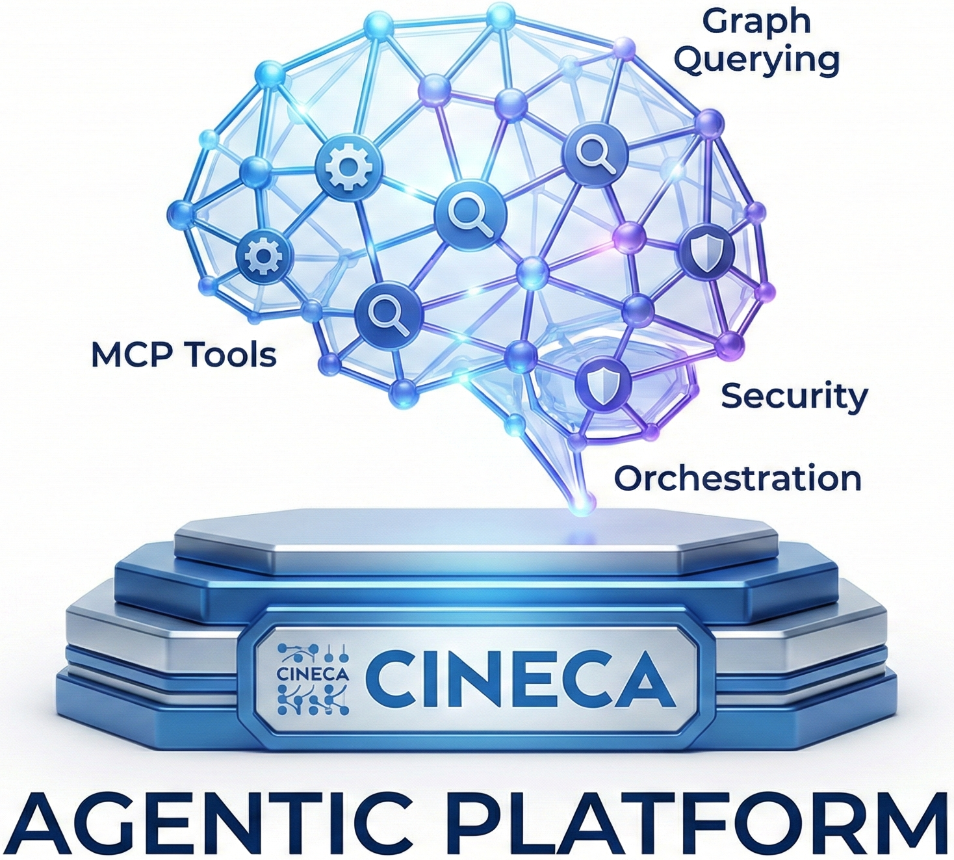
INDEX
Overview of the presentation structure
Production Gap
Final Architecture (Simplified + Full)
What Was Delivered
Authentication Layer & UI
Security Middleware Stack
API Layer - Routers
Job Creation
Workers + Agent.run Handler → Job Processing Engine
Service Layer → Orchestrator Service
LLM Providers → Model-Agnostic Architecture
MCP Runtime & Tools - 34 Tools, 12 Categories
Data Layer → Redis, PostgreSQL, Memgraph
Adapters + Resilience
Background Tasks + Observability
Comparison with the State of the Art
Conclusion + Future Work
Arman Feili

Slide 3
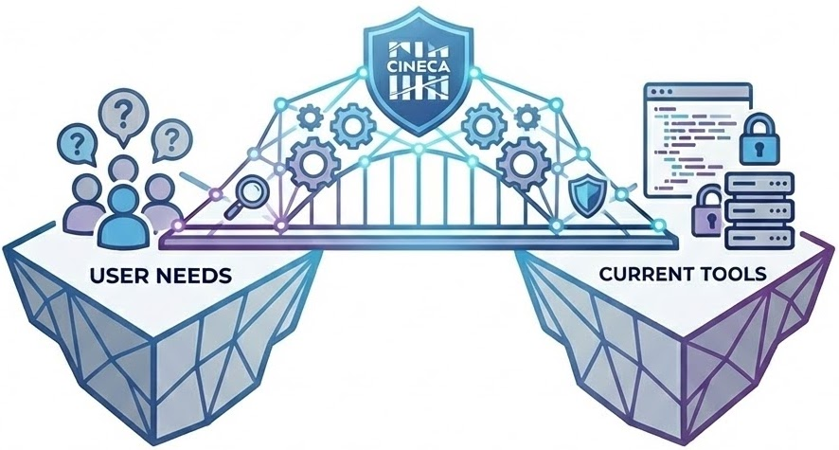
PRODUCTION GAP
The gap between what users need and what current tools provide.
The Problem
Most users cannot write Cypher, so they depend on developers to access graph data. This creates delays and keeps data locked behind technical complexity.
Why Simple Chatbots Are Not Enough
Basic chatbots can answer questions, but they cannot
handle multi-step tasks
query databases or run jobs
enforce security and access control
provide audit trails and traceability
Why This Matters for CINECA
CINECA needs a platform that lets users query graph data directly in natural language, while remaining:
Secure
Scalable
Reproducible
cost-efficient
flexible across LLM providers
Arman Feili

Slide 4
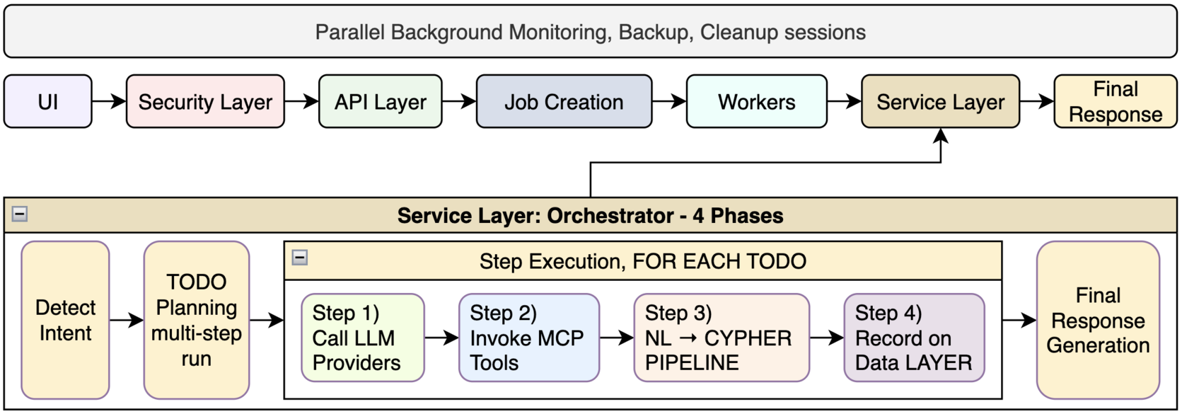
FINAL ARCHITECTURE
Simplified
Arman Feili

Slide 5
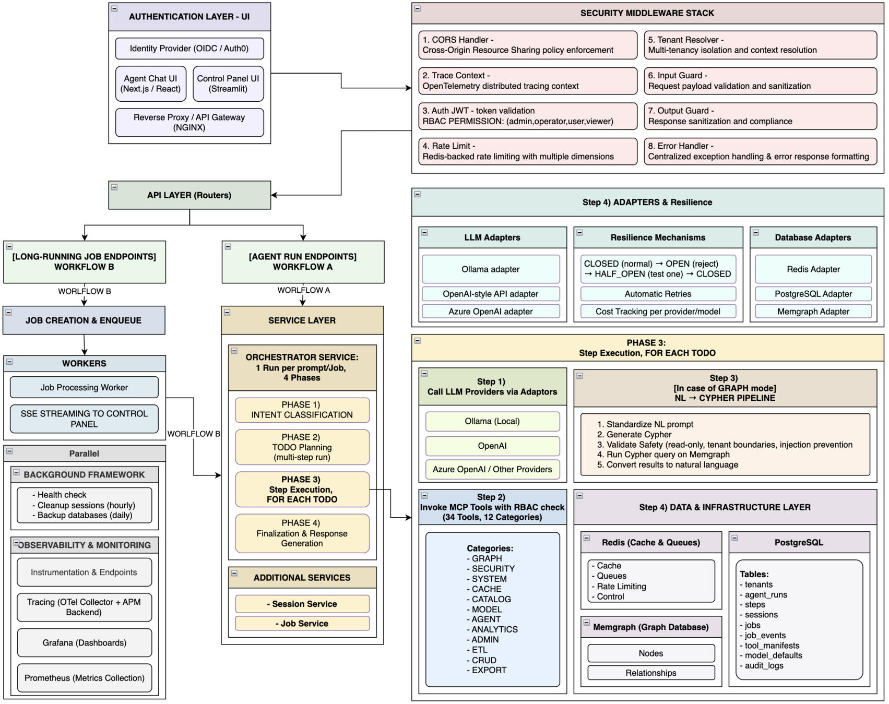
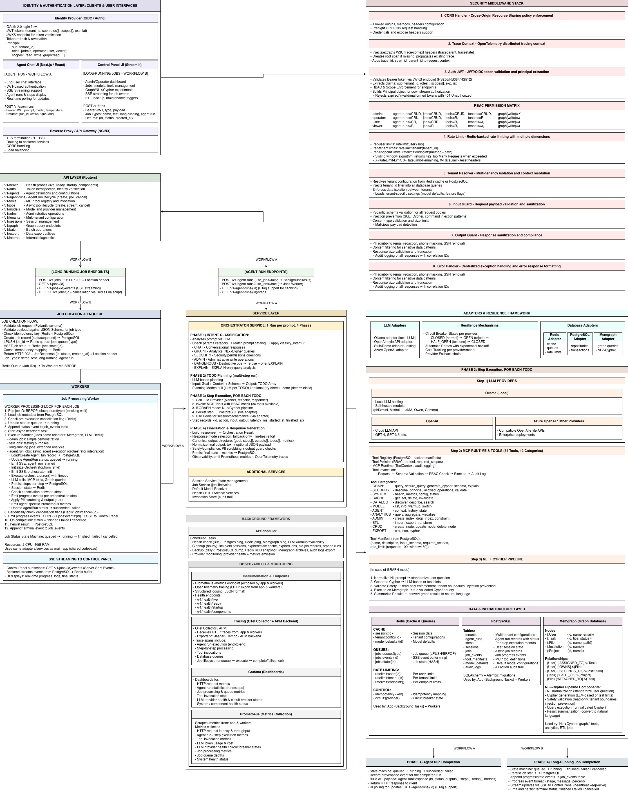
FINAL ARCHITECTURE
Full
Arman Feili

Slide 6
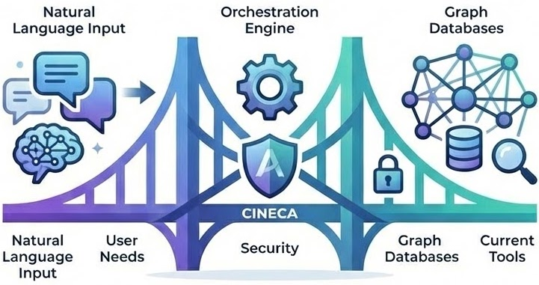
WHAT WAS DELIVERED
A production-ready agentic platform for secure natural-language access to graph data.
Core Delivery
End-to-end platform: UI, APIs, orchestration, workers, and a three-database backend
Safe 4-phase agent workflow with NL→Cypher capabilities
Multi-tenant security and support for multiple LLM providers
Reliability, background processing, and observability built in
Production Evidence
16+ platform components (databases, queues, gateway, tracing)
76 API endpoints across 16 router groups (e.g. auth, tools, jobs, graph)
34 tools across 17 categories with governed execution
3,000+ automated tests (unit, integration, security, end-to-end)
~411,700 total lines of code
Arman Feili

Slide 7
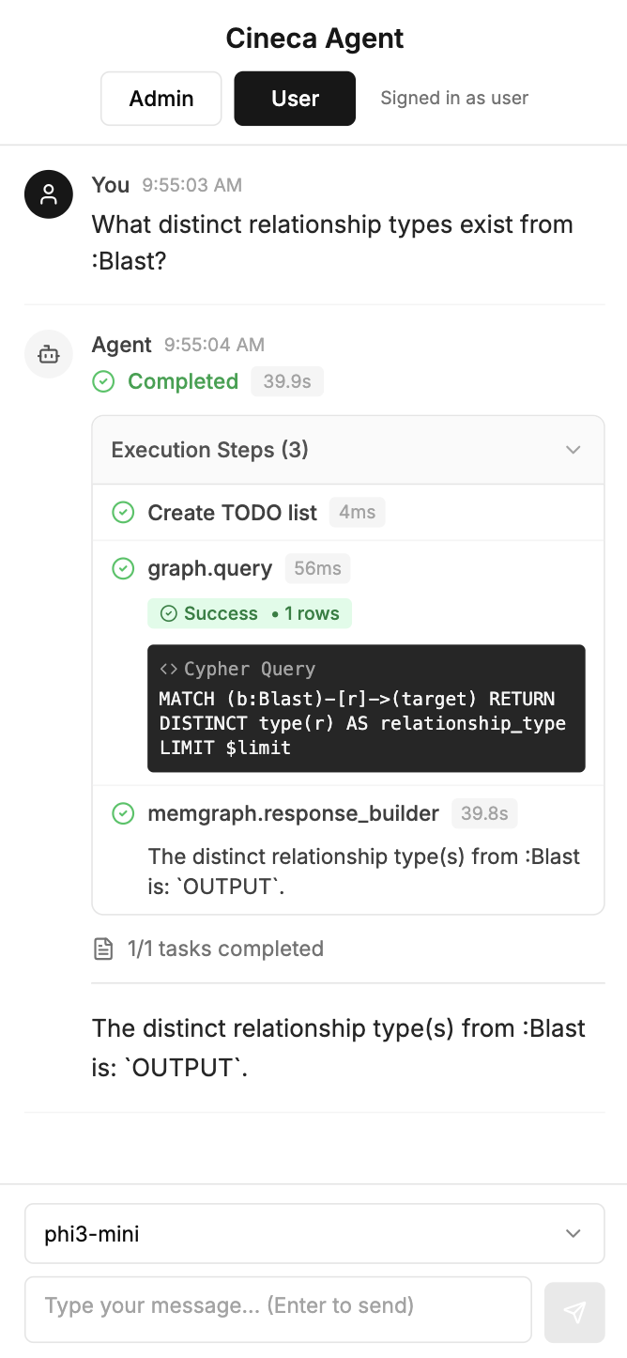
AUTHENTICATION LAYER & UI
Users sign in through an identity provider, receive a JWT, and access the platform through a secure gateway.
Authentication & Access
Users log in with OAuth 2.0 and receive a JWT with their identity, tenant, role, and permissions
Every request verifies the token and applies role-based access control
The UI adapts to different access levels
Agent Chat UI
Main interface for asking questions in natural language and interacting with agents
Sends authenticated requests to the backend
Shows live progress, execution steps, final results, and the selected model
Gateway
NGINX handles secure access, routing, and CORS
Arman Feili

Slide 8
SECURITY MIDDLEWARE STACK (Part 1/2)
Every request passes through 8 Security middleware layers before reaching the business logic.
1. CORS Handler Controls which websites can call the API. - Example: requests from the official chat UI are allowed; unknown domains are blocked. 2. Trace Context Assigns a trace ID so one request can be followed across the whole system. - Example: one user request can be tracked through the API, orchestrator, and database. 3. JWT Auth + RBAC Checks the user token and enforces role-based permissions. - Example: a viewer tries to delete a run and gets 403 Forbidden. 4. Rate Limiter Prevents abuse by limiting how many requests can be sent. - Example: after too many requests in one minute, the user gets 429 Too Many Requests.
Role | agent-runs | jobs | tools | tenants | Graph (write)
admin | CRUD | CRUD | CRUD | CRUD | ✓
operator | CRU | CRUD | R | R | ✗
user | CR | CRD | R | ✗ | ✗
viewer | R | R | R | ✗ | ✗
Arman Feili

Slide 9
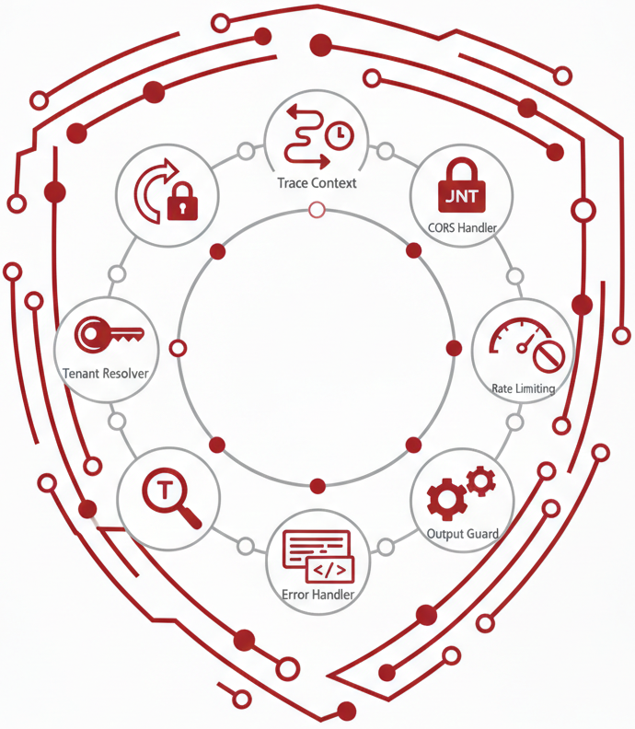
SECURITY MIDDLEWARE STACK (Part 2/2)
Every request passes through 8 Security middleware layers before reaching the business logic.
5. Tenant Resolver Ensures each user only accesses data from their own organization. - Example: a user from one tenant cannot see data from another tenant. 6. Input Guard Validates requests and blocks unsafe or malformed input. - Example: an injection-like prompt is rejected before execution. 7. Output Guard Cleans responses before they are returned to the user. - Example: an email address in the output is redacted. 8. Error Handler Returns safe, standardized errors without exposing internal details. - Example: a database failure returns a generic error plus a correlation ID.
Arman Feili

Slide 10

API LAYER - Routers
The platform exposes 76 endpoints grouped by domain under versioned APIs.
Core API Groups
/v1/health → service and dependency health checks
/v1/auth → authentication and token validation
/v1/agents → agent definitions and configuration
/v1/tenants → tenant settings, limits, and feature control
/v1/models → LLM provider and model management
/v1/tools → MCP tool discovery and invocation
Execution APIs
/v1/jobs → long-running jobs, live progress, and cancellation
/v1/agent-runs → start runs, track status, get results, cancel execution
/v1/graph → direct Cypher queries and NL→Cypher execution
/v1/sessions → session and conversation state management
Operational APIs
/v1/admin → maintenance tasks, cache control, and system stats
/v1/export → export runs, job results, and audit logs
Arman Feili

Slide 11
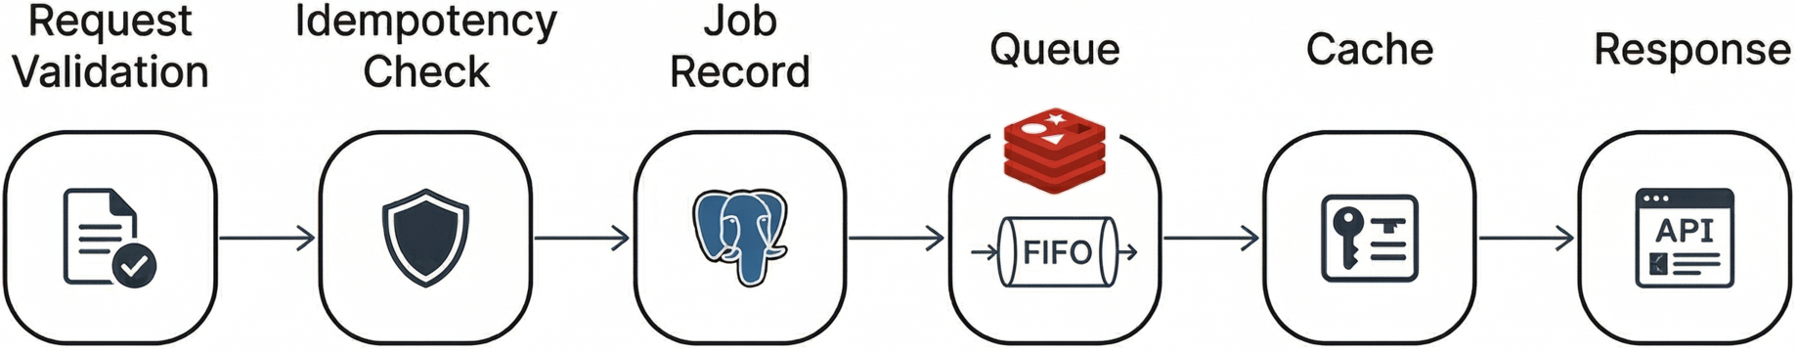
JOB CREATION
Client submits a long-running task → the system validates it, avoids duplicates, and queues it safely.
1. Request Validation
Checks required fields and payload structure
Example: agent.run must include prompt, user_id, and tenant_id
2. Idempotency Check
Looks for an existing job with the same idempotency key
Example: if the client retries after a timeout, the same job is returned
3. Job Record Creation
Creates a new PostgreSQL job record with status = queued
Example: the job is stored before execution starts
Supported Job Types
demo, test, long-running, agent.run
4. Queue Enqueue
Pushes the job ID into the Redis queue for workers
Example: agent.run jobs go to jobs:queue:agent.run
5. Idempotency Cache
Stores key → job ID mapping in Redis for fast duplicate detection
Example: future retries can return the same job immediately
6. HTTP Response
Returns 202 Accepted with the job ID and status
Example: client receives a Location header to poll /v1/jobs/{id}
Arman Feili

Slide 12
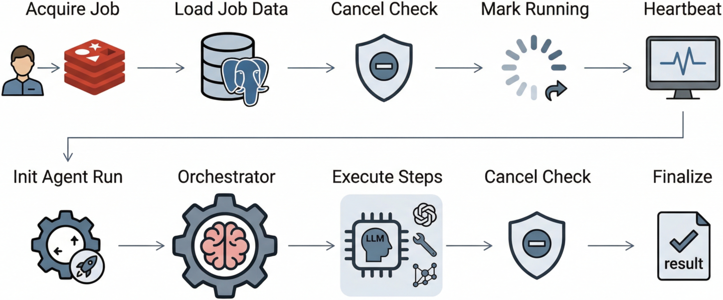
WORKERS + AGENT.RUN HANDLER → JOB PROCESSING ENGINE (Part 1/2)
Background workers pick up queued jobs and execute full agent workflows reliably outside the API process.
1. Acquire Job
The worker waits for a job in Redis and takes exclusive ownership when one appears
This prevents the same job from being processed twice
2. Load Job Data
Using the job ID, the worker loads the full job record from PostgreSQL
PostgreSQL is the source of truth; Redis only provides the queue entry
3. Check Early Cancellation
Before starting, the worker checks whether the job was cancelled
If already cancelled, execution is skipped safely
4. Mark as Running
The worker updates the job state from queued to running
This state change is stored for tracking, audit, and live updates
5. Start Heartbeat
While the job is active, the worker sends periodic heartbeat updates
If the heartbeat stops, the system can detect a stuck or failed worker
Arman Feili

Slide 13
WORKERS + AGENT.RUN HANDLER → JOB PROCESSING ENGINE (Part 2/2)
Background workers pick up queued jobs and execute full agent workflows reliably outside the API process.
6. Initialize Agent Run
For agent.run jobs, the worker creates an AgentRun record linked to the job
Startup events are emitted so the UI can show immediate progress
7. Run the Orchestrator
The worker calls the orchestrator as the core execution engine
The orchestrator plans and executes the workflow step by step
8. Execute and Persist Steps
Each step may call an LLM, invoke MCP tools, or query the graph
Completed steps are saved immediately so progress is not lost
9. Check Cancellation During Execution
Between steps, the worker checks again whether cancellation was requested
If cancelled, it stops cleanly after the current completed step
10. Emit Progress and Finalize
Progress events are streamed live, outputs are post-processed for safety, and metrics are recorded
At the end, the final result is saved and the job is marked as succeeded or failed
Arman Feili

Slide 14
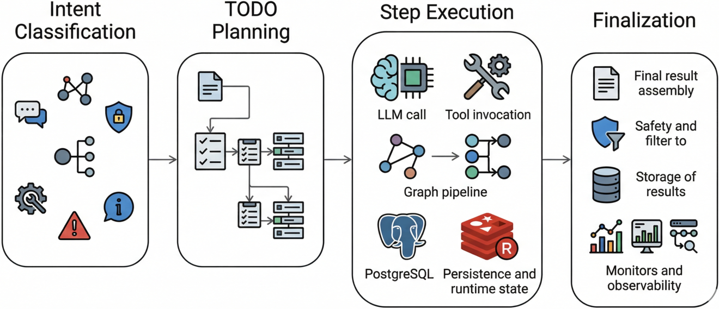
SERVICE LAYER → ORCHESTRATOR SERVICE (Part 1/3) The orchestrator contains the core business logic and processes each prompt in 4 phases.
Phase 1 → Intent Classification
The orchestrator first determines what kind of request the user is making
It checks a prompt catalog first; if no match is found, it uses an LLM classifier
Main intent types include:
CHAT → normal conversational response
GRAPH → NL→Cypher query
SECURITY → permission or access question
ADMIN → administrative action
DANGEROUS → destructive request, refused safely
EXPLAIN → explain an action without executing it
Phase 2 → TODO Planning - For multi-step tasks, the orchestrator turns the prompt into an ordered TODO plan - Planning uses the user request, conversation context, and available schema/tool information - The output is a structured sequence of actions, such as query → analyze → summarize Planning Modes: - full → creates a detailed step-by-step plan for complex tasks - optional → tries direct execution first, plans only if needed - none → uses a fixed path for predefined or catalog-matched requests
Arman Feili

Slide 15
SERVICE LAYER → ORCHESTRATOR SERVICE (Part 2/3) The orchestrator contains the core business logic and processes each prompt in 4 phases.
Phase 3 → Step Execution
The orchestrator executes the TODO plan step by step using LLMs, MCP tools, the graph pipeline, and runtime state.
1. Call LLM Providers
Uses different LLM roles for planning, checking results, and generating responses
Calls go through adapters with retries, fallbacks, and circuit breakers
2. Invoke MCP Tools
Calls tools for graph queries, security checks, cache access, and export
Each tool call is permission-checked and keeps session context
3. Run the Graph Pipeline
For graph requests, the system runs a 6-stage NL→Cypher flow:
normalize input → check catalog match → generate Cypher → validate safety → execute on Memgraph → summarize results.
Validation includes syntax, tenant boundaries, query depth, timeout, result limits, and read-only enforcement
4. Save Progress and Manage State
Each step is saved to PostgreSQL for traceability and recovery
Redis is used for caching and cancellation checks
"Show 5 Blast pairs outputting to same BlastedSeq"
1. Normalize → "blast pairs same blastedseq limit 5"
2. Catalog → No match → LLM
3. Generate →
MATCH (b1:Blast)-[:OUTPUT]->(s)<-[:OUTPUT]-(b2:Blast)
WHERE b1<>b2 LIMIT 5
4. Validate → ✓ Read-only ✓ Tenant ✓ Depth ✓ Timeout
5. Execute → Returns 5 pairs
6. Summarize →
"Found 5 Blast pairs sharing BlastedSeq targets..."
Arman Feili

Slide 16
SERVICE LAYER → ORCHESTRATOR SERVICE (Part 3/3) The orchestrator contains the core business logic and processes each prompt in 4 phases.
Phase 4 → Finalization and Response Generation
The orchestrator assembles the final result, applies safety checks, saves the outcome, and records monitoring data.
1. Build the Final Response
Combines all completed step outputs into one final answer
Can fall back to a cached or default response if needed
2. Normalize the Output
Returns a consistent output format, including user-facing text and optional JSON
3. Apply Safety Checks
Removes sensitive data and filters unsafe content before sending the response
4. Save the Final State
Stores the final status, output, and metrics in PostgreSQL for audit and analysis
5. Emit Observability Data
Records metrics and traces for dashboards, debugging, alerting, and monitoring
{
"goal": "Find collaborating institutions",
"steps": [step1, step2, step3],
"outputs": ["Found 5 institutions..."],
"todos": [completed_todo1, completed_todo2],
"metrics": { "duration_ms": 2340, "tokens": 1850 }
}
Arman Feili

Slide 17
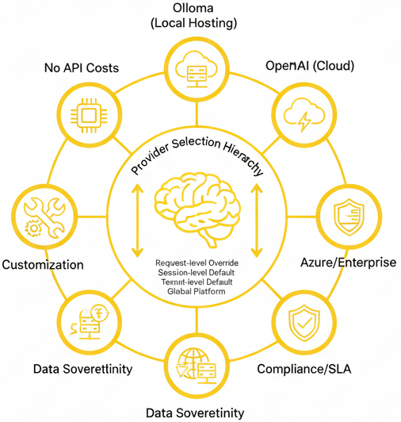
LLM PROVIDERS → MODEL-AGNOSTIC ARCHITECTURE The platform can use multiple LLM providers, both local and cloud, without changing the application logic.
Local Models → Ollama
Supports running open models locally on your own infrastructure
Useful for data control, lower cost, offline use, and custom setups
Example models: Phi-3, Mistral, LLaMA, Qwen, Gemma
Cloud Models → OpenAI / Azure / Others
Supports hosted providers for strong model quality and managed infrastructure
Useful for easy deployment, enterprise compliance, and regional hosting
Examples: OpenAI, Azure OpenAI, and compatible providers
Provider Selection
A model can be chosen at different levels:
This gives flexibility to users, teams, and platform administrators
Request-level override
↓ (if not set)
Session-level default
↓ (if not set)
Tenant-level default
↓ (if not set)
Global platform default
Arman Feili

Slide 18
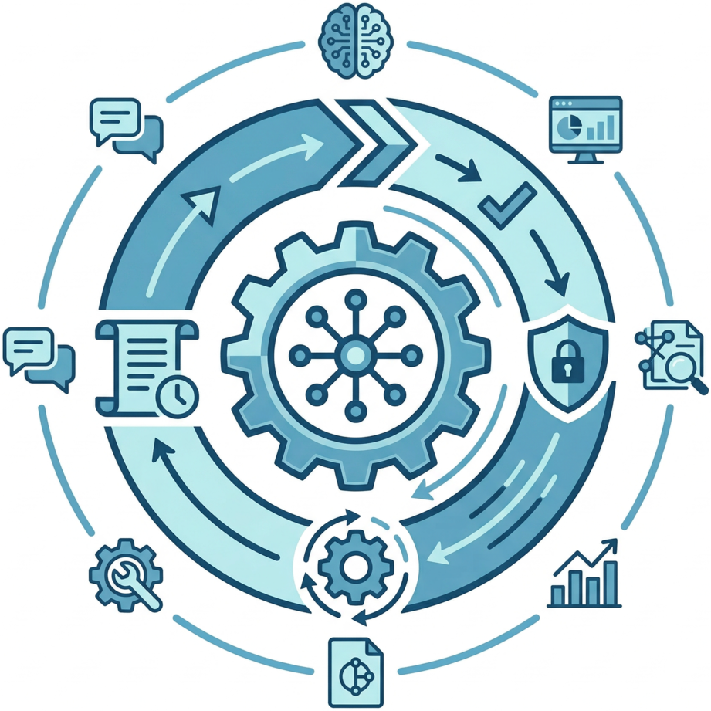
MCP RUNTIME & TOOLS - 34 Tools, 12 Categories Every MCP tool the agent can use is registered, validated, permission-checked, and audited.
Core Ideas
Tool definitions are stored in a registry with schema, required scopes, and limits
Each tool call is checked against user permissions before execution
Tool Invocation Flow
Request → validate input → check permissions → execute tool → audit → return result
Main Categories
Graph → query Memgraph, inspect schema, generate or explain Cypher
Security → inspect identity, permissions, and allowed actions
System → check platform health, metrics, configuration, and status
Catalog → discover available resources, tools, and schemas
Model → list, inspect, warm up, or switch LLMs
Agent → access conversation context, history, and session state
Analytics → run aggregations and prepare visualization data
Admin → perform restricted database administration actions
ETL / CRUD / Export → import data, update graph entities, and export results in formats such as CSV or JSON
Examples
Graph tools can answer a natural-language question by generating and running Cypher
Security tools can tell a user what actions they are allowed to perform
Export tools can return query results as CSV or JSON
Arman Feili

Slide 19
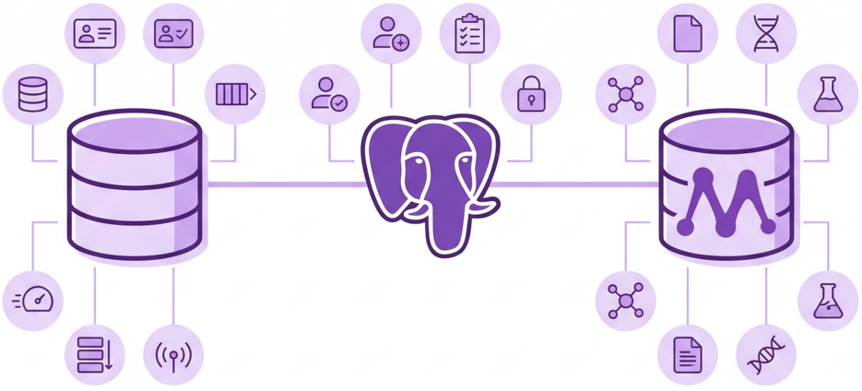
DATA LAYER → REDIS, POSTGRESQL, MEMGRAPH The platform uses three databases, each with a different role: speed, durability, and graph relationships.
Redis → Real-Time Runtime State for speed and real-time coordination
It stores:
cache data, sessions, tenant config, and model defaults
rate limits for users, tenants, and endpoints
job queues, job state, and progress events
cancellation flags, idempotency keys, and circuit-breaker state
PostgreSQL → Durable Platform State for reliable and transactional system data
It stores:
tenants, sessions, runs, steps, and jobs
job events, tool definitions, and tool invocation history
model defaults, user preferences, and provider configs
encrypted secrets, audit logs, and idempotency records
Memgraph → Bioinformatics Graph State for connected bioinformatics data and efficient Cypher queries
It stores:
graph nodes such as users, institutions, tasks, files, datasets, samples, experiments, publications, genes, proteins, pathways, tools, workflows, and results
graph relationships such as WORKS_AT, RUNS, INPUT, and OUTPUT
node and edge metadata such as roles, status, timestamps, tags, and file details
Arman Feili

Slide 20
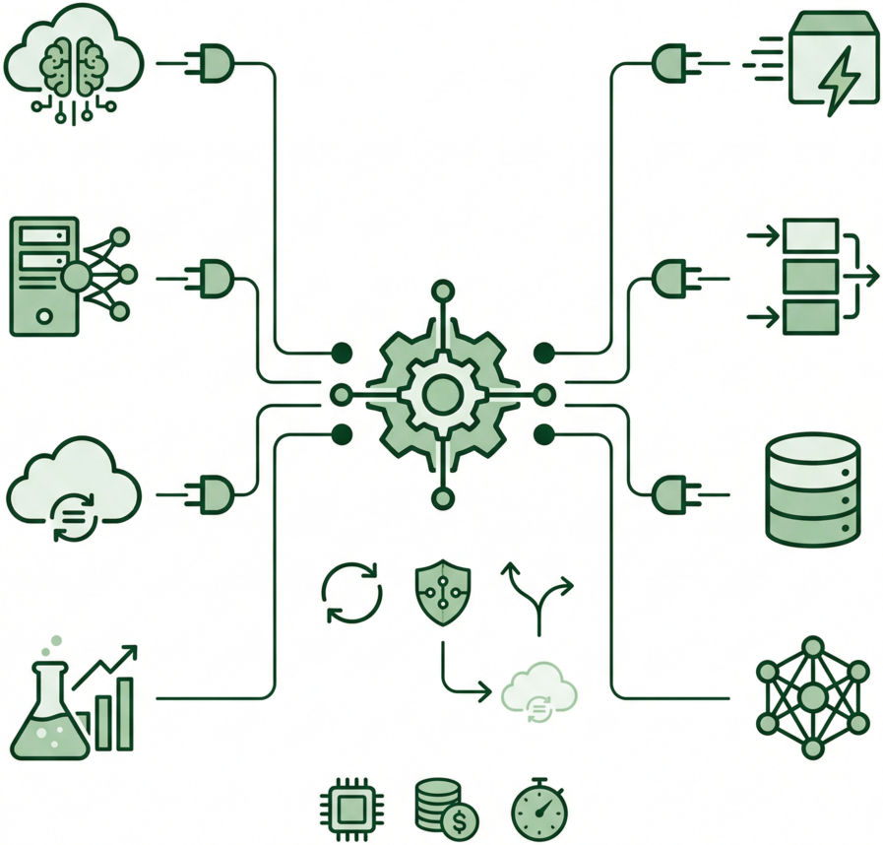
ADAPTERS + RESILIENCE The platform stays flexible and reliable by using swappable adapters and automatic failure handling.
Adapters
The platform uses swappable adapters for both LLM providers and databases
This keeps the business logic independent from specific vendors or storage systems
For LLMs, the same internal interface can work with Ollama, OpenAI, Azure OpenAI, or stub/demo providers
For databases, the same logic can call cache, queue, relational, or graph operations through Redis, PostgreSQL, and Memgraph adapters
Why This Matters
Providers or backends can be changed without rewriting the orchestrator
Example: switching from OpenAI to Azure only changes the adapter, not the rest of the code
The same idea applies to database access such as cache.get() or graph.query()
Resilience
The platform does not fail immediately when a provider has problems
It uses retries with backoff, circuit breakers, and fallback providers
If one provider becomes unhealthy, requests can fail fast or move to another provider
Circuit breakers move between closed, open, and half-open states to control recovery
Operational Tracking
Every LLM call is measured for tokens, cost, and latency
This supports monitoring, budgeting, and capacity planning
Arman Feili

Slide 21
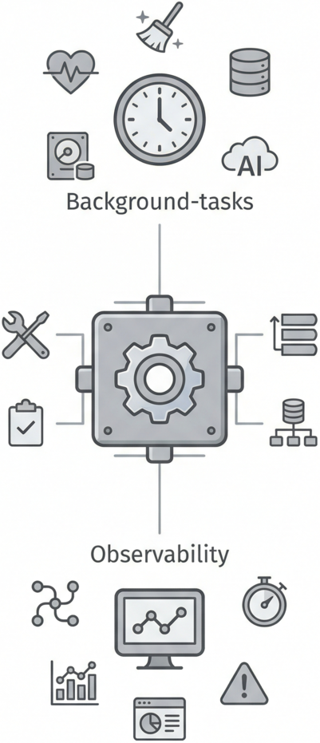
BACKGROUND TASKS + OBSERVABILITY The platform runs scheduled maintenance tasks and collects traces & metrics for visibility, reliability, & recovery.
Background Tasks
APScheduler runs scheduled jobs automatically in the background.
Health checks regularly verify PostgreSQL, Redis, Memgraph, and LLM providers.
Cleanup jobs remove expired sessions, old cache entries, completed jobs, and orphaned runs.
Daily backups protect PostgreSQL, Redis, Memgraph, and audit data.
Provider monitoring updates health status, circuit breakers, and metrics.
Observability
OpenTelemetry traces each request from end to end, including LLM calls, tool invocations, database queries, and job execution.
Prometheus collects metrics from both the app and workers, including HTTP traffic, runs, steps, tools, jobs, LLM usage, circuit breakers, and system health.
Grafana dashboards turn these traces and metrics into views of performance, failures, queue depth, provider health, costs, and overall system status.
Why This Matters
Scheduled background tasks help keep the platform healthy, clean, and recoverable.
Traces and metrics make it easier to diagnose slow requests, failing tools, unhealthy providers, and system-wide issues.
Arman Feili

Slide 22
COMPARISON WITH STATE OF THE ART
Comparison of the CINECA Agentic Platform against Best SOTA platforms
Platform | Platform type | Orchestrator | MCP Tools | Governance | Graph | Monitoring | Model choice | Price | Main value | Why CAP is broader
CINECA Agentic Platform | Full-stack agent platform | ✔ | ✔ | ✔ | ✔ | ✔ | ✔ | Free | Secure enterprise orchestration for cases where users need one platform for agents, jobs, tools, and graph access | CAP is the only one here that combines all major layers in one system
Temporal | Workflow engine | ✔ | ✘ | ✔ | ✘ | ✔ | ✔ | Free | Best for durable backend workflows when retries, recovery, and long-running execution matter most | CAP adds agent planning, MCP-based tooling, and graph-native execution
LangGraph | Agent framework | ✔ | ✘ | ✘ | ✘ | ✘ | ✔ | Free | Best for building custom stateful agents when multi-step reasoning is the main goal | CAP adds security, jobs, UI, and operational platform layers
OpenAI Agents SDK | Agent SDK | ✔ | ✘ | ✘ | ✘ | ✔ | ✘ | Expensive | Best for quickly building tool-using agents when speed and simplicity matter most | CAP adds durability, multi-tenant governance, and graph support
Semantic Kernel | AI middleware | ✔ | ✘ | ✘ | ✘ | ✘ | ✔ | Free | Best for embedding AI into existing enterprise systems when orchestration is only one part of a bigger application | CAP includes the runtime and platform stack that SK leaves to the host app
n8n | Workflow automation platform | ✔ | ✘ | ✘ | ✘ | ✘ | ✔ | Cheap | Best for visual automation and integrations when business workflows matter more than deep agent reasoning | CAP adds true agent orchestration, stronger controls, and secure graph support
Arman Feili

Slide 23
COMPARISON WITH STATE OF THE ART
The CINECA Agentic Platform is more complete than typical libraries.
How CAP Differs:
- It provides a full stack, including UI, APIs, jobs, and orchestration
- It includes durable execution with retries, checkpoints, and background processing
- It supports an agent planning loop with MCP-based tool execution
- It adds strong security and governance through JWT, RBAC, tenancy, and output/input guards
- It includes built-in NL→Cypher support with validation and tenant isolation
- It also includes observability, LLM-provider flexibility, and production controls
How Other Platforms Compare:
- Temporal and Argo are strong for workflow durability, but they are not agent platforms
- LangGraph, OpenAI Agents SDK, Semantic Kernel, LlamaIndex, and Haystack support agent logic, but usually require extra work for security, durability, and platform operations
- n8n and Windmill provide useful workflow UIs, but they are not designed as secure agent orchestration platforms
Main Takeaway
CAP stands out because it combines full-stack delivery, durable orchestration, governed tool execution, secure graph querying, and observability in one platform, while most alternatives are strong only in some of these areas
Arman Feili

Slide 24
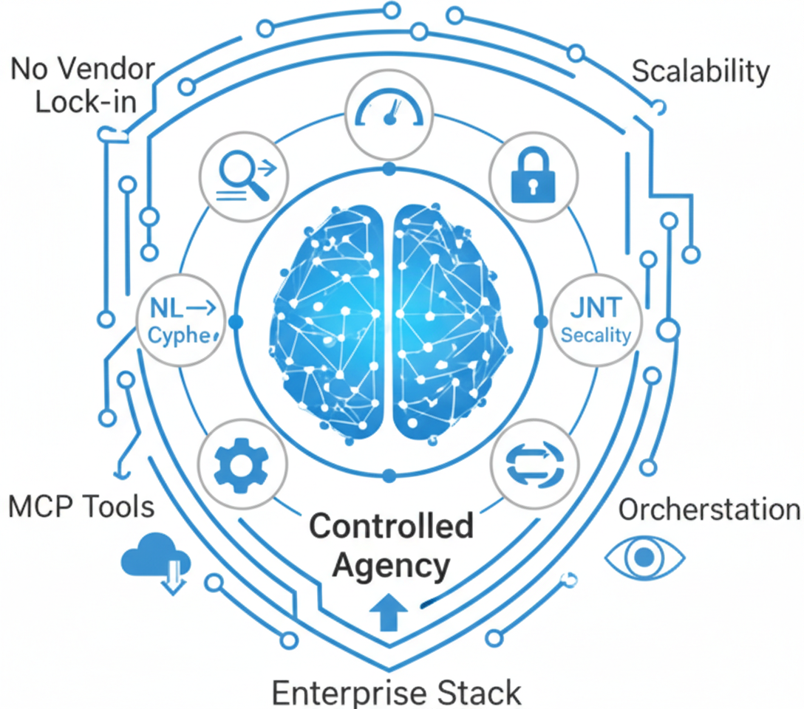
CONCLUSION + FUTURE WORK
Closed the production gap.
What Was Achieved
The platform closes the production gap by turning natural language into safe, traceable graph actions
It delivers a full enterprise stack with secure UIs, APIs, orchestration, workers, and a multi-database backend
Agent runs are controlled, not just conversational, with MCP tools, RBAC, tenant isolation, and safe NL→Cypher execution
It is production-ready, with large API coverage, governed tools, resilience mechanisms, and built-in observability
It remains flexible across providers such as OpenAI, Azure, and Ollama
Key Contribution
A secure and extensible NL-to-action platform ready to grow across tools, models, and tenants
Future Work
Add an “Ask Mode” for lightweight question answering without full agent planning
Make the orchestrator handle more prompt types more reliably, from simple to ambiguous or multi-step requests
Improve recovery and reproducibility through stronger checkpointing and deterministic re-runs
Add smarter scheduling with priorities, quotas, and backpressure under heavy load
Arman Feili

Slide 25
Thanks For Your Attention
Feel free to ask any question
Arman Feili

