Slide 1
Hash table analysis
By N.ARMAN

Slide 2
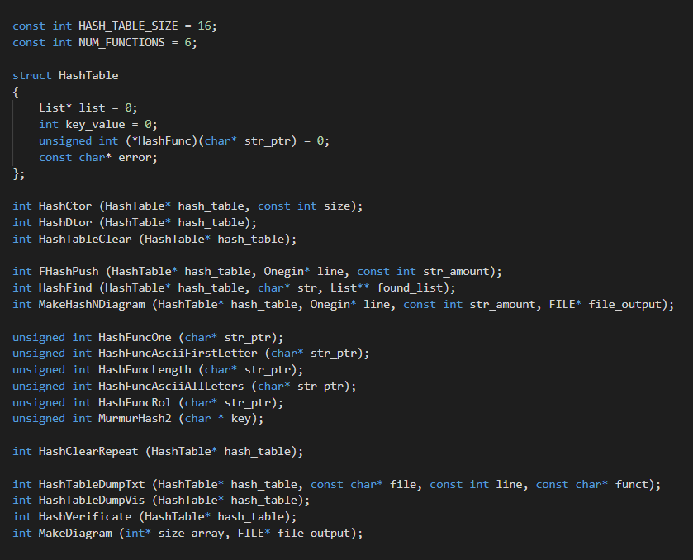
Hash table characters
Size = 16
Num of functions = 6

Slide 3
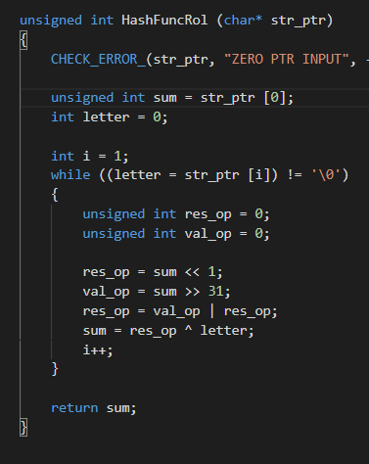
Functions
1. Return 1
2. Return ASCII first letter
3. Return ASCII all str letter
4. Return length of str
5. Have recursive form with ROL
6. MurMurHash

Slide 4
Graph of second function

Slide 5
Graph of third function

Slide 6
Graph of fourth function

Slide 7
Graph of fifth function

Slide 8
Graph of sixth function

Slide 9

Making optimization

Slide 10
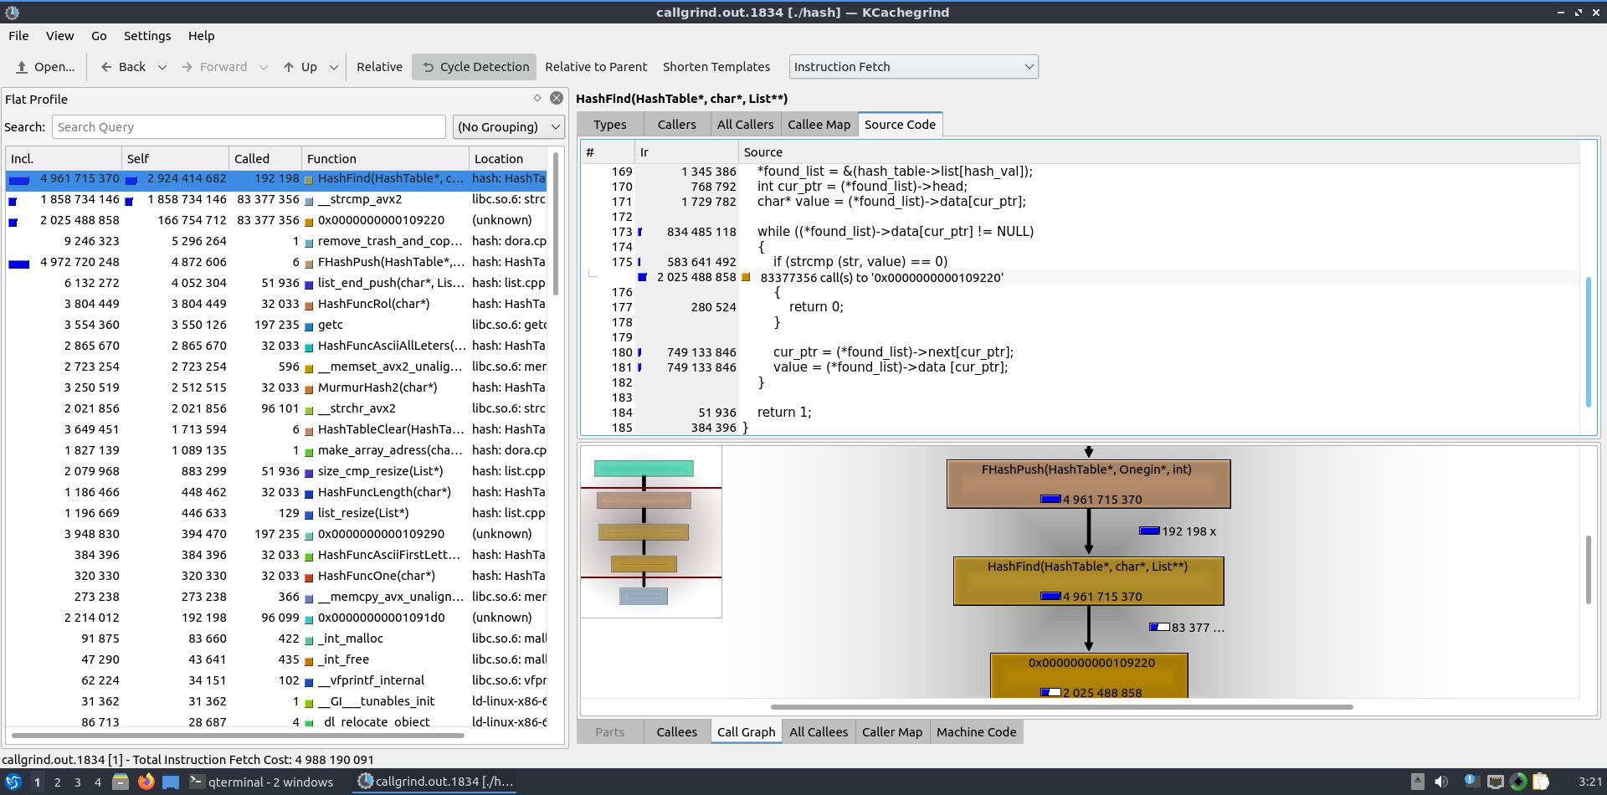
Without opt. flag –O0

Slide 11
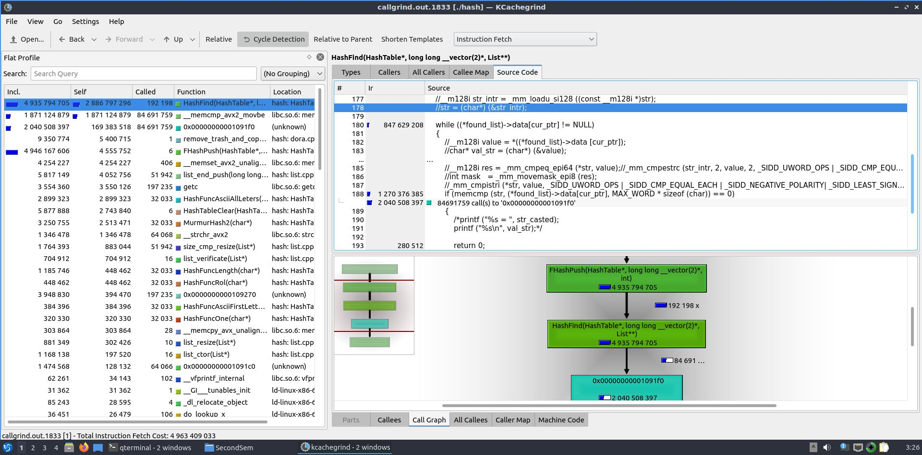
With opt. flag –O0

Slide 12
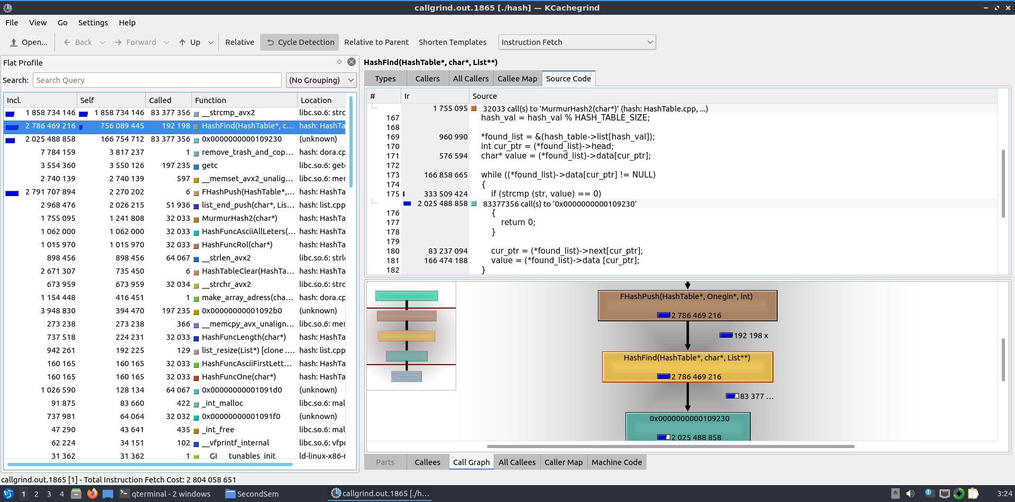
Without opt. flag –O2

Slide 13
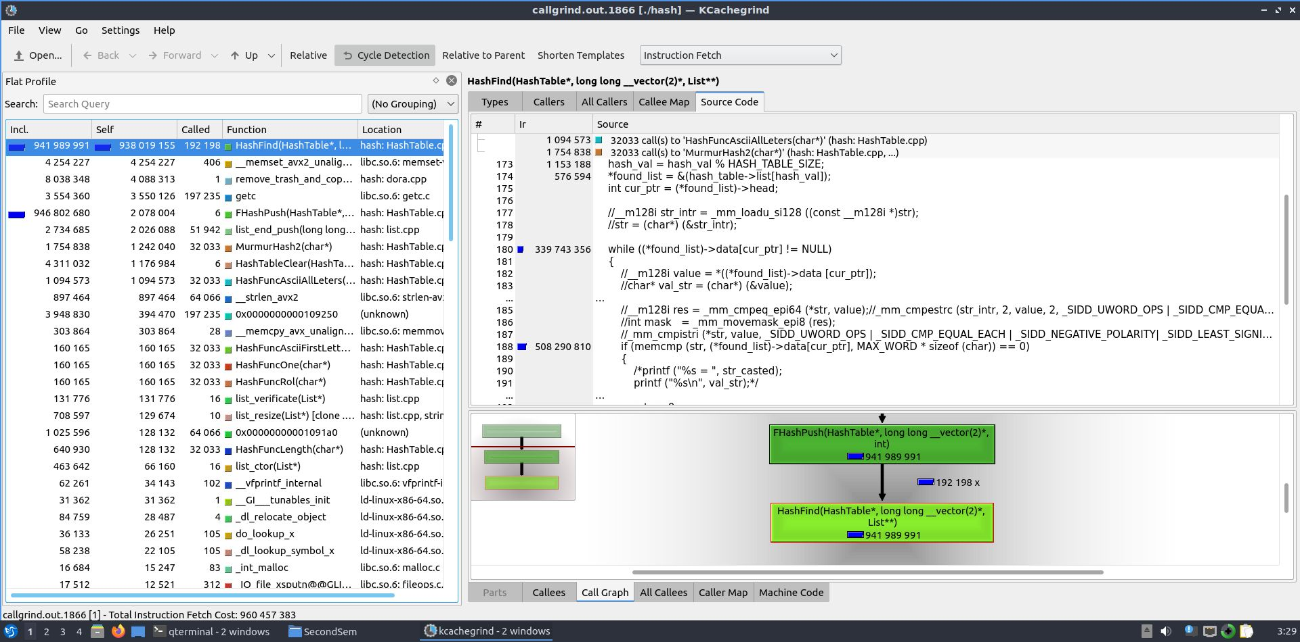
With opt. flag –O2

