Slide 1

UNICORN STORE Sales Report (2015 – 2018)
Investigating Negative Profit (Losses)
Generated by the Product Subcategories

Slide 2

INTRODUCTION
Among the 17 subcategories, there are $2,307,249 total sales in the years from 2015 to 2018. Despite having profit, we have total $22,399 Loss.
 | Total
Sales | $2,307,249
Loss | $22,399

Slide 3
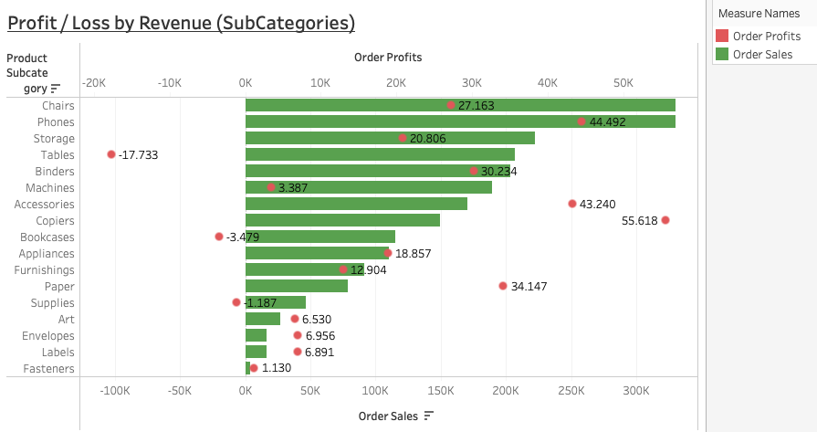
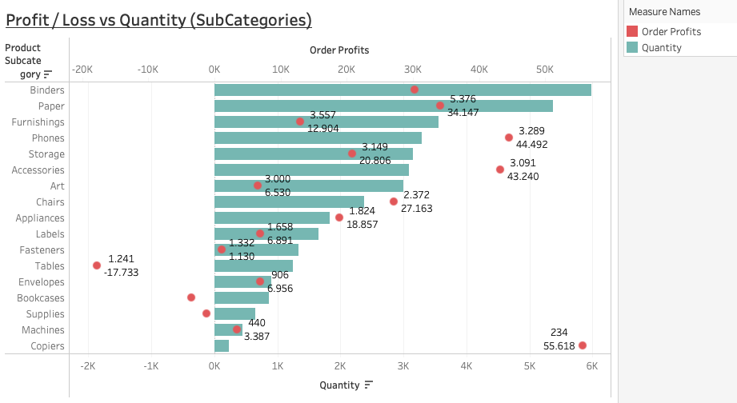
PROFIT / LOSS vs REVENUE
PROFIT / LOSS vs Qty

Slide 4
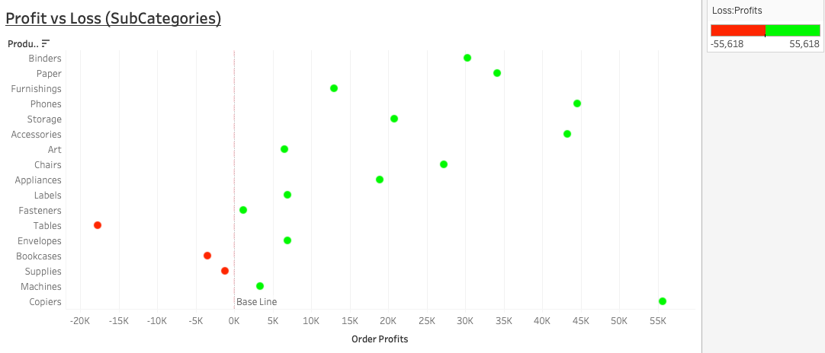

Slide 5
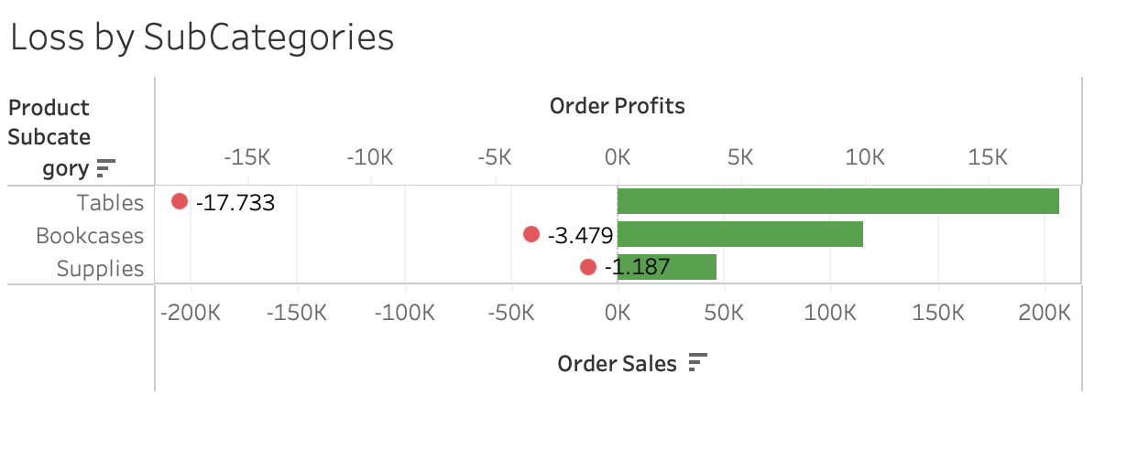
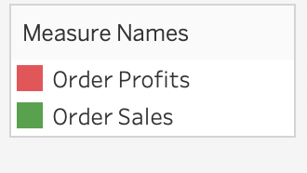
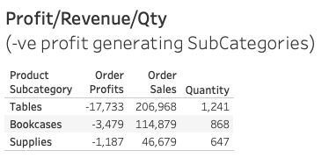
LOSS BY 3 SUBCATEGORIES
 | Total | SubCategory “Table” | Percentage | Rank
Sales | $2,307,249 | $206,968 | 8.97% | 4th
Loss | $22,399 | $17,733 | 79.17% | 1st

Slide 6
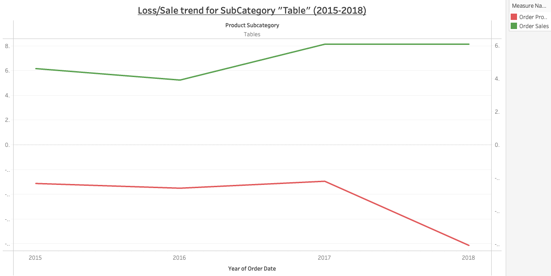

Slide 7

RECOMMENDATIONS
More Investigation (Ex Product Name, Manufacturer) on SubCategory “Table”
Research on the Market Trend of this SubCategory
Rectify the root cause

Slide 8
THANK YOU
Ramya
Arman
Amna
Sri Priya
Data Analytics Team
www.unicorn.com

