Slide 1

SAMSUNG PRISM
Generative AI
Hackathon
3rd Edition 2026 – 27
Theme ID – 05 · Interruptible Real-Time Agents
Team Name – CODALYST
College Name – SRM Institute of Science and Technology (SRMIST)
Member Name & Email 1 – Arman Panigrahi · ap4064@srmist.edu.in
Member Name & Email 2 – Vanshika Singh · vs6813@srmist.edu.in
Member Name & Email 3 – Kushagra Srivastava · ks8869@srmist.edu.in
Submission GitHub link – github.com/armanpanigrahi59/SamsungPrism_GenAI_Hackathon
prism-agent Speculate first. Cancel if wrong. Never freeze.
Notes:
Team CODALYST from SRMIST, Theme 05: Interruptible Real-Time Agents. Our project, prism-agent, is a voice-native assistant that starts working while you are still talking and cancels the moment you change your mind. Members: Arman Panigrahi, Vanshika Singh, Kushagra Srivastava.

Slide 2
Theme
Theme 05 · Interruptible Real-Time Agents — fast-and-slow execution with robust interruption handling
The problem
How Theme 05 is scored
Assistants today are half-duplex: listen, think, then speak. People don't talk that way. They interrupt, re-plan and correct themselves mid-sentence, while a tool call is already running.
…and where prism-agent earns each part
Task completion
40%
“Book a flight from Delhi to Paris on the 5th… actually, make it Tokyo.”
Schema-driven tool calls on a real world flight model
Interruption recovery
35%
Typical half-duplex assistant
Listen
Think
Search Delhi → Paris (stale)
Answers about Paris
Generation-tagged cancellation in ~2 ms, no stale re-runs
Response latency
15%
prism-agent (full-duplex)
Speculative dispatch + instant spoken acknowledgments
Listen + speculate
Cancel ~2 ms
Re-plan: Tokyo
Right answer
Safety & protocol
10%
Only the corrected slot changes: origin and date survive the interruption.
Idempotency keys + JSON-validated actions
Plus a 0.8×–1.2× quality multiplier; multimodal scenarios weigh 1.5× on the hidden set.
Team CODALYST · SRMIST | Samsung PRISM Generative AI Hackathon · Theme 05 — Interruptible Real-Time Agents
2 / 12
Notes:
Theme 05 asks for assistants that keep working when the user interrupts. Standard assistants are half-duplex: they finish a stale search and answer the wrong question. Scoring is 40% task completion, 35% interruption recovery, 15% latency and 10% safety. Our design targets each one directly.

Slide 3




Existing Solutions & Gaps
Barge-in today mostly means “stop talking”. The work already in flight — searches, bookings, half-built state — is left for the developer to clean up.
Typical out-of-the-box behaviour
Classic voice assistants
Alexa · Siri · Google Assistant
Realtime voice LLM APIs
GPT Realtime · Gemini Live
Agent frameworks
LangChain · LangGraph
prism-agent (ours)
Team CODALYST
built-in
partial / developer's job
missing
Barge-in stops speech output
yes
yes
not voice-native
+ ack in ~3 ms
Cancels tool calls already in flight
no
app's job
aborts whole run
~2 ms, per call
Reuses still-valid results after a correction
no
no
no
salvage cache
Session slots with localized corrections
per-skill dialogs
chat history
custom state
SlotState
Never double-books on retries
per skill
app's job
app's job
idempotency keys
Handles tools it has never seen
fixed skills
function calling
tool schemas
manifest → args
Offline, deterministic replay
cloud
cloud
possible
virtual clock
The gap: interruption is handled as an exception to clean up. prism-agent makes cancel-and-re-plan the normal path on every turn.
Team CODALYST · SRMIST | Samsung PRISM Generative AI Hackathon · Theme 05 — Interruptible Real-Time Agents
3 / 12
Notes:
Existing assistants handle barge-in by stopping speech, but the tool calls already running keep going or the whole run is aborted. Nobody reuses the work that a correction did not invalidate, and duplicate bookings on retries are left to the developer. This matrix shows typical out-of-the-box behaviour.

Slide 4
















Our Solutions & Architecture Diagram
prism-agent speculates while you're still talking, cancels the instant you correct yourself, and reuses whatever still holds.
INPUT EVENTS
COORDINATOR · LAYER 0 — CANCELLATION SPINE
OUTPUT ACTIONS
Text chunks
+ end-of-turn
filler
spoken ack
SlotState { intent, slots, generation: N }
Every tool call is tagged with the generation it started in. A barge-in or slot correction calls bump_generation() and every call with an older tag is cancelled through its own trio CancelScope. No polling.
Audio clips
WAV → Whisper
tool_call
explicit call_id
Video frames
PNG
FAST PATH
Fillers · acknowledgements · clarifications
First action in ~3 ms
SLOW PATH
Speculative + final tool calls, NLU, multimodal fusion
One CancelScope per call
cancellation
stale call torn down
Interruptions
barge-in signal
clarification
ask, don't guess
Tool results
asynchronous
L1
Speculation
fires read-only calls before end-of-turn
L2
Salvage cache
reuses cancelled-but-valid results
L3
Belief fusion
text · audio · video; clarify on conflict
L4
Schema tools
args for never-seen manifest tools
final_response
+ state snapshot
Tool manifests
read-only vs mutating
Every payload JSON-validated before it is emitted
NLU Groq → Ollama → regex + world airport gazetteer
Tools Offline world flight model (3,244 airports) + support mocks
Web Quart-Trio WebSocket bridge → live browser timeline
Team CODALYST · SRMIST | Samsung PRISM Generative AI Hackathon · Theme 05 — Interruptible Real-Time Agents
4 / 12
Notes:
Everything hangs off SlotState and its generation counter. Every tool call carries the generation it started in; an interruption bumps the generation and every older call is cancelled through its own trio CancelScope. The fast path acknowledges within milliseconds while the slow path runs tools. Layers 1 to 4 add speculation, the salvage cache, multimodal belief fusion and schema-driven tools. Outputs are the five protocol actions, each JSON-validated.

Slide 5
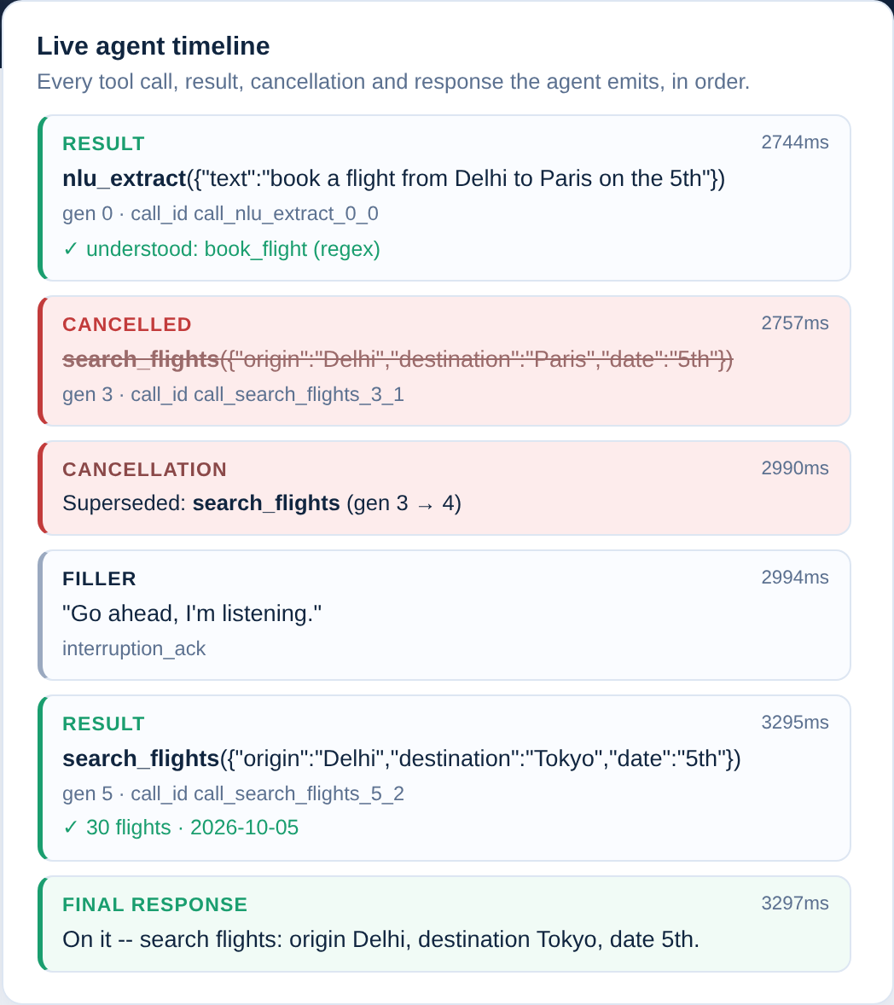
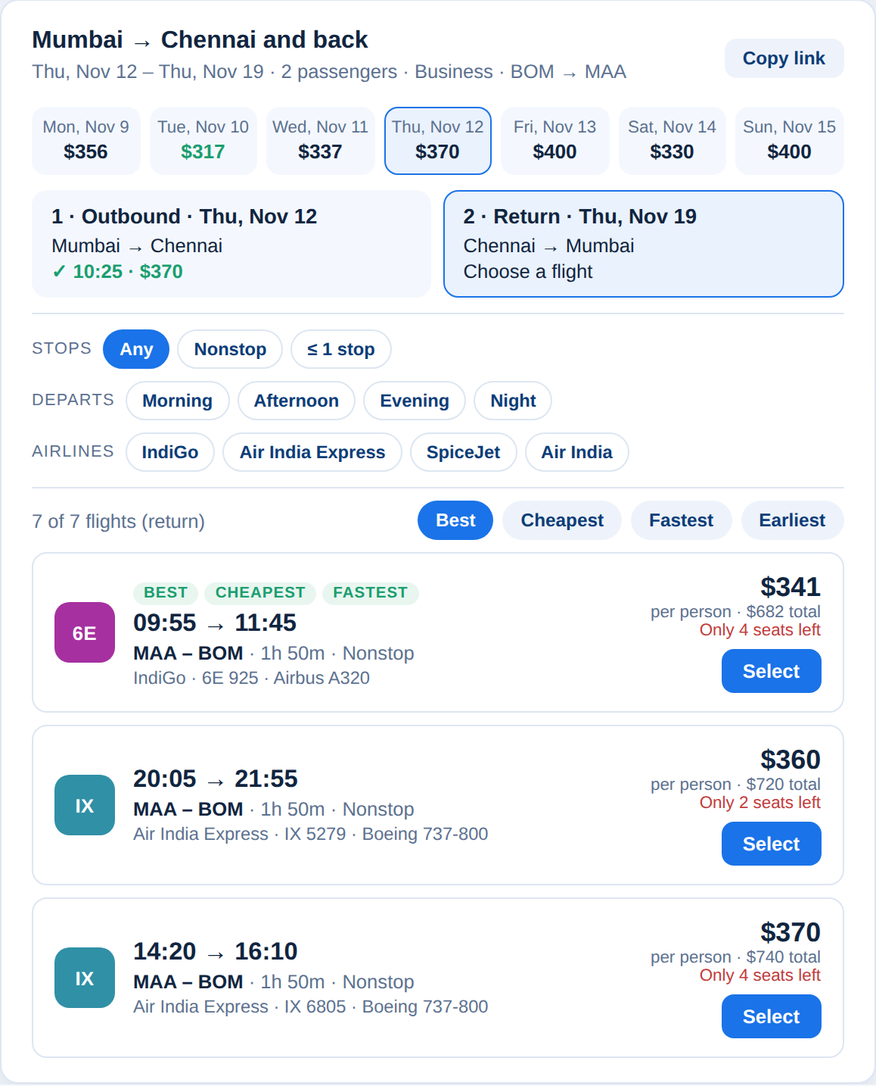
Demo & Product Walkthrough
1
Just say it
“Delhi to Paris on the 5th”: a speculative search starts before you finish.
2
Barge in
“…actually, Tokyo.” The stale call is struck through in ~2 ms.
3
Re-plan
Only the changed slot updates; a real day's schedule comes back.
4
Pick & book
Round trip, 1–9 passengers, 4 cabins, fare calendar; one idempotent booking.
5
Explore
3,244 airports by continent and country, with one-click search.
Live agent timeline during the barge-in demo
Round-trip results: fare strip, filters, per-leg booking
Team CODALYST · SRMIST | Samsung PRISM Generative AI Hackathon · Theme 05 — Interruptible Real-Time Agents
5 / 12
Notes:
Live demo: run python server/app.py and open the Flights page. Type a request; a speculative search starts before Enter. Click Interrupt or say 'actually Tokyo': the stale call is struck through in the timeline in about 2 ms and a filler acknowledges. The corrected search returns a modeled schedule; pick outbound and return, enter names and book. Then show the Airports explorer.

Slide 6




Tools and tech stack used
Concurrency core
Language understanding
Speech & vision
Python 3.10–3.12
Trio structured concurrency
One CancelScope per tool call
Virtual-clock replay harness
Groq · llama-3.1-8b-instant
Ollama · llama3.2:3b (local)
Regex NLU + world airport gazetteer
Automatic fallback chain
faster-whisper local ASR
Audio + frame observations
Cross-modal belief fusion
Clarify on disagreement
Why trio: cancellation can never leak.
Why a chain: it still works offline.
Why local: speech stays on-device.
Web app
World flight model
Quality & tooling
Quart-Trio + Hypercorn (ASGI)
WebSocket bridge + REST fallback
Vanilla HTML/CSS/JS, no build step
Port guard for stale servers
OurAirports + OpenFlights data
3,244 airports · 497 airlines
Gravity model, ~106k flights/day
zoneinfo local times (DST-aware)
pytest + pytest-trio · 159 tests
Playwright · 97 browser checks
JSON-schema protocol checks
Git + GitHub
Why vanilla: loads instantly, no build.
Why build it: no API keys, reproducible.
Why: every number here is tested.
Team CODALYST · SRMIST | Samsung PRISM Generative AI Hackathon · Theme 05 — Interruptible Real-Time Agents
6 / 12
Notes:
The core is Python on trio, because structured concurrency gives every tool call its own cancel scope. NLU falls back from Groq to a local Ollama model to a deterministic regex parser, so the agent works offline. The web app is Quart-Trio with WebSockets and plain JavaScript. The flight model is built from public datasets. Quality is backed by 159 tests and 97 browser checks.

Slide 7




Impact & Use case
In-car & hands-free
Destination changes while the route is being computed.
Customer-support bots
Customer changes dates or passengers mid-booking.
The stale route or flight search is cancelled in ~2 ms and the new one dispatched; the driver never hears an answer for the old destination.
Slots update in place; idempotency keys guarantee exactly one booking even when a call is retried.
Layer 0 · cancellation spine
Layer 0 · idempotency keys
Field & device troubleshooting
“My Galaxy screen is flickering” + a camera frame.
Accessibility
Hesitations and self-repairs: “uh, Delhi… no, Mumbai.”
Grounds the query in manuals and frames, and asks a clarifying question instead of guessing (live Support page).
Self-repairs are normal input, not errors: only the corrected slot changes and still-valid work is reused.
Layer 3 · belief fusion
Layers 1–2 · speculation + salvage
~2 ms
to cancel a stale call
~3 ms
to acknowledge a barge-in
0
duplicate bookings
100%
offline-capable path
Team CODALYST · SRMIST | Samsung PRISM Generative AI Hackathon · Theme 05 — Interruptible Real-Time Agents
7 / 12
Notes:
The theme lists four use cases and the same mechanism serves all of them: in-car destination changes, support bots changing a booking mid-flow without double-booking, troubleshooting grounded in manuals and camera frames with clarifying questions, and accessibility where self-repairs are normal input.

Slide 8



Innovation highlights, results and limitations
Innovation highlights
Results
Limitations
Interrupt-first spine. Every call carries a generation; one bump cancels all stale calls.
Speculative dispatch. Read-only calls fire before end-of-turn once slots are complete enough.
Salvage cache. A cancelled call whose slots didn't change is reused, not re-run.
Belief fusion. Text, audio and video observations reconciled; clarify only on real conflict.
Schema-driven tools. Arguments for never-seen tools built from the manifest's JSON schema.
1.9 ms
3.1 ms
Video frames assume pre-grounded fields; no live vision model yet.
Speculation confidence is a slot-completeness heuristic, not a calibrated model.
Flights are modeled on a 2014 route network (updated for mergers and new airports), not live availability.
The browser demo is typed text; mic → Whisper streaming isn't in the UI yet.
Scored on our own replay harness until the official evaluation kit is released.
median interrupt → cancel (p90 2.6 ms)
interrupt → spoken acknowledgment
2.6 ms
159/159
text chunk → first action
automated tests passing
97/97
0
browser end-to-end checks
duplicate state-changing calls
25 replayed barge-in runs, regex NLU. With an LLM NLU, network latency is hidden behind speculation and fillers.
Team CODALYST · SRMIST | Samsung PRISM Generative AI Hackathon · Theme 05 — Interruptible Real-Time Agents
8 / 12
Notes:
Five innovations: the interrupt-first spine, speculative dispatch, the salvage cache, belief fusion and schema-driven tools. Measured over 25 replayed barge-in runs: 1.9 ms median from interruption to cancellation, 3.1 ms to a spoken acknowledgment, all 159 tests and 97 browser checks passing, zero duplicate state-changing calls. We are open about limitations: vision is pre-grounded, the confidence heuristic is simple, and flight data is modeled, not live.

Slide 9


What’s next
1
2
3
NEXT 2 WEEKS
1–2 MONTHS
3–6 MONTHS
Evaluation-ready
Truly multimodal
On-device & in-product
Run the 9 public + hidden-style scenarios on the official kit
Tune speculation thresholds per scenario type
Latency and cancellation dashboards from traces
Streaming mic → faster-whisper in the browser
Vision-model frame grounding feeding belief fusion
Spoken replies that duck instantly on barge-in
Small on-device NLU for privacy and offline use
Calibrated confidence model for speculation
New domains via manifests: smart home, in-car, support
Outcome: a scored report on the official kit
Outcome: voice and camera, end to end
Outcome: a private, offline-first assistant
Goal: an assistant you can interrupt like a person — on phones, cars and TVs — that never acts on what you un-said.
Team CODALYST · SRMIST | Samsung PRISM Generative AI Hackathon · Theme 05 — Interruptible Real-Time Agents
9 / 12
Notes:
Next two weeks: run the official evaluation kit and tune speculation thresholds. In one to two months: real streaming speech and a vision model feeding belief fusion, with spoken replies that stop instantly on barge-in. In three to six months: on-device NLU, a calibrated confidence model and new domains added purely through tool manifests.

Slide 10
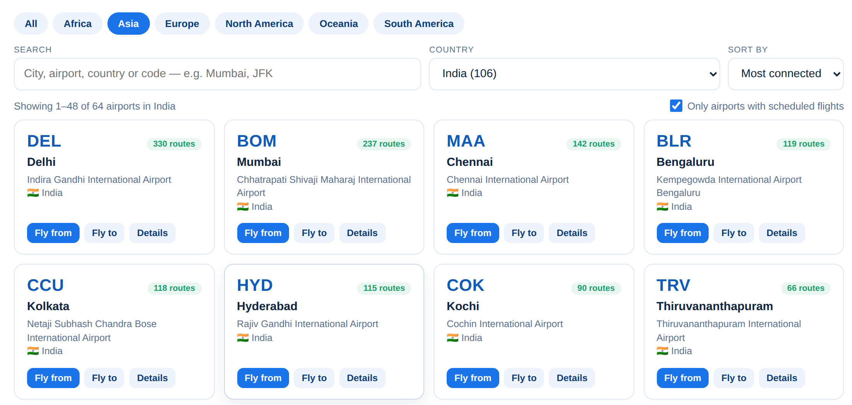





Brownie points (differentiation)
Interrupt-first, not interrupt-tolerant
Zero wasted work
Cancellation is the normal path on every turn, built into one data structure.
Results a correction didn't invalidate are reused from the salvage cache.
Unseen tools, zero code
A world flight model we built
Airport explorer: every airport, its routes and top destinations
Arguments for new manifest tools come straight from their JSON schema.
Real airports and routes, day-by-day schedules and fares; no airline API, fully offline.
3,244
airports
233
countries
Degrades gracefully
Engineering rigor
28,178
routes
497
airlines
Groq → Ollama → regex; WebSocket → REST; stale servers auto-replaced.
159 tests, 97 browser checks and a deterministic replay trace for every run.
Team CODALYST · SRMIST | Samsung PRISM Generative AI Hackathon · Theme 05 — Interruptible Real-Time Agents
10 / 12
Notes:
What sets us apart: the design is interrupt-first rather than interrupt-tolerant, it never throws away work a correction did not invalidate, it handles new tools with zero code, and it ships a real product on top: a world flight model we built from public data, a booking flow and an airport explorer, backed by 159 tests.

Slide 11




Checklist- Updated on Public GitHub
Working prototype code: public GitHub repo
github.com/armanpanigrahi59/SamsungPrism_GenAI_Hackathon
Y
README with reproducible setup instructions
pip install -e ".[dev,web]" → python server/app.py → python -m pytest
Y
Demo video (max 5 minutes, YouTube or Drive link)
Add the link here before submitting
TO ADD
Presentation file (PPT or PDF)
SRMIST_CODALYST_Submission.pptx (this deck)
Y
Try it: clone the repo → pip install -e ".[dev,web]" → python server/app.py → open http://127.0.0.1:8000
Team CODALYST · SRMIST | Samsung PRISM Generative AI Hackathon · Theme 05 — Interruptible Real-Time Agents
11 / 12
Notes:
Code and README are public on GitHub with reproducible setup; the test suite runs with one command. Add the demo video link on this slide before submitting.

Slide 12
Thank you
Team CODALYST · SRMIST
Arman Panigrahi · Vanshika Singh · Kushagra Srivastava
github.com/armanpanigrahi59/SamsungPrism_GenAI_Hackathon
Organised by the Language AI Team and the PRISM Team, Samsung R&D Institute India
Notes:
Thank you. The code, README and this deck are on GitHub. Happy to run the live barge-in demo or take questions.

