Slide 1
Student Performance AI
BIT Management System Prototype

Slide 2
Project Objective
Predict student performance bands using academic and behavioral data.
Identify at-risk students for early intervention.
Generate recommendation-oriented support actions.

Slide 3
Why Random Forest
Strong fit for structured tabular data.
More explainable than deep learning for review presentations.
Captures non-linear relationships between student indicators.
Provides feature importance for interpretation.

Slide 4
Input Features
Attendance, assignments, quizzes, internal exams, lab performance.
Study hours, LMS logins, previous GPA, project score.
Department, study mode, internet access, part-time job, extracurricular activity.

Slide 5
Target And Output
Target variable: performance_band.
Low: Performance score below 105
Medium: Performance score between 105 and 123
High: Performance score above 123
The system also maps predictions into at-risk support output.

Slide 6
Model Pipeline
Impute numeric values with median.
Impute categorical values with most frequent values.
Apply one-hot encoding to categorical features.
Train RandomForestClassifier on the processed feature set.
Generate predictions, risk output, and recommendations.

Slide 7
Current Results
Accuracy: 0.6458
Weighted F1-score: 0.6349
Training rows: 960
Test rows: 240
Medium class is predicted most strongly in the current prototype.

Slide 8
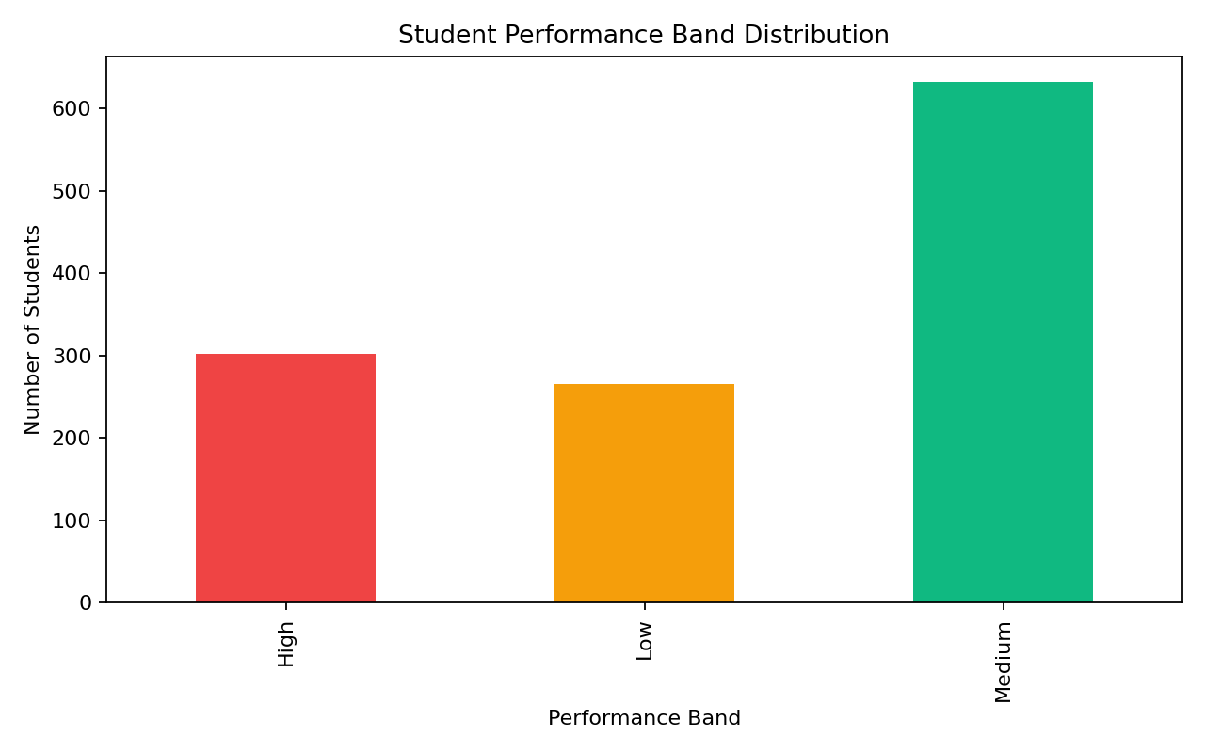
Performance Distribution
Distribution of Low, Medium, and High performance bands.

Slide 9
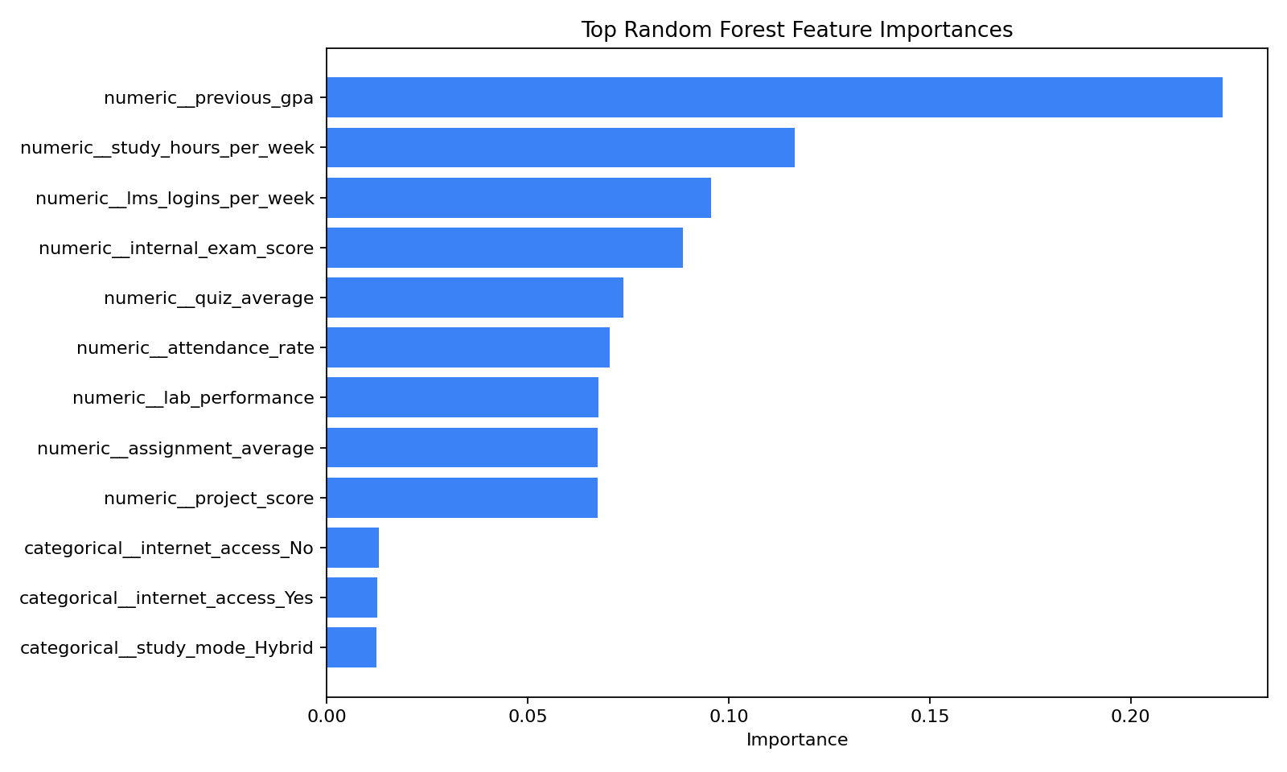
Feature Importance
Random Forest highlights the strongest performance drivers.

Slide 10
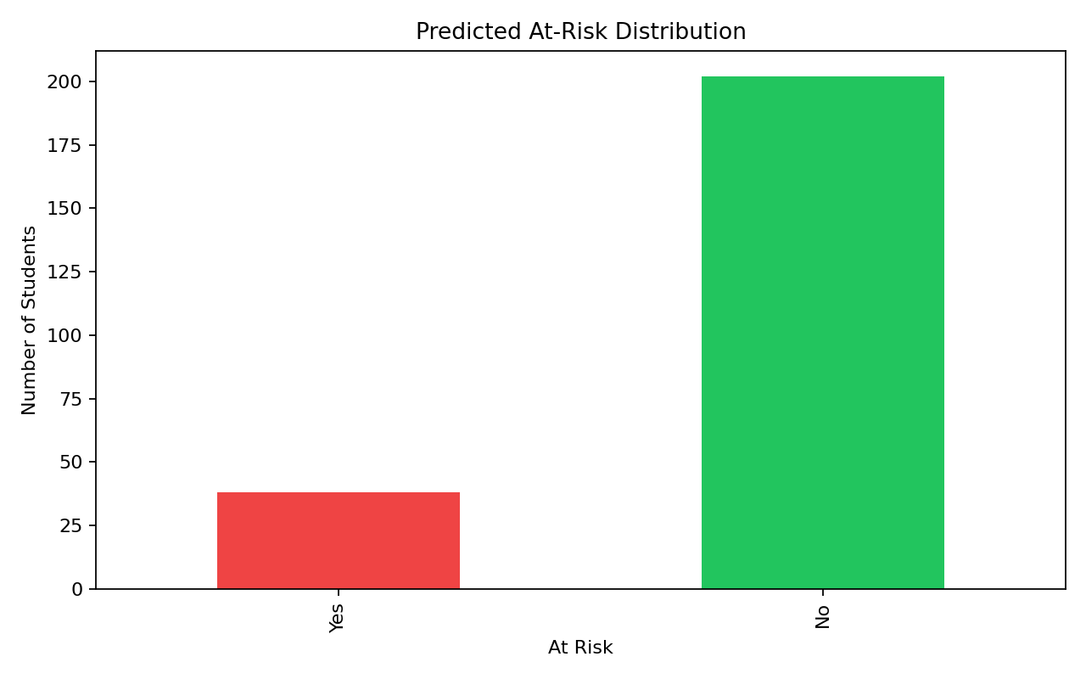
Predicted Risk Distribution
Dashboard-ready view of at-risk prediction output.

Slide 11
Recommendation Logic
Prediction is combined with rule-based intervention support.
Low attendance triggers attendance mentoring.
Weak internal exams trigger remedial support.
Low assignments or quizzes trigger targeted academic guidance.
Low engagement triggers study planning and LMS support.

Slide 12
Dashboard Demo
Shows model metrics and class distributions.
Displays top important predictors.
Presents sample predictions from test data.
Allows live student input for real-time prediction and recommendations.

Slide 13
How To Run
Use run_app.bat or run_app.ps1 for one-click launch.
Or run python -m src.student_performance_ai.training and streamlit run app/dashboard.py.
Open the local Streamlit URL in the browser.

Slide 14
Conclusion
Random Forest is an appropriate review-ready model for this prototype.
The system combines analytics, prediction, and recommendations.
The next step is integration with real student data and backend APIs.

