Slide 1
Python
Basic to Advance

Slide 2
Variable
Variable is like a container where we can put values.
A variable name must start with a letter or underscore.
A variable name cannot start with a number
Variable names are case sensitive.for example: container, Container,CONTAINER are three different variable
A variable cannot have special character such as: @ # $ % &

Slide 3
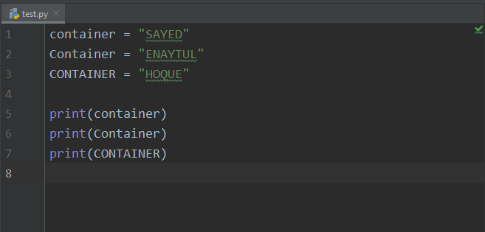
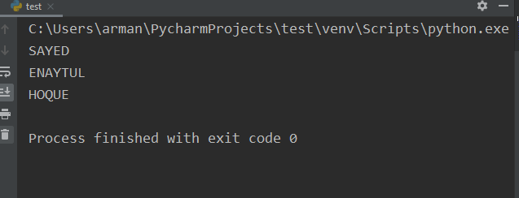
Code:
Output:

Slide 4
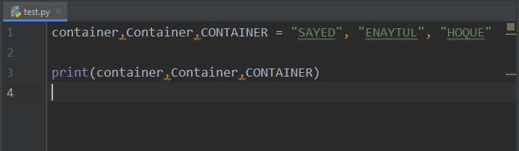
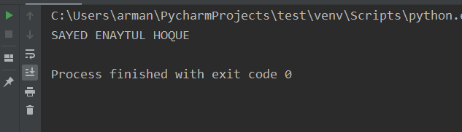
Code:
Output:

Slide 5
Data Type
Numeric (int, float, complex, bool)
Sequence(string,list,set,trouple,range)
Dictionary

Slide 6
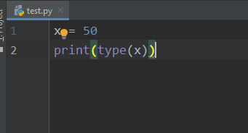
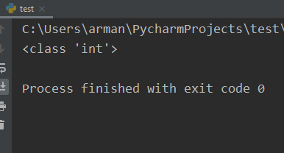
Code:
Output:

Slide 7
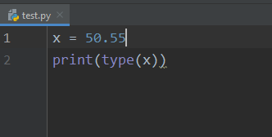
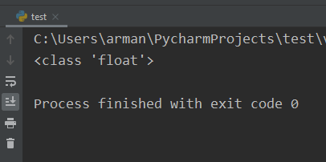
Code:
Output:

Slide 8
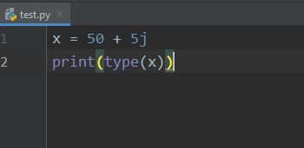
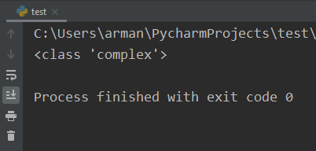
Code:
Output:

Slide 9
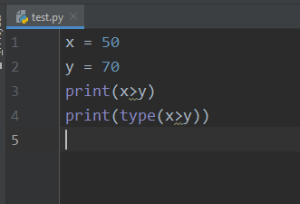
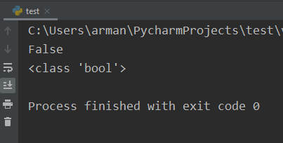
Code:
Output:

Slide 10
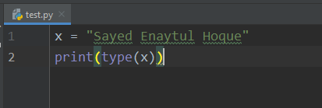
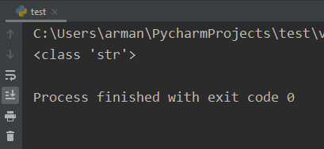
Code:
Output:

Slide 11
Within 3rd parenthesis [] list is define
Within 1st parenthesis () trouple is define
Within 2nd parenthesis {} set is define

Slide 12
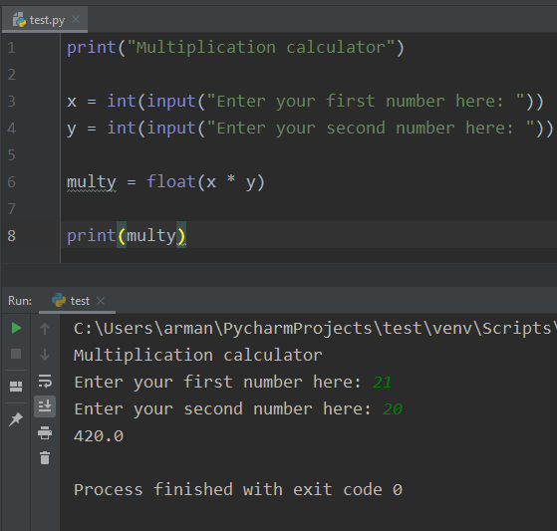
Code:
Output:

Slide 13
Operators
Arithmatic | Meaning | Relational | Meaning | Logical | Meaning
+ | Summetion | > | Greater than | And | Only if, Both True
- | Subtraction | < | Smaller than
* | Multiplication | == | Equal to | Or | If, Any condition true
/ | Division | != | Not Equal to
% | Modulo | >= | Greater than or equal | Not
** | Power | <= | Smaller then or equal
//

Slide 14
Question 1: Accept two integer numbers from a user and return their product and if the product is greater than 1000, then return their sum

Slide 15
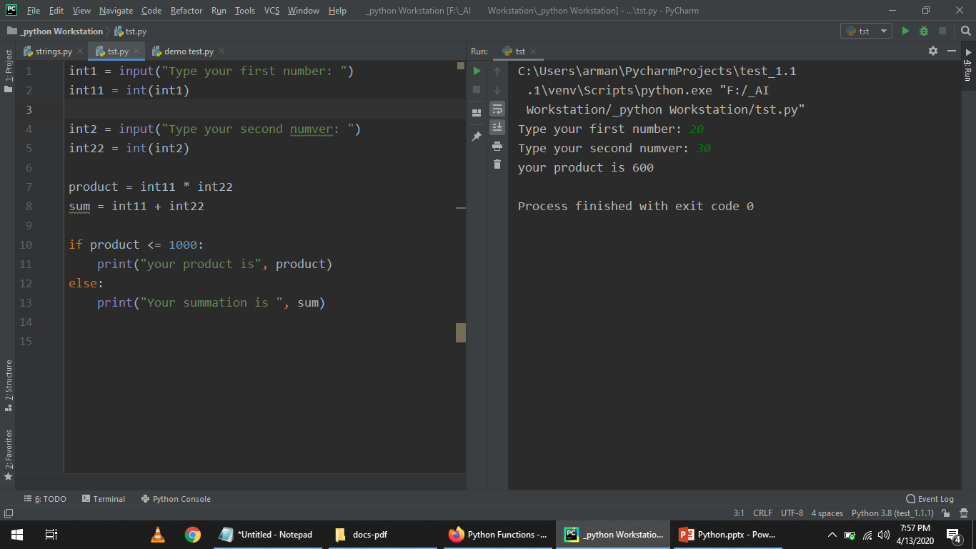

Slide 16
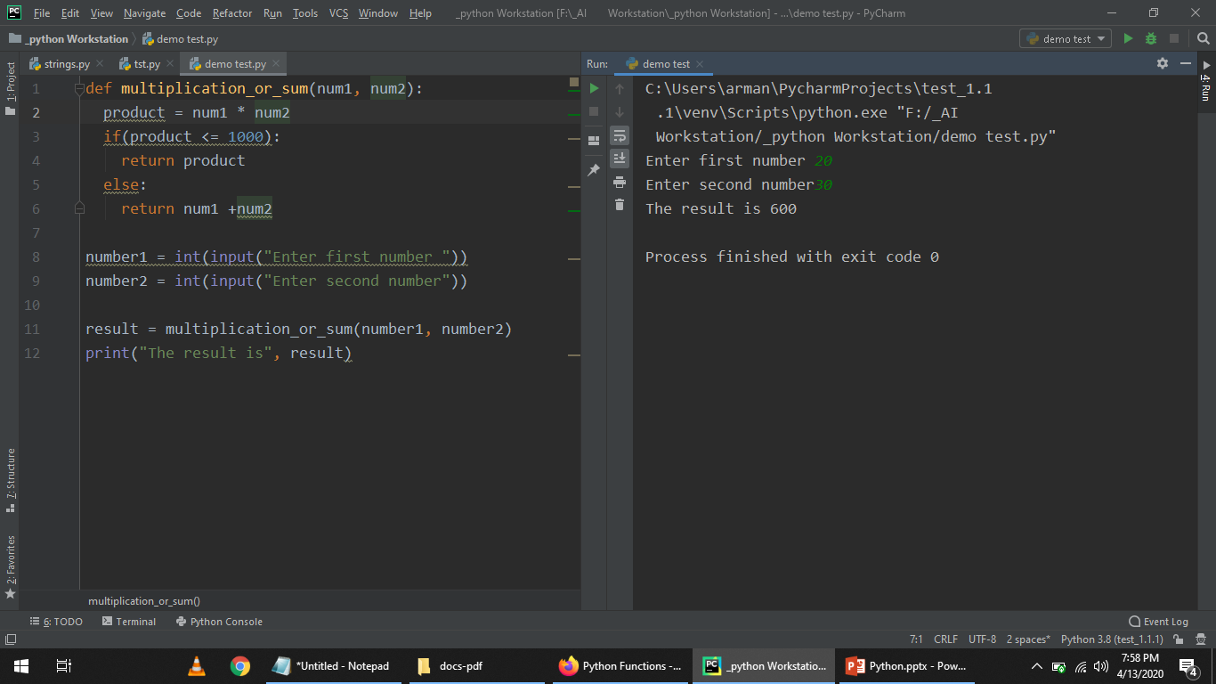

Slide 17
Question 2: Given a range of first 10 numbers, Iterate from start number to the end number and print the sum of the current number and previous number

Slide 18
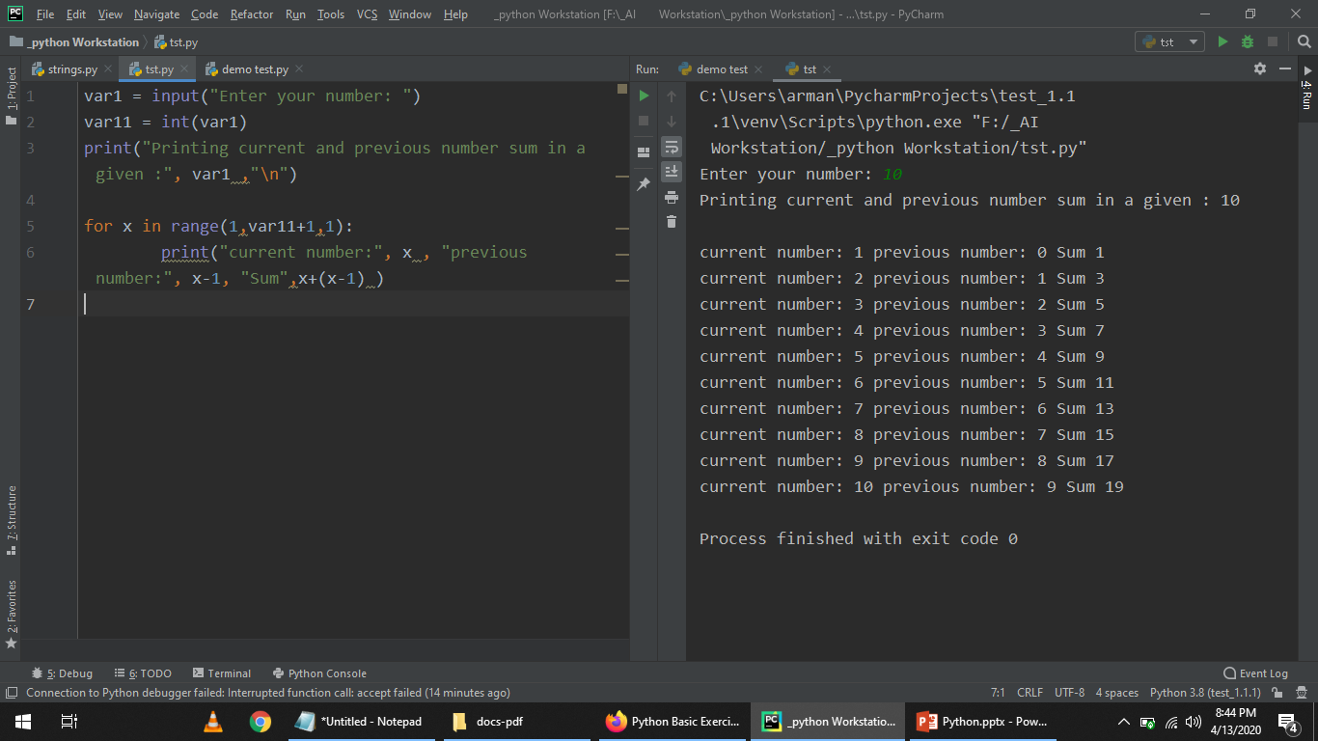

Slide 19
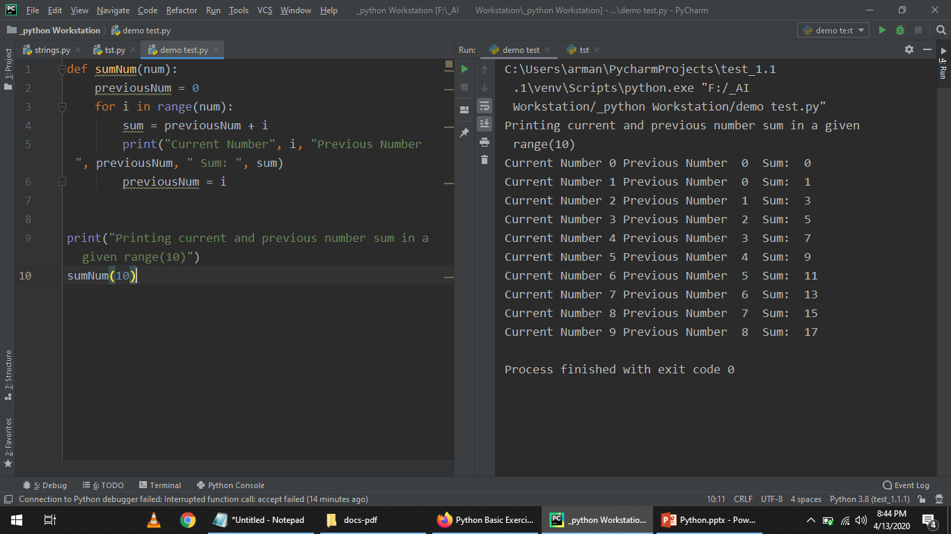

Slide 20
Question 3: Accept string from a user and display only those characters which are present at an even index number.

Slide 21
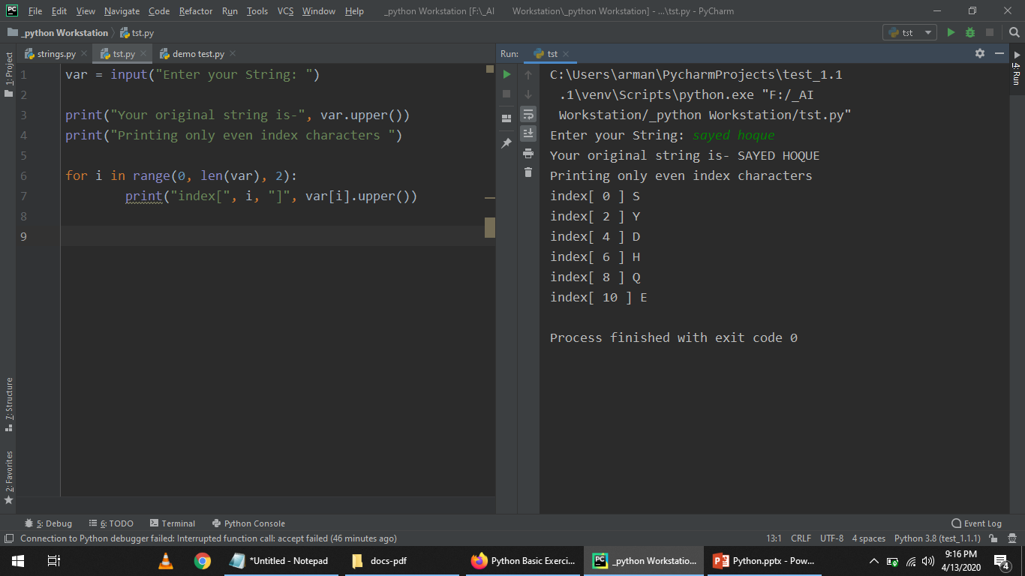

Slide 22
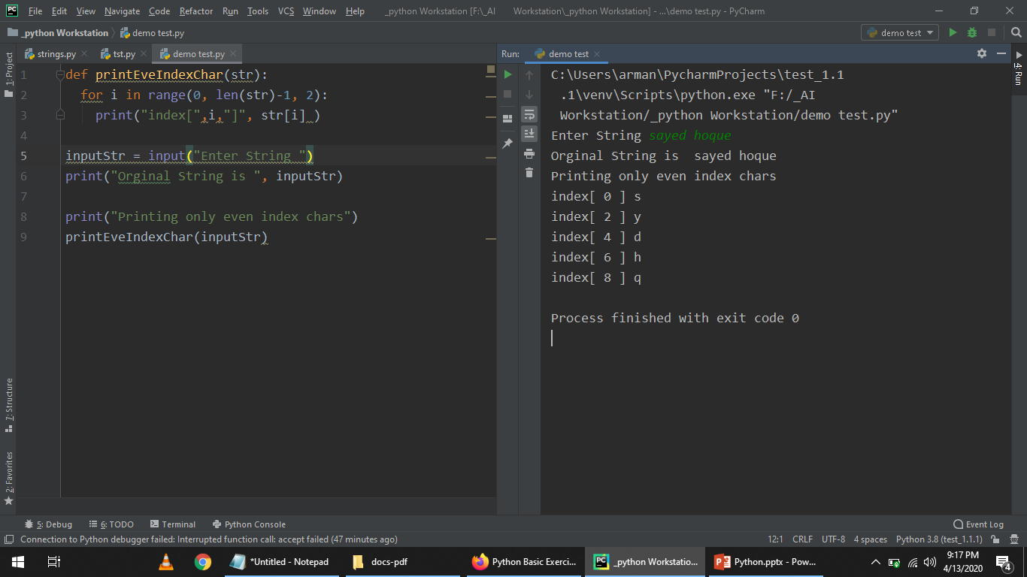

Slide 23
Question 4: Given a string and an integer number n, remove characters from a string starting from zero up to n and return a new string

