Slide 1
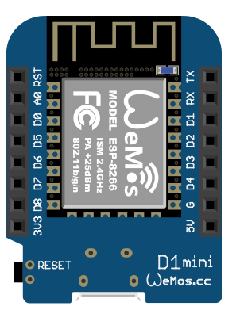
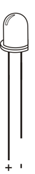

Slide 2
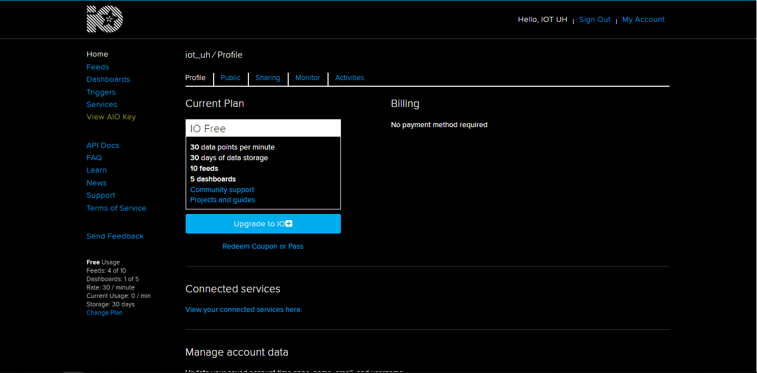
Server mqtt menggunakan IO.Adafruit.com

Slide 3
Library
#include <ESP8266WiFi.h>
#include "Adafruit_MQTT.h"
#include "Adafruit_MQTT_Client.h"
#include <IRsend.h>
#include <IRremoteESP8266.h>
#include <ir_Daikin.h>
#include <DNSServer.h>
#include <ESP8266WebServer.h>
#include <WiFiManager.h>

Slide 4
Pin yang di gunakan
IR_LED esp recomended D2

Slide 5
Type Subscribe
Adafruit_MQTT_Subscribe onoffbutton = Adafruit_MQTT_Subscribe(&mqtt, AIO_USERNAME "/feeds/onoff");
Adafruit_MQTT_Subscribe suhu = Adafruit_MQTT_Subscribe(&mqtt, AIO_USERNAME "/feeds/suhu");
Adafruit_MQTT_Subscribe modeac = Adafruit_MQTT_Subscribe(&mqtt, AIO_USERNAME "/feeds/modeac");

Slide 6
Setup
void setup() {
Serial.begin(115200);
delay(10);
daikinir.begin();
Serial.println(F("Connenct to"));
// Connect to WiFi access point.
//Serial.println(); Serial.println();
//Serial.print("Connecting to ");
//Serial.println(WLAN_SSID);
WiFiManager wifiManager;
//WiFi.begin(WLAN_SSID, WLAN_PASS);
//while (WiFi.status() != WL_CONNECTED) {
// delay(500);
// Serial.print(".");
//}
Serial.println();
wifiManager.autoConnect("ConnectAP");
Serial.println("WiFi connected");
Serial.println("IP address: "); Serial.println(WiFi.localIP());
// Setup MQTT subscription for onoff feed.
mqtt.subscribe(&onoffbutton);
mqtt.subscribe(&suhu);
mqtt.subscribe(&modeac);
}

Slide 7
Wifi manager

Slide 8
Void loop
Adafruit_MQTT_Subscribe *subscription;
while ((subscription = mqtt.readSubscription(5000))) {
if (subscription == &onoffbutton) {
Serial.print(F("AC "));
Serial.println((char *)onoffbutton.lastread);
if (strcmp((char *)onoffbutton.lastread, "ON") ==0) {
daikinir.on();
daikinir.setFan(1);
daikinir.setMode(DAIKIN_COOL);
daikinir.setTemp(25);
daikinir.setSwingVertical(false);
daikinir.setSwingHorizontal(false);
Serial.println("AC ON");
}
if (strcmp((char *)onoffbutton.lastread, "OFF") ==0) {
daikinir.off();
Serial.println("AC OFF");
}
}
if (subscription == &suhu) {
String value = (char *) suhu.lastread;
Serial.print(F("SUHU: "));
Serial.println((char *)suhu.lastread);
daikinir.setTemp(value.toFloat());
}

Slide 9
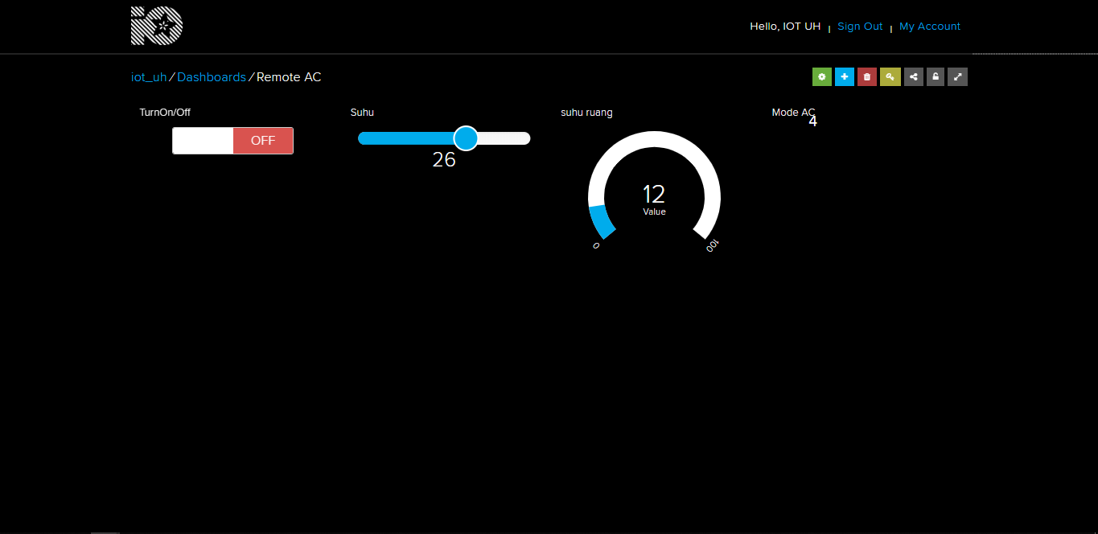
Tampilan control wemos melalui IO.Adafruit

