Slide 1
RESSICHEM
Production Site Area
Daily production records for Hub, SITE, and Lahore.
Reactor Area · Liquid (LMS) · Drymix · BFS Packing
4 November 2026
Notes:
Open with this line: Production Site is where Hub, SITE, and Lahore record what was made today. The sheet you save is the record the dashboard, the daily report, and the batch trace all use.

Slide 2
THE MODULE
One login. Four logs. One record.
Epoxy reactors, liquid formulation, drymix, and packing each have their own process sheet.
Every sheet is for Hub, SITE, or Lahore.
The dashboard, the daily report, and traceability read the saved sheet. The same batch is not typed again for the report.
A grade or reactor that is not on the list can still be typed.
Notes:
Say: this replaces the loose paper log. The person fills the sheet once. Every report after that comes from that sheet.

Slide 3
ACCESS
Who opens it
Sign in at Production Site.
An operator, a manager, and an overall admin all open the same four logs.
Reactor Area, Liquid (LMS), Drymix, and BFS Packing.
Production Hub, as its own login, is not part of this module yet. Hub here is the Hub factory on each log.
Notes:
If someone asks about Hub: point at the Hub factory on the sheet, then say the separate Hub login will be added later.

Slide 4
THE PAPER FORMS
Each area keeps its process-sheet number
Area | Format | What is recorded
Reactor Area | PRD/FRM-001-01 | Reactor, batch, grade, charging and draining, materials, temperature
Liquid (LMS) | PRD/FRM-001-02 | Vessel, product, batch, and the chemical lines with recipe and actual
Drymix | PRD/FRM-001-03 | Raw-material weights, QC sample, and packaging
BFS Packing | PRD/FRM-001-04 | Resin batch, hardener batch, kit size, and kit quantity
Notes:
Walk the four rows. Pause on BFS and say the output kilograms are calculated. The person does not type the output. It is kit size times kit quantity.

Slide 5
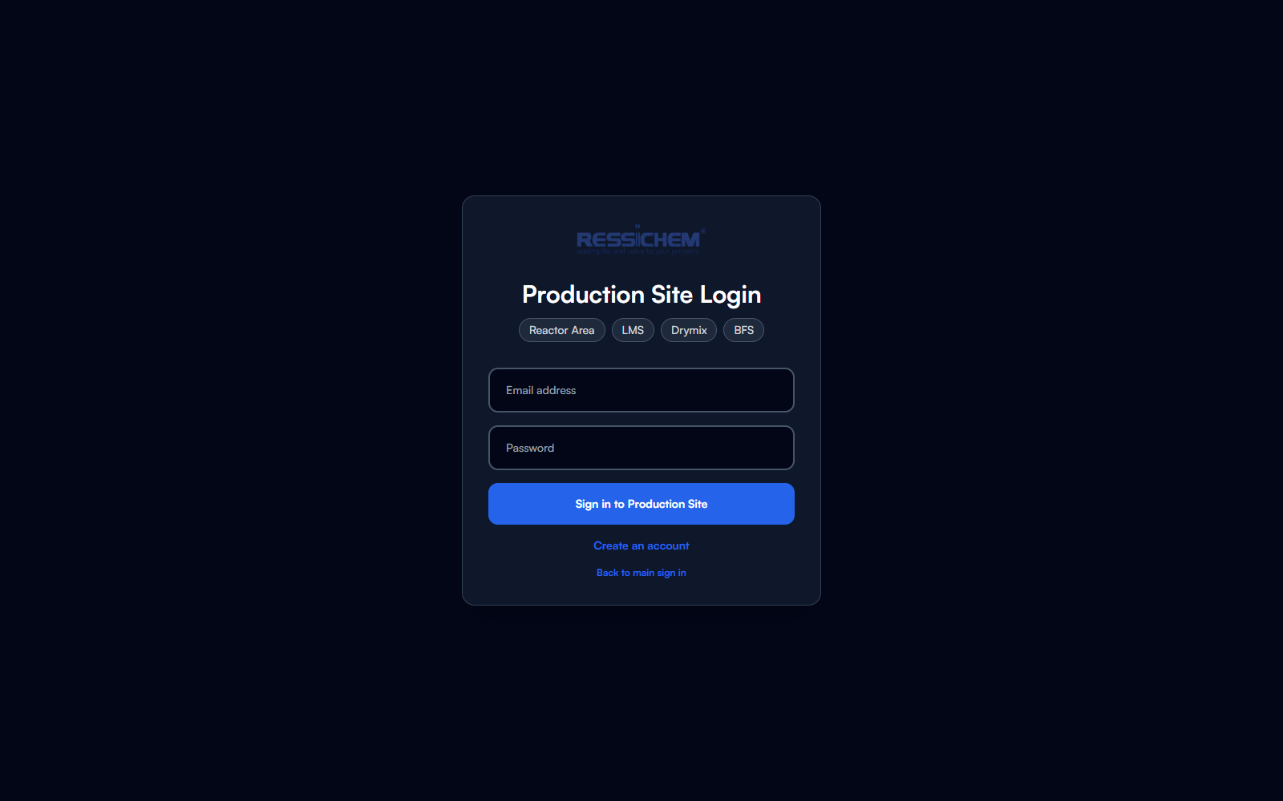
SIGN IN
Production Site login
This is the door into the module.
After sign-in the person lands on the dashboard.
The account opens Reactor Area, Liquid, Drymix, and BFS.
Notes:
Show the login, then say you will walk the screens in the order a production user opens them.

Slide 6
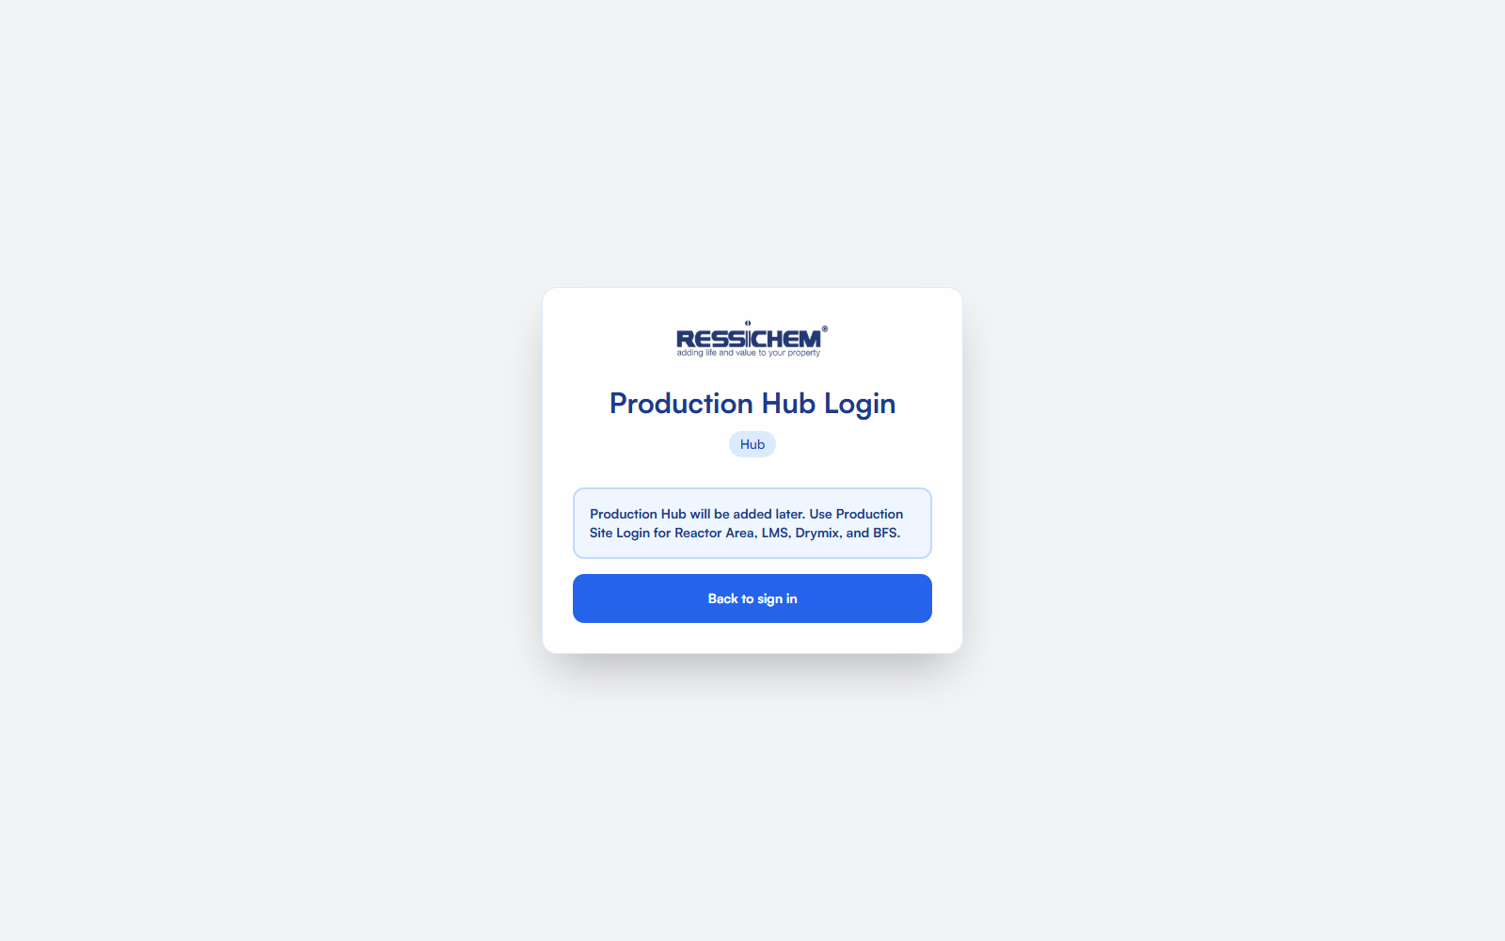
SIGN IN
Production Hub is later
The Hub login is a holding page.
Use Production Site for the four logs.
Hub, SITE, and Lahore are factories chosen on each sheet.
Notes:
Say this once so nobody expects a second system in this presentation. Then go back to Production Site.

Slide 7
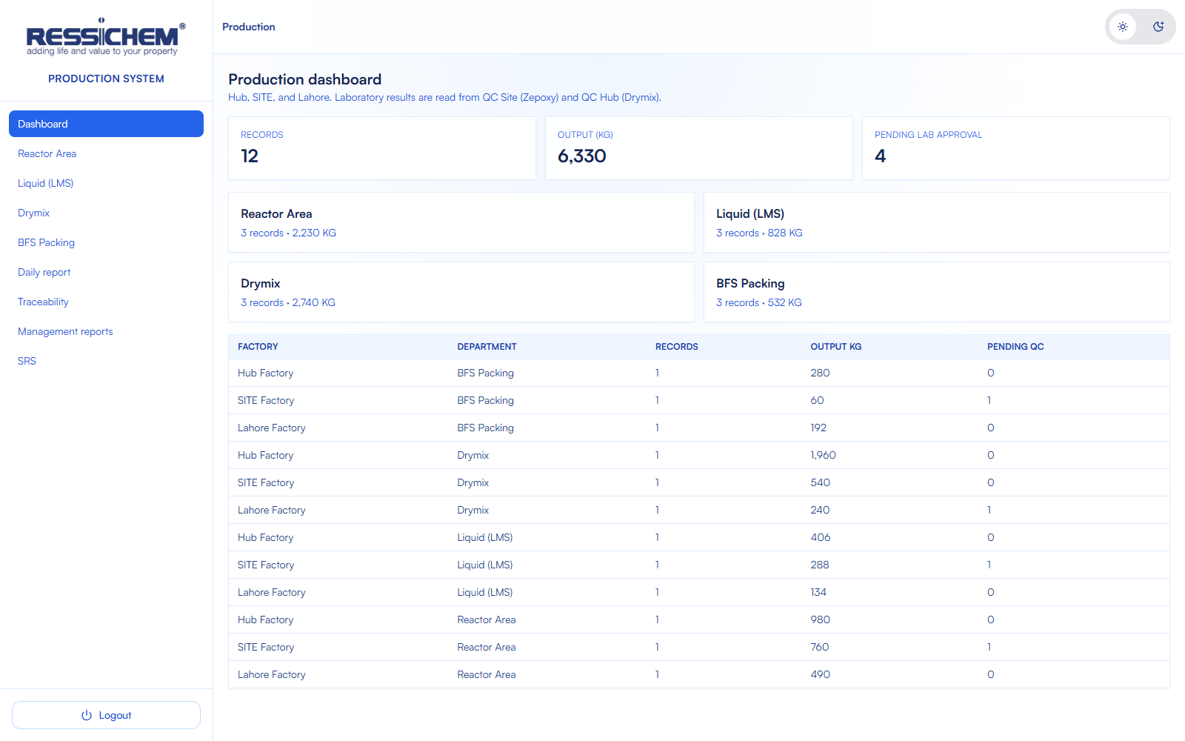
DASHBOARD
What was recorded
Records, output in kilograms, and batches still waiting for laboratory approval.
Each area is a card. Open the area you are recording.
The factory table splits Hub, SITE, and Lahore.
Notes:
Point at Pending lab approval. Say this number comes from the laboratory result when a QC record matches the batch, and from the sheet when it does not.

Slide 8
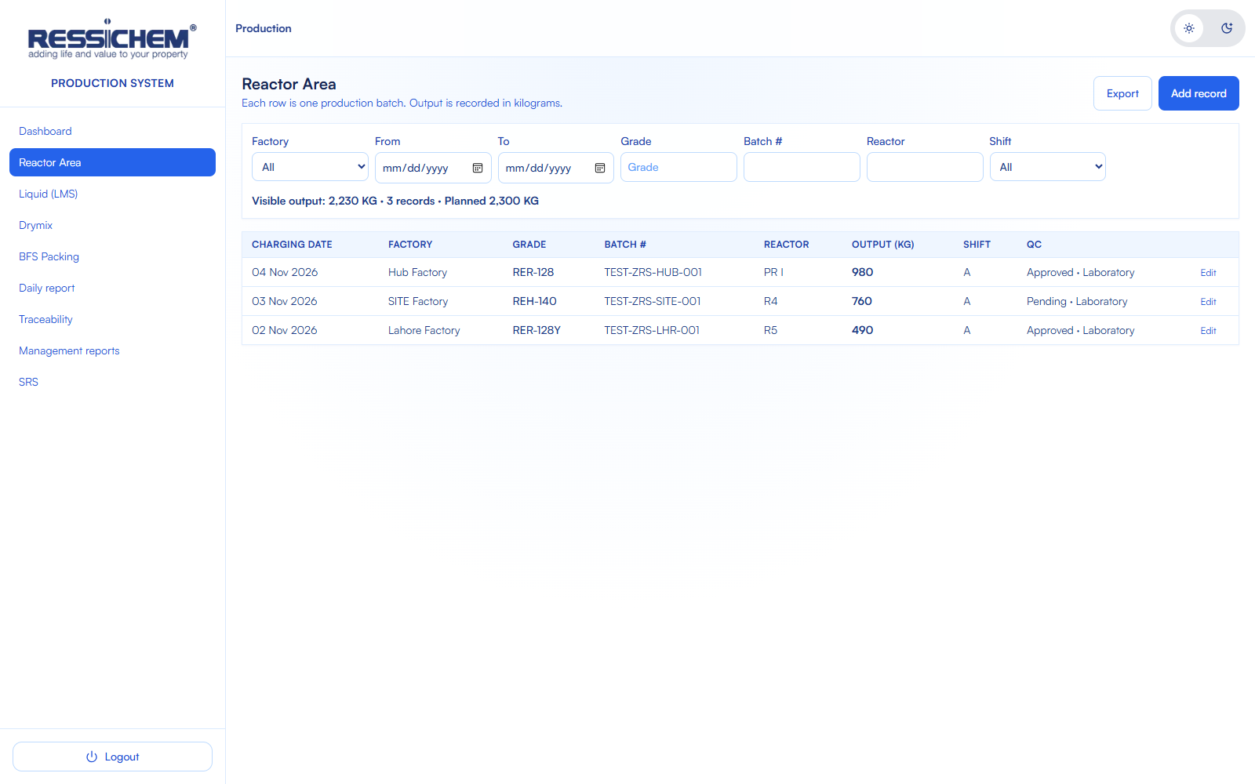
REACTOR AREA
The log, then the sheet
The list is every saved reactor batch.
Filter by factory, date, grade, or reactor.
Add record opens the paper sheet. Edit opens a saved one.
Notes:
This is the working list. The next slide is the sheet itself.

Slide 9
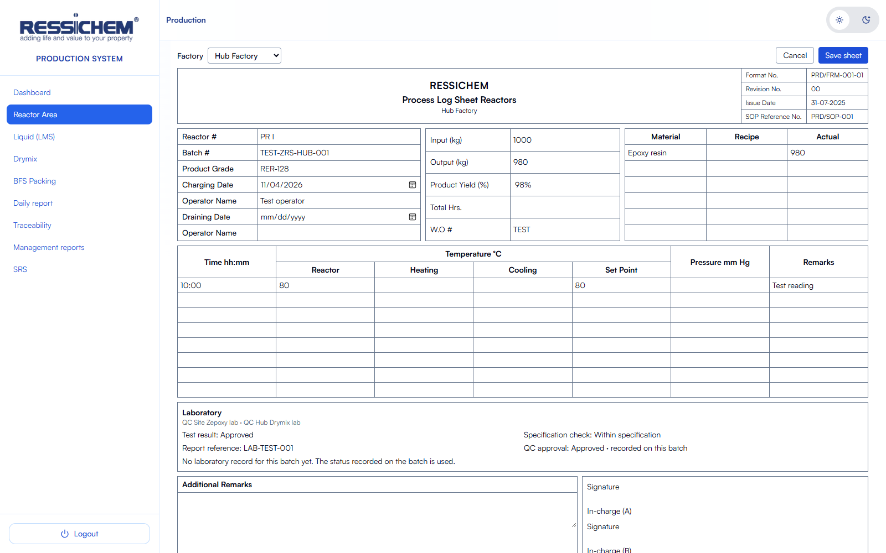
PRD/FRM-001-01
Process Log Sheet Reactors
Reactor, batch, grade, charging date, and operators.
Input, output, yield, and the work order.
Material lines and the temperature log sit on the same sheet.
Notes:
Say the header carries the format number, revision, issue date, and SOP reference, the same way the paper form does.

Slide 10
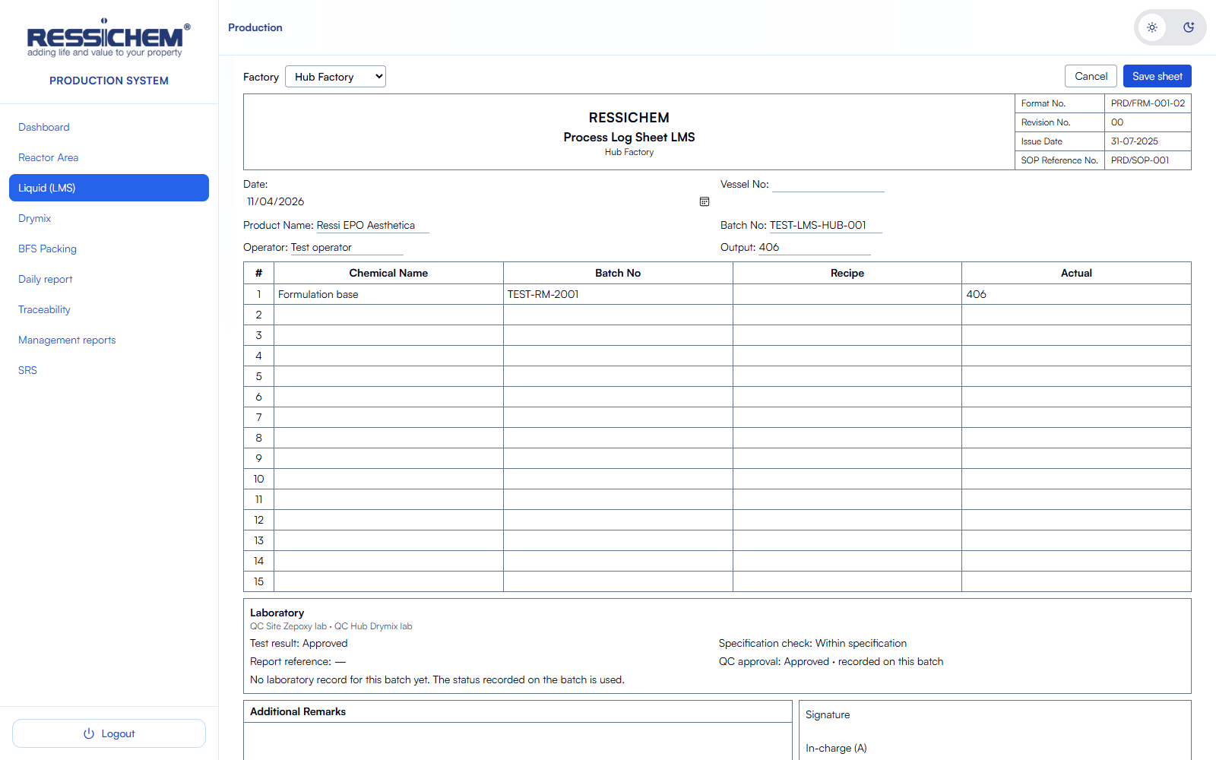
PRD/FRM-001-02
Process Log Sheet LMS
Date, vessel, product name, batch, and operator.
Each chemical line has a name, batch, recipe, and actual quantity.
Output is recorded in kilograms.
Notes:
Point at recipe and actual. Those lines are what traceability shows for the batch.

Slide 11
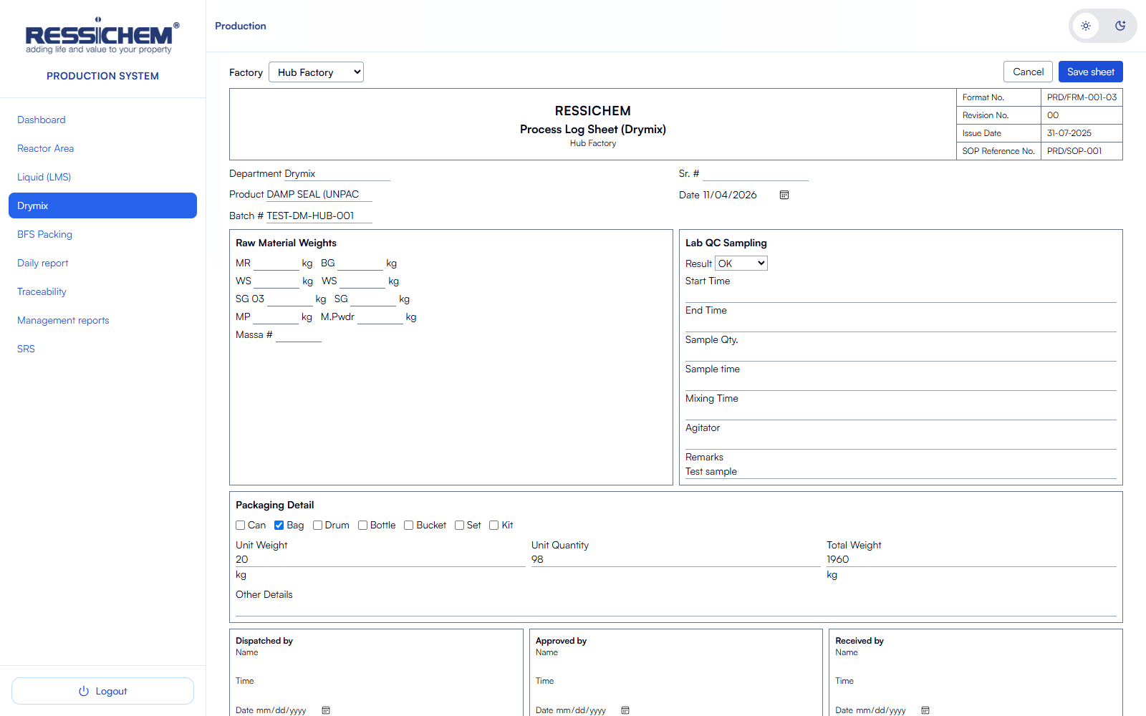
PRD/FRM-001-03
Process Log Sheet Drymix
Department, product, date, and batch.
Raw-material weights are entered on the sheet.
A QC sample of OK approves the batch. NOT OK rejects it.
Notes:
Drymix is open to the operator and the manager, the same as the other three logs.

Slide 12
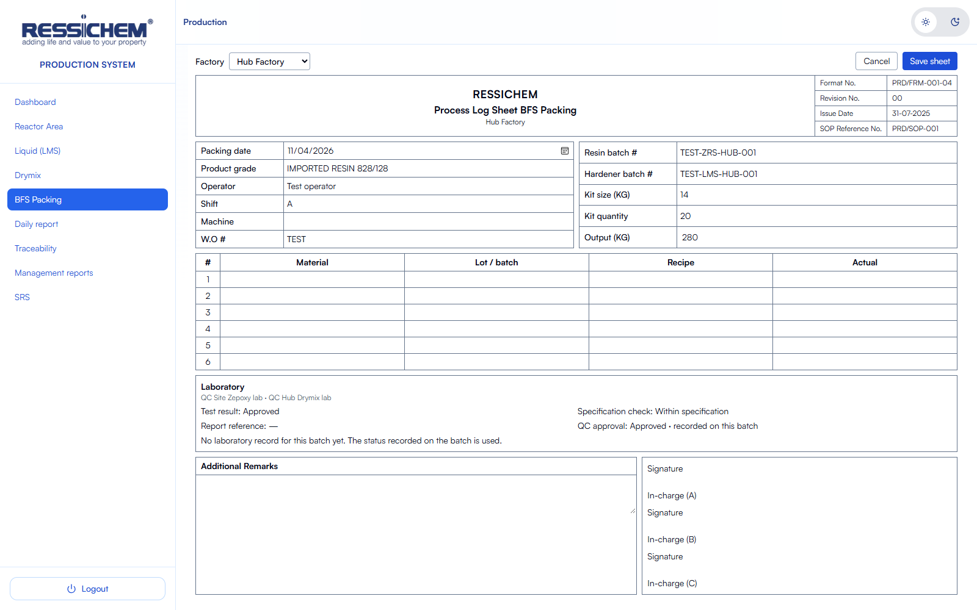
PRD/FRM-001-04
Process Log Sheet BFS Packing
Packing date, grade, operator, shift, machine, and work order.
Resin batch, hardener batch, kit size, and kit quantity.
Output kilograms are kit size times kit quantity. They are not typed.
Notes:
Say a packed kit is found later by the resin batch or the hardener batch. The material table records the lots used.

Slide 13
LABORATORY
The result follows the batch number
QC Site and QC Hub are checked when the batch is saved and when it is opened.
A match supplies the test result, the specification check, the report reference, and the approval.
Packing is approved only when both the resin batch and the hardener batch are approved.
Until a laboratory record exists, the status written on the sheet stays. The daily report counts batches still pending.
Notes:
If asked where the lab result is typed: on the sheet until QC has that batch. After QC approves or rejects it, the log and the daily report use that result.

Slide 14
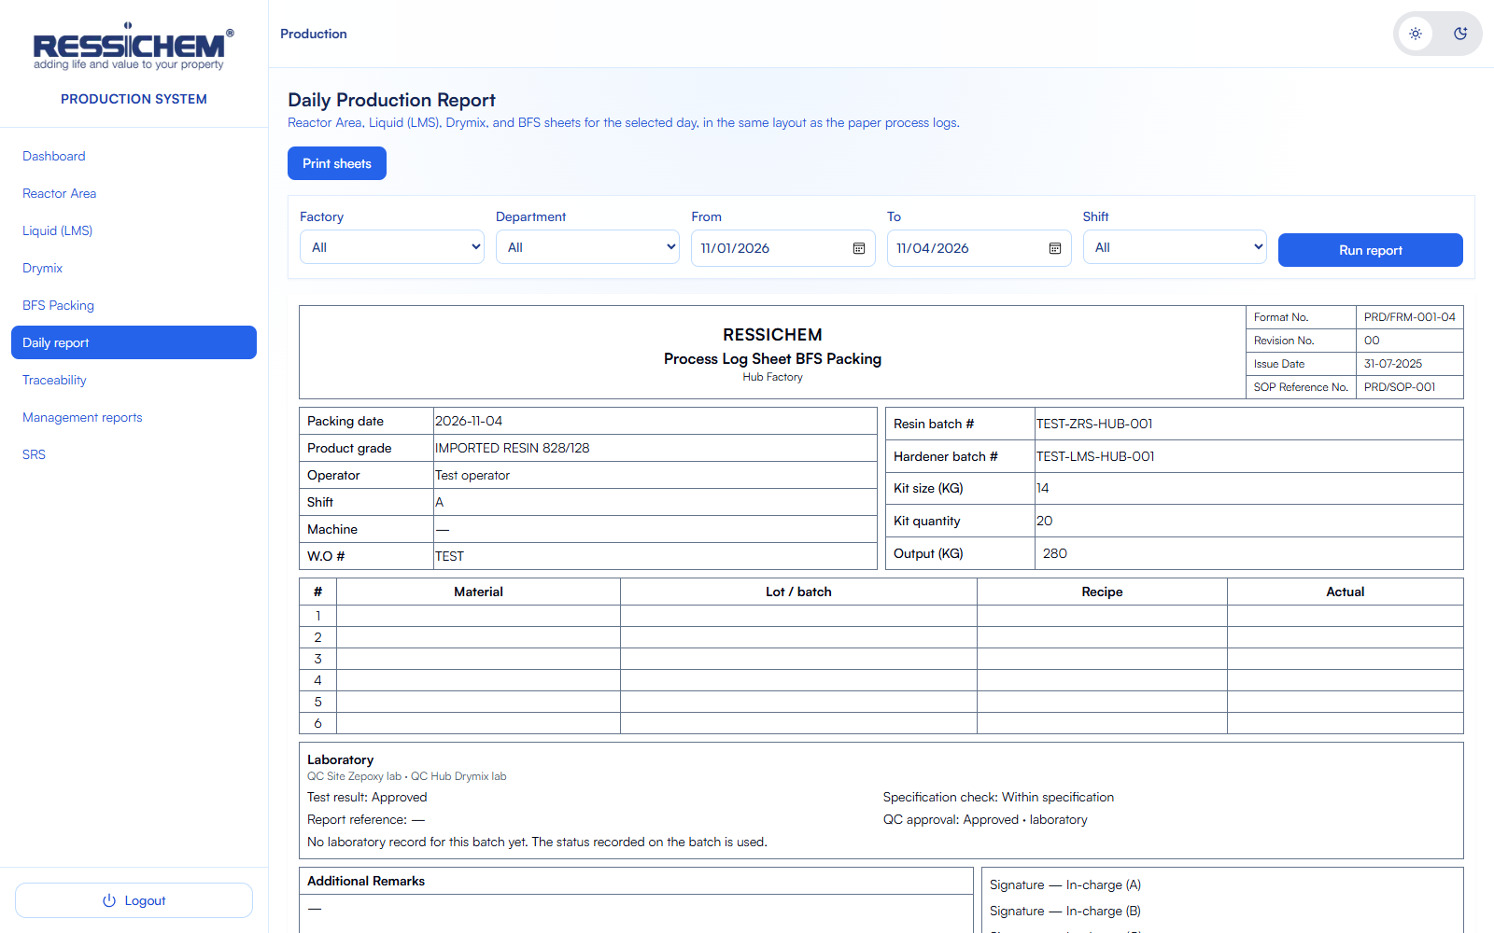
DAILY REPORT
The paper sheets, then the totals
Choose factory, area, dates, and shift, then run the report.
The saved sheets print in the paper layout.
The table groups the day by date, factory, area, grade, shift, and machine.
It shows plan, output, packing, consumption, wastage, rejected quantity, rework, downtime, work in progress, pending laboratory approval, yield, and the operators.
Notes:
Run the report live if you can. The picture is the same screen: filters on top, then the sheets and the grouped totals.

Slide 15
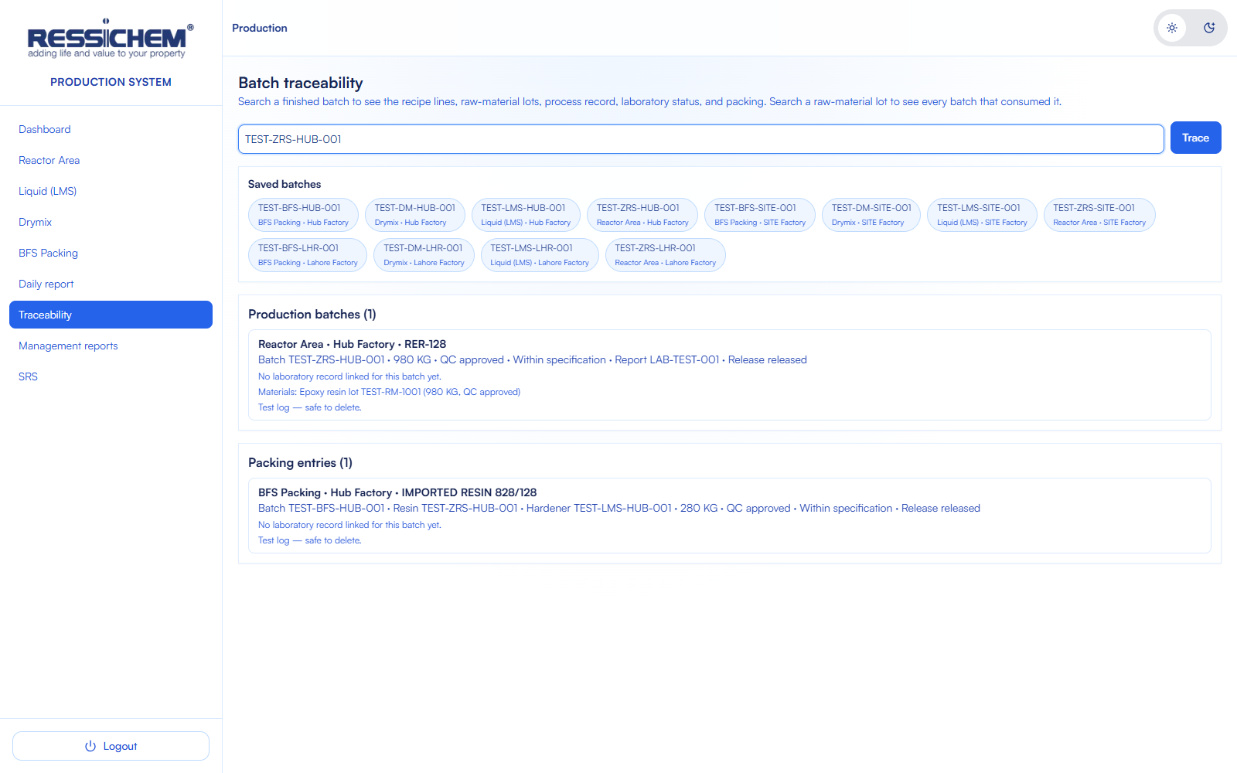
TRACEABILITY
From a batch or a lot back to the record
Type a batch, a lot, a grade, or a material. Saved batches are listed and can be clicked.
A finished batch shows the production record, the material lots, the process notes, the laboratory status, and any packing that used that resin or hardener.
A raw-material lot shows every batch and packed kit that recorded it.
Notes:
Use the example batch on the screen. Then say a lot search works the same way, in the other direction.

Slide 16
STILL AHEAD
Two connections are not in this module
Material name, code, lot, and quantity are typed on the sheet until SAP issues are connected.
Consumption on the daily report is the sum of those lines.
A separate Production Hub login will be added later. Hub today is a factory on the log.
Notes:
Be plain about these two. Do not describe them as already live. Then close on the next slide.

Slide 17
THE SHEET IS THE RECORD
The daily report and the trace read that same record.
The laboratory result follows the batch number.
RESSICHEM · Production Site Area
Notes:
Close on those two sentences. Stop there and take questions.

