Slide 1
East Asians
Africans
South Asians
Americans
Europeans

Slide 2
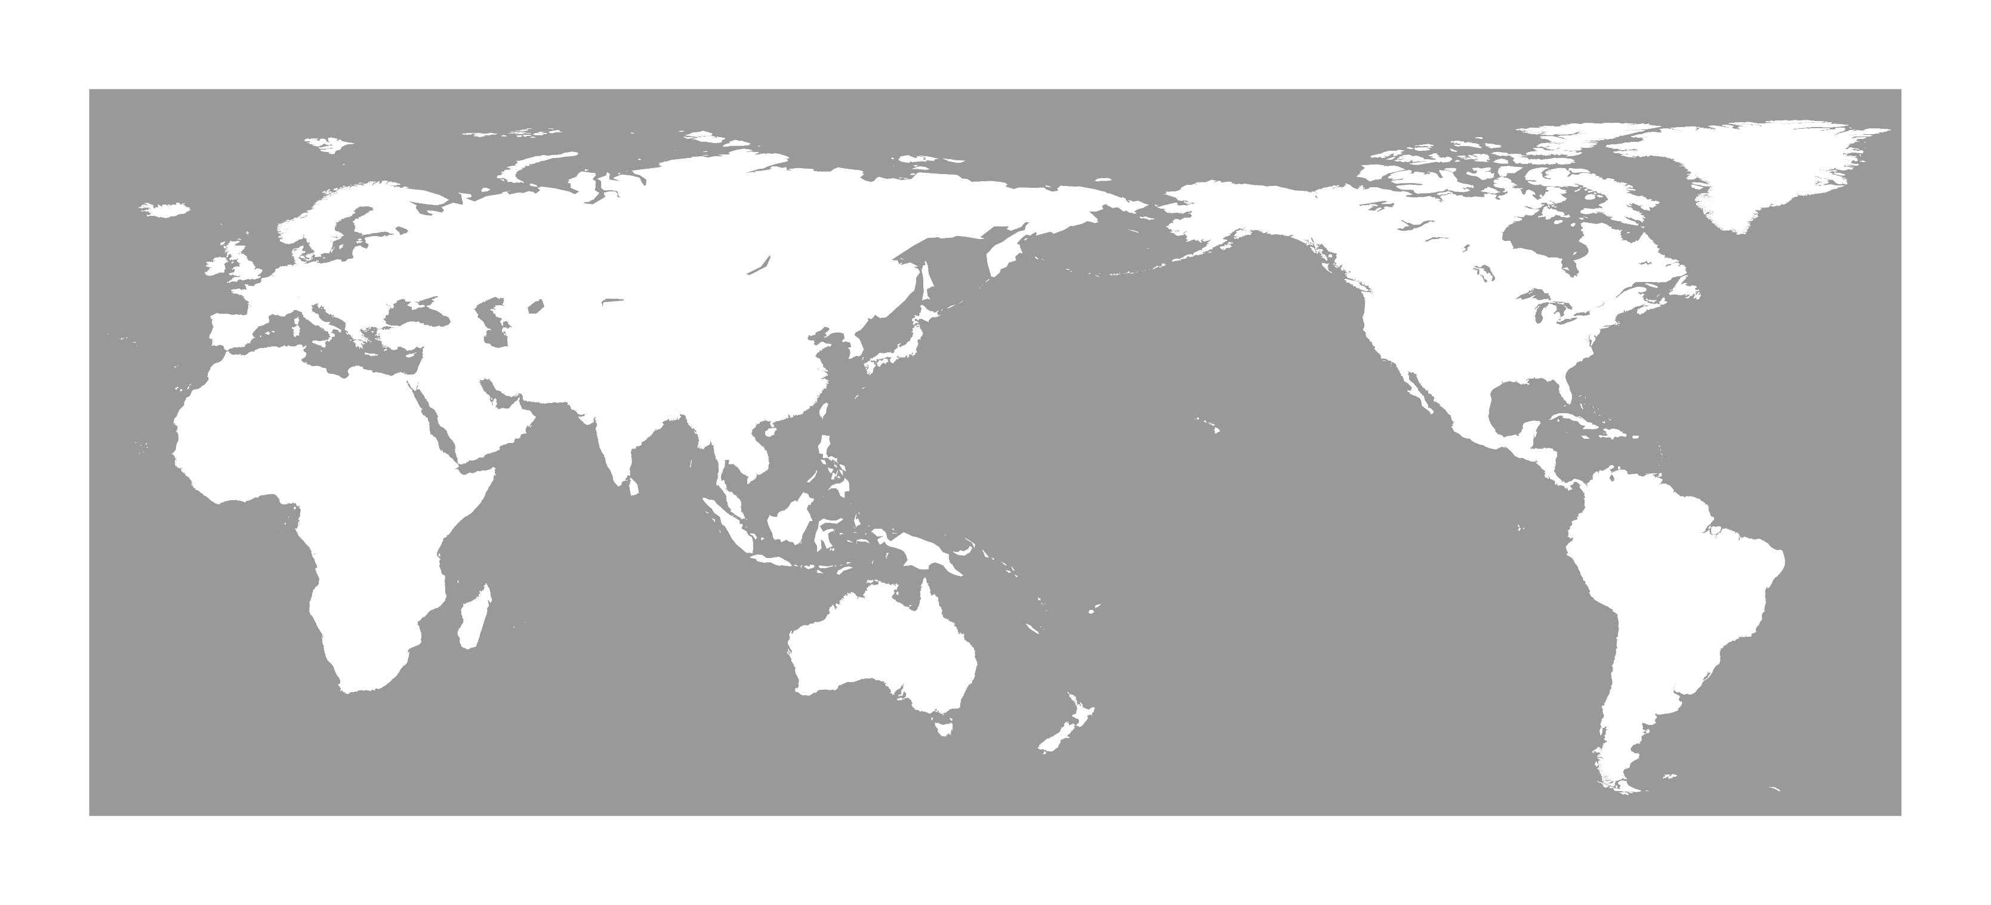
15Kya
45Kya
35-40Kya
55-65Kya
45Kya
100-150Kya
Founder effect
Source of founder effect
Migration path

Slide 3


Slide 4
