Slide 1
INVESTMENT ASSIGNMENT SUBMISSION
Name: Abhishek Ravindrakumar Maurya

Slide 2
Investment Analysis Assignment
Spark Funds, an asset management company wants to make investments in a few companies. The CEO of Spark Funds wants to understand the global trends in investments so that she can take the investment decisions effectively.
Spark Funds has two minor constraints for investments:
It wants to invest between 5 to 15 million USD per round of investment.
It wants to invest only in English-speaking countries because of the ease of communication with the companies it would invest in.
Business Objective:
The objective is to identify the best sectors, countries, and a suitable investment type for making investments.

Slide 3
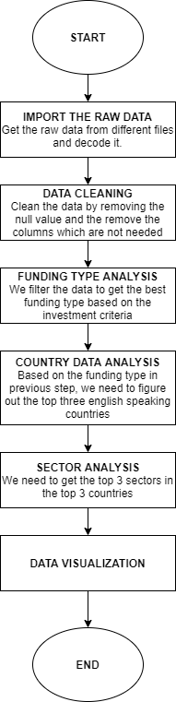
Problem Solving Methodology

Slide 4
Investment type analysis
Investment type | Average
Venture | 11.89 million dollars
Angel | 0.99 million dollars
Seed | 0.76 million dollars
Private equity | 75.97 million dollars
Based on the investment criteria, venture investment type is the best option for the company since it’s average is between $5 million and $15 million.

Slide 5
Country Analysis
Rank | Country code | Country name
1 | USA | United States of America
2 | GBR | United Kingdom
3 | IND | India
Since the company is looking to invest in the English speaking country, out of the 9 countries shortlisted based on the criteria, we have finalized the above 3 countries.

Slide 6
Sector Analysis
Segment | USA | GMR | IND
Top Sector name (no. of investment-wise) | Others | Others | Others
Second Sector name (no. of investment-wise) | Social, Finance, Analytics, Advertising | Social, Finance, Analytics, Advertising | Social, Finance, Analytics, Advertising
Third Sector name (no. of investment-wise) | Cleantech / Semiconductors | Cleantech / Semiconductors | News, Search and Messaging
Number of investments in top sector | 2758 | 140 | 103
Number of investments in second sector | 2590 | 128 | 59
Number of investments in third sector | 2147 | 115 | 49

Slide 7
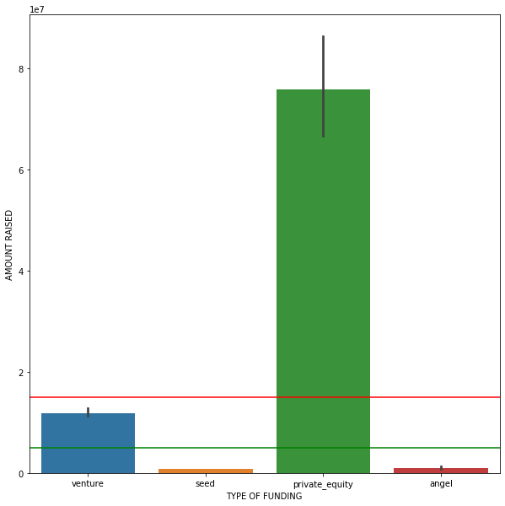
TYPE OF FUNDING ANALYSIS

Slide 8
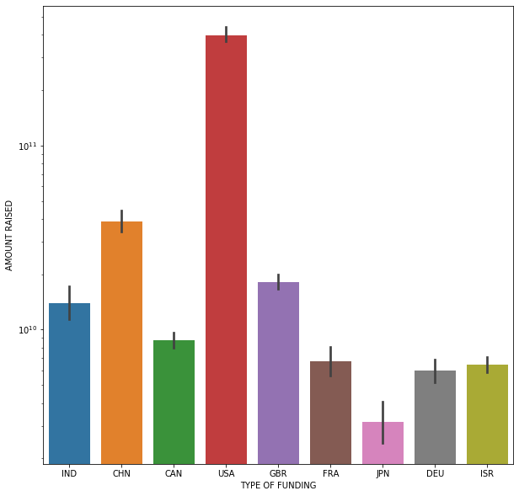
COUNTRY ANALYSIS

Slide 9
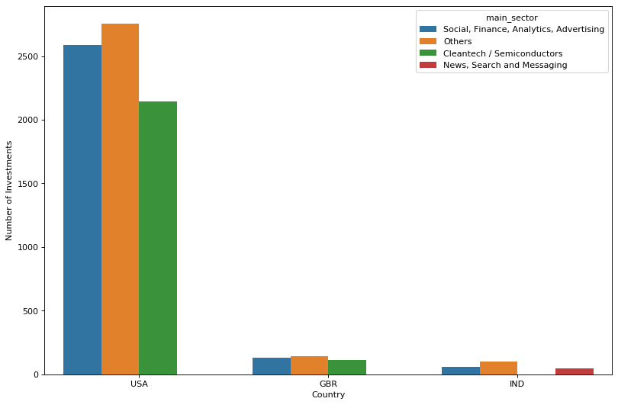
INVESTMENTS

Slide 10
Conclusion
Best investment type with an average size of investment in the 5-15 M USD range is Venture Capital.
• Top 3 English Speaking Countries receiving the highest investment amounts in Venture Capital funding types are
USA
Great Britain
India
• The most suitable sectors for funding in the above three countries are
Others
Cleantech/Semiconductors
Social/Finance/Analytics/Advertising

