Slide 1
LENDING CLUB CASE STUDY
Name: Abhishek Ravindrakumar Maurya
Sunil S

Slide 2
Lending Club Case Study
When the company receives a loan application, the company has to make a decision for loan approval based on the applicant’s profile. Two types of risks are associated with the bank’s decision:
If the applicant is likely to repay the loan, then not approving the loan results in a loss of business to the company
If the applicant is not likely to repay the loan, i.e. he/she is likely to default, then approving the loan may lead to a financial loss for the company
Business Objective:
We need to understand the driving factors behind why the loans default i.e strong indicators of default. The company can utilize this knowledge for its portfolio and risk assessment.

Slide 3
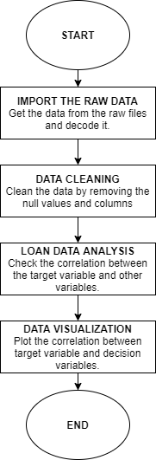
Problem Solving Methodology

Slide 4
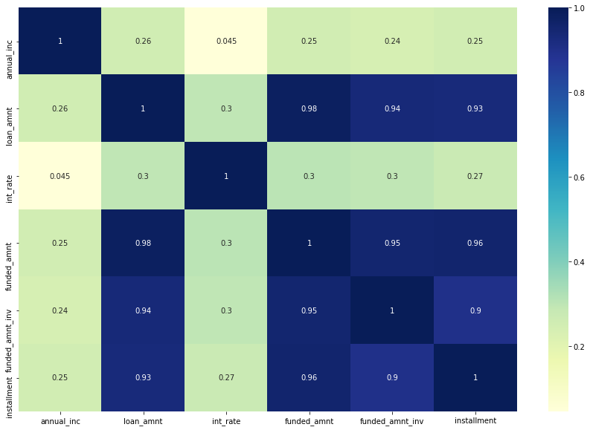
Correlation Analysis

Slide 5
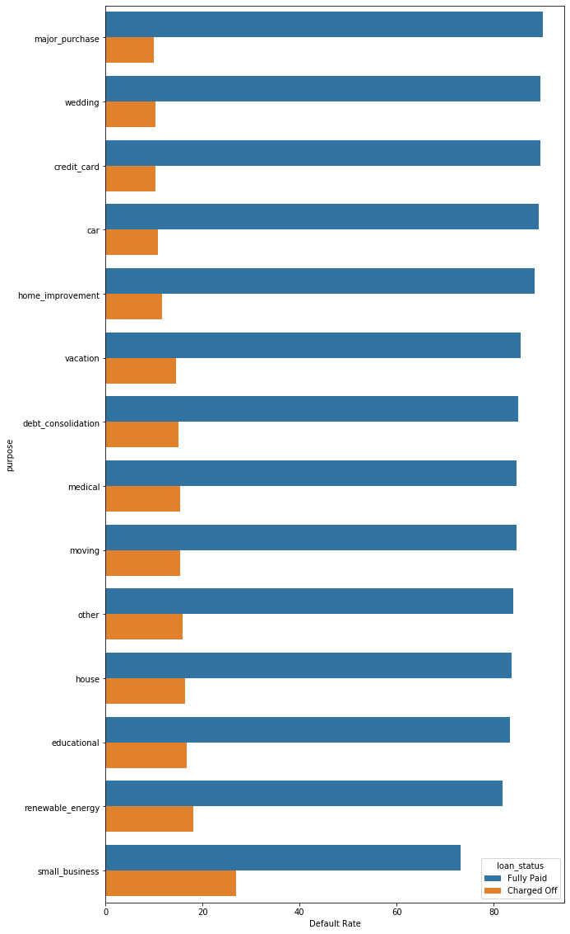
Lending Analysis (Purpose vs Default rate)
Since the company is looking to invest in the English speaking country, out of the 9 countries shortlisted based on the criteria, we have finalized the above 3 countries.

Slide 6
Lending Analysis (Purpose vs Default rate)
On plotting the purpose of taking the loan against the default rate (as seen in the previous slide), we see that default rates are most when it lend to the small business.
It can also be seen that changes of the fully being paid are more when the loan is issued for the major purchases.

Slide 7
Lending Analysis (Term vs Default)
Term | Loan status | Count
36 | Charged off | 2899
60 | Charged off | 2232
On studying the table displaying the term vs default, we can see that lesser loans defaulted when the term of the loan was 60 instead of 36.
Thus one of the recommendations here can be that company should provide the loans for the longer term.

Slide 8
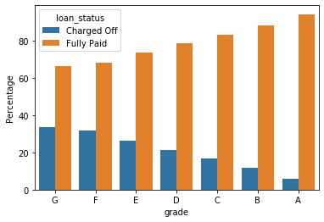
Lending Analysis (Grade vs Default rate)
 | Grade | Loan Status | Percentage
12 | G | Charged Off | 33.68056
13 | G | Fully Paid | 66.31944
10 | F | Charged Off | 31.8872
11 | F | Fully Paid | 68.1128
8 | E | Charged Off | 26.45085
9 | E | Fully Paid | 73.54915
6 | D | Charged Off | 21.38247
7 | D | Fully Paid | 78.61753
4 | C | Charged Off | 16.59223
5 | C | Fully Paid | 83.40777
2 | B | Charged Off | 11.82766
3 | B | Fully Paid | 88.17234
0 | A | Charged Off | 5.653253
1 | A | Fully Paid | 94.34675
We can see the grade A loans are full paid. Hence we the company could issue more grade A since the risk on these loans are less. However as we see in the next slide, the interest rates on these loans are less.

Slide 9
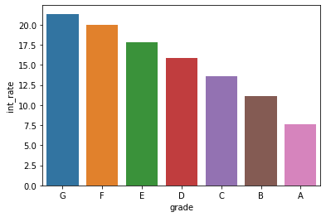
Lending Analysis (Grade vs Interest rate)
We can see from the plot that interest rate on the Grade A loans are very less compared and it gradually increases the grade of the loan degrades.

Slide 10
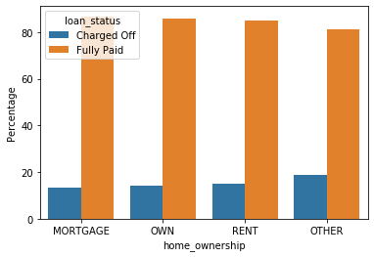
Lending Analysis (Home ownership vs Default rate)
 | Home Ownership | Loan Status | Percentage
0 | MORTGAGE | Charged Off | 13.277774
4 | OWN | Charged Off | 14.141414
6 | RENT | Charged Off | 15.023421
2 | OTHER | Charged Off | 18.75
3 | OTHER | Fully Paid | 81.25
7 | RENT | Fully Paid | 84.976579
5 | OWN | Fully Paid | 85.858586
1 | MORTGAGE | Fully Paid | 86.722226
From the plot we can see that there is no correlation between home ownership and the default rate.

Slide 11
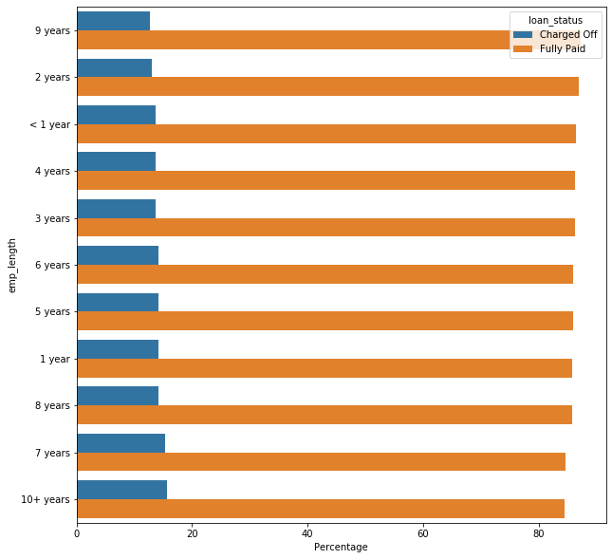
Lending Analysis (Employee experience vs Default rate)
From the plot above, we can see the number of the experience of the employee doesn’t have any effect on the default rates.

Slide 12
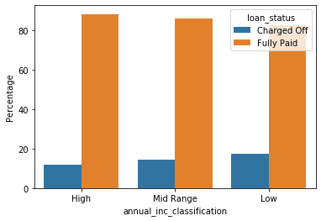
Lending Analysis (Income classification vs Interest rate)
From the plot above, we can see that when the income is high the number of the default cases are lesser.

Slide 13
Conclusion
From the analysis, we can conclude that below variables are driver variables for predicting the defaulting of loans,
Annual income classification
Term
Grade
Purpose
We can also recommend from the analysis the company should try to achieve balance between various grades of loans in it’s portfolio. Company cannot just issue Grade A loans although it is risk free since the interest rate on such loans are less. It cannot also give out Grade G loans although it has the highest interest rate since such loans are more likely to default.

