Slide 1
Mozilla Release Engineering
Brownbag for New Hires
(April 8th, 2011)
Notes:
The idea is to spend 20mins to help newly hired engineers be useful on their first day
Anything missing?
Anything need to be rephrased or dropped?

Slide 2
First code change
hg clone http://hg.mozilla.org/mozilla-central
hg diff –pU 8 > yourpatch.diff
Attach patch to bug in bugzilla
  set “r?”, “sr?” to ask for review
If you don’t have commit access:
  add “checkin-needed” in the bug’s keyword

Slide 3
What next?
Check in detected
  build jobs queued to run on next available machines
As builds become available:
  Unit test and performance jobs are queued
Results on tbpl.mozilla.org
All with your change, and only your change.
Notes:
In times of heavy load, jobs may be consolidated together. Called “queue compression” or “collapsing the queue”.
More details later.

Slide 4
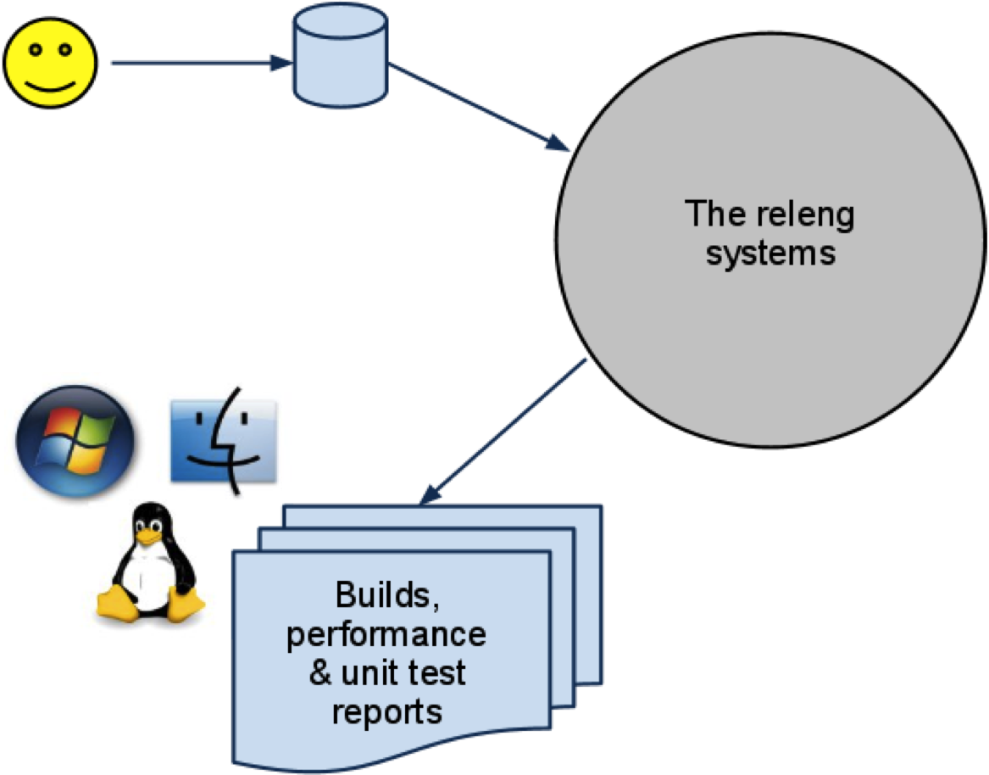

Slide 5
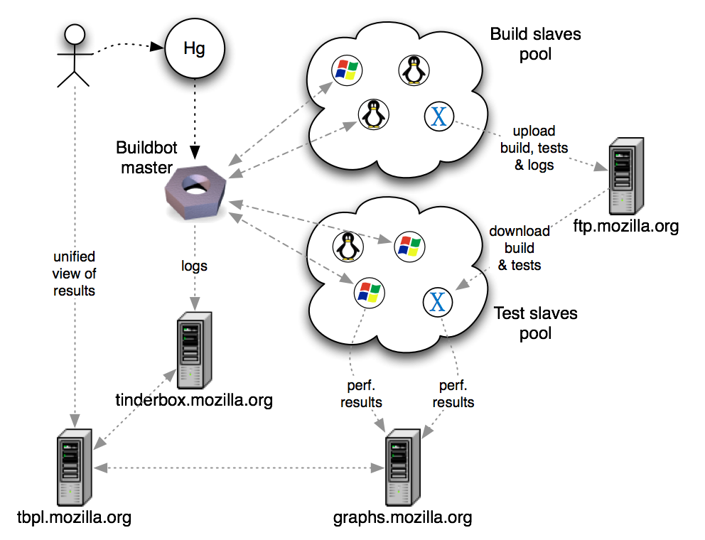
Notes:
TODO:
add email sent to dev.tree-management
remove tinderbox.mozilla.org from the page

Slide 6
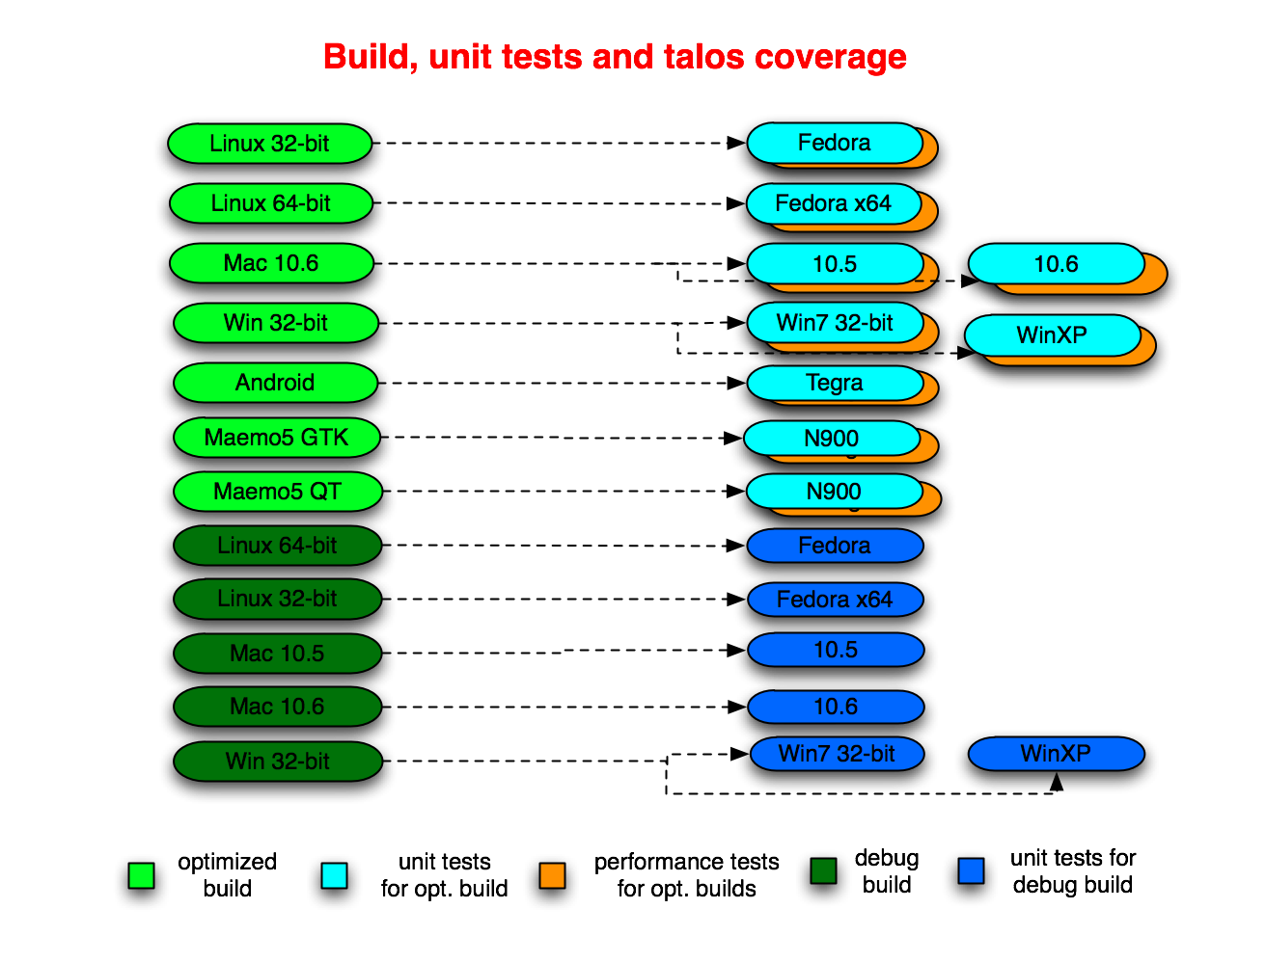
Notes:
In times of heavy load, jobs may be consolidated together. Called “queue compression” or “collapsing the queue”.
More details later.

Slide 7
Unit test suites
jetpack
jsreftest
mochitest
  (1, 2, 3, 4, 5, other)
mozmill-all
reftest
reftest-ipc
xpcshell
crashtest
crashtest-ipc
a11y
Talos suites
chrome
cold
dirty
dromaeo
nochrome
scroll
svg
tp4

Slide 8
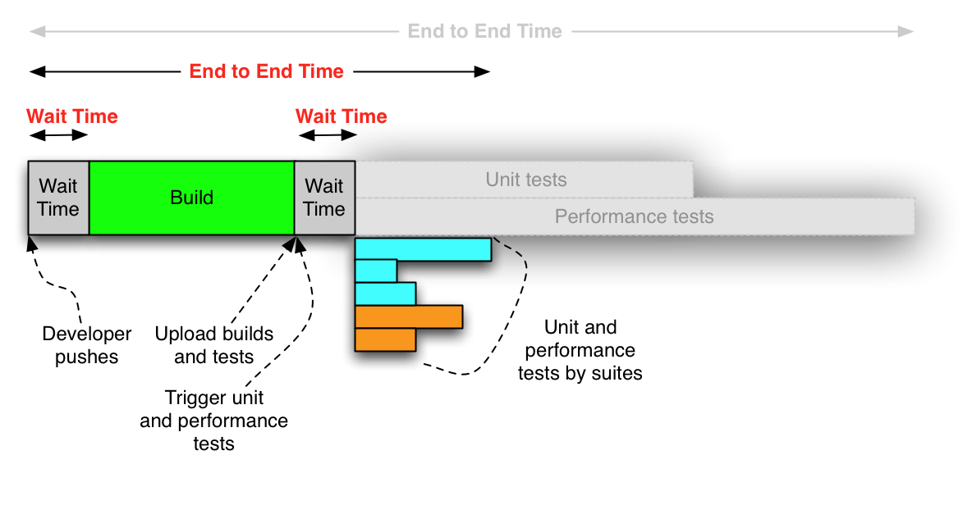
End to end

Slide 9
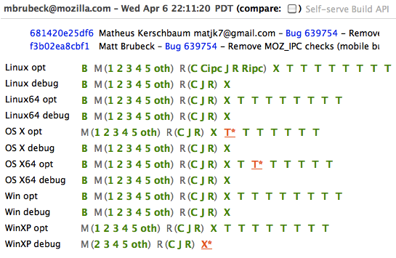
tbpl.mozilla.org

Slide 10
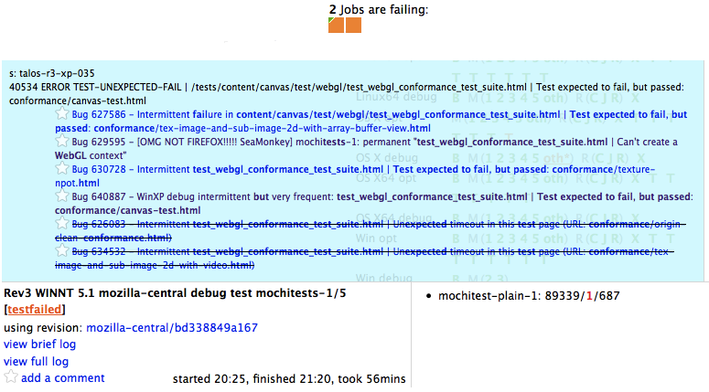
Starring an orange

Slide 11
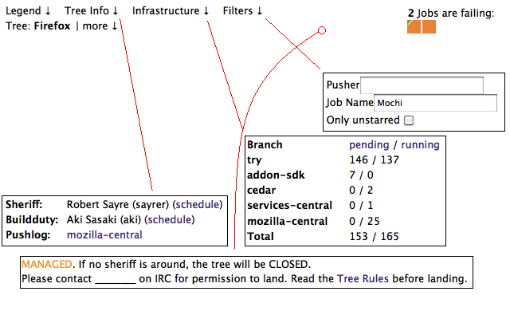
Tree Status on TBPL

Slide 12
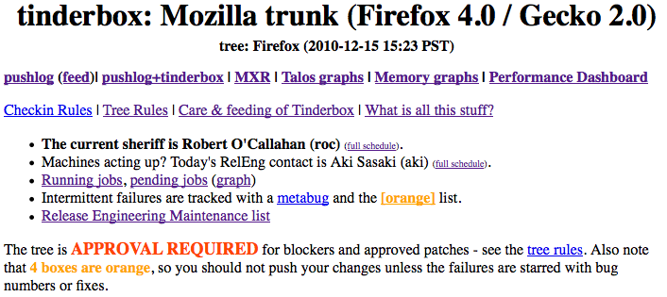
Tree Status on tinderbox
http://tinderbox.mozilla.org/showbuilds.cgi?tree=Firefox

Slide 13
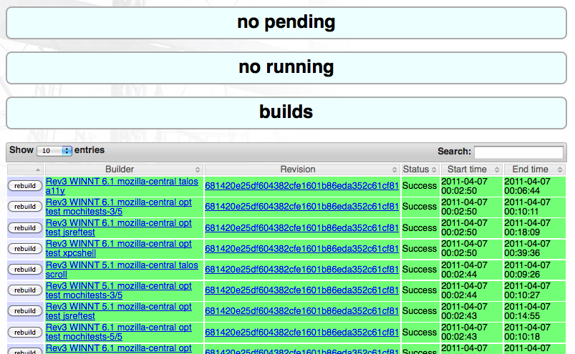
Self-serve

Slide 14
TryServer
Use it If:
  Test something risky
  Test something on behalf of someone (the same before)
Work on a clone of m-c and push to try
Use the TryChooser syntax
  http://mzl.la/i1wj8t
Compare unit tests with m-c rather than try
Compare talos jobs with:
  http://perf.snarkfest.net/compare-talos/

Slide 15
Nightly builds
do builds for each OS
    full clobber, not dependent
same changeset across platforms
create localized repacks (aka L10n)
    80+ locales, per OS
creates “nightly” updates
use self-serve to trigger nightly builds
Notes:
In times of heavy load, jobs may be consolidated together. Called “queue compression” or “collapsing the queue”.
More details later.

Slide 16
Branches
release repos
  stable
  development
project repos
rentable repos
tryserver repo
NOTE: if you need a new project branch, let us know
Notes:
release repos
stable
release, mozilla-2.0, mozilla-1.9.2, mozilla-1.9.1
development
m-c, aurora, beta
project repos
http://hg.mozilla.org/projects
electrolysis, jaegermonkey, places, tracemonkey, mobile-browser
rentable repos
birch, maple & cedar
tryserver repo

Slide 17
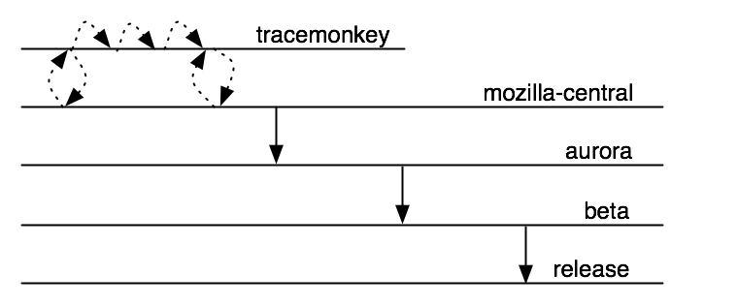
Branches
Notes:
Before landing on m-c, consider asking project branch owner to refresh (“resync”) the project branch with the latest changes in mozilla-central.
Reduce risk of surprises

Slide 18
Current terminology
Tinderbox server / Tinderbox waterfall
Tinderbox PushLog / TBPL
Buildbot master, pool-o-slaves, pods
TryServer
Builds
    depend, clobber, nightly, beta, RCs, release, debug, opt/PGO
    L10N repacks, partner repacks
Unittest suites
    mochitest1-5, reftest, xpcshell, crashtest, browserchrome, a11y
Talos/performance suites, GraphServer
    Tp4, nochrome, jss, dirty, cold, Tsvg, Tsspider, Twinopen
Updates, AUS
    partial, complete, nightly, beta, release, minor, major
Notes:
There are several master and pool-o-slaves.
Talos-master, production-master, production-master02, staging-master, more coming

Slide 19
Current terminology
Project branch
Tree rules, “When is it OK to checkin?”
“is the tree green”?
Release Driver
“wait times”
“end to end cycle time”
“Queue collapsing”
“Tree stable timer”

Slide 20
Obsolete terminology
Tinderboxen / tinderboxes / tinderbox client
Hourly builds
Unittest machines
L10n machines
build-and-unittest

Slide 21
Where can I get more help?
Developers have “Sheriff of the day”
  Schedule is on tbpl.m.o
  Releng have “Buildduty” person to handle escalations
Bugs in mozilla.org:ReleaseEngineering
irc: #build
email release@mozilla.com

Slide 22
Q&A

