Slide 1
Mozilla Release Engineering
Brownbag for New Hires
(April 8th, 2011)
Notes:
The idea is to spend 20mins to help newly hired engineers be useful on their first day
Anything missing?
Anything need to be rephrased or dropped?

Slide 2
How to make your first code change
hg clone http://hg.mozilla.org/mozilla-central
Edit source files
hg diff –U 8 > foo.out
Attach foo.out to bug in bugzilla
    set “r?”, “sr?” to ask for review
If you have commit access, you can checkin a reviewed patch using “hg push”
    “checkin-needed” to ask someone else to commit

Slide 3
What happens when you checkin?
Checkin to hg.m.o is detected
  build jobs queued to run on next available machines
Completed builds are put here
  http://ftp.mozilla.org/pub/firefox/tinderbox-builds/[branch]-[OS]/[time]
As builds become available:
  Unit test and performance jobs are queued
Results on tbpl.mozilla.org
All with your change, and only your change.
Notes:
In times of heavy load, jobs may be consolidated together. Called “queue compression” or “collapsing the queue”.
More details later.

Slide 4
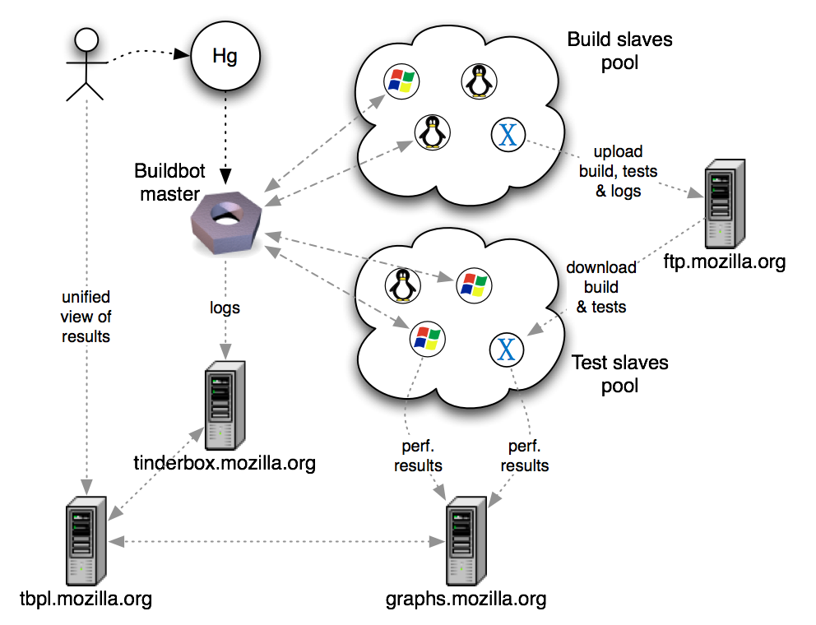
Notes:
TODO:
add email sent to dev.tree-management
remove tinderbox.mozilla.org from the page

Slide 5
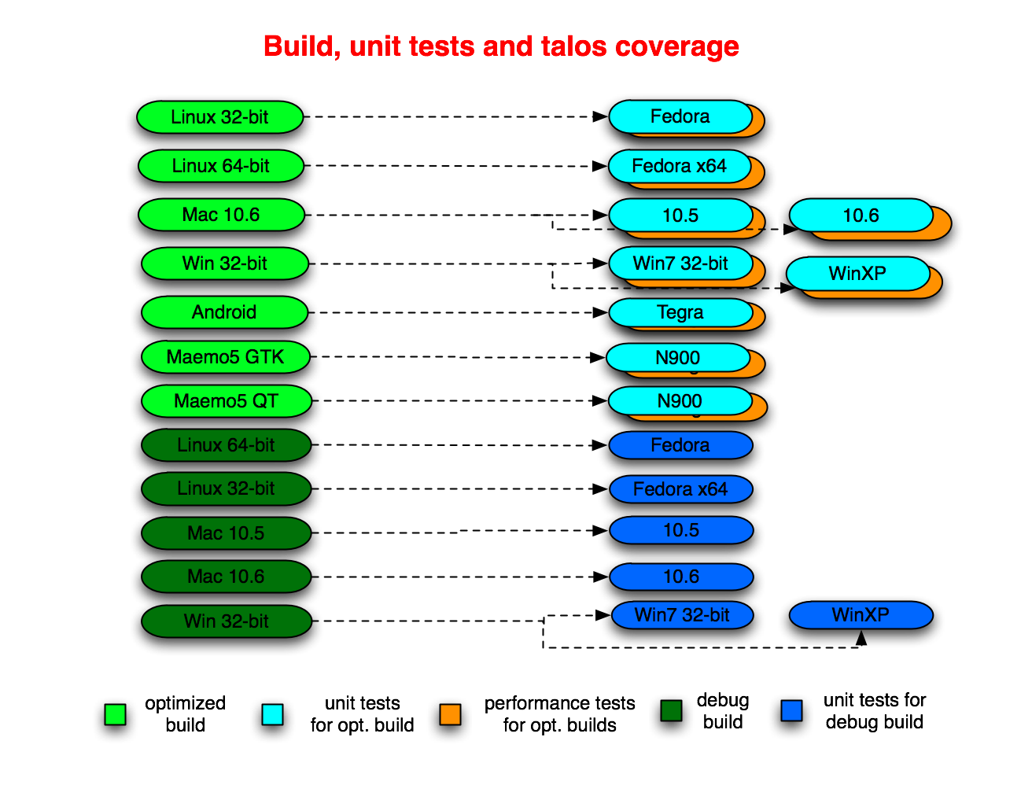
Notes:
In times of heavy load, jobs may be consolidated together. Called “queue compression” or “collapsing the queue”.
More details later.

Slide 6
Unit test suites
jetpack
jsreftest
mochitest
  (1, 2, 3, 4, 5, other)
mozmill-all
reftest
reftest-ipc
xpcshell
crashtest
crashtest-ipc
a11y
Talos suites
chrome
cold
dirty
dromaeo
nochrome
scroll
svg
tp4

Slide 7
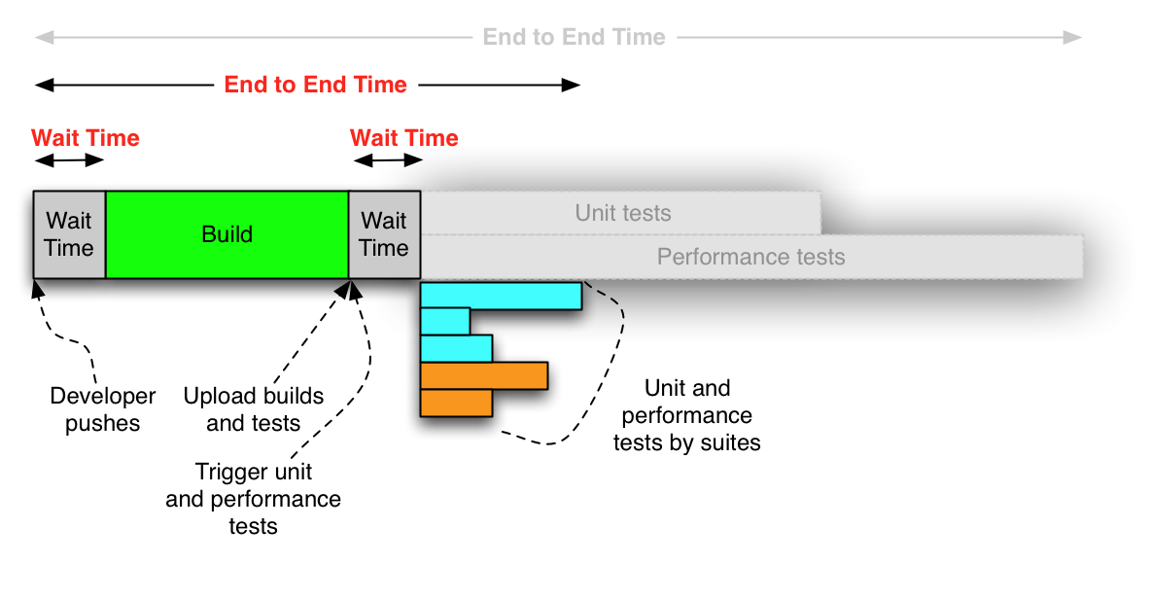
End to end – our reality

Slide 8
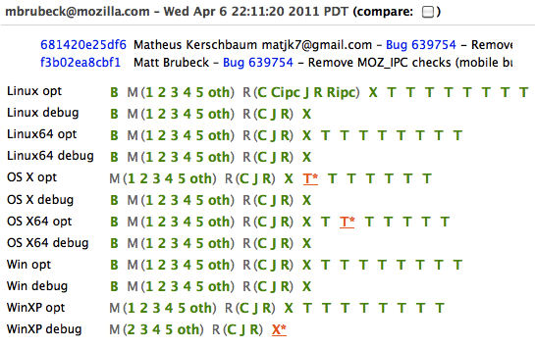
tbpl.mozilla.org

Slide 9
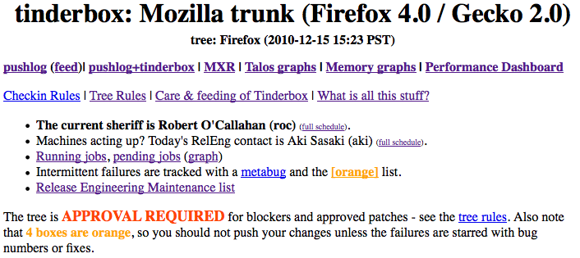
Tree Status
http://tinderbox.mozilla.org/showbuilds.cgi?tree=Firefox

Slide 10
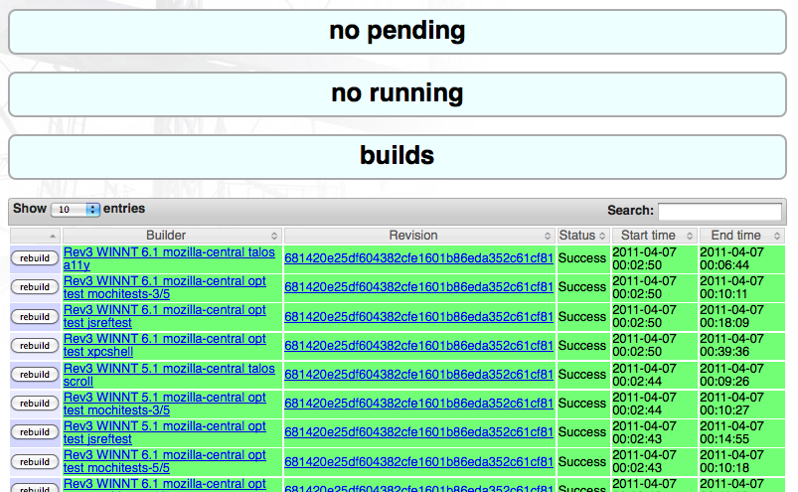
Self-serve

Slide 11
TryServer
Land changes first on Try or project branch before landing on mozilla-central
For best results, refresh your local repo to latest before using TryServer.
Use the TryChooser syntax!(http://mzl.la/i1wj8t)
Don’t compare your results to other TryServer jobs.
    Instead compare to results for production code you are based on – where your change is the only difference.

Slide 12
Nightly builds
do builds for each OS
    full clobber, not dependent
same changeset across platforms
create localized repacks (aka L10n)
    80+ locales, per OS
create “nightly” updates
Notes:
In times of heavy load, jobs may be consolidated together. Called “queue compression” or “collapsing the queue”.
More details later.

Slide 13
Branches
release repos
  stable
  development
project repos
rentable repos
tryserver repo
NOTE: if you need a new project branch, let us know
Notes:
release repos
stable
release, mozilla-2.0, mozilla-1.9.2, mozilla-1.9.1
development
m-c, aurora, beta
project repos
http://hg.mozilla.org/projects
electrolysis, jaegermonkey, places, tracemonkey, mobile-browser
rentable repos
birch, maple & cedar
tryserver repo

Slide 14
Where and when to land changes?
If working on a project branch, land there first and make sure there are no regressions
    e.g. tracemonkey
Land on mozilla-central after checking with Sheriff and Tree rules
If also needed in specific release, get approval in bug, and then land in mozilla-1.9.1/2 as directed by Release Driver.
Notes:
Before landing on m-c, consider asking project branch owner to refresh (“resync”) the project branch with the latest changes in mozilla-central.
Reduce risk of surprises

Slide 15
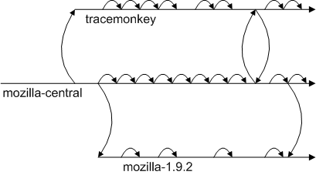
Where and when to land changes?
Notes:
Before landing on m-c, consider asking project branch owner to refresh (“resync”) the project branch with the latest changes in mozilla-central.
Reduce risk of surprises

Slide 16
Tracking work across branches
File bugs for all work going to release branches, and get approval
Use the correct branch flags!
Followon work should be in linked bug.
    Link to original bug
    Use “regression” keyword
    This helps release-drivers track regressions across branches, and helps prevent firedrill releases.

Slide 18
Current terminology
Tinderbox server / Tinderbox waterfall
Tinderbox PushLog / TBPL
Buildbot master, pool-o-slaves, pods
TryServer
Builds
    depend, clobber, nightly, beta, RCs, release, debug, opt/PGO
    L10N repacks, partner repacks
Unittest suites
    mochitest1-5, reftest, xpcshell, crashtest, browserchrome, a11y
Talos/performance suites, GraphServer
    Tp4, nochrome, jss, dirty, cold, Tsvg, Tsspider, Twinopen
Updates, AUS
    partial, complete, nightly, beta, release, minor, major
Notes:
There are several master and pool-o-slaves.
Talos-master, production-master, production-master02, staging-master, more coming

Slide 19
Current terminology
Project branch
Tree rules, “When is it ok to checkin?”
“is the tree green”?
Release Driver
“wait times”
“end to end cycle time”
“Queue collapsing”
“Tree stable timer”

Slide 20
Obsolete terminology
Tinderboxen / tinderboxes / tinderbox client
Hourly builds
Unittest machines
L10n machines
build-and-unittest

Slide 21
Where can I get more help?
Developers have “Sheriff of the day”
    Schedule is on tinderbox
    ReleaseEngineering now have “Buildduty” person to handle escalations
Bugs in mozilla.org:ReleaseEngineering are best.
irc: #build
email release@mozilla.com

Slide 22
Q&A

