Slide 1
Mozilla Release Engineering
Brownbag for New Hires
(16dec2010)
Notes:
The idea is to spend 20mins to help newly hired engineers be useful on their first day
Anything missing?
Anything need to be rephrased or dropped?

Slide 2
How to make your first code change
hg clone http://hg.mozilla.org/mozilla-central
Edit source files
hg diff –U 8 > foo.out
Attach foo.out to bug in bugzilla
    set “r?”, “sr?” to ask for review
If you have commit access, you can checkin a reviewed patch using “hg push”
    “checkin-needed” to ask someone else to commit

Slide 3
What happens when you checkin?
Checkin to hg.m.o is detected
  jobs to do builds are queued to run on next available machines
Completed builds are put here
  http://ftp.mozilla.org/pub/firefox/tinderbox-builds/[branch]-[OS]/[time]
As builds become available:
  Unit test and performance jobs are queued
Results on tbpl.mozilla.org
All with your change, and only your change.
Notes:
In times of heavy load, jobs may be consolidated together. Called “queue compression” or “collapsing the queue”.
More details later.

Slide 4
What happens when you checkin?
One check-in:
  170+ testing jobs (just desktop)
  70+ hours of desktop testing
  25+ hours of mobile testing
  More than 4 days of CPU usage per check-in
Notes:
In times of heavy load, jobs may be consolidated together. Called “queue compression” or “collapsing the queue”.
More details later.

Slide 5
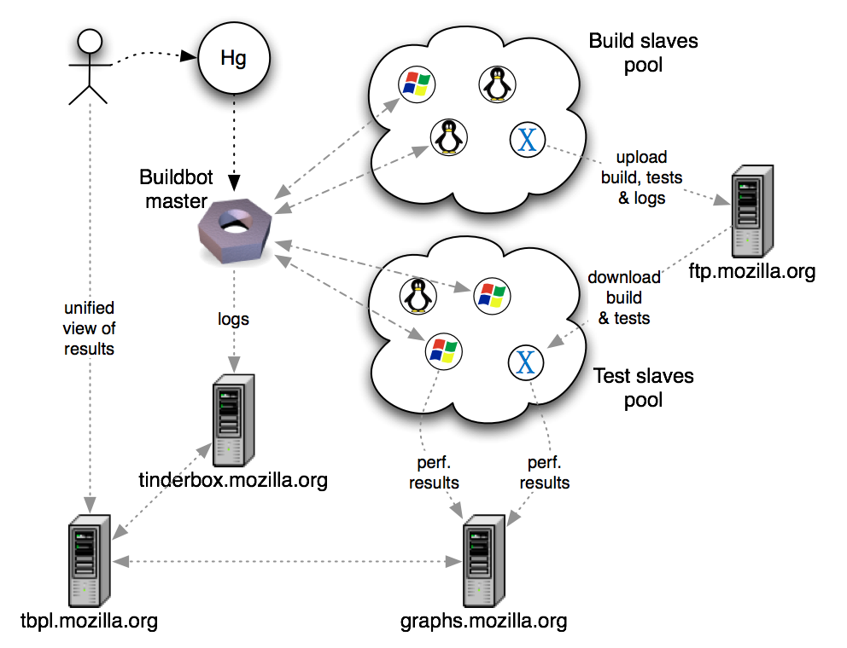

Slide 6
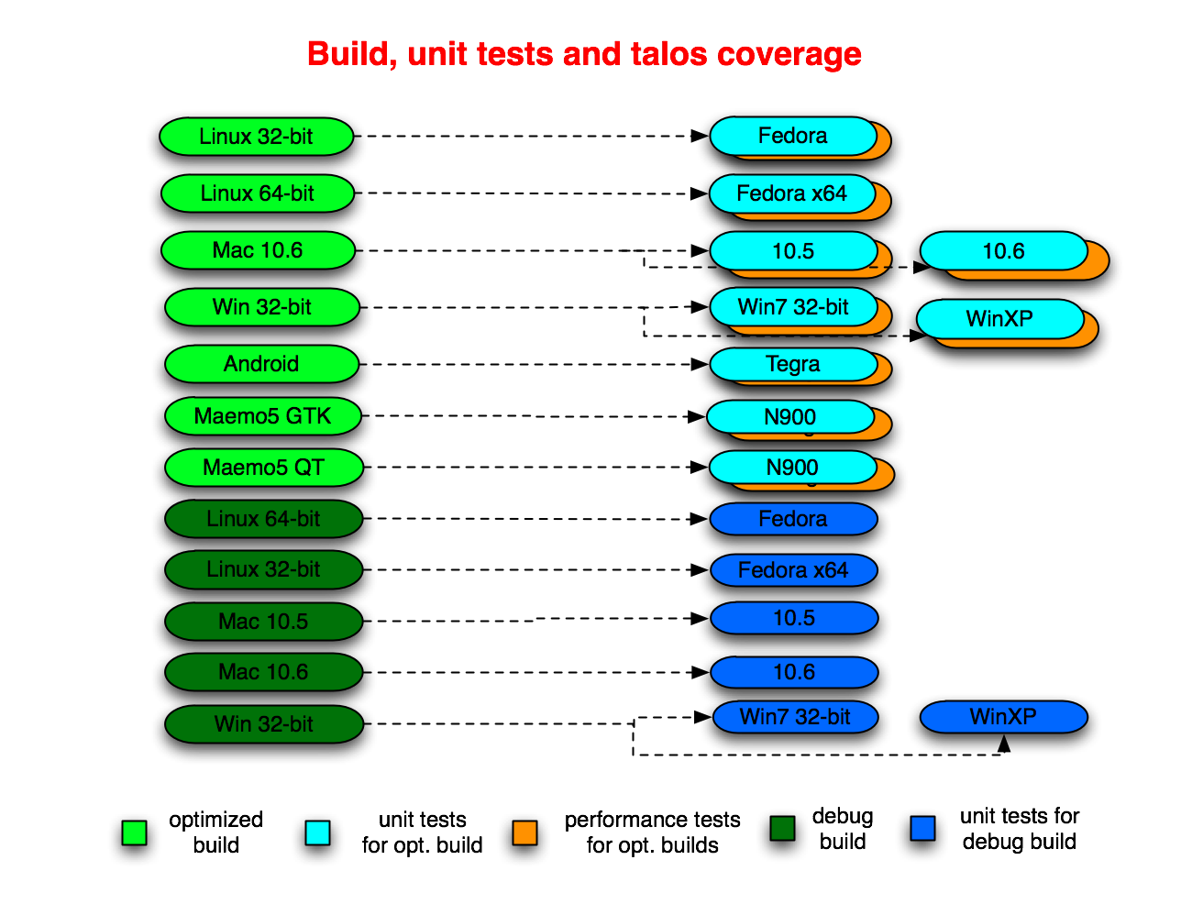
Notes:
In times of heavy load, jobs may be consolidated together. Called “queue compression” or “collapsing the queue”.
More details later.

Slide 7
Unit test suites
jetpack
jsreftest
mochitest
  (1, 2, 3, 4, 5, other)
mozmill-all
reftest
xpcshell
crashtest
a11y
Talos suites
chrome
cold
dirty
dromaeo
nochrome
scroll
svg
tp4

Slide 8
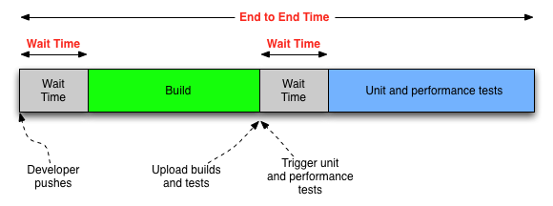
End to end – one block

Slide 9
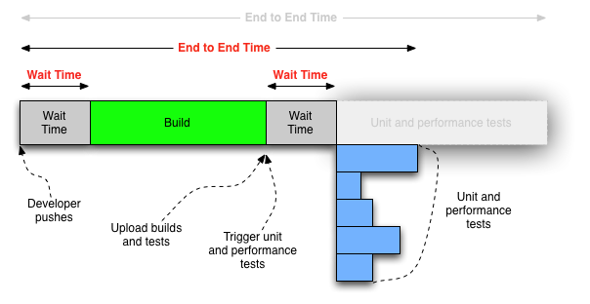
End to end – broken into pieces

Slide 10
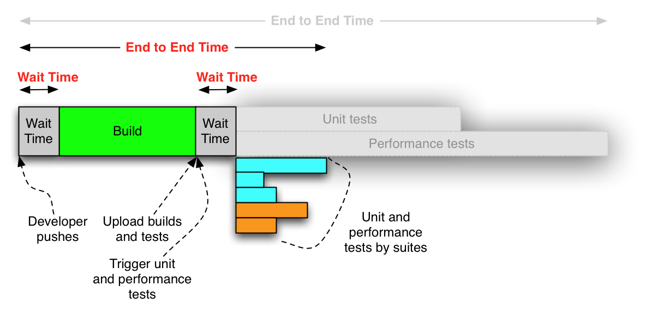
End to end – our reality

Slide 11
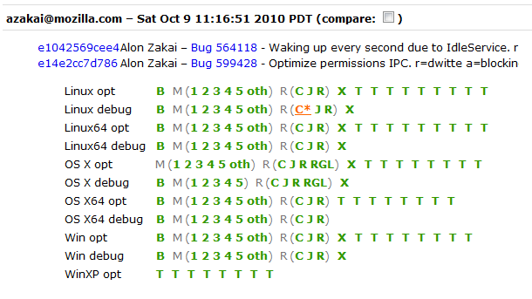
tbpl.mozilla.org

Slide 12
Then every night, we…
do all the same builds again
    full clobber, not dependent
same changeset across platforms
create L10n repacks
    80+ locales, per OS
create “nightly” updates
    someone running yesterday’s nightly build will be prompted to update to tonight’s nightly
Notes:
In times of heavy load, jobs may be consolidated together. Called “queue compression” or “collapsing the queue”.
More details later.

Slide 13
TryServer
Land changes on TryServer first before landing on mozilla-central**
For best results, refresh your local repo to latest before using TryServer.
Use the TryChooser syntax!(http://mzl.la/i1wj8t)
Don’t compare your results to other TryServer jobs.
    Instead compare to results for production code you are based on – where your change is the only difference.
** Unless you have coverage through a project branch

Slide 14
What can releng do for you?
Re-trigger build/test
Run multiple perf tests
Cancel running jobs
    Very important. Specially for the TryServer
File a bug in mozilla.org:RelEng
    RelEng working to make this self-service
Do NOT re-submit to TryServer for missing jobs
    TryServer will rebuild everything again
    It will take longer to get results
    It will slow down TryServer for others and yourself
Notes:
Each TryServer job will rebuild, and then run tests on that new build.
This is different to re-running on the pre-existing build.

Slide 15
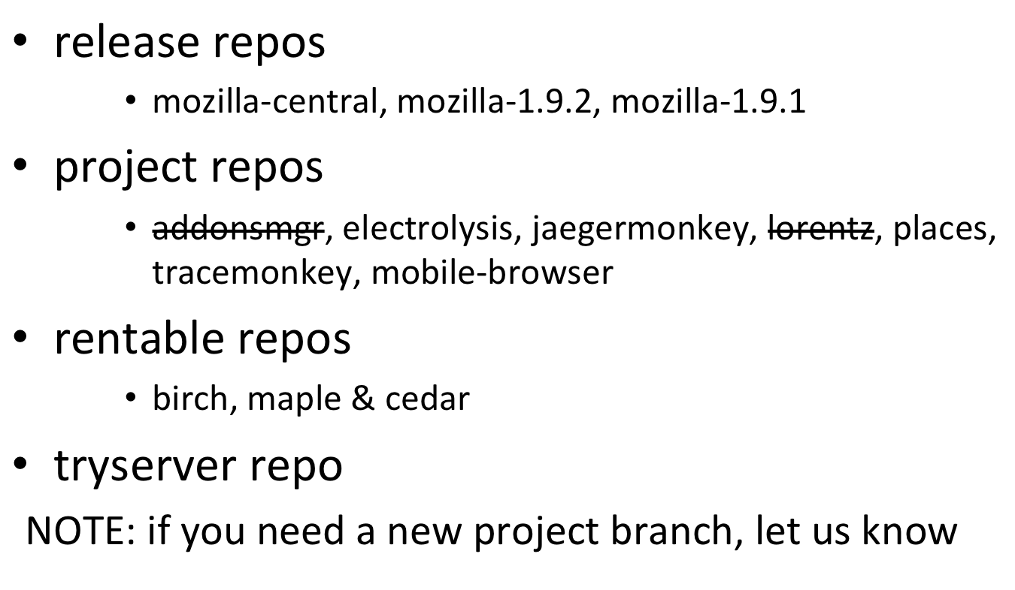
Where and when to land changes?
Notes:
If you need a new project branch, let us know.

Slide 16
Where and when to land changes?
If working on a project branch, land there first and make sure there are no regressions
    e.g. tracemonkey
Land on mozilla-central after checking with Sheriff and Tree rules
If also needed in specific release, get approval in bug, and then land in mozilla-1.9.1/2 as directed by Release Driver.
Notes:
Before landing on m-c, consider asking project branch owner to refresh (“resync”) the project branch with the latest changes in mozilla-central.
Reduce risk of surprises

Slide 17
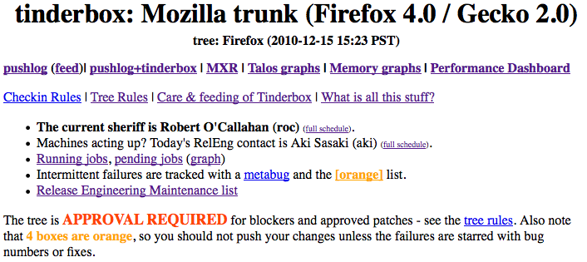
Tree Status
http://tinderbox.mozilla.org/showbuilds.cgi?tree=Firefox

Slide 18
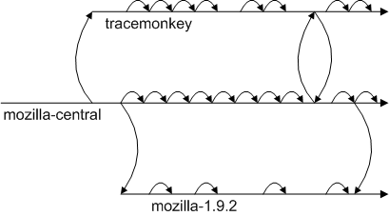
Where and when to land changes?
Notes:
Before landing on m-c, consider asking project branch owner to refresh (“resync”) the project branch with the latest changes in mozilla-central.
Reduce risk of surprises

Slide 19
Tracking work across branches
File bugs for all work going to release branches, and get approval
Use the correct branch flags!
Followon work should be in linked bug.
    Link to original bug
    Use “regression” keyword
    This helps release-drivers track regressions across branches, and helps prevent firedrill releases.

Slide 21
Current terminology
Tinderbox server / Tinderbox waterfall
Tinderbox PushLog / TBPL
Buildbot master, pool-o-slaves, pods
TryServer
Builds
    depend, clobber, nightly, beta, RCs, release, debug, opt/PGO
    L10N repacks, partner repacks
Unittest suites
    mochitest1-5, reftest, xpcshell, crashtest, browserchrome, a11y
Talos/performance suites, GraphServer
    Tp4, nochrome, jss, dirty, cold, Tsvg, Tsspider, Twinopen
Updates, AUS
    partial, complete, nightly, beta, release, minor, major
Notes:
There are several master and pool-o-slaves.
Talos-master, production-master, production-master02, staging-master, more coming

Slide 22
Current terminology
Project branch
Tree rules, “When is it ok to checkin?”
“is the tree green”? (http://isthetreegreen.com)
Release Driver
“wait times”
“end to end cycle time”
“Queue collapsing”
“Tree stable timer”

Slide 23
Obsolete terminology
Tinderboxen / tinderboxes / tinderbox client
Hourly builds
Unittest machines
L10n machines
build-and-unittest

Slide 24
Where can I get more help?
Developers have “Sheriff of the day”
    Schedule is on tinderbox
    ReleaseEngineering now have “Buildduty” person to handle escalations
Bugs in mozilla.org:ReleaseEngineering are best.
irc: #build
email release@mozilla.com

Slide 25
Q&A

