Slide 1
Mozilla Release Engineering
Brownbag for NewHires
(14jun2010)
Notes:
The idea is to spend 20mins to help newly hired engineers be useful on their first day
Anything missing?
Anything need to be rephrased or dropped?

Slide 2
How to make your first code change
hg clone http://hg.mozilla.org/mozilla-central
Edit source files
hg diff –U 8 > foo.out
Attach foo.out to bug in bugzilla
    set “r?”, “sr?” to ask for review
If you have commit access, you can checkin a reviewed patch using “hg push”
    “checkin-needed” to ask someone else to commit

Slide 3
What happens when you checkin?
Checkin to hg.m.o is detected
    jobs to do builds are queued to run on next available machines
Completed builds are put here
    http://ftp.mozilla.org/pub/firefox/tinderbox-builds/[branch]-[OS] /[time]
As builds become available:
    jobs to run unittest are queued; results posted to tinderbox server
    jobs to run performance suites are queued; results posted to tinderbox server and graphserver
All with your change, and only your change.
One checkin will trigger 120+ jobs
  approx 40hours desktop and 25 hours mobile devices
Notes:
In times of heavy load, jobs may be consolidated together. Called “queue compression” or “collapsing the queue”.
More details later.

Slide 4
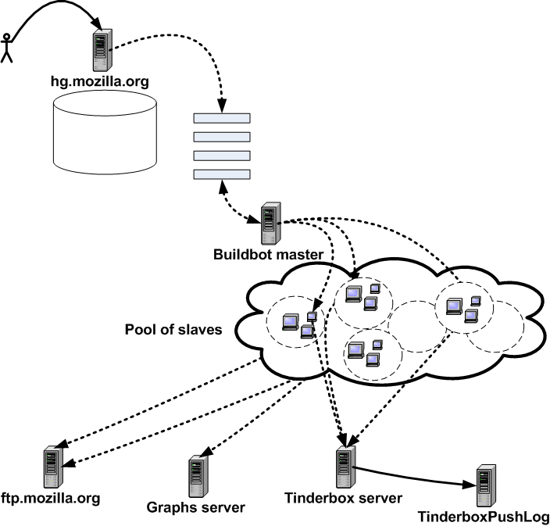

Slide 5
When you checkin: first we build…
linux32
    debug depend build; opt depend build
linux64
    debug depend build; opt depend build
Win32
    debug depend build, opt (PGO) depend build
OSX 10.5
    debug depend build; opt depend build
    This universal binary is also OSX10.4 PPC compatible
OSX 10.6 64bit
    debug depend build; opt depend build
Android
    debug depend build; opt depend build
maemo4
    debug depend build; opt depend build
    three Fennec desktop build – one each for win32, linux, osx
maemo5gtk
    debug depend build; opt depend build
maemo5qt
    debug depend build; opt depend build
Notes:
In times of heavy load, jobs may be consolidated together. Called “queue compression” or “collapsing the queue”.
More details later.

Slide 6
When you checkin: …then we test!
linux32 opt: mochitest (1, 2, 3, 4, 5, everythingelse), talos (tp4, nochrome, jss, dirty, cold , Tsvg, Tsspider, Twinopen)
linux32 debug: mochitest (1, 2, 3, 4, 5, everythingelse)
linux64 opt: mochitest (1, 2, 3, 4, 5, everythingelse), talos (tp4, nochrome, jss, dirty, cold , Tsvg, Tsspider, Twinopen)
linux64 debug: mochitest (1, 2, 3, 4, 5, everythingelse)
Win32 opt: mochitest (1, 2, 3, 4, 5, everythingelse), talos (tp4, nochrome, jss, dirty, cold , Tsvg, Tsspider, Twinopen)
Win32 debug: mochitest (1, 2, 3, 4, 5, everythingelse)
OSX 10.5 opt: mochitest (1, 2, 3, 4, 5, everythingelse), talos (tp4, nochrome, jss, dirty, cold , Tsvg, Tsspider, Twinopen)
OSX 10.5 debug: mochitest (1, 2, 3, 4, 5, everythingelse)
OSX 10.6 opt: mochitest (1, 2, 3, 4, 5, everythingelse), talos (tp4, nochrome, jss, dirty, cold , Tsvg, Tsspider, Twinopen)
OSX 10.6 debug: mochitest (1, 2, 3, 4, 5, everythingelse)
Android opt/debug: no tests yet
maemo4 opt: mochitest (1, 2, 3, 4, 5, everythingelse), talos (tp4, nochrome, jss, dirty, cold , Tsvg, Tsspider, Twinopen)
maemo4 debug: mochitest (1, 2, 3, 4, 5, everythingelse)
Notes:
In times of heavy load, jobs may be consolidated together. Called “queue compression” or “collapsing the queue”.
More details later.

Slide 7
Then every night, we…
do all the same builds again
    full clobber, not depend
create l10n repacks
    75 locales, per OS
create “nightly” updates
    someone running yesterday’s nightly build will be prompted to update to tonight’s nightly
run all the same unittest and talos suites
Notes:
In times of heavy load, jobs may be consolidated together. Called “queue compression” or “collapsing the queue”.
More details later.

Slide 8
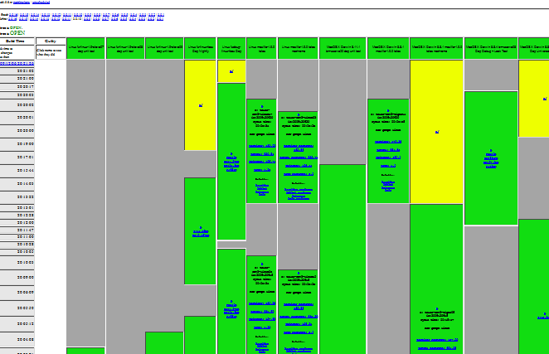
Tracking it all: Tinderbox waterfall
Organized by time
    Harder to triage
Unique machines literally each working at own speed
Fragile
Notes:
Very early continuous integration
Builds out-of-sync ➔ different builds contain different fixes ➔ harder to debug regressions ➔ longer tree closures
Dedicated machines == no redundancy. Single machine failure closed the tree.

Slide 9
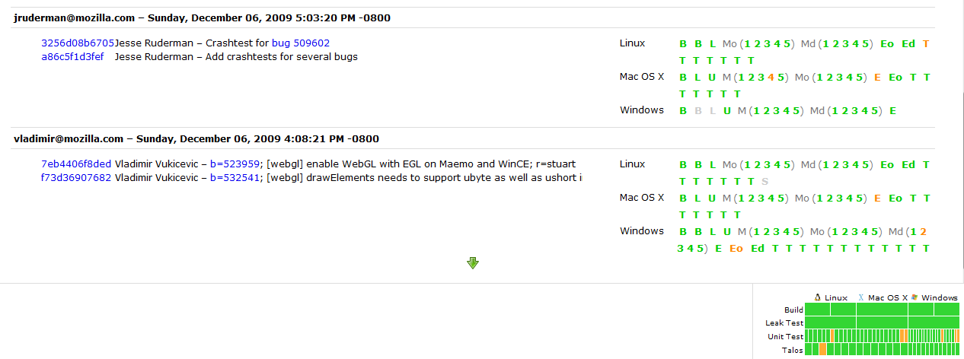
Tracking it all: TBPL
Organized by checkin/changeset
    Easier to triage
Only run when there is something to do
Shared pool of identical machines
Notes:
More efficient; only use CPU time when there is something new to do
Organised as a queue of pending jobs

Slide 11
TryServer
When you want to land your code, but you don’t have build/test/perf machines running locally to first verify your code is safe to land on every OS
… or when you have experimental code you don’t yet want to checkin, but you want to share tested builds on every OS with others
For best results, refresh your local repo to latest *before* using TryServer.
Don’t compare your results to other TryServer jobs.
    Instead compare to results for production code you are based on – where your change is the only difference.

Slide 12
To rerun specific tests on specific build
Do file a bug in mozilla.org:RelEng and we will manually trigger
    it used to not be possible to rerun on same build
    RelEng working to make this self-service
Do NOT just re-submit to TryServer
    TryServer will rebuild everything, so your re-test will be on different bits.
    It will take longer
    It will waste time running a bunch of others jobs you don’t want, slowing down TryServer for others.
Notes:
Each TryServer job will rebuild, and then run tests on that new build.
This is different to re-running on the pre-existing build.

Slide 13
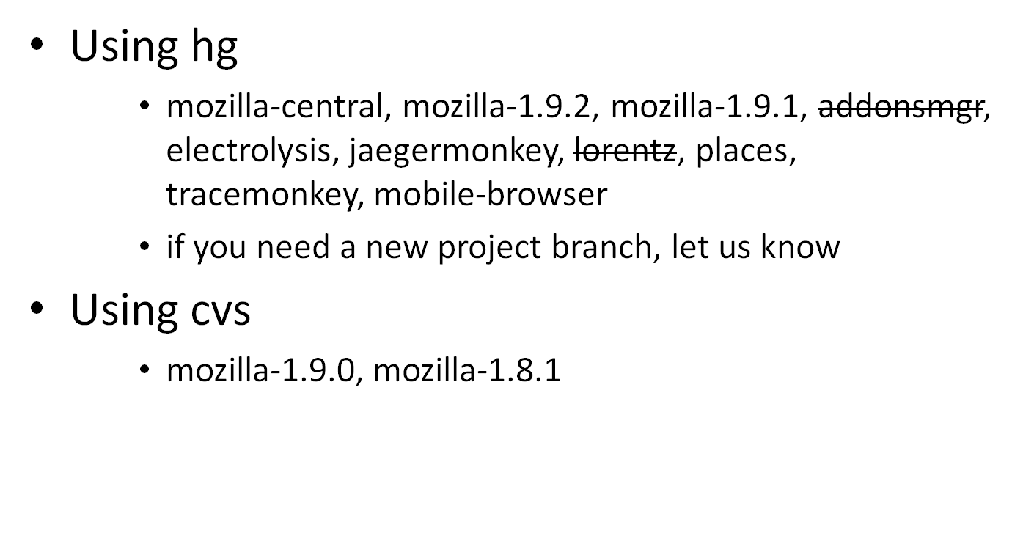
Where and when to land changes?
Notes:
If you need a new project branch, let us know.

Slide 14
Where and when to land changes?
If working on a project branch, land there first and make sure there are no regressions
    i.e. tracemonkey
Land on mozilla-central after checking with Sheriff and Tree rules
If also needed in specific release, get approval in bug, and then land in mozilla-1.9.0/1/2 as directed by Release Driver.
Notes:
Before landing on m-c, consider asking project branch owner to refresh (“resync”) the project branch with the latest changes in mozilla-central.
Reduce risk of surprises

Slide 15
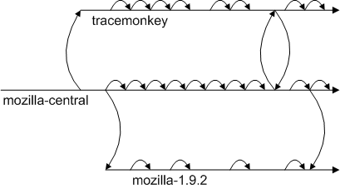
Where and when to land changes?
Notes:
Before landing on m-c, consider asking project branch owner to refresh (“resync”) the project branch with the latest changes in mozilla-central.
Reduce risk of surprises

Slide 16
Tracking work across branches
File bugs for all work going to release branches, and get approval
Use the correct branch flags!
Followon work should be in linked bug.
    Link to original bug
    Use “regression” keyword
    This helps release-drivers track regressions across branches, and helps prevent firedrill releases.

Slide 18
Current terminology
Tinderbox server / Tinderbox waterfall
Tinderbox PushLog / TBPL
Buildbot master, pool-o-slaves, pods
TryServer
Builds
    depend, clobber, nightly, beta, RCs, release, debug, opt/PGO
    L10N repacks, partner repacks
Unittest suites
    mochitest1-5, reftest, xpcshell, crashtest, browserchrome, a11y
Talos/performance suites, GraphServer
    Tp4, nochrome, jss, dirty, cold, Tsvg, Tsspider, Twinopen
Updates, AUS
    partial, complete, nightly, beta, release, minor, major
Notes:
There are several master and pool-o-slaves.
Talos-master, production-master, production-master02, staging-master, more coming

Slide 19
Current terminology
Project branch
Tree rules, “When is it ok to checkin?”
“is the tree green”?
Release Driver
“wait times”
“end to end cycle time”
“Queue collapsing”
“Tree stable timer”

Slide 20
Obsolete terminology
Tinderboxen / tinderboxes / tinderbox client
Hourly builds
Unittest machines
L10n machines
build-and-unittest

Slide 21
Where can I get more help?
Developers have “Sheriff of the day”
    Schedule is on tinderbox
    ReleaseEngineering now have “Buildduty” person to handle escalations
Bugs in mozilla.org:ReleaseEngineering are best.
irc: #build
email release@mozilla.com

Slide 22
Q&A

