Slide 1




XChemExplorer
Updates – v1.7.2
16/07/2020
Tobias Krojer

Slide 2
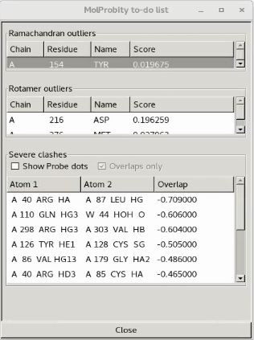

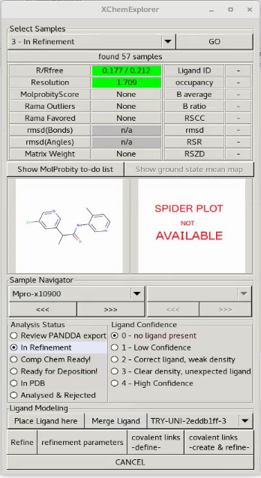
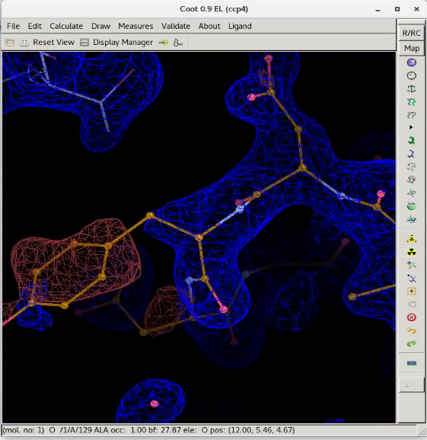
Molprobity to-do list
(after buster-report)
Must open COOT in buster refinement mode

