Slide 1




XChemExplorer
Updates – v1.7.1
13/07/2020
Tobias Krojer

Slide 2

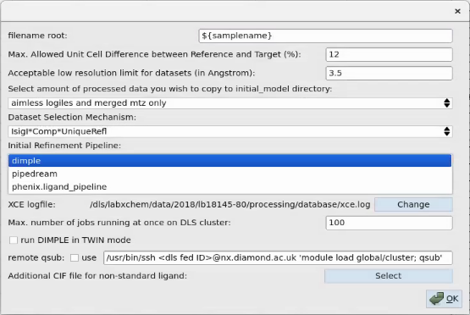

Initial refinement
Additional automated refinement pipelines
Initial refinement pipelines are not selected via the preferences menu anymore !!!
Note: Phenix & Pipedream take muuuuuch longer than Dimple!!!

Slide 3
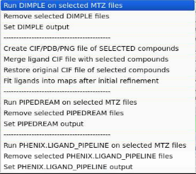

Initial refinement
Additional automated refinement pipelines
Different automated refinement pipelines are now selected, set or removed within the ’Maps & Restraints’ action box
DIMPLE
Restraints
pipedream
phenix.ligand_pipeline

Slide 4
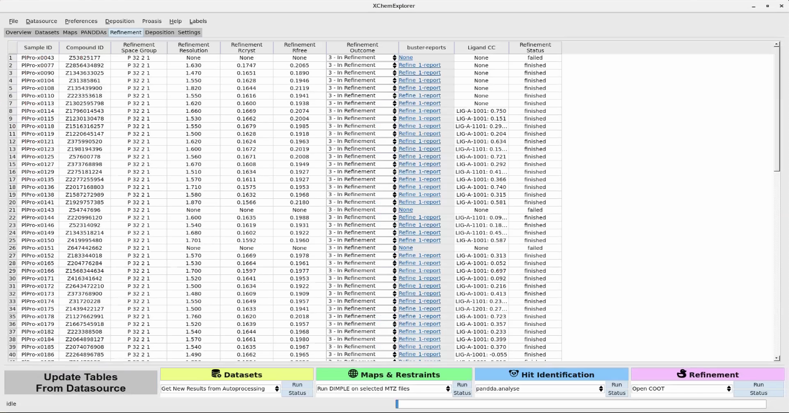
Refinement tab
new layout
Ligand ID & CC
Link to buster-report html file of the respective refinement cycle
Note: press ‘update tables from datasource’ before clicking on buster-report link, so that latest refinement cycle will be displayed/ used.

