Slide 1
Mathematics for Computer Science MIT 6.042J/18.062J
Generating Functions
for Recurrences
lec 12W.1

Slide 2
Generating Functions so far
sums

Slide 3
Generating Functions so far
shifts

Slide 4
Generating Functions so far
products

Slide 5
Shifting Right
lec 12W.5

Slide 6
Homogenous Recurrence Relation
-
lec 12W.6

Slide 7
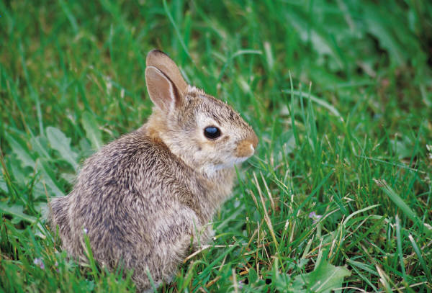
The Rabbit Population
A breeding pair of rabbits
produces a newborn pair every month.
Rabbits breed after one month.
After n months:
w_{n}::= # newborn pairs
b_{n}::= # breeding pairs
Start with a newborn pair: w₀ = 1
b₀ = 0
lec 12W.7

Slide 8
The Rabbit Population
w_{n}::= # newborn pairs
b_{n}::= # breeding pairs
Therefore,
lec 12W.8

Slide 9
The Rabbit Population
b_{n} = b_{n-1} + b_{n-2}
It was Fibonacci who was studying rabbit population growth!
lec 12W.9

Slide 10
Generating Function for Rabbits

Slide 11
Generating Function for Rabbits

Slide 12
Generating Function for Rabbits

Slide 13
Coefficient notation

Slide 14
Generating Function for Rabbits
use partial fraction expansion to find closed form for
lec 12W.14

Slide 15
Closed Form for [x^{n}]B(x)
factor the denominator
use quadratic formula
lec 12W.15

Slide 16
Closed Form for [x^{n}]B(x)
factor the denominator
lec 12W.16

Slide 17
Closed Form for [x^{n}]B(x)
Method of partial fractions:
lec 12W.17

Slide 18
Closed Form for [x^{n}]B(x)
need to solve for a and b
lec 12W.18

Slide 19
Closed Form for [x^{n}]B(x)
Multiply both sides by
Solve for a and b
⎯letting
x be 1/α, then 1/β makes it easy
lec 12W.19

Slide 20
the answer
amazing!
lec 12W.20

Slide 21
the answer
lec 12W.21

Slide 22
the answer
converges to 0 as n grows
lec 12W.22

Slide 23
the answer
rabbit population grows
exponentially
lec 12W.23

Slide 24
Simpler Closed Form
round to nearest integer
lec 12W.24

Slide 25
Towers of Hanoi
n
move stack to Post #2
larger disc not above smaller
lec 12W.25

Slide 26
Towers of Hanoi
Move_{1,2}(n)::= [Move_{1,3}(n-1);
big disk 1→2;
Move_{3,2}(n-1)]
lec 12W.26

Slide 27
Towers of Hanoi
h_{n}::=# steps by Move_{1,2}(n)
h_{n} = 2h_{n-1} + 1
h₀ = 0
lec 12W.27

Slide 28
Hanoi Generating Function
h_{n} = 2h_{n-1} + 1
h₀ = 0
lec 12W.28

Slide 29
Hanoi Generating Function
(The gen func from last lecture)
lec 12W.29

Slide 30
Hanoi Generating Function
by partial fractions
from last lecture
lec 12W.30

Slide 31
linear recurrences
this method solves
+1

Slide 32
nonhomogeneous terms
handle with
⋅⋅⋅+ 1 1/(1-x)
⋅⋅⋅+ 2^{n} 1/(1-2x)
⋅⋅⋅+ n x/(1-x)²
⋅⋅⋅+ n² x(1+x)/(1-x)³
⋅⋅⋅+ α^{n}⋅n^{k} P(x)/Q(x)

Slide 33
Team Problems
Problems
1 & 2
lec 12W.34
Notes:
‹#›
34

