Slide 1
Mathematics for Computer Science 6.042J/18.062J
PROOFS, II

Slide 2
Another Bogus Proof
Theorem: Every polynomial,
has two roots over .
Proof (by calculation). The roots are:
and

Slide 3
Another Bogus Proof
Counter-examples:
has 0 roots
has 1 root
The bug: divide by zero error
The fix: require a ≠ 0

Slide 4
Another Bogus Proof
Counter-example:
1x² + 0x + 0 has 1 root.
The bug: r₁ = r₂
The ﬁx: require D ≠ 0 where
D::= b² - 4ac

Slide 5
Another Bogus Proof
What if D < 0?
x² + 1 has roots i, -i
--ambiguous which is r₁ and which is r₂?

Slide 6
1 = -1 ?
ambiguity can cause problems:
Moral:
Be sure rules are properly applied.
Thoughtless calculation no
substitute for understanding.

Slide 7
1 = -1 ?
pictures are not the only
source of false proofs
Moral:
Calculation is a risky substitute for understanding.
Be sure you know the rules.

Slide 8
Consequences of 1 = -1
½ = -½ (multiply by ½)
2 = 1 (add )
“Since I and the Pope are clearly 2,
we conclude that I and the Pope are 1.
That is, I am the Pope.”
-- Bertrand Russell

Slide 9
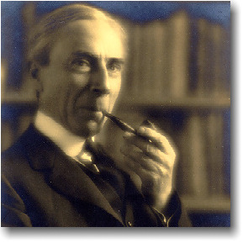
Consequences of 1 = -1
Bertrand Russell (1872 - 1970)
(Picture source: http://www.users.drew.edu/~jlenz/brs.html)

